Slide 1

Light Vehicle Diesel Engines
First Edition
Chapter 10
Air Induction and EGR Systems
Copyright © 2018, 2015, 2011 Pearson Education, Inc. All Rights Reserved

Slide 2
LEARNING OBJECTIVES (1 of 2)
10.1 Prepare for the ASE Light Vehicle Diesel Engine (A9) ASE certification test content area “E” (Air Induction and Exhaust Systems Diagnosis and Repair).
10.2 Identify the components of the air induction system.
10.3 Identify the components of the EGR systems.
10.4 Describe the function of each of the components in the air induction system.

Slide 3
LEARNING OBJECTIVES (2 of 2)
10.5 Explain the function of each of the components in the EGR systems.
10.6 Discuss the diagnosis of drivability concerns related to the air induction and EGR systems.

Slide 4
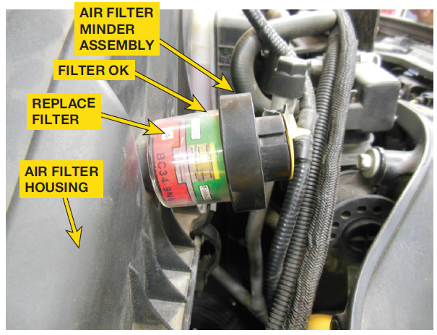
AIR INDUCTION SYSTEM (1 of 1)
Air Induction System Provides
  Adequate supply of clean, dry, fresh air
  Support combustion events
  Delivering desired engine performance
  Clean tailpipe emissions
    Inadequate air flow can cause
      Engine overheat
      Black exhaust smoke
      High exhaust temperatures

Slide 5
AIR INDUCTION SYSTEM (1 of 5)
Air Filter Assembly Includes
  Air filter, mass air flow/temperature sensor assembly,
  Air filter minder
    Measures vacuum in air induction system
    Inches of water vacuum
    Designed to operate
    At 20–25 inches of
    Water vacuum under a full load

Slide 6
FIGURE 10–1 The air filter minder is designed to alert the driver or service technician when the filter element needs to be serviced. The gauge is designed to show the difference between atmospheric pressure and the air pressure in the filter housing under maximum load.

Slide 7
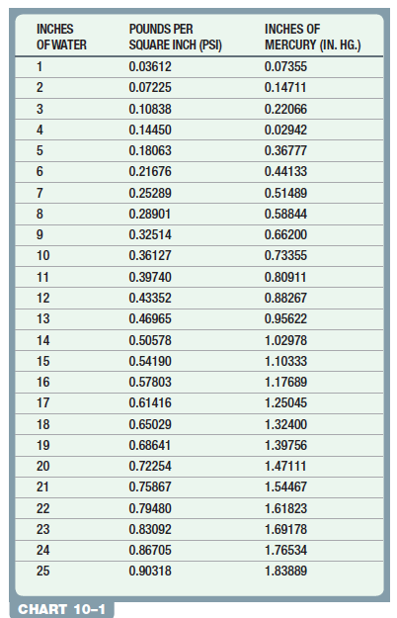
CHART 10-1 conversion of inches of water to pounds per square inch and inches of mercury

Slide 8
QUESTION 1: ?
What does the below device do?

Slide 9
ANSWER 1:
A typical air filter restriction indicator used on a diesel truck engine. The indicator turns red when it detects enough restriction to require a filter replacement.

Slide 10
AIR INDUCTION SYSTEM (2 of 5)
Excessive Black Or Gray Smoke
  Restriction in air induction system
  Corrected by replacing air filter element
CAUTION: Use of modified/performance air filter assemblies may negatively affect engine operation and emissions.

Slide 11
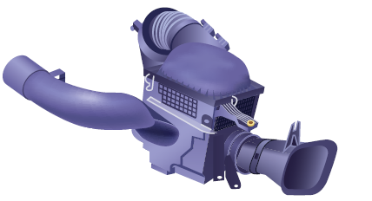
FIGURE 10–2 The air filter housing contains two air inlets.
The inlet in the fender is for normal operation and the ram air inlet faces the grille opening.

Slide 12

Why is Outside Air Used and Under-the-Hood Air Not Used?
Colder temperature of air entering engine, greater is its power potential. General rule for this advantage is that for every 10° cooler of incoming air, power is increased by 1%. Under-the-hood temperatures can be 30°or higher than outside (ambient) air temperature. If there is 30°difference, then using outside air could result in 3% increase in power compared to using air from under hood. For example if engine is producing 200 HP, using under-the-hood air, it would produce 206 HP using outside air that is 30° cooler.

Slide 13
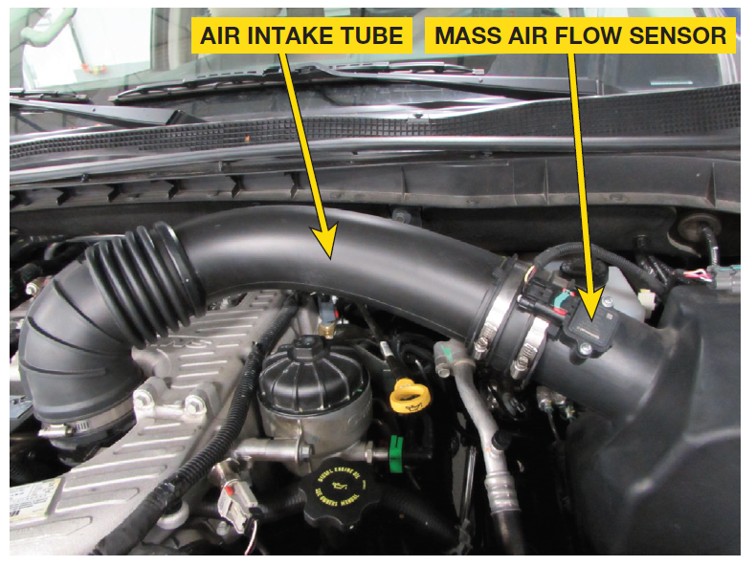
AIR INDUCTION SYSTEM (3 of 5)
MAF (Mass Air) Flow Sensor
  Measures amount of intake air into engine
  Hot film thermal flow meter
  With integrated temperature sensor

Slide 14
FIGURE 10–3 The mass air flow sensor provides powertrain control module with data regarding air flow. Exhaust gas recirculation (EGR) strategies are, in part, derived from this sensor. This sensor, along with the boost sensor and temperature sensor are used in the calculation.

Slide 15
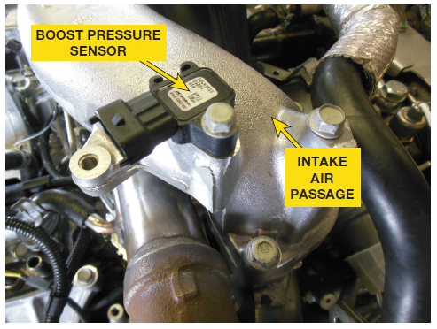
AIR INDUCTION SYSTEM (4 of 5)
Boost Pressure Sensor
  Used by PCM monitor air pressure in intake
  Location Varies
    Dual-stage turbochargers
    Multiple boost pressure sensors
    3-wire sensor receives 5-volt reference
    Shares sensor ground
      Manifold pressure low (high vacuum) 0.25 and 1.8 volts.
      Pressure high, due to boost 2.0-4.7 volts.

Slide 16
FIGURE 10–4 The boost pressure sensor, which may be combined with a temperature sensor, is used to calculate the mass of air entering the intake manifold.

Slide 17
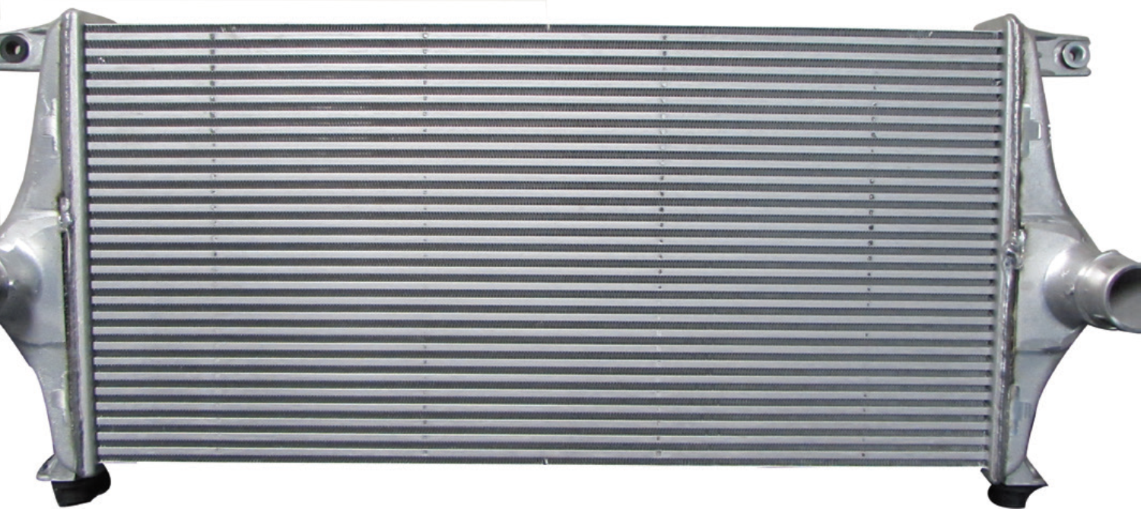
AIR INDUCTION SYSTEM (5 of 5)
Charge Air Cooler (CAC): Page 119
  Heat Exchanger Mounted Between
    Turbocharger & inlet air side (intercooler)
    hot, compressed air flows out of turbocharger to CAC
    As air travels through CAC & is cooled
    To Become a Denser Charge for more power

Slide 18
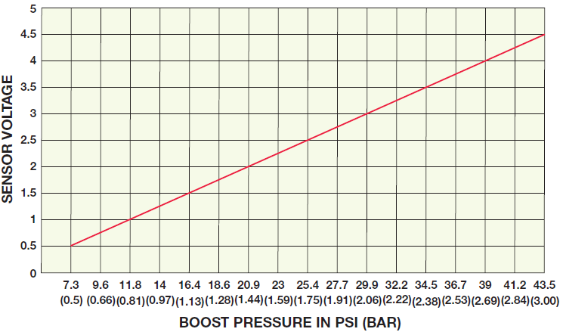
FIGURE 10–5 graph depicts normal voltage to pressure increase graph for typical boost pressure sensor.

Slide 19
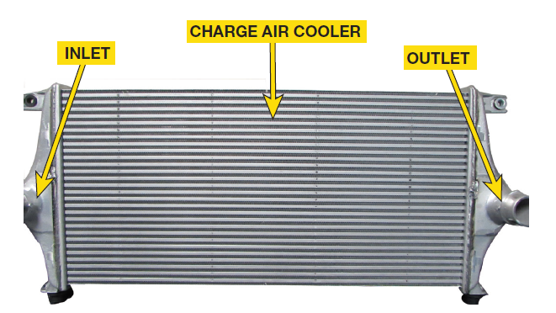
FIGURE 10–6 A charge air cooler from a Nissan Titan is an example of the surface area needed to provide sufficient cooling of the air charge after it leaves the turbocharger.

Slide 20
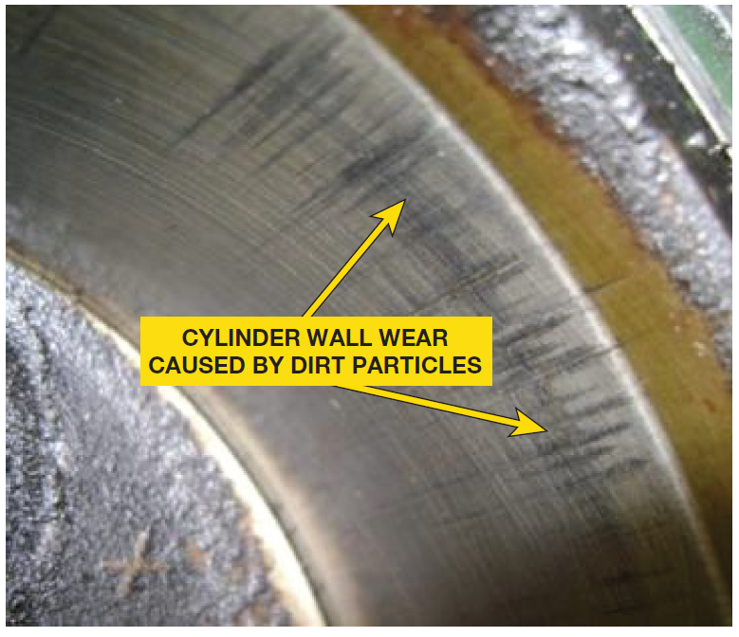
AIR INDUCTION SYSTEM
DIAGNOSIS (1 of 1)
Charge Air Cooler Diagnosis: Pages 120-121
  FIGURE 10–7
  Dust-Out Diagnosis
    Dust-out is condition where small dust & dirt particles
    Enter air induction system by bypassing filter.

Slide 21
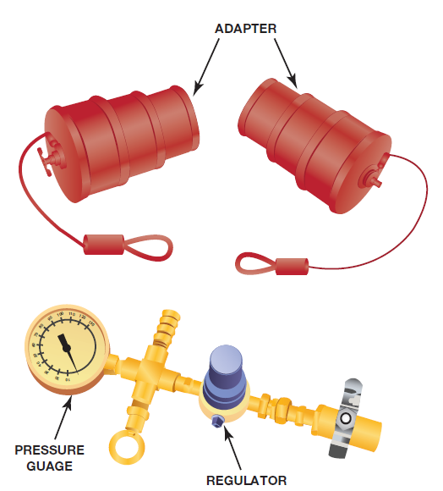
FIGURE 10–7 charge air cooler is sealed with test adapters and then pressurized with regulated shop air. The liquid soap and water solution will bubble in area of leak and identify reason for low boost condition.

Slide 22
FIGURE 10–8 The wear on cylinder wall is a result of an incorrectly installed air filter element that allowed unfiltered air into induction system. The foreign material in intake air scored the cylinder walls when it was drawn into the cylinder in a boost condition.

Slide 23
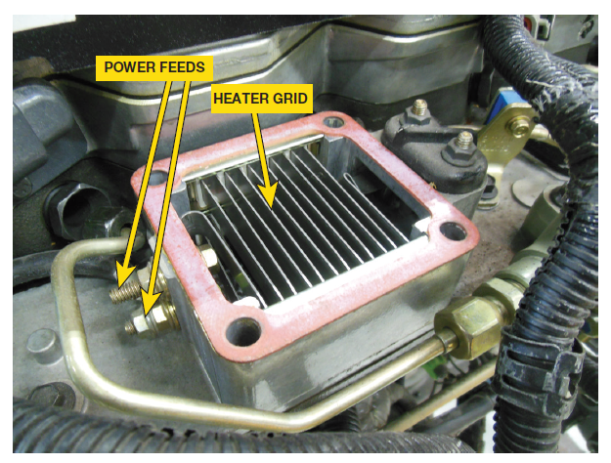
INTAKE MANIFOLD HEATER (1 of 1)
Intake Manifold Heater
  Warms air as it enters engine
  During cold start and warm-up period
  Operate until warms to 60–70 °F (15–21°)
  Controlled by PCM/ECM

Slide 24
FIGURE 10–9 The intake heater grid is used to warm intake air and increase pre-ignition temperatures. The heater may continue to be cycled to decrease the amount of time needed to warm the engine.

Slide 25

Case of Erratic Electrical Symptoms (1 of 2)
The owner of a 2010 Dodge Truck with a 6.7-Liter Cummins complained of a noticeable change in level of interior or exterior lighting, as well as speed of the blower motor. Owner stated that this situation occurred just after starting truck. The service technician was able to verify the customer concern and monitored battery voltage using a scan tool to confirm what technician thought was happening. The intake heaters on the Cummins 6.7 draw so much current that battery voltage is reduced, causing diming of the interior lights and the blower motor to turn slower than normal. The intake manifold heaters may continue to run for several minutes after the vehicle has started. No repairs were made and the customer was informed as to why this situation was occurring.

Slide 26
Case of Erratic Electrical Symptoms (2 of 2)
Summary:
Complaint – Customer complained that the interior lights were dimmer than normal shortly after starting the engine.
Cause – The battery voltage was reduced by the high amperage draw of the intake heaters.
Correction – No repairs were needed and the customer was informed that this was a normal condition on this diesel pickup.

Slide 27
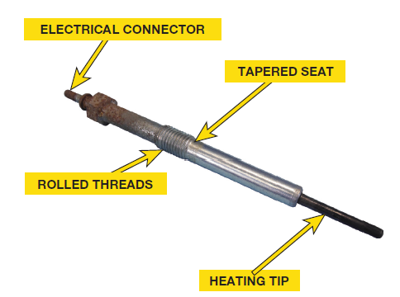
GLOW PLUGS (1 of 3)
Glow plugs
  Assist in starting engine
  During cold weather conditions
    Energized, glow plugs can reach temperatures
  1,500 °F (815°C) within 2 seconds
  Extra heat promotes combustion
  Location determined by type of
  injection system

Slide 28
FIGURE 10–10 The glow plug is controlled by the powertrain control module. The glow plug on-time is based on inputs from the
ECT, BARO, and battery voltage. The on-time varies from 1 to 180 seconds. The amperage through the glow plug varies with design.

Slide 29
GLOW PLUGS (2 of 3)
Glow Plugs
  CAUTION: Not all glow plugs operate using 12 volts. Some operate on 7 volts. Some glow plug control systems use a PWM voltage to control the glow plug. Do not test with 12 volts until it is determined the type of control and operating voltage of the system being serviced.
Glow Plug Control Module: PAGE 122
Pressure Sensing Glow Plugs

Slide 30
FIGURE 10–11 This glow plug control module example is from a Nissan Titan equipped with a 5.0 liter Cummins engine.
The module controls the glow plugs based on messages received from the powertrain control module on the high speed CAN Bus network.

Slide 31
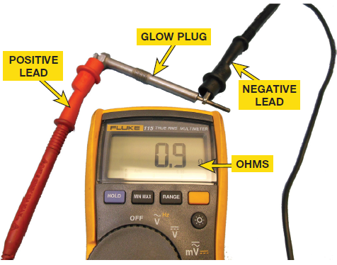
GLOW PLUGS (3 of 3)
Glow Plug Diagnosis & Service:
  Page 123 of text
  Using voltmeter, glow plug system can be
  Checked for proper voltage at the glow plug
  Glow plug itself can be checked with ohmmeter
  To ensure it has proper resistance

Slide 32
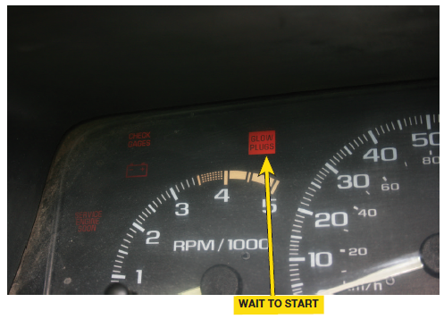
FIGURE 10–12 The Wait-To-Start Light is controlled by the powertrain control module and is illuminated during the time the glow plugs are heating.

Slide 33
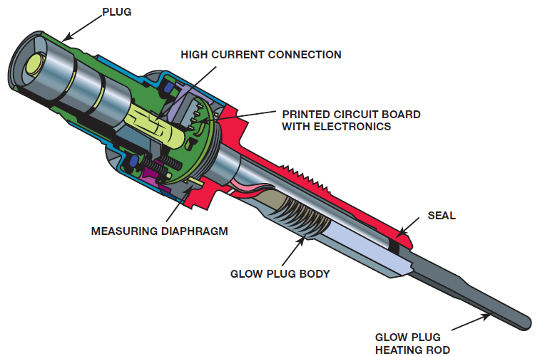
FIGURE 10–13 The measuring diaphragm in the pressure sensing glow plug is designed to provide feedback on the cylinder pressure. The feedback allows the powertrain control module to adjust fuel quantity and timing in an effort to reduce tailpipe emissions.

Slide 34
FIGURE 10–14 ohmmeter shows a resistance of 0.9 ohms which is normal for most glow plugs that usually have a specification of 0.6 to 6.0 ohms. Check service information for the exact resistance specification for vehicle being tested.
CAUTION: Glow plugs are sensitive to shock and impact. If they are dropped, they should be replaced, even if no visible damage is detected. Never install a glow plug with an impact wrench.

Slide 35
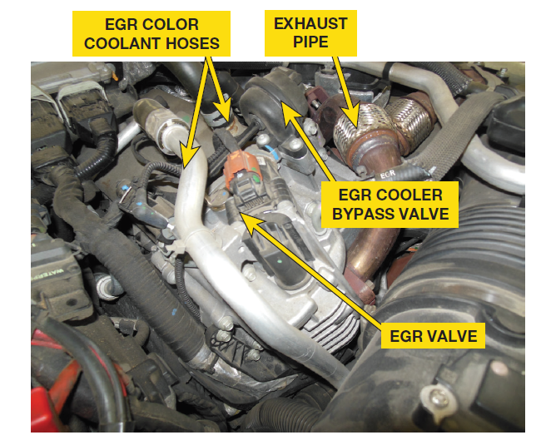
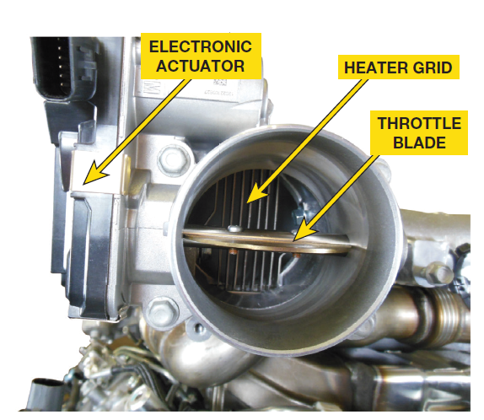
EGR SYSTEM (1 of 2)
Purpose of EGR
  Lower combustion temperatures & pressures
  Recirculating inert exhaust gases back into air intake
  System Design:
    Page 124
  Cooler Page 124
  Throttle Valve Page 124
    Figure 10-17
  Temperature Sensor Page 124

Slide 36
FIGURE 10–15 EGR valve meters flow of non-combustible exhaust gases into intake manifold. The exhaust gases displace combustible air in intake air stream and reduce combustion pressures and temperatures, effectively lowering NOx levels in exhaust.

Slide 37
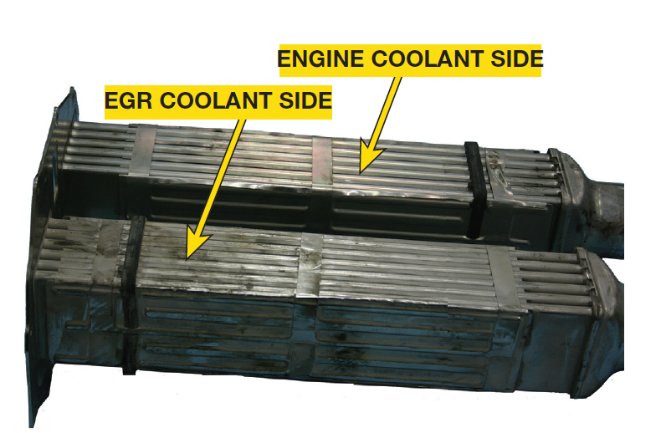
FIGURE 10–16 The EGR cooler lowers the exhaust gas temperatures, allowing it to absorb more combustion chamber heat.

Slide 38
FIGURE 10–17 electronic throttle valve is used to increase flow of exhaust gases in intake manifold. Position of throttle valve creates a pressure difference in intake manifold draws more exhaust gas into cylinders.

Slide 39
EGR SYSTEM (2 of 2)
EGR Operation: Page 125
  PWM controlled by PCM
    Increasing duty cycle of valve opening will increase as duty cycle increases
    Sensors Used
      Accelerator pedal position sensor
      Barometric pressure sensor
      Engine coolant temperature
      Engine speed sensor
      Exhaust gas temperature sensor
      Intake air temperature sensor
      Mass air flow sensor
      NOx sensor
      Oxygen sensor

Slide 40
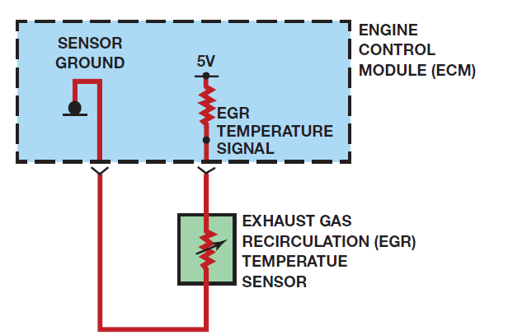
FIGURE 10–18 The engine control module provides the sensor with a 5 volt feed and a ground. The change in exhaust gas temperature affects the resistance of the sensor. The resulting change in the monitored voltage is used as part of the EGR flow calculation.

Slide 41
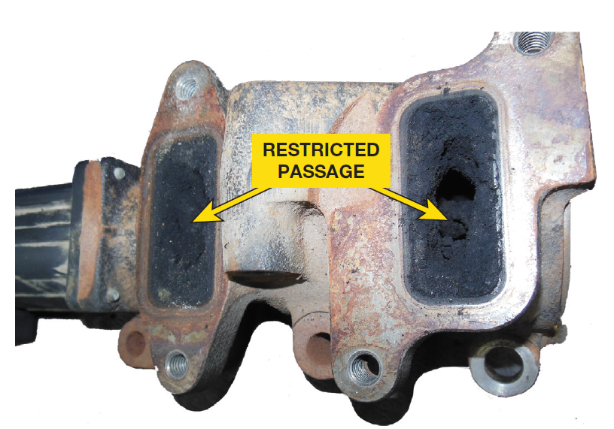
FIGURE 10–19 The EGR valve is electrically functional; however, passages through the valve are almost completely closed due to carbon buildup.

Slide 42
EGR SYSTEM DIAGNOSIS (1 of 1)
Electrical Failures: Page 126
System Performance Failures Page 126
  P0401 EGR Flow Low
  P0402 EGR Flow High
NOTE: MAF sensor not used for fuel control but for EGR control
Service Procedures & Parts Replacement
  Page 126

Slide 43
Case of the Failed EGR system (1 of 2)
2013 Ford F250 with 6.7 L Power Stroke with malfunction indicator lamp illuminated. Customer noticed MIL illuminated, but the vehicle exhibited no drivability concerns. P0401 (low EGR flow) code was recorded and the EGR cooler was found to be restricted. A check of truck’s hour meter found a high percentage of idle time. Vehicles fuel sample indicated low Cetane level. EGR cooler was replaced & customer instructed to shut off the vehicle instead of letting it idle. It was also suggested that customer treat the fuel with an additive to improve Cetane level.

Slide 44
Case of the Failed EGR system (2 of 2)
Summary:
Complaint – Ford F250 equipped with 6.7 liter Power Stroke diesel engine check engine light was on, but the truck seemed to be running fine.
Cause –P0401 (Low EGR Flow) code was recorded and the EGR cooler was found to be restricted.
Correction –EGR cooler was replaced and customer was instructed to shut off vehicle instead of letting it idle excessively.

Slide 45
Case of Duramax EGR Low Flow (1 of 2)
2006 GMC truck with 6.6L Duramax with 35,578 miles in shop with a complaint of a MIL Illuminated & reported no drivability concerns. Scan tool found a diagnostic trouble code (DTC) for low EGR flow (P0401). A functional test with scan tool verified the electrical operation of EGR valve; however, valve failed the flow test. Upon disassembly, passageways in EGR valve and EGR cooler were nearly closed off due to heavy carbon buildup. Buildup determined to be excessive idle time and low engine temperatures. EGR valve and EGR cooler were both replaced and the intake passages were cleaned.

Slide 46
Case of Duramax EGR Low Flow (2 of 2)
Summary:
Complaint – The owner of the diesel pickup truck complained that “check engine” light was on with no apparent problems with the operation of engine.
Cause –P0401 (Low EGR Flow) code was recorded and the EGR cooler was found to be restricted.
Correction –EGR cooler was replaced and customer was instructed to shut off vehicle instead of letting it idle excessively.

Slide 47
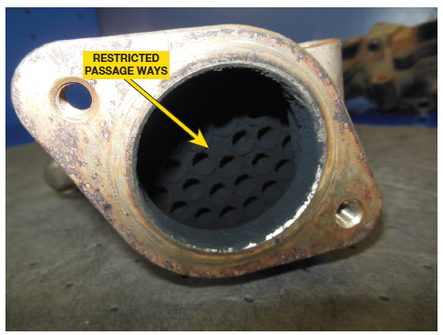
FIGURE 10–20 The EGR cooler passages are restricted due to a heavy carbon buildup. The buildup was beyond the normal level that could be cleaned and the unit was replaced.

Slide 48

“The “Simple Green” Treatment”
EGR passages/valves are often clogged with carbon. Some shops have discovered that if the part is soaked in a container of concentrated Simple Green cleaner overnight, part often looks like new. FIGURE 10–21. According to Safety Data Sheet (SDS), the only active ingredient is Butoxyethanol, colorless organic liquid, which acts as main cleaning solvent in Simple Green. carbon is removed not by dissolving carbon because no chemical can dissolve carbon. Active ingredient acts as a detergent and dispersant. A dispersant is able to break bond that causes carbon particles to adhere to each other. There is natural tendency for “carbon to attract carbon.” By causing carbon particles to become separated, they simply become mixed with the Simple Green solution & disposed of down a sanitary sewer because there are no hazardous materials associated with this cleaning process.

Slide 49
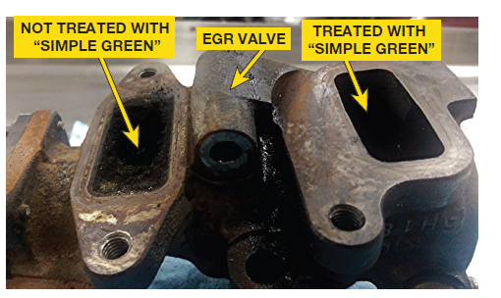
FIGURE 10–21 right side of this exhaust part was soaked in Simple Green. Prior to soaking, the areas inside looked like the left side.

Slide 50
Summary (1 of 3)
The air induction system provides an adequate supply of clean, dry, fresh air that is needed to support combustion events, thereby delivering the desired engine performance, as well as clean tailpipe emissions.
The air filter assembly includes the air filter, mass air flow/temperature sensor assembly and an air filter minder.
The mass air flow (MAF) sensor is used to measure the amount of intake air the engine is using.
The boost pressure sensor allows the powertrain control module (PCM) to monitor the air pressure in the intake manifold. The location of the pressure sensor will vary with the design of the boost system.

Slide 51
Summary (2 of 3)
The charge air cooler is a heat exchanger that is mounted between the turbocharger and the inlet air side of the engine. The charge air cooler is sometimes referred to as the intercooler.
Dust-out is a condition where small dust and dirt particles enter the air induction system by bypassing the filter.
Glow plugs are used to assist in starting the engine during cold weather conditions.
An intake manifold heater is used to warm the air as it enters the engine during a cold start and the subsequent warm-up period.

Slide 52
Summary (3 of 3)
The purpose of the exhaust gas recirculation (EGR) system is to lower combustion temperatures and pressures by recirculating inert exhaust gases back into the air intake stream.
The powertrain control module (PCM) uses a variety of inputs to verify the performance of the EGR system.

