Slide 1
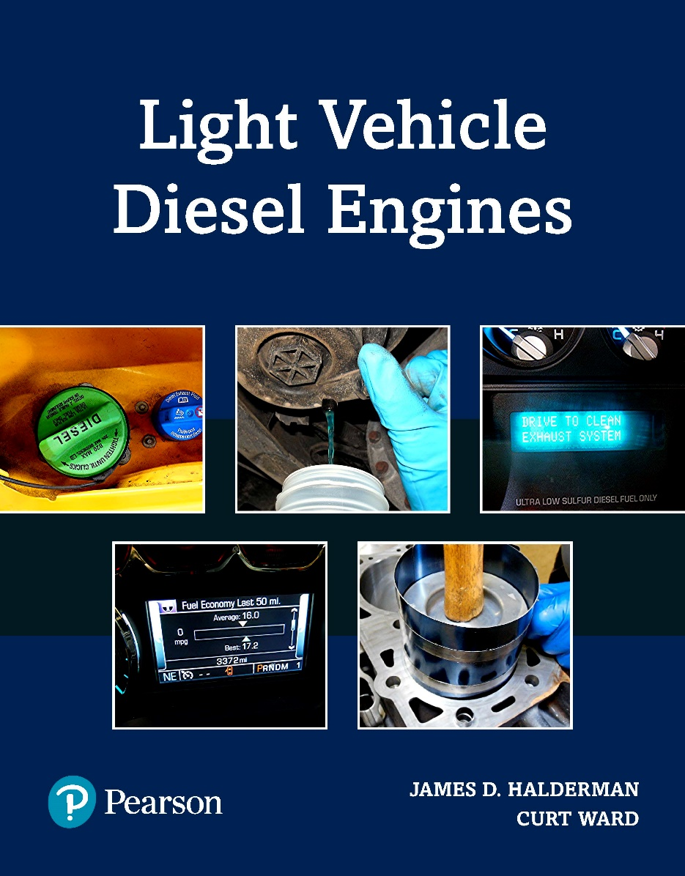
Light Vehicle Diesel Engines
First Edition
Chapter 13
High-Pressure Common Rail Diesel Fuel System
Copyright © 2018, 2015, 2011 Pearson Education, Inc. All Rights Reserved

Slide 2
LEARNING OBJECTIVES (1 of 1)
13.1 Prepare for the Light Vehicle Diesel Engine (A9) ASE certification fuel system diagnosis and repair area “F” (Fuel System Diagnosis and Repair).
13.2 Describe the safety concerns related to working with high-pressure fuel systems.
13.3 Identify the components of a high-pressure common rail injection system.
13.4 Discuss the operation of a high-pressure common rail injector.
13.5 Determine the need for service and repair of a high pressure common rail injection systems.

Slide 3
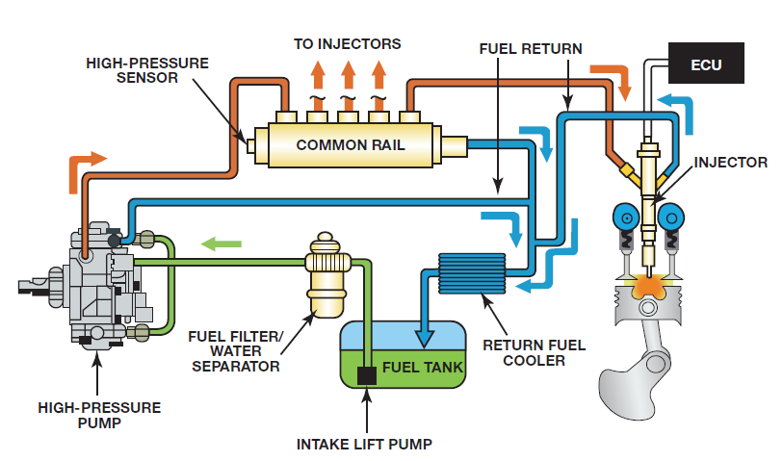
FUNCTIONS OF HIGHPRESSURE
INJECTION SYSTEMS (1 of 3)
High Pressure Common Rail (HPCR)
  Introduced on light-duty diesel vehicles in 1990s
  Emission standards became more stringent
  Fuel economy expectations increased

Slide 4
FUNCTIONS OF HIGHPRESSURE
INJECTION SYSTEMS (2 of 3)
HPCR REASONS
  Fuel must be injected with enough velocity
  Mix with dense air mass
  As pressure continues to climb, fuel distribution difficult.
  At higher engine speeds, time available decreases
  High pressure allows for adequate fuel distributed

Slide 5
FIGURE 13–1 typical high-pressure common rail (HPCR) diesel fuel system.

Slide 6
WARNING (1 of 2)
Duel system may be under extreme pressure 30,000 PSI (2,086 BAR). Do not open high pressure fuel system with engine running. Engine operation causes high-fuel pressure. High-pressure fuel spray can cause serious injury or death. SEE FIGURE 13–2.

Slide 7
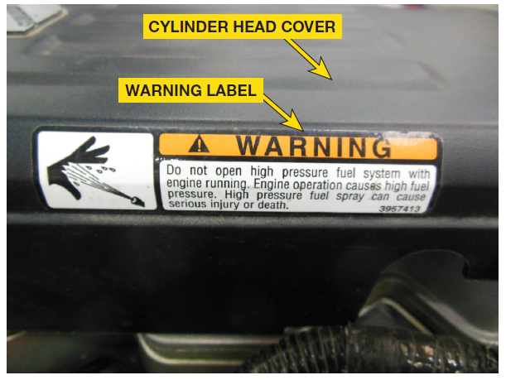
FIGURE 13–2 example of an under hood high-pressure fuel warning decal, warning of dangers related to system.

Slide 8
FUNCTIONS OF HIGHPRESSURE
INJECTION SYSTEMS (3 of 3)
ADVANTAGES OF COMMON RAIL: Page 142
DISADVANTAGES OF COMMON RAIL: Page 143

Slide 9
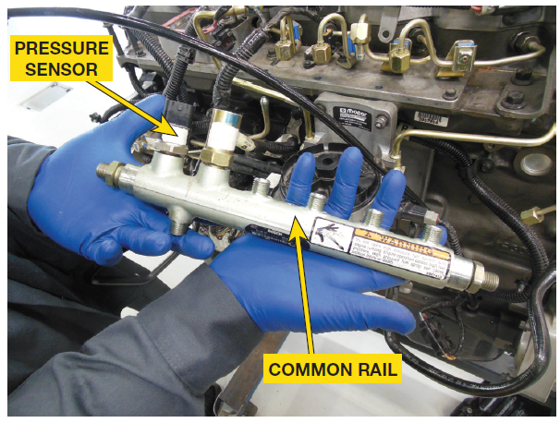
HIGH PRESSURE COMMON RAIL
INJECTION (1 of 6)
Common Rail/Tube: Figure 13-3
  Supply manifold used to store
  Distribute pressurized fuel to each injector
  Match the engine speed and load

Slide 10
FIGURE 13–3 high-pressure common rail supplies the fuel injectors with the same fuel pressure and act as a pulse dampener as they operate.

Slide 11
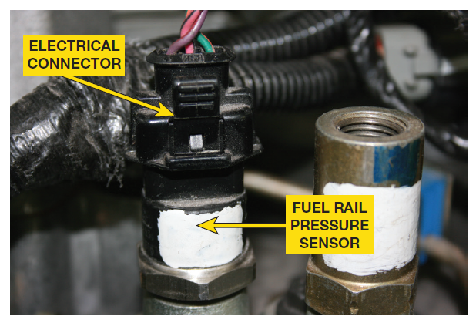
FIGURE 13–4 fuel rail pressure sensor provides feedback to the powertrain control module so the high-pressure fuel pump can operate most efficiently.

Slide 12
HIGH PRESSURE COMMON RAIL
INJECTION (2 of 6)
Fuel Rail Pressure Sensor
  Monitors fuel pressure in rail
  Sends info to PCM
  Uses info as part of calculation for desired fuel pressure
  Piezo-resistive-type or variable capacitance type
  Both supplied reference voltage & ground
  Signal sent on third wire
  Serviced separately, or part of common rail

Slide 13
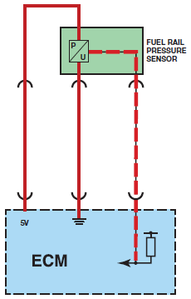
FIGURE 13–5 typical fuel rail pressure sensor wiring diagram.

Slide 14
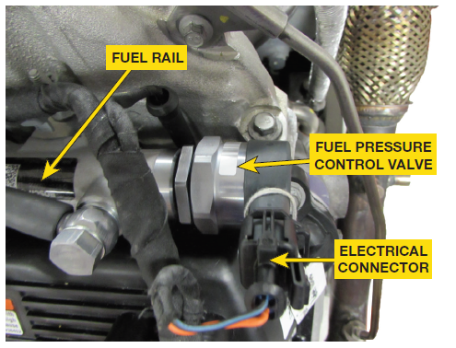
FIGURE 13–6 high-pressure common rail supplies the fuel injectors with the same fuel pressure, and acts as a pulse dampener as they operate.

Slide 15
HIGH PRESSURE COMMON RAIL
INJECTION (3 of 6)
Fuel Rail Temperature Sensor
  Located on fuel rail downstream in fuel system
  Two-wire sensor with reference voltage & Return
  Temperature has an effect on fuel viscosity

Slide 16
HIGH PRESSURE COMMON RAIL
INJECTION (4 of 6)
Fuel Pressure Relief Valve/Fuel Pressure Control Valve
  Normally open, pulse width modified (PWM)
  Along with volume control valve
  ON high-pressure pump
  Regulates fuel rail pressure

Slide 17
HIGH PRESSURE COMMON RAIL
INJECTION (5 of 6)
Fuel Injector Supply Lines Page 145
Transfer Tubes Figure 13-7 Page 145
  P0087 code for fuel rail/system pressure too low
  P0093 for a fuel system large leak detected
Return Lines Page 145

Slide 18
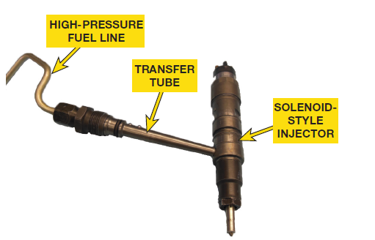
FIGURE 13–7 fuel line is threaded onto transfer tube. Transfer tube allows the fuel to flow to the injector. Components must be precisely oriented and torqued to ensure system is sealed properly.

Slide 19
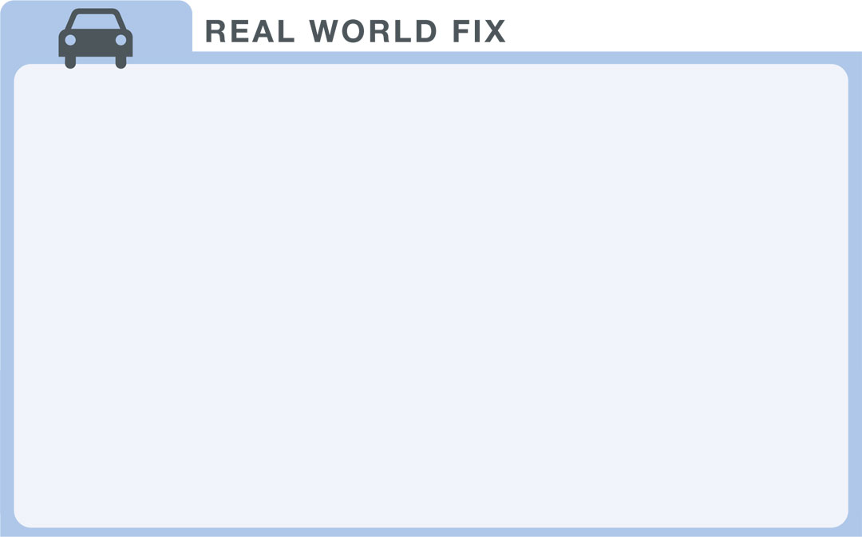
Case of the Loose Transfer Tubes (1 of 2)
2010 Dodge Ram equipped with 6.7 liter Cummins diesel engine is in shop with rough running engine. Service history revealed vehicle had recently had injectors and connecting tubes replaced for a similar complaint. Inspection of work previously performed found the retaining nuts for #5 and #6 connecting tubes below the OEM torque specification. Re-torqueing retaining nuts to specifications eliminated rough running condition. System did not have any internal leaks, however, the under-torqued retaining nuts allowed air to be drawn into the high-pressure fuel system, creating rough running condition.

Slide 20
Case of the Loose Transfer Tubes (2of 2)
Summary:
  Complaint – The customer complained of a rough running engine.
  Cause – The #5 and #6 transfer tube retaining nuts were under-torqued.
  Correction – Re-torqued the transfer tube retaining nuts to specifications.

Slide 21
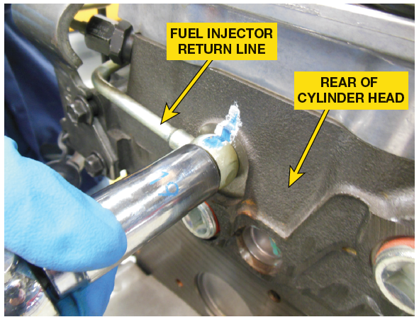
HIGH PRESSURE COMMON RAIL
INJECTION (6 of 6)
Return Lines
  May be in various locations
  Based on high-pressure fuel system design
  Small amounts of fuel returned from injectors
  High-pressure pump, and the rail FIGURE 13–9.

Slide 22
FIGURE 13–9 return line allows a small amount of fuel from the injectors and the high-pressure pump to be returned to the tank.

Slide 23
HIGH-PRESSURE PUMP (1 of 5)
High-Pressure Pumps
  Developing pressure required for injection
  Create enough volume
  vary with some pump pistons configured
  inline and others in a radial configuration
  Older systems favor inline configuration
  Newer systems radial configuration

Slide 24
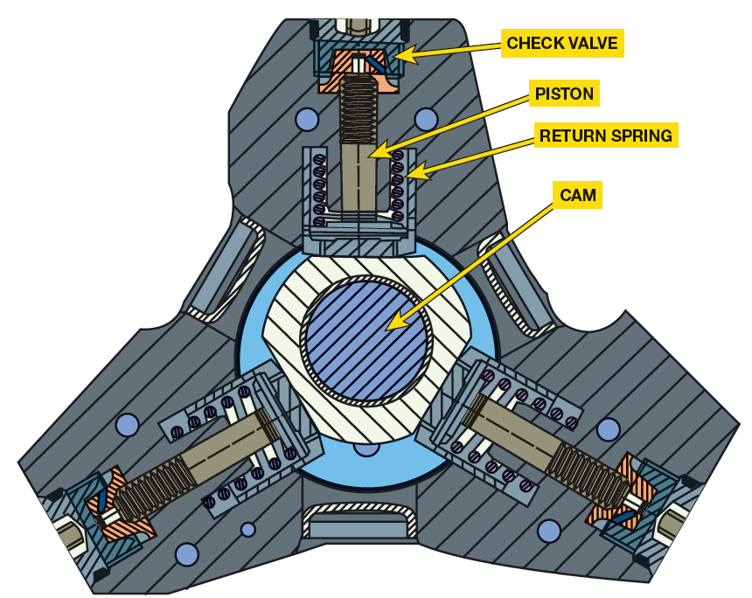
FIGURE 13–11 example of a multi-piston pump that uses a three-lobe cam as the actuator.

Slide 25
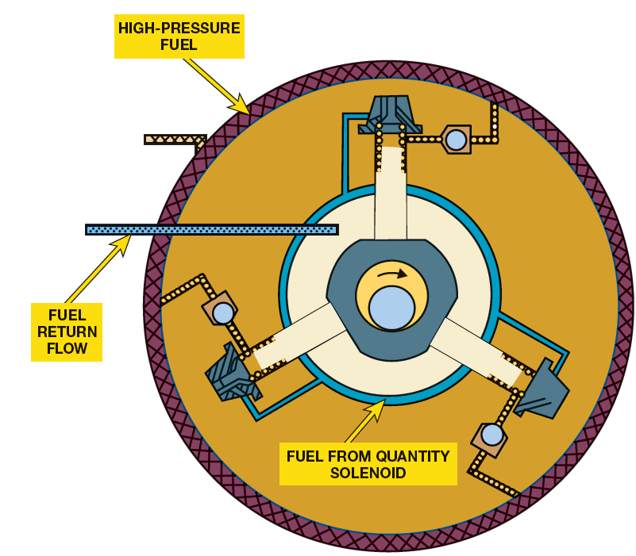
FIGURE 13–12 example of how fuel is fed into pumping chamber and how it is delivered under high pressure. The lubrication circuit is also depicted.

Slide 26
HIGH-PRESSURE PUMP (2 of 5)
Single piston pumps in smaller displacement
Multiple piston pumps on larger displacement
  Driven by camshaft or crankshaft gear
  Timed for purpose of fuel delivery or vibration
  Each high-pressure pump piston
    Compressed by an eccentric cam
    Return facilitated by return spring
    Piston chamber has inlet & outlet check valve
    Controls the flow of fuel into the cylinder

Slide 27
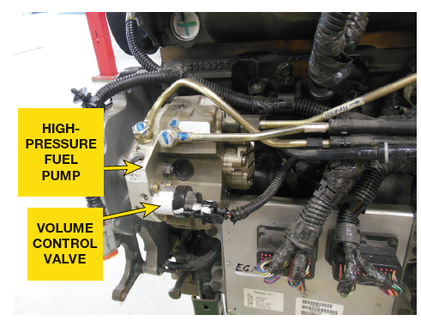
HIGH-PRESSURE PUMP (3 of 5)
High-pressure Pump
Depending on Design, House:
  Fuel Quantity Solenoid,
  Volume Control Valve
  Electronic Fuel Control Actuator,
  Cascade Overflow Valve
    Regulate Amount Of Fuel Through Pump
    Minimize Parasitic Losses

Slide 28
FIGURE 13–13 volume-control valve (Fuel Pressure Control Valve) meters fuel from low-pressure system into high-pressure pump to minimize parasitic loss.

Slide 29

HIGH-PRESSURE PUMP (4 of 5)
Volume Control Valve
  Fuel Pump Actuator or Fuel Quantity Solenoid,
  Normally open, PWM controlled fuel volume
  From low-pressure system into high-pressure pump
  PCM controls operation of volume control valve
  Reduce/increase fuel amount
  Absence of signal valve defaults to wide open

Slide 30
HIGH-PRESSURE PUMP (5 of 5)
Cascade Overflow Valve
  Regulates fuel pressure to volume control valve
  Diverts excess fuel back to tank
  Via low-pressure return system

Slide 31
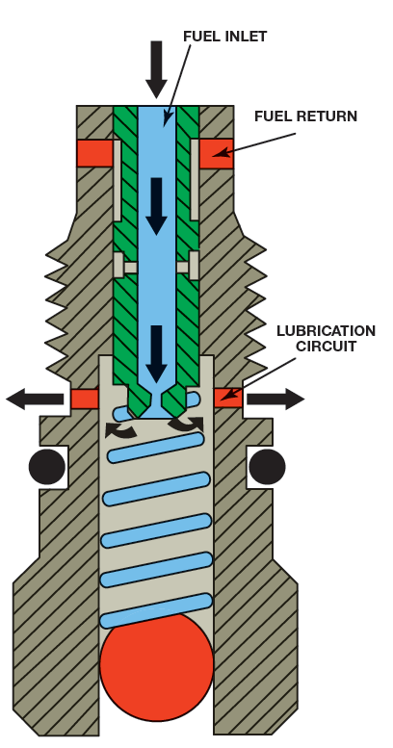
FIGURE 13–14 cascade overflow valve is a serviceable component of the high-pressure pump that determines flow rate and allows for lubrication of internal pump components.

Slide 32
COMMON RAIL INJECTOR (1 of 4)
Meet Injection Requirements Of Diesel Engine
  Number of manufacturers
  Fall into one of two designs:
    1. Solenoid Controlled
    2. Piezoelectric Actuated

Slide 33
COMMON RAIL INJECTOR (2 of 4)
Deliver fuel to meet torque and horsepower
Deliver clean tailpipe emissions
  Range 19,000 to 23,000 PSI (13,000 to 159,000 kPa)
  Versions delivered fuel at pressures that exceed
  35,000 PSI (240,000 kPa).

Slide 34
COMMON RAIL INJECTOR (3 of 4)
Solenoid Injector
  Uses electromagnetic field generated by solenoid and
  Hydraulic pressure of fuel to open and close injector

Slide 35
COMMON RAIL INJECTOR (4 of 5)
Piezoelectric Injectors
  Require electrical current, high-pressure fuel
  Reversed electrical current to inject fuel
  Solenoid replaced with stack of piezo ceramic discs
  Changes shape when electrical current introduced

Slide 36
COMMON RAIL INJECTOR (5 of 5)
Piezoelectric Injectors
  When energized, piezo stack becomes shorter
  Reduces hydraulic pressure on top of nozzle valve
  Allows injector to open and fuel be delivered.
  Piezo stack de-energized, stack returns to original height,
  Closes hydraulic leak, allowing pressure to equalize

Slide 37
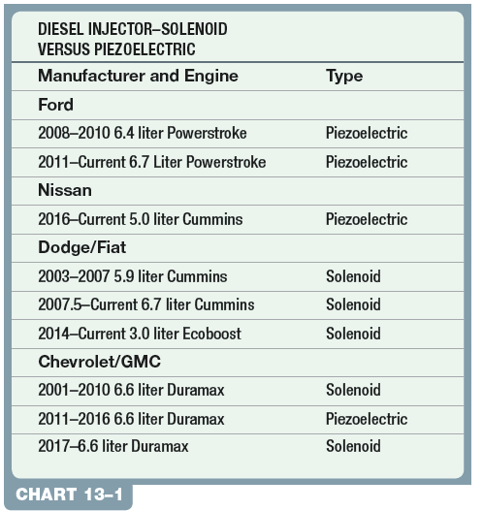
CHART 13-1 type of fuel injector used, sorted by manufacturer and model year.

Slide 38
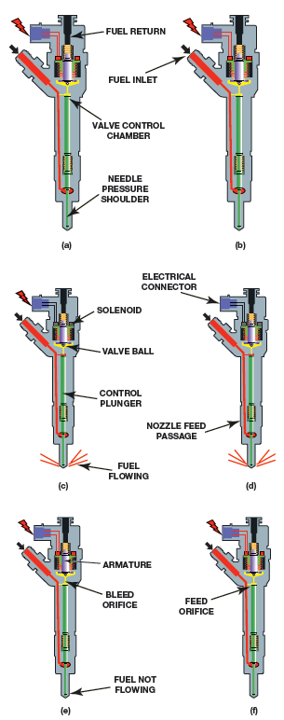
FIGURE 13–15 Sequence of a solenoid high-pressure common rail injector going through an injection cycle.

Slide 39
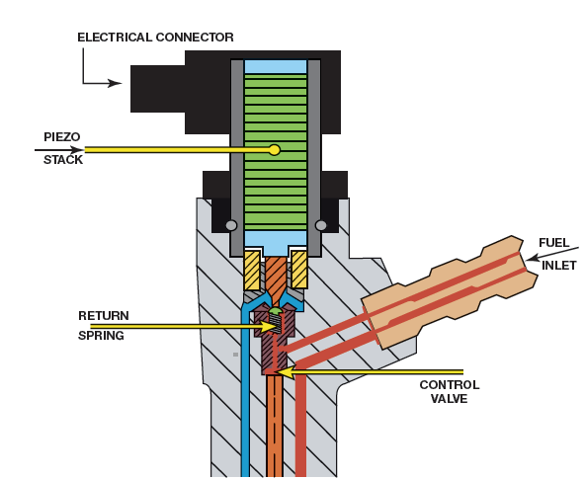
FIGURE 13–16 Sequence of piezoelectric high-pressure common rail injector going through a fuel cycle.

Slide 40
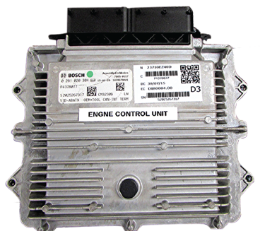
POWERTRAIN CONTROL
MODULE (1 of 2)
Contains Driver Circuits Needed
  Operate HPCR rail injector
  May contain DC-DC converter
  Step up system voltage to operate injectors
  Voltage as high as 250 volts
    19 amps
  Monitors operation of injectors
  Store codes
  Freeze frame data if failure occurs

Slide 41
FIGURE 13–17 powertrain control module contains driver circuits and DC-DC converter needed to operate injectors.

Slide 42
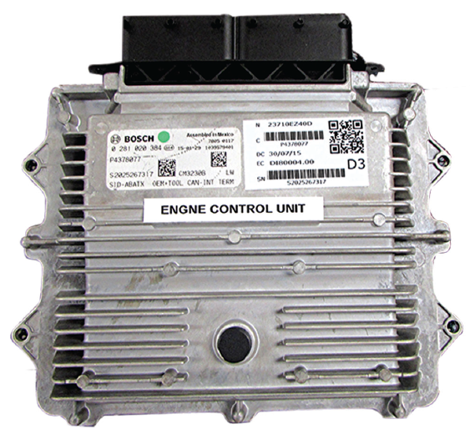
POWERTRAIN CONTROL
MODULE (2 of 2)
DC-to-DC Converters
  Transform DC voltage from one level of DC voltage to another higher or lower level
    Converts 14 volts to 5 volts V-Ref
    Transformer isolates input (42 V) from output (14 V)
      Power transistor pulses high-voltage coil of transformer
      Resulting changing magnetic field induces voltage in coil windings of lower-voltage side of transformer

Slide 43
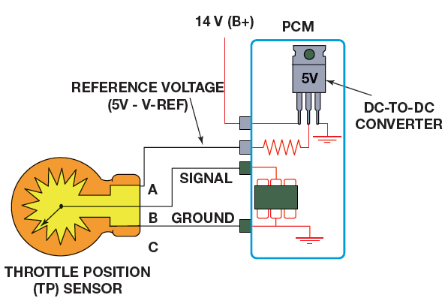
FIGURE 13–18 DC-DC converter in this example is used to create the 5 volts used for the v-reference signal.

Slide 44
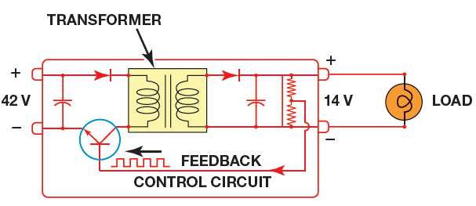
FIGURE 13–19 DC converter is used to convert system voltage (14 volts) to the 42 volts needed for operation.

Slide 45
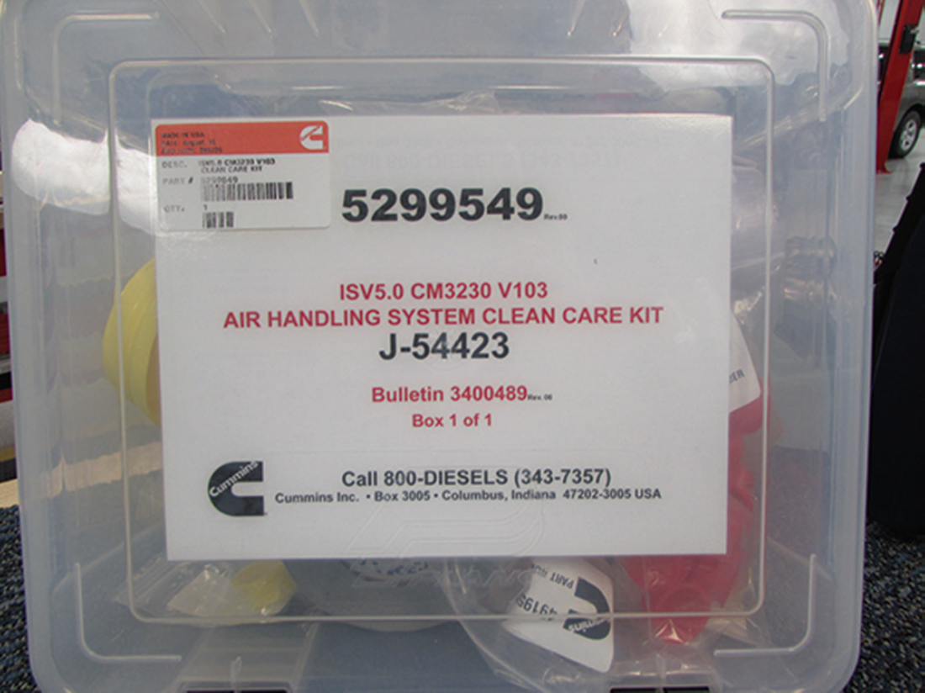
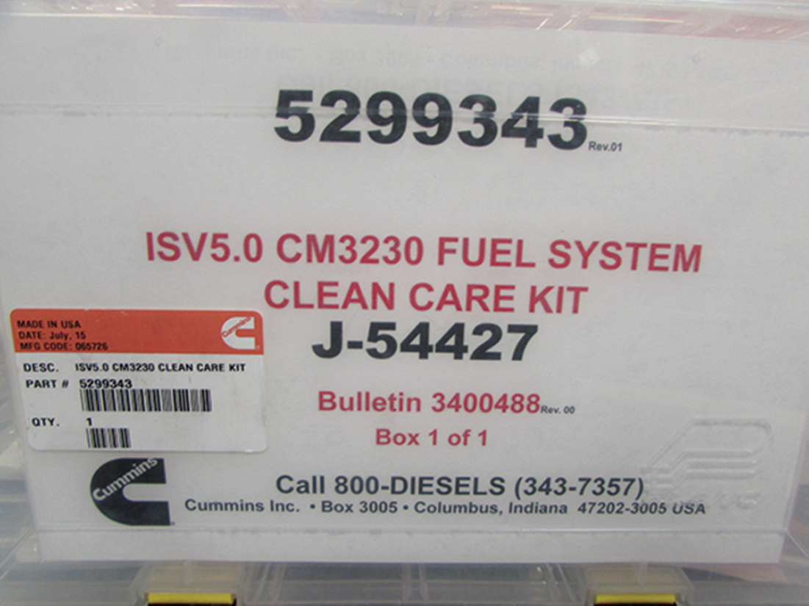
HIGH-PRESSURE COMMON RAIL (HPCR) FUEL SYSTEM SERVICE PROCEDURES ( 1 of 2)
Many Fuel & Air Management System OEMS
  Kits that provide caps and covers
  For fuel and air management systems that
  Open due to testing by service technician

Slide 46
FIGURE 13–20 Cummins Clean Care kit. Kit is used to seal air management system during testing.

Slide 47
FIGURE 13–21 Cummins Clean Care kit. Kit is used to seal openings in fuel management system during testing.

Slide 48
Case of High-Pressure Fuel System
Components Failure (1 of 3)
2012 Ford with a 6.7 liter Power Stroke diesel engine in the shop with complaint of being hard to start and running rough. MIL illuminated. DTC P1292 (injector shorted to voltage or ground) found. A test of the high-pressure fuel system return volume to tank revealed an amount above specifications. It was determined that the high-return volume was a result of internal wear in the numerous injectors. Further investigation revealed that the wear was due to fuel contamination by DEF) The presence of DEF in the injectors was also responsible for the P1292 code. DEF crystals were found in the primary fuel filter. To correct the condition, fuel system was cleaned, the fuel filters were replaced, and all eight injectors were replaced per the Ford Technical Service Bulletin # 11-10-10.

Slide 49
Case of High-Pressure Fuel System
Components Failure (2 of 2)
Summary:
  Complaint – The customer complained vehicle was hard to start, the engine ran rough, and the MIL was illuminated.
  Cause – The failure was a result of diesel exhaust fluid (DEF) in the fuel system.
  Correction – Per the Ford TSB #11-10-10, fuel system was cleaned, the fuel filters were replaced, and all eight injectors were replaced.

Slide 50
WARNING (2 of 2)
Duel system may be under extreme pressure 30,000 PSI (2,086 BAR). Do not open high pressure fuel system with engine running. Engine operation causes high-fuel pressure. High-pressure fuel spray can cause serious injury or death.

Slide 51
HIGH-PRESSURE COMMON RAIL (HPCR) FUEL SYSTEM SERVICE PROCEDURES ( 2 of 2)
High-Pressure Fuel System Leaks
  Difficult & dangerous to locate
    Diagnostic Process #1: Many manufacturers’ instructions recommend using a piece of cardboard to find the fuel leak
    Diagnostic Process #2:dye should be added to fuel system.

Slide 52
FIGURE 13–22 Fuel system fluorescent dye is readily available. In many cases, the dye can be used for more than one system.

Slide 53
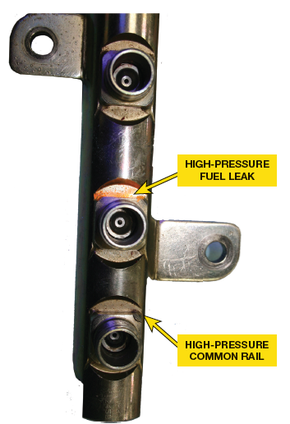
FIGURE 13–23 Using a black light, fluorescent dye is visible at the location of high-pressure fuel leak.

Slide 54
Case of High-Pressure Fuel System
Components Failure (2 of 3)
2012 Ford with a 6.7 liter Power Stroke diesel engine in the shop with complaint of being hard to start and running rough. MIL illuminated. DTC P1292 (injector shorted to voltage or ground) found. A test of the high-pressure fuel system return volume to tank revealed an amount above specifications. It was determined that the high-return volume was a result of internal wear in the numerous injectors. Further investigation revealed that the wear was due to fuel contamination by DEF) The presence of DEF in the injectors was also responsible for the P1292 code. DEF crystals were found in the primary fuel filter. To correct the condition, fuel system was cleaned, the fuel filters were replaced, and all eight injectors were replaced per the Ford Technical Service Bulletin # 11-10-10.

Slide 55
Case of High-Pressure Fuel System
Components Failure (3 of 3)
Summary:
  Complaint – The customer complained vehicle was hard to start, the engine ran rough, and the MIL was illuminated.
  Cause – The failure was a result of diesel exhaust fluid (DEF) in the fuel system.
  Correction – Per the Ford TSB #11-10-10, fuel system was cleaned, the fuel filters were replaced, and all eight injectors were replaced.

Slide 56
Case of the Multiple Injector Washers (1 of 2)
2009 Dodge Ram with 5.9 liter Cummins in the shop with a complaint of hard to start and lack of power on acceleration. The vehicle had all 6 injectors replaced recently at another shop. A test of fuel return volume indicated an abnormally high return volume. After removing all six of the previously installed injectors, the number five injector was found to have 2 sealing washers at the tip. One of the washers was new and the other washer was original to the engine and was not removed when the injector was replaced. The additional washer caused damage to the new injector and the cylinder head. Both the cylinder head and the new injector had to be replaced to solve the customer concern: FIGURE 13-24

Slide 57
Case of the Multiple Injector Washers (2of 2)
Summary:
  Complaint – customer complained vehicle was hard to start and lacked power on acceleration
  Cause – number five replacement injector was installed with two sealing washers (the original and replacement), causing damage to the cylinder head and the injector
  Correction – cylinder head and the injector were both replaced

Slide 58
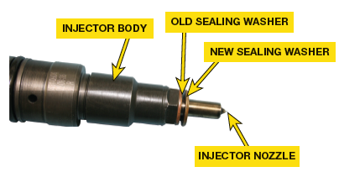
FIGURE 13–24 failure to install injector with its sealing washers properly can lead to leakage and system performance problems.

Slide 59
HIGH-PRESSURE COMMON RAIL (HPCR) FUEL SYSTEM SERVICE PROCEDURES ( 3 of 3)
Injector Replacement
Injector Quantity Adjustment
  Many HPCR injectors have injector classification code
  Assigned to them at time of manufacturing.
    SEE FIGURE 13–25
HP Pump Replacement Page 154
  CAUTION: When servicing high-pressure fuel system components, refer to service information for correct reuse policy. Many components must be replaced and cannot be reused even when no visible damage is noted.

Slide 60
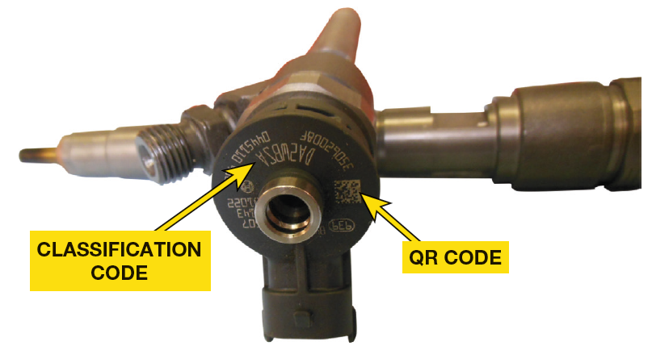
FIGURE 13–25 calibration code must be programmed into PCM when injector is replaced. The calibration allows PCM to make the proper adjustments to fuel delivery of that cylinder, resulting in smoother operating engine.

Slide 61
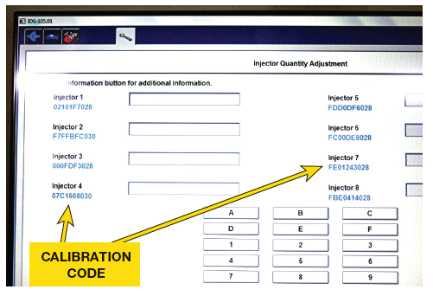
FIGURE 13–26 scan tool shows the list of calibration codes that are programmed into the powertrain control module for that vehicle. A technician can compare those values to the actual injectors to ensure they were properly programmed.

Slide 62
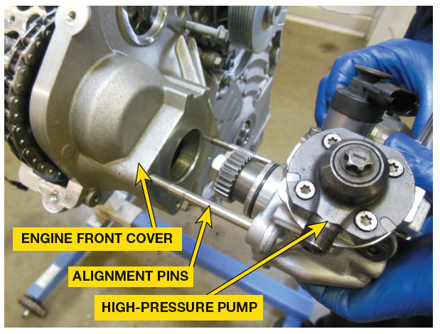
FIGURE 13–27 pump and its gear are aligned with cam gear to ensure there are no abnormal engine vibrations in engine as pump generates high rail pressures.

Slide 63

What Is Needed to Install a New High-Pressure Pump?
Many OEMS require specific tools used in process. Special tools include index tools, alignment pins, degree wheels, and more. Camshaft & crankshaft position will need to be verified & pump will need to be positioned properly prior to installation. Failure to follow procedure may result in low or no fuel pressure or vibration.

Slide 64
How Do I Inspect the Pump-Line-Nozzle (PLN-E) Fuel Systems on Older Diesel Engines?
Pump-line-nozzle (PLN-E) systems are found on older diesel engines where fuel delivery was timed to engine speed. Most OEMS used a nozzle pop-tester to determine if nozzle opened at correct pressure and a traditional pressure gauge was used to measure fuel pressure. Refer to the OEM service information

Slide 65
FIGURE 13–28 A typical pop tester used to check the spray pattern of a diesel engine injector.

Slide 66
QUESTION 1
What are the components in a typical high-pressure common rail injection system?

Slide 67
ANSWER 1
Components that are mounted on the common rail tube are the pressure relief, or pressure control valve, the fuel pressure sensor, the injector supply lines, and the return line.

Slide 68
Summary (1 of 2)
The high-pressure fuel system is responsible for receiving the fuel from the low-pressure system and injecting it into the combustion chamber.
High-pressure common rail (HPCR) fuel systems were introduced on light-duty diesel vehicles in the early 1990s as diesel emission standards began to become more stringent and fuel economy expectations increased.
Components that are mounted on the common rail tube are the pressure relief, or pressure control valve, the fuel pressure sensor, the injector supply lines, and the return line.

Slide 69
Summary (2 of 2)
The high-pressure pump is responsible for developing the pressure required for injection under all operating conditions. They create enough volume so that when they are subjected to the normal system restrictions, they create adequate pressure. High-pressure pump applications vary with some pump pistons configured inline and others in a radial configuration.
Although there are a number of manufacturers of high pressure common rail injectors, they fall into one of two designs: Solenoid controlled & Piezoelectric actuated
Dirt and debris that enters the fuel system and the air induction system are the root cause of many high-pressure fuel system failures.

