Slide 1
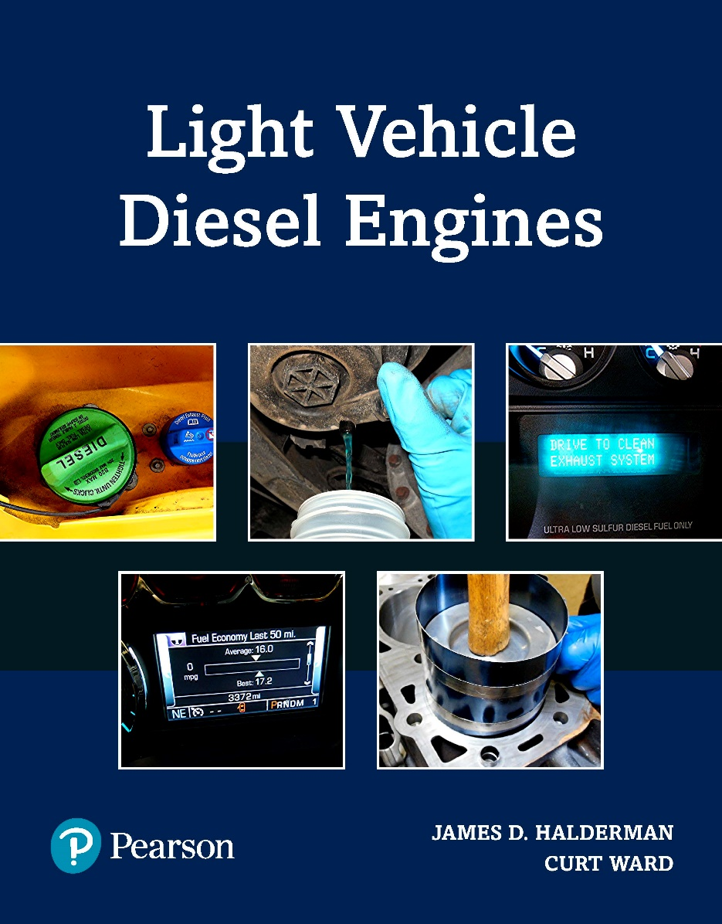
Light Vehicle Diesel Engines
First Edition
Chapter 15
Exhaust and Aftertreatment Systems
Copyright © 2018, 2015, 2011 Pearson Education, Inc. All Rights Reserved

Slide 2
LEARNING OBJECTIVES (1 of 1)
15.1 Identify the components of the exhaust and aftertreatment systems.
15.2 Describe the function of each aftertreatment system.
15.3 Explain the differences between active and passive regeneration.
15.4 Explain how temperature sensors are used to monitor component operation.
15.5 Describe the function of the diesel exhaust fluid (DEF) in the selective catalyst reduction (SCR) system.

Slide 3
EXHAUST CHEMISTRY (1 of 4)
Emission Standards: FIGURE 15–1
  Changes in standards resulted in requirement
  Reduce PM & NOx emissions by 90%
  Changes to fuel control strategies helped to achieve

Slide 4
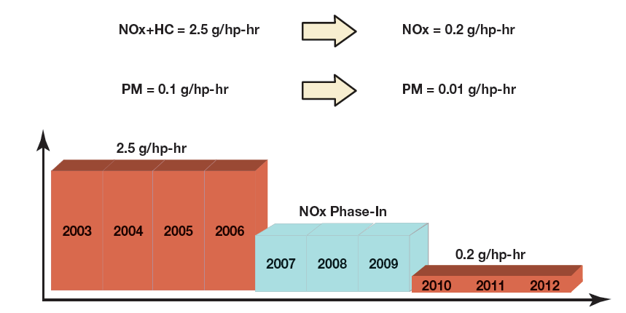
FIGURE 15–1 emission chart shows the mandated reductions in tailpipe emissions, how they have driven changes in way diesel engines operate, and how exhaust aftertreatment is configured.

Slide 5
EXHAUST CHEMISTRY (2 of 4)
Hydrocarbons (HC)
  Unburned diesel fuel measured in PPM
Carbon Monoxide (CO)
  Partially burned diesel fuel
  CO combine with O2 to form CO2
Oxides Of Nitrogen (NOx)
  Colorless, tasteless, odorless gas leaves engine
  Reaches atmosphere mixes with O2, forms NO2
  NO & NO2 grouped together and referred to NOx
  ‘x’ represents any number of oxygen (O2) atoms
Particulate Matter (PM)
  Soot, tiny particles of solid/semisolid material

Slide 6
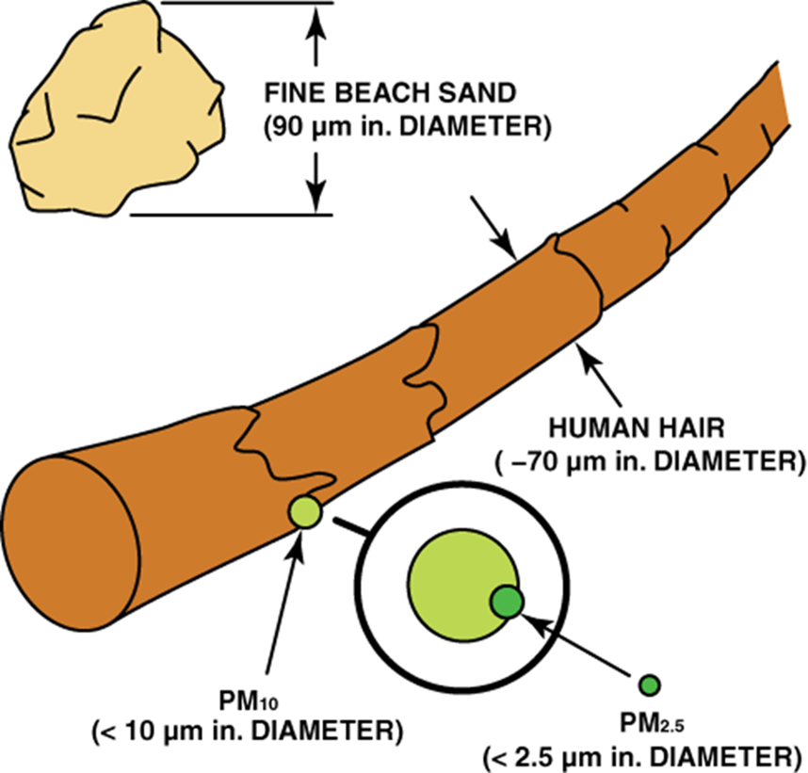
EXHAUST CHEMISTRY (3 of 4)
TSP (Total Suspended Particulate)
  Particles 0.1 & 50 microns
  PM10
    PM 10 microns or less (approximately 1/6 the diameter of a human hair).
    EPA standard for particles based on levels of PM10.
  PM2.5
    PM 2.5 microns or less
    (1/20 diameter of human hair), called “fine” particles.
    July 1997, EPA approved PM2.5
    SEE FIGURE 15–2.

Slide 7

FIGURE 15–2 Relative size of particulate matter to a human hair.

Slide 8
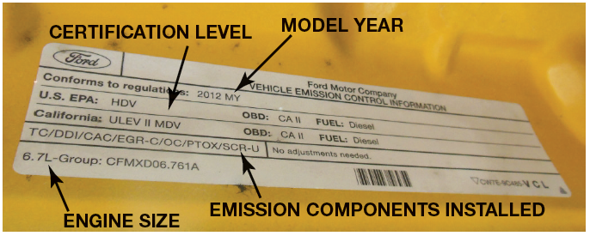
EXHAUST CHEMISTRY (4 of 4)
Vehicle Emissions Certification: Figure 15-3
  Exhaust System Function: Page 166
  Aftertreatment System Consists:
    Diesel oxidation catalyst (DOC)
    Particulate filters
    NOx catalysts

Slide 9
FIGURE 15–3 emissions certification label identifies how the vehicle is certified.

Slide 10
WARNING
Exhaust system components and exhaust air stream can be hot enough to cause damage or personal injury. Do not park or operate vehicle in areas where exhaust might come in contact with anything that can burn. Use extreme caution when working around these components.

Slide 11
EXHAUST SYSTEM
COMPONENTS
Exhaust Downpipe: Figure 15-4: Page 167
Exhaust Backpressure Regulators (EBPR) Figure 15-5
Exhaust Tailpipe Figure 15-6

Slide 12
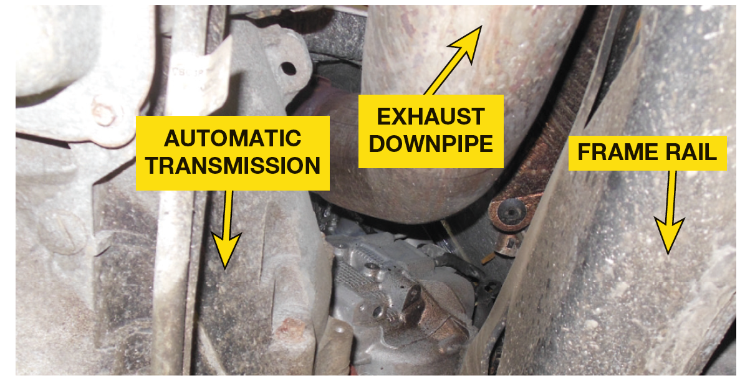
FIGURE 15–4 exhaust downpipe is constructed to retain heat to help the aftertreatment work as designed.

Slide 13
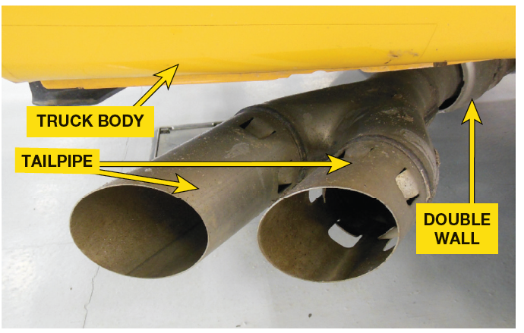
FIGURE 15–5 exhaust backpressure regulator (EBPR) allows engine to warm to operating conditions more quickly.

Slide 14
FIGURE 15–6 design of tailpipe allows for cooling of exhaust during regeneration event.

Slide 15
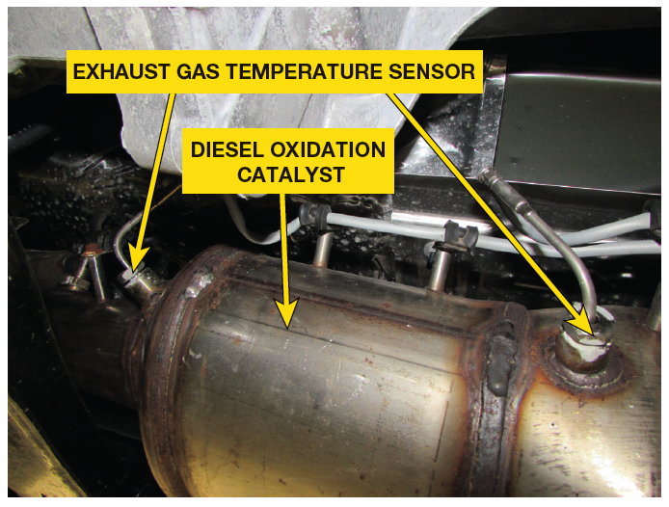
DIESEL OXIDATION
CATALYST (DOC)
Diesel Oxidation Catalyst (DOC)
  Helps to reduce HC & CO FIGURE 15–7
  Helps to reduce level of PM
  Convert NO to nitrogen dioxide

Slide 16
FIGURE 15–7 diesel oxidation catalyst (DOC) reduces hydrocarbons (HC) and carbon monoxide (CO) through oxidation. The heat generated from process is used to reduce particulate matter.

Slide 17
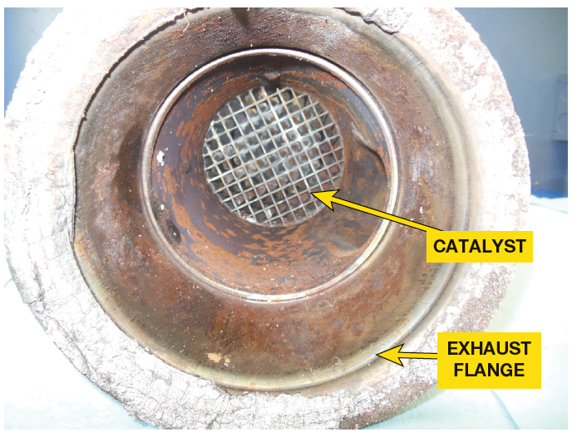
NOx ADSORBER CATALYST
NOx Adsorber Catalyst
  Maintenance-free strategy for removing NOx emissions
  Low-temperature, oxygen-rich environment
  Smaller Diesel Engines
  Operation Page 168

Slide 18
FIGURE 15–8 NOx Adsorber catalyst holds NOx emissions during lean conditions and oxidizes them when operating conditions are rich.

Slide 19
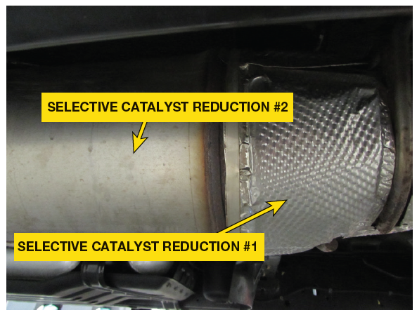
SELECTIVE CATALYST
REDUCTION (SCR) (1 of 2)
Selective Catalyst Reduction (SCR)
  Reduce level of NOx
  Before or after DPF
  Ceramic substrate covered W/
    Washcoat of copper & iron
    Near inlet of SCR catalyst is reductant dosing module. This module includes injection nozzle, diffuser, mixer
    Some use 2- stage catalyst
    Atomize DEF and disperse it evenly onto the substrate

Slide 20
FIGURE 15–9 SCR catalyst reduces level of NOx emissions when diesel exhaust fluid (DEF) is injected onto its substrate.

Slide 21
SELECTIVE CATALYST
REDUCTION (SCR) (2 of 2)
SCR Operation
  AS DEF heats up
  Separates into carbon dioxide & ammonia
  When ammonia reacts with NOx
  Reduction reaction takes place
  NOx converted to nitrogen dioxide and water
  SCR catalyst monitored by NOx sensor

Slide 22
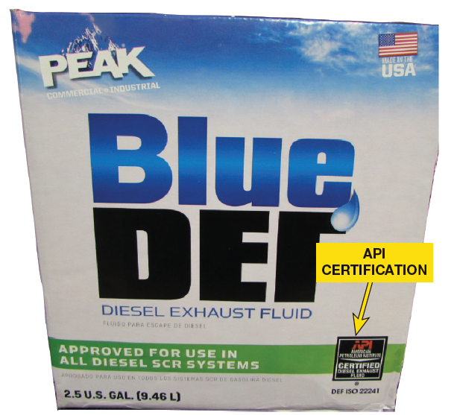
DIESEL EXHAUST FLUID
Diesel Exhaust Fluid (DEF)
  Mixture of 32.5% laboratory grade urea
  67.5% deionized water
    Deionized water deeply demineralized
  Urea: synthetic ammonia & CO₂
  Nontoxic & not harmful to handle
  Injected into exhaust stream upstream of SCR
  Once inside catalyst, heat causes DEF to decompose into ammonia and CO₂
  Refractometer measures its density

Slide 23
FIGURE 15–10 Diesel exhaust fluid (DEF) is available in consumer-friendly containers or in bulk.

Slide 24
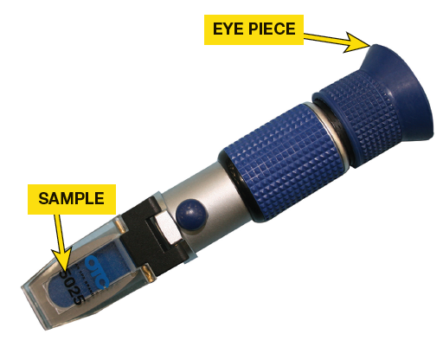
FIGURE 15–11 refractometer is used to measure quality of diesel exhaust fluid (DEF).

Slide 25
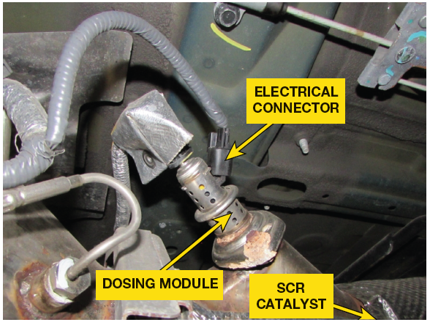
REDUCTANT DOSING
MODULE
Reductant Dosing Module
  Inject DEF
  Module includes injection, nozzle, diffuser, & mixer
  Components atomize DEF
  Disperse it evenly onto substrate

Slide 26
FIGURE 15–12 reductant dosing module contains DEF injector, diffuser, and mixer.

Slide 27
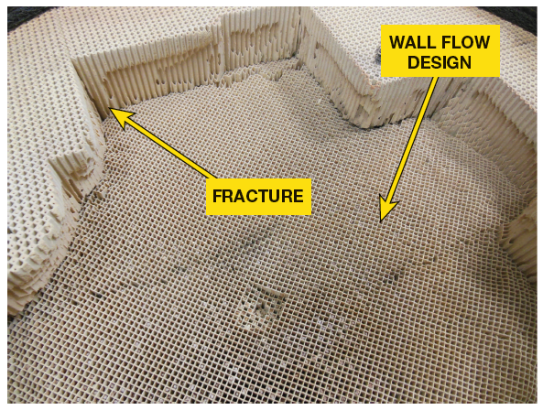
DIESEL PARTICULATE FILTER (DPF)
Diesel Particulate Filter (DPF)
  Near DOC, Make Exhaust smokeless
  Closed off wall flow ceramic monolith
  Forces gasses through porous walls
  Holds PM too large to pass through
  Stores PM
  As PM gathers in filter assembly, exhaust restricts
  PM oxidized into CO2 by increasing temperature
  Through regeneration, ash is left

Slide 28
FIGURE 15–13 DPF monolith is responsible for capturing particulate matter and holding it until a regeneration event occurs. DPF pictured failed due to internal fracture.

Slide 29
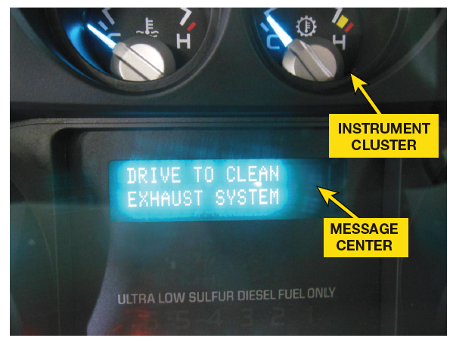
FIGURE 15–14 DPF warning lamp used to warn driver vehicle needs to be driven in manner that regeneration event can occur.

Slide 30
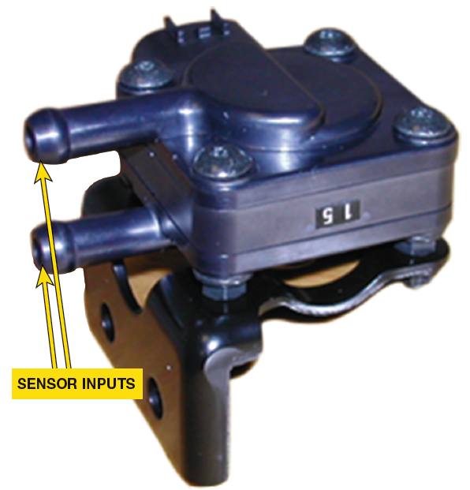
DIFFERENTIAL
PRESSURE SENSOR
Differential Pressure Sensor
  Determine if restriction exists in DPF
  Need for service or replacement
  Compares pressure at inlet and outlet of DPF
  Uses data to determine if regeneration event needed

Slide 31
FIGURE 15–15 sequence of drawings shows steps of a regeneration event. SENSOR SHOWN IN FIGURE
DIFFERENTIAL
PRESSURE SENSOR

Slide 32
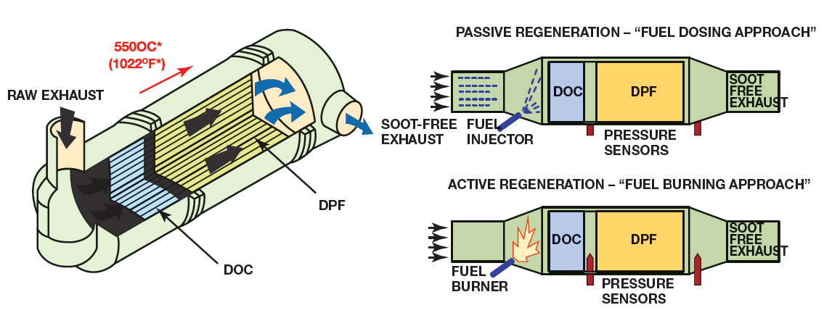
FIGURE 15–16 feedback from the differential pressure sensor is used by the powertrain control module to determine when a regeneration event is needed.

Slide 33
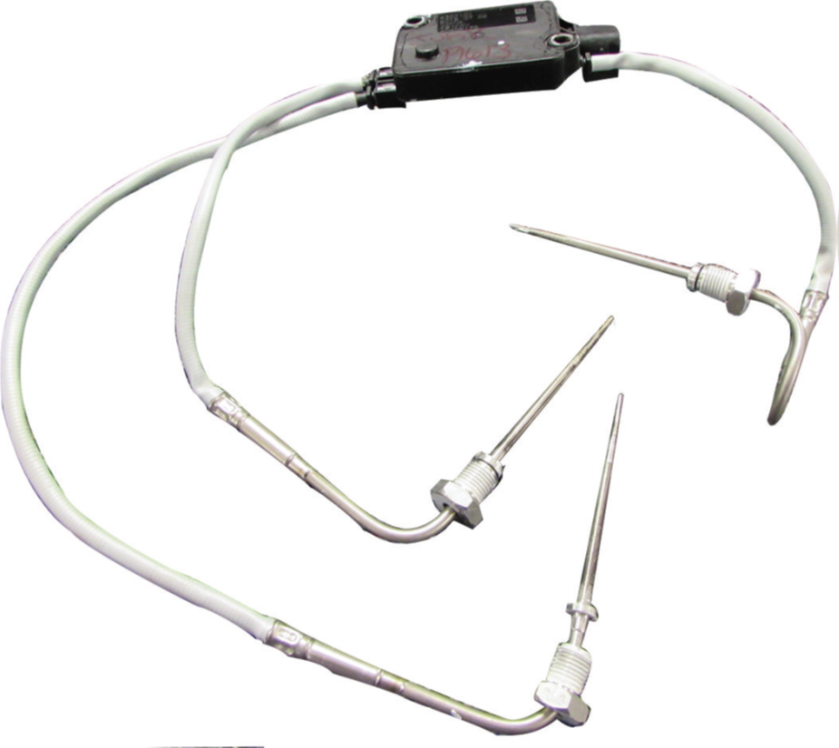
TEMPERATURE SENSORS
Exhaust Aftertreatment System
  Uses multiple temperature sensors
  Monitor function of components within system

Slide 34
FIGURE 15–17 Temperature sensors are used by PCM to monitor function of various components in aftertreatment system.

Slide 35
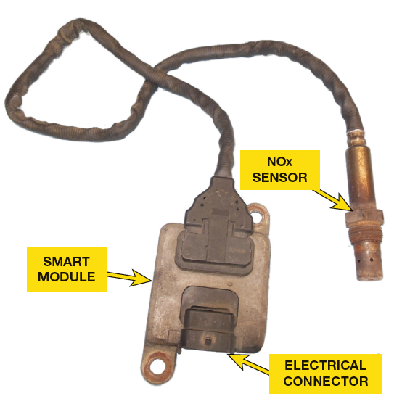
NOX SENSORS
NOx Sensors
  Part of Smart Module
  Serviced Together
  Measure Level of NOx Emissions
    In Aftertreatment System
    Determine If DEF Being Delivered To Exhaust
    Adequate Volume & Quantity

Slide 36
FIGURE 15–18 NOx sensor is used to measure NOx emissions in aftertreatment system.

Slide 37
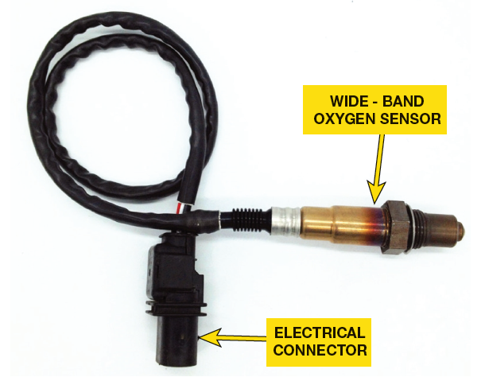
FIGURE 15–19 oxygen sensor is used to monitor operation of EGR system.

Slide 38
QUESTION? 1
What is the role of an O₂ sensor (if equipped) in the exhaust aftertreatment system?

Slide 39
ANSWER 1
Oxygen sensor is used to monitor operation of EGR system.

Slide 40
QUESTION? 2
What happens if the customer fails to maintain the diesel exhaust fluid (DEF) at a minimum level?

Slide 41
ANSWER 2
The quality of the diesel exhaust fluid (DEF) is critical for proper catalyst operation. The system is designed to warn the driver when the system fluid level gets low.

Slide 42
QUESTION? 3
What is the difference between a passive and an active regeneration event?

Slide 43
ANSWER 3
Passive Regeneration. During a passive regeneration event, the engine load is sufficient enough to create the exhaust temperatures needed to eliminate the particulate matter.
Active Regeneration. During active regeneration event, heat is created by adding fuel to exhaust stream. This fuel can be added either through a post injection shot at cylinder or through a dosing valve in the exhaust. Temperature of diesel particulate filter (DPF) is hotter during an active regeneration event than a passive event.

Slide 44
Summary (1 of 3)
Tier II diesel emission standards were introduced in 2007 and were phased in until 2010.
The tailpipe emissions include hydrocarbons (HC), carbon monoxide (CO), oxides of nitrogen (NOx), particulate matter (PM), oxygen (O2), and carbon dioxide (CO2).
To comply with federally mandated Tier II diesel emission standards, the aftertreatment system consists of following:
  Diesel oxidation catalyst (DOC)
  Particulate filters
  NOx catalysts

Slide 45
Summary (2 of 3)
On most modern diesel engines, the diesel oxidation catalyst (DOC) is the first major component in the exhaust aftertreatment system after the exhaust downpipe.
NOx absorber catalyst is a maintenance-free strategy for removing NOx emissions in a low-temperature, oxygen-rich environment.
The selective catalyst reduction (SCR) system is designed to reduce the level of oxides of nitrogen (NOx) in the exhaust stream.
DPF is located in a stainless steel housing near diesel oxidation catalyst (DOC). It is responsible for making the exhaust virtually smokeless.

Slide 46
Summary (3 of 3)
Diesel exhaust fluid (DEF) is a mixture of 32.5% laboratory grade urea and 67.5% deionized water.
Regeneration events occur automatically throughout course of normal driving when the particulate filter becomes restricted.
A differential pressure sensor is used to determine if a restriction exists in the DPF, indicating a need for service or replacement.
The exhaust aftertreatment system uses multiple temperature sensors to monitor the function of components within the system. Some OEMS refer to these sensors as exhaust gas temperature sensors.
Newer diesel vehicles use a wide-band oxygen sensor that is capable of accurately monitoring the oxygen level in the exhaust stream throughout its broad operating range

