Slide 1
Light Vehicle Diesel Engines
First Edition
Chapter 16
Service Procedures
Copyright © 2018, 2015, 2011 Pearson Education, Inc. All Rights Reserved

Slide 2
LEARNING OBJECTIVES (1 of 2)
16.1 Prepare for the ASE Light Vehicle Diesel Engine (A9) ASE certification test content area “D” (Lubrication and Cooling Systems Diagnosis and Repair).
16.2 Perform the maintenance pre-check on a modern diesel equipped light-duty vehicle.
16.3 Discuss the need to service the intake air system.
16.4 Identify the correct oil and filter for the engine being serviced.

Slide 3
LEARNING OBJECTIVES (2 of 2)
16.5 Discuss the need for servicing the cooling system.
16.6 Explain how to service the fuel system on a modern diesel engine.
16.7 Discuss how to service the diesel exhaust fluid system on an equipped vehicle.

Slide 4
OVERVIEW (1 of 4)
Importance of Routine Service: Page 176
Pre-Maintenance Check Page 176

Slide 5
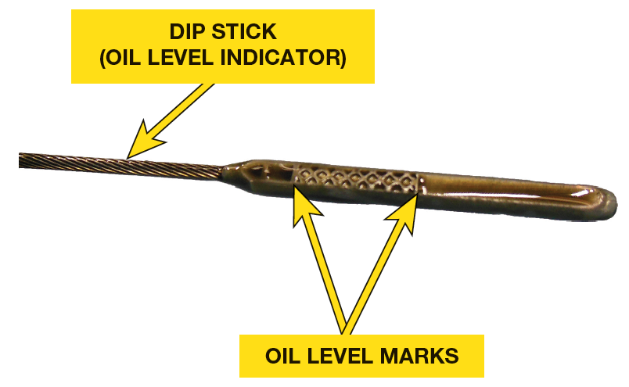
FIGURE 16–1 over-full oil dipstick is an indication that system was over-filled on a previous service or something is leaking into crankcase. It is not uncommon for fuel to get past piston rings and contaminate oil. If technician finds this condition, further diagnosis will be necessary.

Slide 6
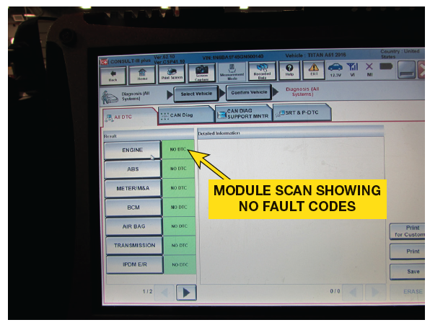
FIGURE 16–2 presence of DTC may provide insight into how the vehicle is being operated or maintained. The technician can use this data to investigate further or to make specific recommendations about needed service.

Slide 7
INTAKE AIR SYSTEM MAINTENANCE
Airflow Restriction Gauge
Designed to measure a pressure
< Atmospheric so will sense a restriction
When air filter needs to be replaced

Slide 8
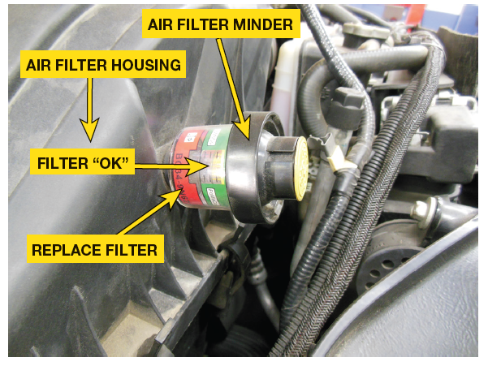
FIGURE 16–3 air intake restriction gauge allows technician to determine condition of air filter element without opening air filter housing. This will eliminate the possibility of misdiagnosing a dirty element and missinstallation of filter element after it is inspected.

Slide 9
Use Air Filter Gauge as a Guide
An engine air filter operates most efficiently when it is slightly dirty. Do not change the filter unless the restriction gauge indicates it is near failure. This will increase system efficiency and reduce maintenance costs.

Slide 10
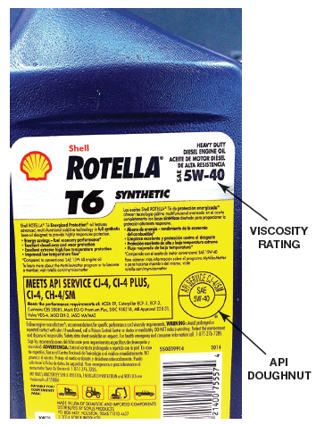
ENGINE OIL SERVICE
Need For Oil Change: Page: 178
API & SAE Ratings
OEM specify type, grade, and viscosity of oil
All equipped with DPF must use oil
API service rating of CJ-4,
FIGURE 16–4.
Since 2018, a new API service rating of CK-4
For vehicles AFTER 2018. ● SEE FIGURE 16–5.
Historically, diesel engines use SAE 15W-40
Newer models use SAE 10W-30

Slide 11
FIGURE 16–4 proper oil must be used when servicing any diesel engine. Engine oil with a rating of CJ-4 meets the service requirements for most late model light-duty diesel engines.

Slide 12
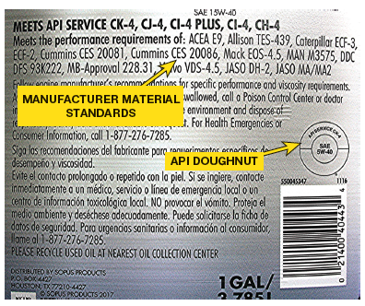
FIGURE 16–5 Diesel engines manufactured for use after January 1, 2017, may require the use of diesel motor oil that has a rating of CK-4.

Slide 13
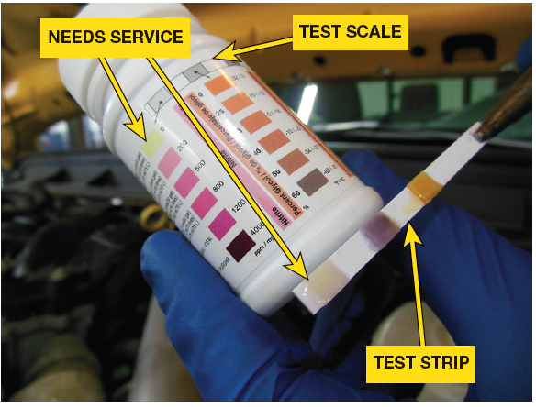
COOLING SYSTEM SERVICE (1 of 2)
Importance of Servicing Cooling System
Prior To Servicing Cooling System, Page 178
Determine type of coolant
know ABOUT cavitation erosion
PREMIX: coolant ready to use out of a container
Use only deionized water
tap water may contain a high mineral content
Use service information determine MIX
KNOW SERVICE INTERVAL
Know bleeding procedure
Check for TSBs
Check for Secondary Cooling System

Slide 14
Color of the Coolant
Many will attempt to identify correct coolant by color. This practice is not recommended as there is not standardization of colors in coolant industry. Always check service information to determine what coolant should be used in vehicle being serviced.

Slide 15
FIGURE 16–6 Cooling system test strips that are used on diesel engines need to test the level of nitrates, as well as determine the freeze point and the alkalinity of the coolant.

Slide 16
COOLING SYSTEM SERVICE (2 of 2)
Coolant Leak Check Page 179
Freezing Point Check Page 179
Nitrate Level Check Page 179
PREMIX Page 179
SERVICE INTERVAL Page 179

Slide 17
FUEL SYSTEM SERVICE (1 of 2)
Diesel Fuel Rating
Diesel fuel Quality critical to performance & life
Meets ASTM standards for either 100% diesel
Standards for biodiesel blends

Slide 18
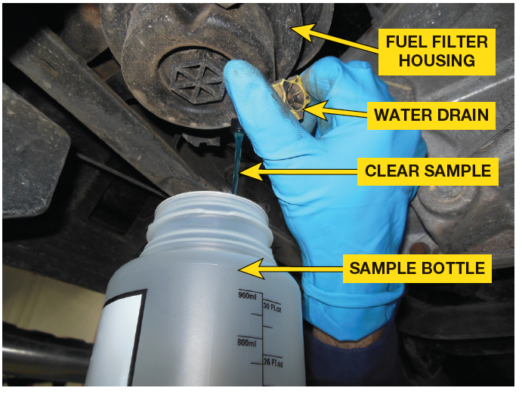
FUEL SYSTEM SERVICE (2 of 2)
Diesel Filters
Equipped with one or two fuel filters
Water separator with a drain valve
Water-in-fuel sensor (WIF)
Water drain must be opened
Replaced at specific intervals

Slide 19
FIGURE 16–7 Many manufacturers recommend that the water be drained every 30 days. When all the water is drained, only diesel fuel will be coming out of the drain.

Slide 20
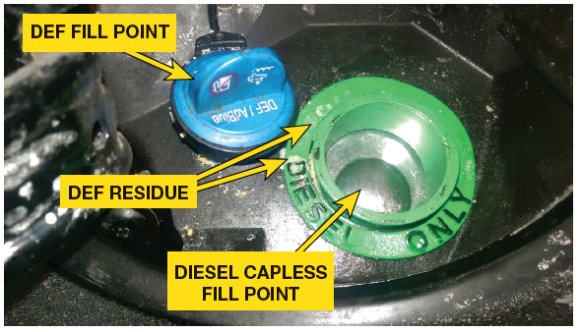
DIESEL EXHAUST FLUID SERVICE
DEF critical to keeping emission compliant
DEF mixture of 32.5% laboratory grade ammonia
67.5% deionized water
Fluid gets low, reminder light illuminated
Fail to refill system, MIL ON, DTC SET
Reduced Power Mode/Won’t Run At All Mode
CAUTION: Do not put DEF in fuel tank. DEF will cause damage to fuel system components & may have an effect on warranty.

Slide 21
FIGURE 16–8 operator must ensure that only diesel exhaust fluid (DEF) gets into DEF system, and only diesel fuel gets into fuel tank. The presence of DEF in fuel tank or presence of diesel fuel in DEF reservoir can lead to expensive repairs.

Slide 22
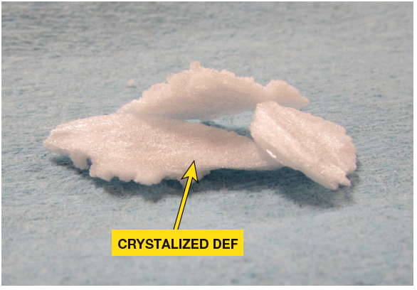
FIGURE 16–9 C rystalized diesel exhaust fluid (DEF) can cause harm to the vehicle and needs to be discarded.

Slide 23
QUESTION 1
Why must a “CJ-4” rated oil be used on a 2007 or newer vehicle equipped with a diesel engine?

Slide 24
ANSWER 1
All late model light-duty diesel vehicles that are equipped with diesel particulate filters (DPF) must use oil that meets American Petroleum Institute (API) service rating of CJ-4.

Slide 25
Summary (1 of 2)
Routine maintenance is the key to an engine that operates clean and efficiently.
For every gallon of diesel fuel that is used by a diesel engine, 10,000 gallons of air flows through the air intake system.
Most recent diesel engine intake air systems are equipped with an intake air restriction gauge.
The length of time between oil services will depend on time, mileage, or driving habits. Idle time is one of most overlooked criteria for an oil service on current modern diesel engines.

Slide 26
Summary (2 of 2)
All late model light-duty diesel vehicles that are equipped with diesel particulate filters (DPF) must use oil that meets American Petroleum Institute (API) service rating of CJ-4.
As a part of routine service, it is very important to check coolant for proper level, the freeze protection, acidity, and the level of nitrates.
The water separator contains a water-in-fuel sensor (WIF) that is used to illuminate an indicator on instrument panel when service is needed.
The maintenance of the diesel exhaust fluid (DEF) system is critical to keeping many modern diesel vehicles within emissions compliance. DEF is a mixture of 32.5% laboratory grade ammonia and 67.5% deionized water.

