Slide 1

Light Vehicle Diesel Engines
First Edition
Chapter 17
Diesel Engine Electronics
Copyright © 2018, 2015, 2011 Pearson Education, Inc. All Rights Reserved

Slide 2
LEARNING OBJECTIVES (1 of 2)
17.1 Prepare for the ASE Light Vehicle Diesel Engine (A9) ASE certification test content area “A” General Diagnosis and “F” Fuel System Diagnosis and Repair.
17.2 Explain the characteristics of electricity.
17.3 Differentiate between conductors, insulators, and semiconductors.
17.4 Explain the units of electrical measurement.

Slide 3
LEARNING OBJECTIVES (2 of 2)
17.5 List the parts of a complete circuit.
17.6 Discuss the types of electrical circuit faults.
17.7 Explain how to detect and measure electrical voltage, current, and resistance.
17.8 Discuss the purpose of terminals, connectors, relays, and switches.
17.9 Explain the operation of speed sensors and throttle position (TP) sensors.

Slide 4
INTRODUCTION
Electricity
  Difficult to learn for following reasons
    It cannot be seen
    Only results of electricity can be seen
    It has to be detected & measured

Slide 5
ELECTRICITY (1 OF 2)
Electricity
  Movement of electrons from one atom to another
  Nucleus: Protons, neutrons, & electrons
  Automotive electricity uses
    Conventional theory: electricity flows from positive to negative
Magnets & Electrical Charge
Electron Orbits
Note: Example of relative sizes of parts of atom, consider that if atom were magnified so that nucleus were size of period at end of this sentence, whole atom would be bigger than a house

Slide 6
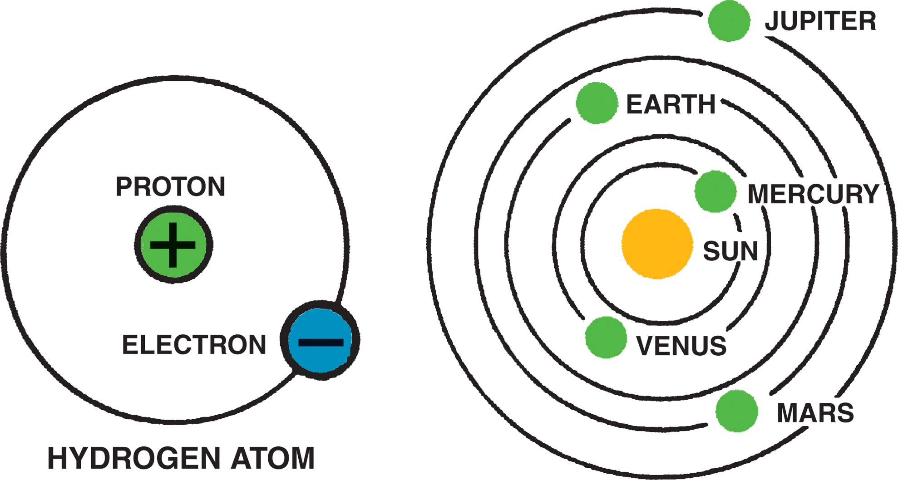
Figure 17-1 In an atom (left), electrons orbit protons in the nucleus just as planets orbit the sun in our solar system (right).
Notes:
Figure 39-1 In an atom (left), electrons orbit protons in the nucleus just as planets orbit the sun in our solar system (right).

Slide 7
Figure 17–2 nucleus of an atom has a positive (+) charge and the surrounding electrons have a negative (–) charge

Slide 8
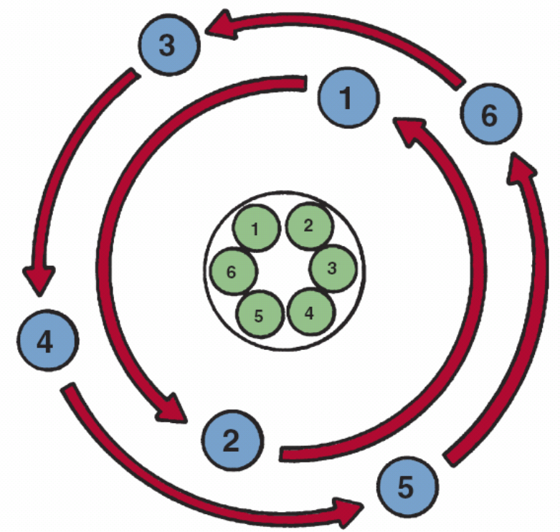
FIGURE 17–3 shows a balanced atom. The number of electrons is the same as the number of protons in the nucleus.

Slide 9
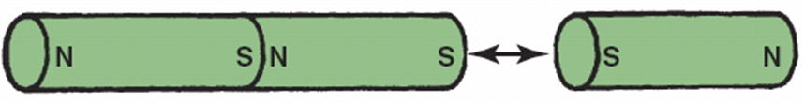
FIGURE 17–4 Unlike charges attract and like charges repel.

Slide 10
ELECTRICITY (2 OF 2)
Conductors
  Materials < 4 electrons in their atom’s outer orbit.
Insulators
  Materials with > 4 electrons in outer orbit.
Semiconductors
  Materials with exactly 4 electrons in their outer orbit

Slide 11
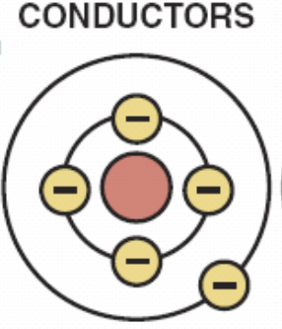
FIGURE 17–5 A conductor is any element that has one to three electrons in its outer orbit.

Slide 12
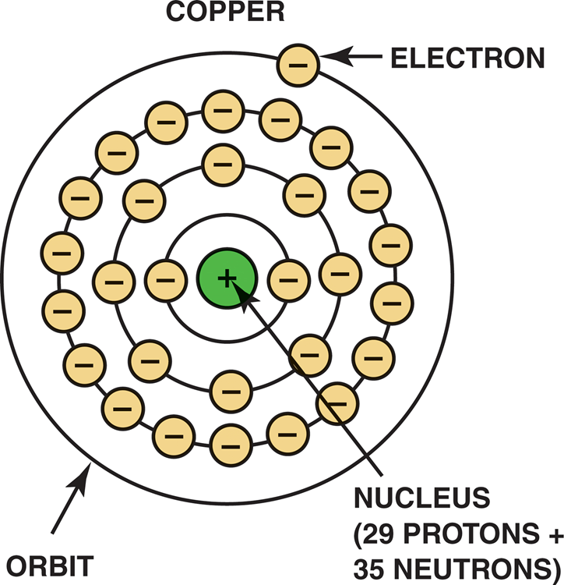
FIGURE 17–6 Copper is excellent conductor of electricity because it has just 1 electron in its outer orbit, making it easy to be knocked out of its orbit and flow to other nearby atoms. This causes electron flow, which is definition of electricity.

Slide 13
Figure 17-7 Insulators are elements with 5 to 8 electrons in the outer orbit

Slide 14
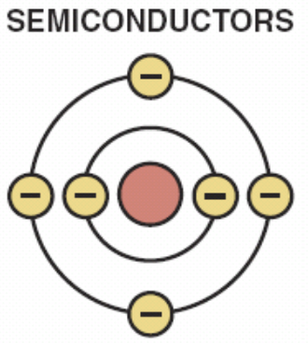
FIGURE 17–8 Semiconductor elements contain exactly 4 electrons in the outer orbit

Slide 15
HOW ELECTRONS MOVE THROUGH CONDUCTOR
Current Flow
  Conventional Theory
    1 charge; moved from positive to negative
      FIGURE 17–10
  Electron Theory
    From discovery of electron & its negative charge
    Electron flow from negative to positive

Slide 16
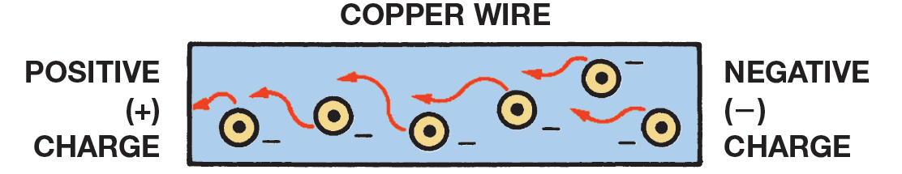
FIGURE 17–9 Current electricity is the movement of electrons through a conductor.

Slide 17
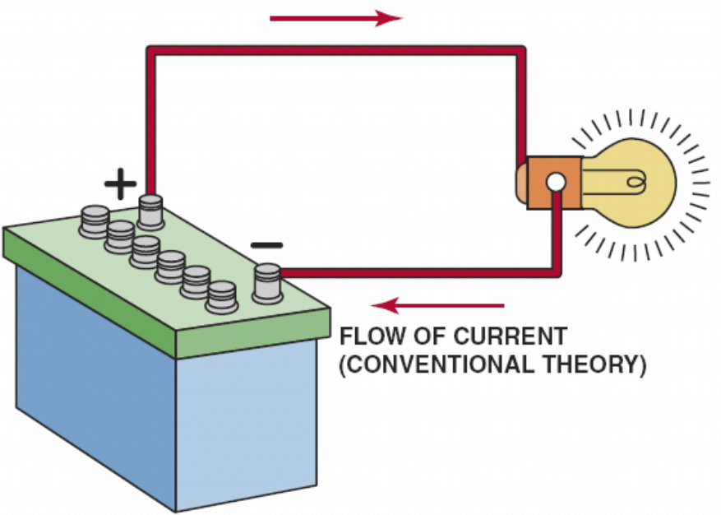
FIGURE 17–10 Conventional theory states that current flows through a circuit from positive (+) to negative (–). Automotive electricity uses the conventional theory in all electrical diagrams and schematics.

Slide 18
UNITS OF ELECTRICITY (1 OF 5)
3 Fundamentals Of Electricity-related Units
  Ampere, Volt, & Ohm
    Ampere Measure Amount of Current Flow
    Voltage Unit of Electrical Pressure
    Ohm Unit of Electrical Resistance

Slide 19
UNITS OF ELECTRICITY (2 OF 5)
Ampere measures current flow
  6.28 billion billion electrons a coulomb: FIGURE 17–11
  Like “gallons per minute” to measure water flow
  Electrician Andrè Marie Ampére (1775–1836)
  A & amps: abbreviations for amperes
  Capital letter I, for intensity used in math
    Amperes do actual work in circuit
    Movement of electrons through light bulb or motor
    Makes electrical device work FIGURE 17–12

Slide 20
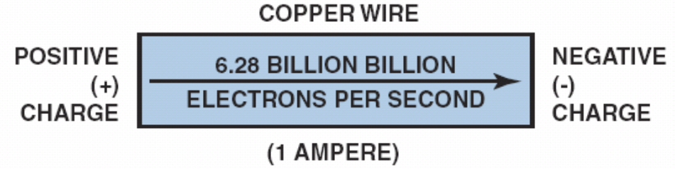
FIGURE 17–11 One ampere is the movement of 1 coulomb
(6.28 billion billion electrons) past a point in 1 second.

Slide 21
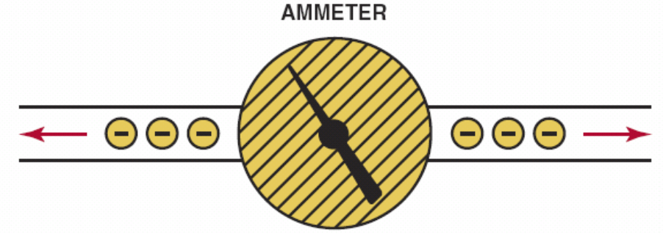
FIGURE 17–12 Ammeter is installed in path of electrons similar to a water meter used to measure flow of water in gallons per minute. The ammeter displays current flow in amperes.

Slide 22
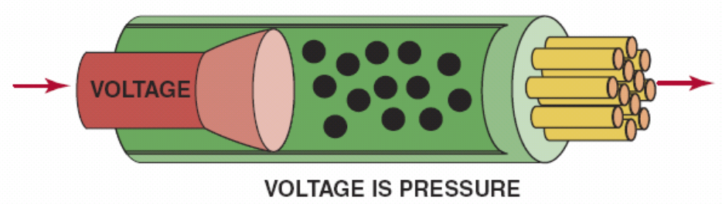
FIGURE 17–13 Voltage is electrical pressure that causes the electrons to flow through a conductor.

Slide 23
UNITS OF ELECTRICITY (3 OF 5)
Volt: unit of measurement for electrical pressure.
Electromotive force, abbreviated EMF
  Another way of indicating voltage
  V is generally accepted abbreviation for volts
  Symbol in calculations is E, for electromotive force
  Volts measured by a voltmeter SEE FIGURE 17–14.

Slide 24
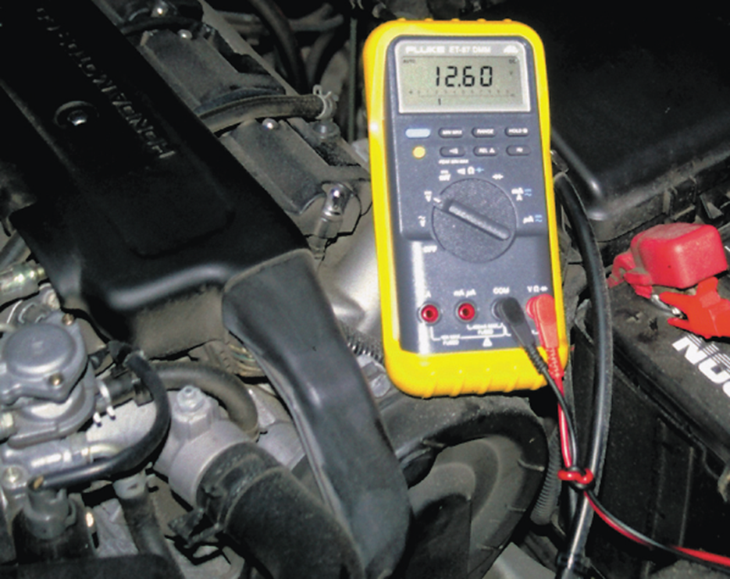
FIGURE 17–14 digital multimeter set to read DC volts is being used to test the voltage of a vehicle battery. Most multimeters can also measure resistance (ohms) and current flow (amperes).

Slide 25
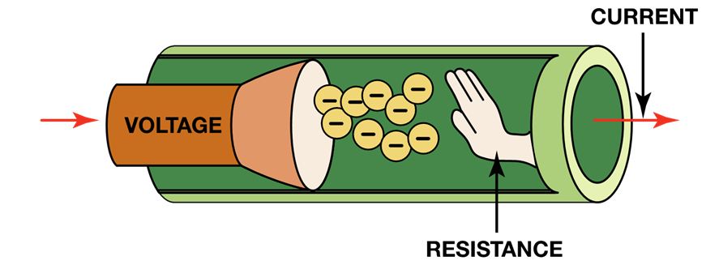
UNITS OF ELECTRICITY (4 OF 5)
Resistance to flow of current through conductor
  Measured in units called ohms, named after
  Physicist George Simon Ohm (1787–1854)
  Resistance to flow of free electrons through conductor
  Results from countless collisions electrons cause
    Within atoms of conductor. FIGURE 17–15.

Slide 26
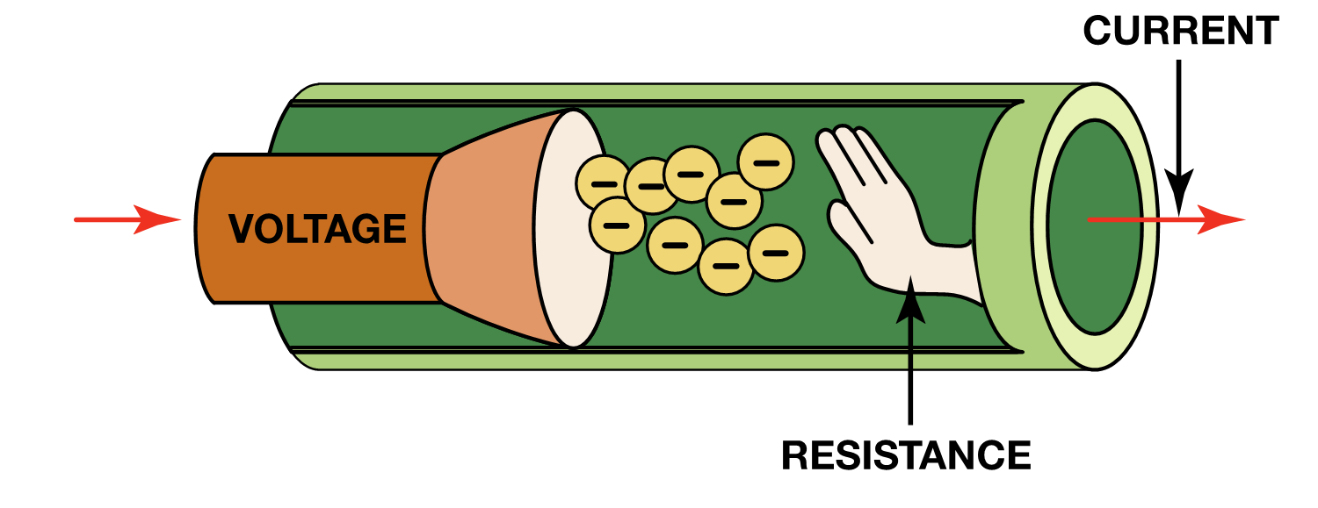
UNITS OF ELECTRICITY (5 OF 5)
Resistance can be:
  Desirable when part of how circuit works
  LIKE resistance of a filament in light bulb
  Undesirable, such as corrosion in a connection
  Restricting amount of current flow in circuit

Slide 27
FIGURE 17–15 Resistance to flow of electrons through conductor is measured in ohms.

Slide 28
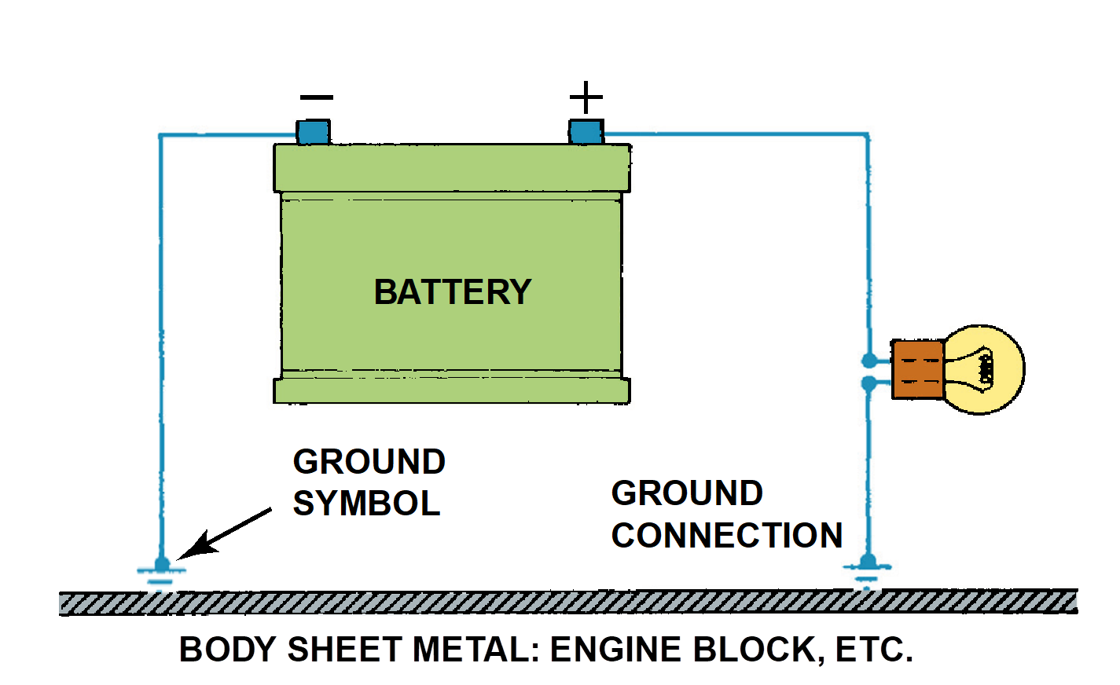
ELECTRICAL CIRCUITS
All Complete Electrical Circuits Have:
  Power source, circuit protection device
  Power-side wire or path, an electrical load
  Ground return path & Switch or control device.
    Circuit testers include test lights and fused jumper leads.

Slide 29
Figure 17–16 The return path back to the battery can be any electrical conductor, such as a copper wire or the metal frame or body of the vehicle

Slide 30
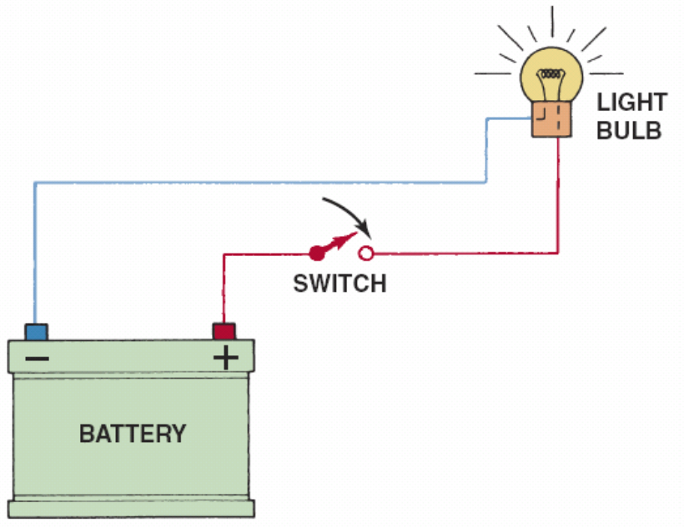
FIGURE 17–17 electrical switch opens circuit and no current flows. The switch could also be on the return (ground) path wire.

Slide 31
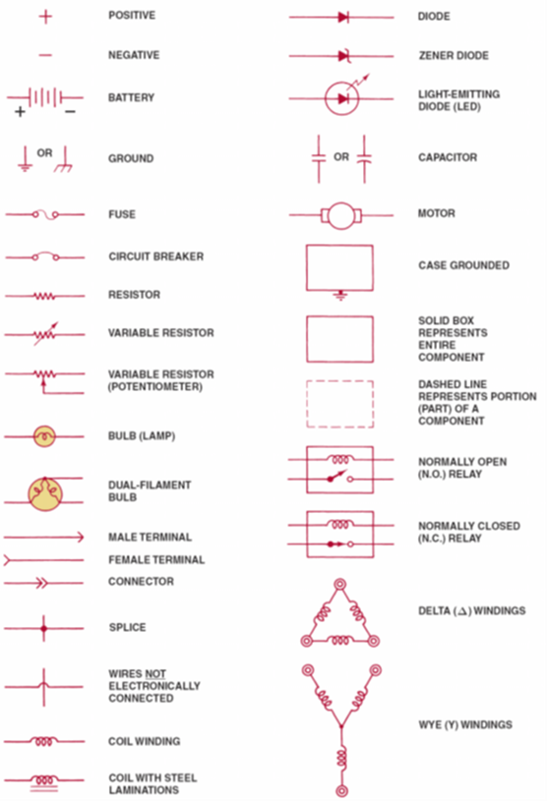
ELECTRICAL SCHEMATICS (1 OF 2)
All circuit schematics or diagrams include:
  Power-side wiring of the circuit
  All splices
  Connectors
  Wire size
  Wire color
  Trace color (if any)
  Circuit number
  Electrical components

Slide 32
ELECTRICAL SCHEMATICS (2 OF 2)
All circuit schematics or diagrams include:
  Ground return paths
  Fuses and switches
Circuit information
Wire size
Open circuits
Short-to-voltage
Short-to-ground
High resistance

Slide 33
FIGURE 17–18 The center wire is a solid color wire, meaning that the wire has no other identifying tracer or stripe color. The two end wires could be labeled “BLU/WHT,” indicating a blue wire with a white tracer or stripe.

Slide 34
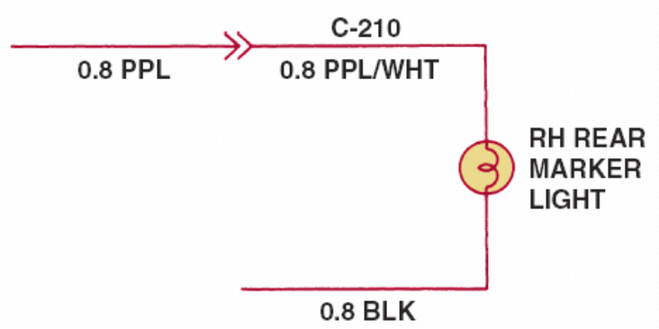
FIGURE 17–19 Typical section of a wiring diagram. Notice that the wire color changes at connection C210. The “0.8” represents the metric wire size in square millimeters.

Slide 35
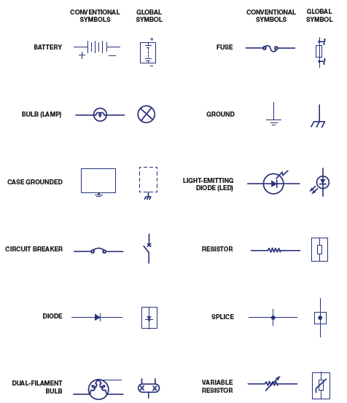
FIGURE 17–20 Electrical and electronic symbols used in automotive wiring and circuit diagrams. Both the conventional and the global symbols are shown side-by-side to make reading schematics easier. The global symbols are used by many vehicle manufacturers.

Slide 36
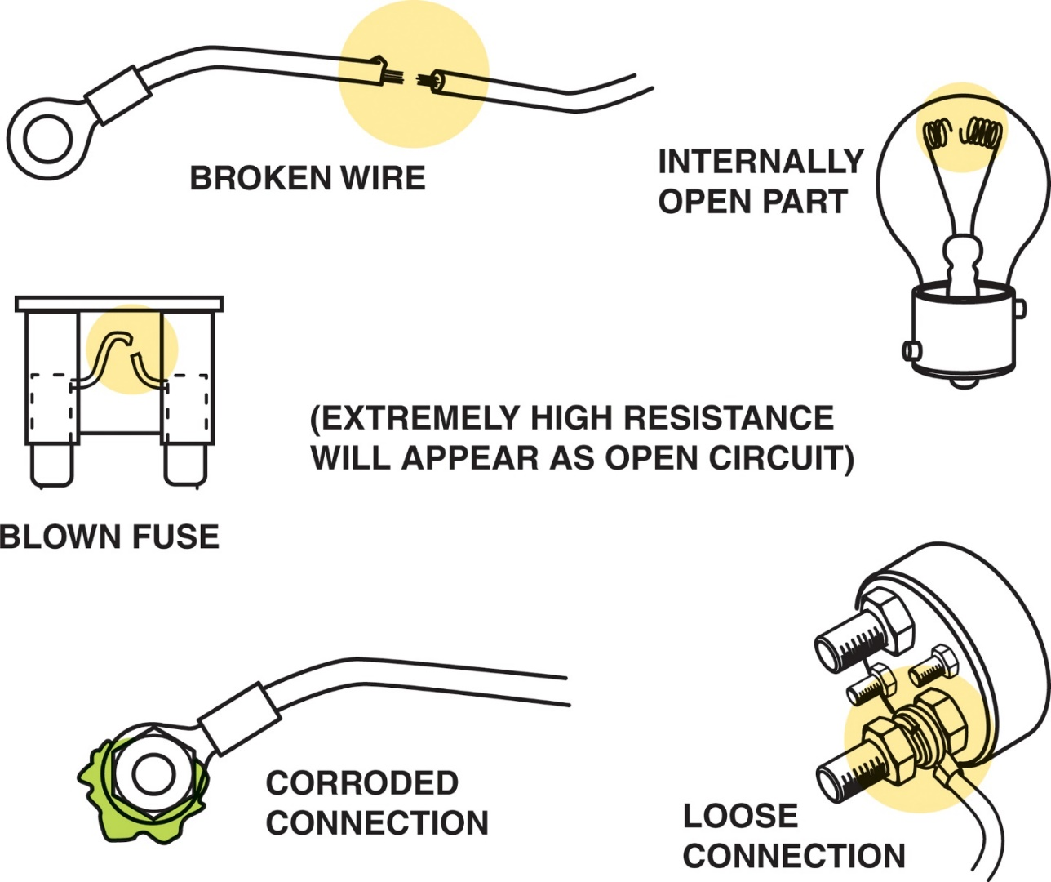
Figure 17-21 Examples of common causes of open circuits. Some of these causes are often difficult to find.
Notes:
Figure 40-4 Examples of common causes of open circuits. Some of these causes are often difficult to find.

Slide 37
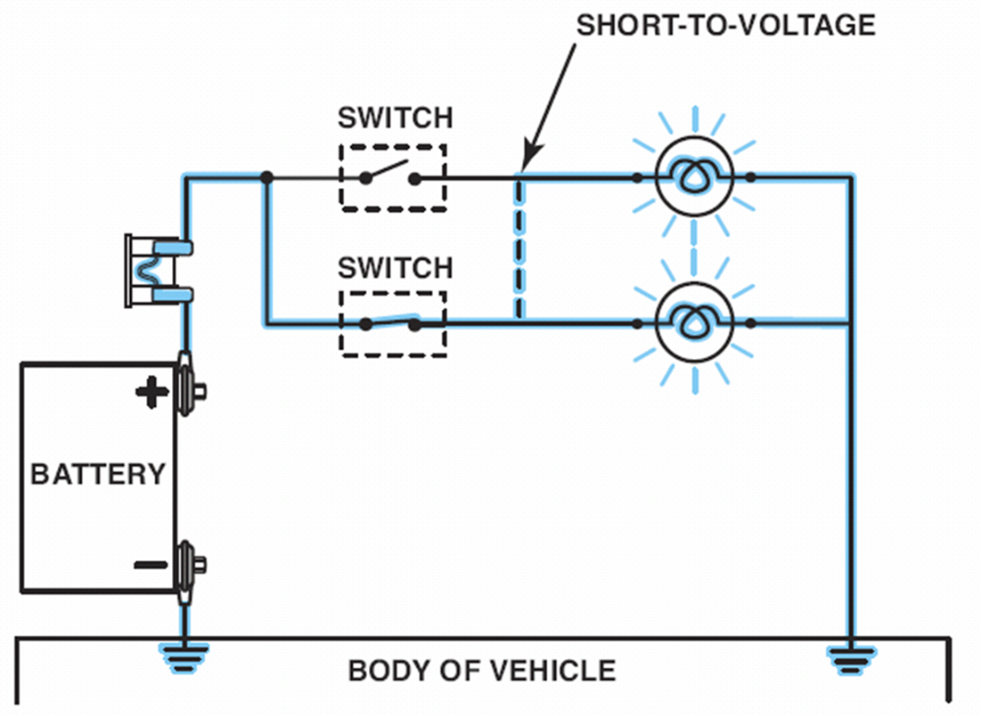
TYPES OF CIRCUIT FAULTS (1 OF 2)
Open Circuit
  Circuit not complete, or lacks continuity
    Such as a broken wire
SHORT-TO-VOLTAGE
  Power side of one circuit is electrically connected
  TO power side of another circuit

Slide 38
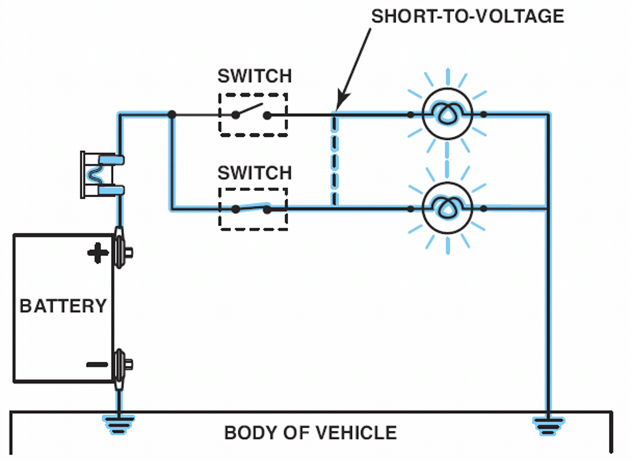
FIGURE 17–22 A short circuit permits electrical current to bypass some or all of the resistance in the circuit.

Slide 39
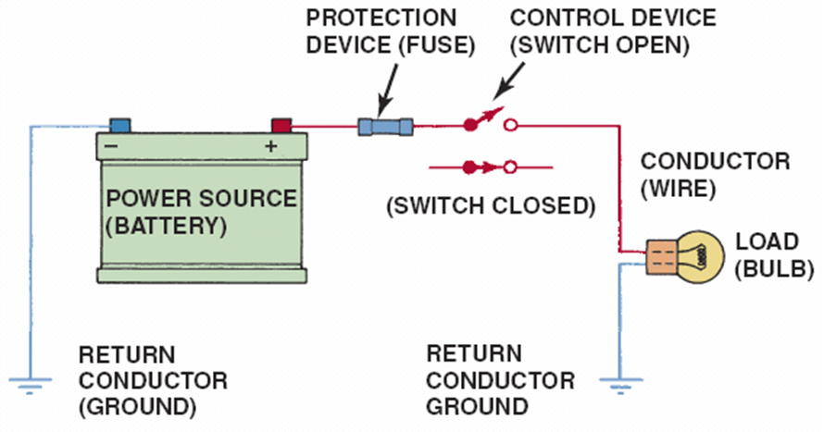
FIGURE 17–23 A fuse or circuit breaker opens circuit to prevent possible overheating damage in event of a short circuit.

Slide 40
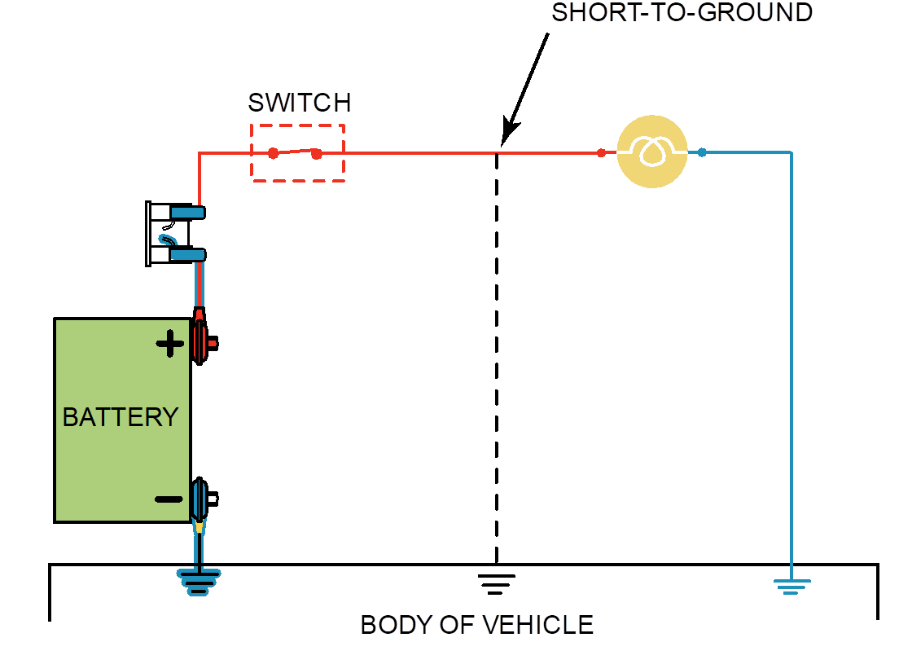
TYPES OF CIRCUIT FAULTS (2 OF 2)
SHORT-TO-GROUND
  Short circuit that occurs when current bypasses
  Part of normal circuit & flows directly to ground
  High resistance is resistance higher
    Than normal circuit resistance.

Slide 41
FIGURE 17–24 A short-to-ground affects the power side of the circuit. Current flows directly to the ground return, bypassing some or all of the electrical loads in the circuit. There is no current in the circuit past the short. A short-to-ground will also cause the fuse to blow.

Slide 42
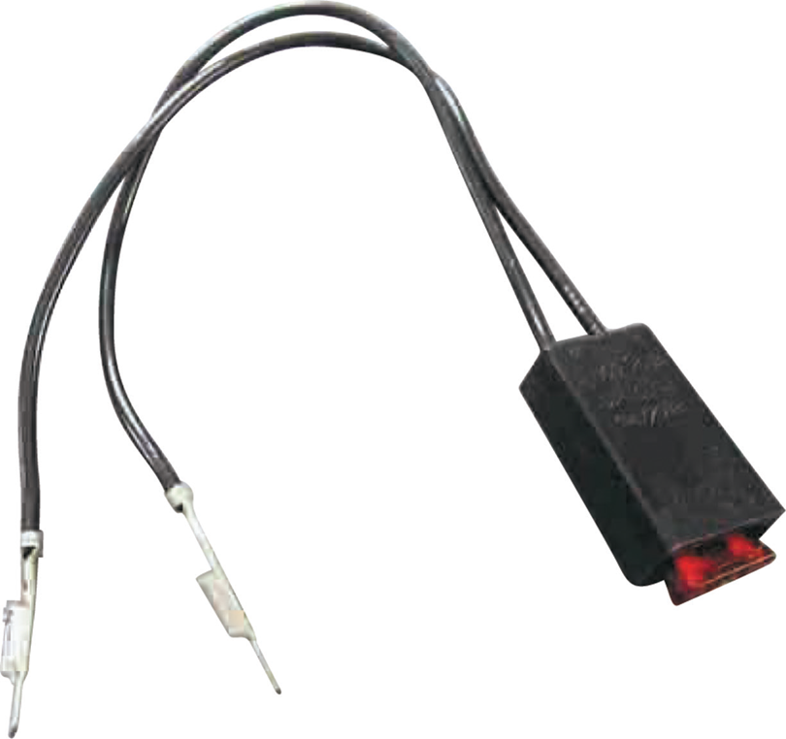
FUSED JUMPER WIRE
Purpose & Function
  Check Circuit By Bypassing Switch/Provide Power
    Or Ground to Component
  Fuse
  Alligator clip ends
  Good-quality insulated wire
CAUTION: Never use fused jumper wire to bypass any resistance or load in the circuit. Increased current flow could damage wiring and blow fuse on the jumper lead. Be very cautious when working on or around any computer circuit. Permanent damage to computer or electronic module could result if power or ground goes to wrong circuit.

Slide 43

FIGURE 17–25 A technician-made fused jumper lead, which is equipped with a red 10-ampere fuse. This fused jumper wire uses terminals for testing circuits at a connector instead of alligator clips.

Slide 44
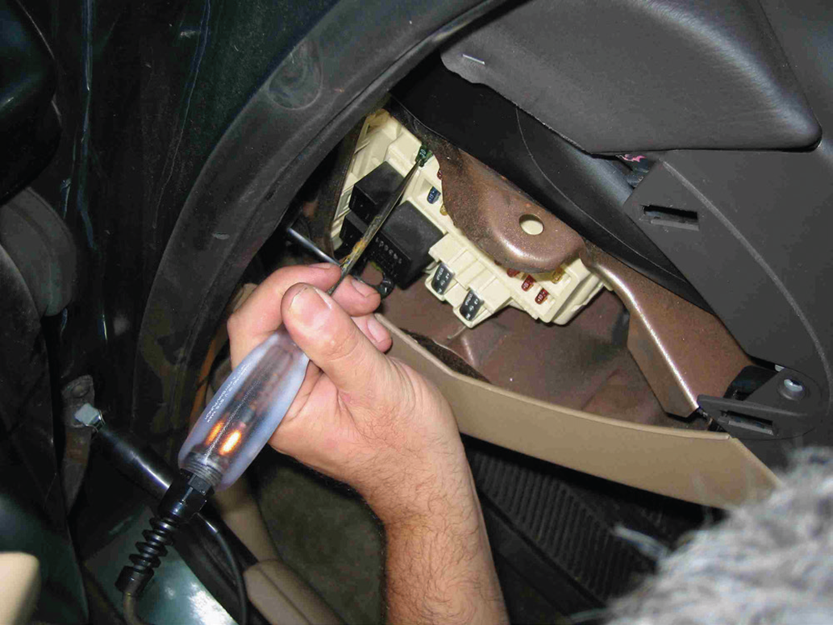
TEST LIGHT
Non-powered test light
Use of a 12-volt test light
  Electrical power
  Grounds

Slide 45

FIGURE 14–26 Testing a fuse with a test light. If the fuse is good, the test light should light on both sides (power side and load side) of the fuse.

Slide 46
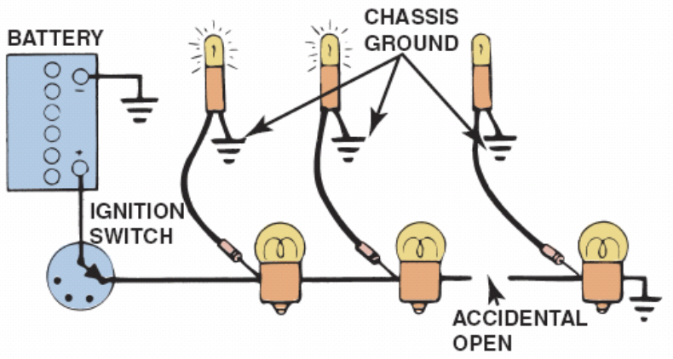
FIGURE 17–27 A test light can be used to locate an open in a circuit. Note that the test light is grounded at a different location than the circuit itself.

Slide 47
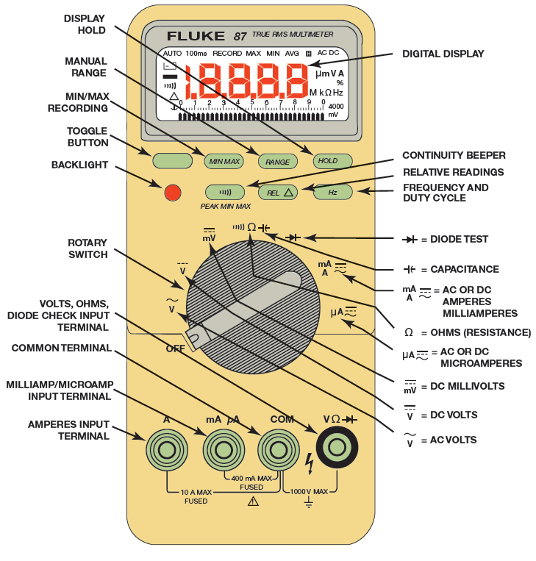
DIGITAL MULTIMETERS (1 OF 9)
Digital multimeter (DMM)
  Digital volt-ohm-meter (DVOM)
    Terms commonly used to describe digital meters

Slide 48
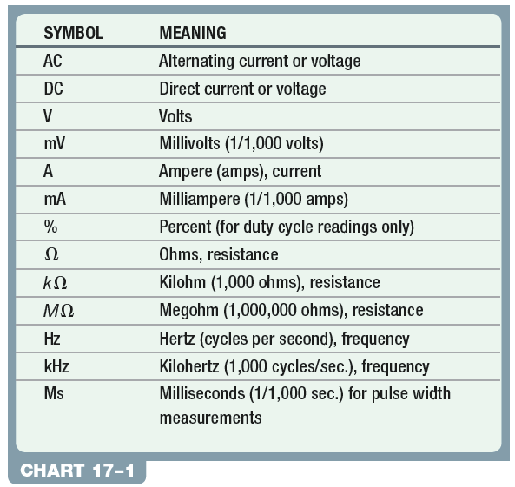
CHART 17-1 Common symbols & abbreviations used on digital meters.

Slide 49
FIGURE 17–28 digital multimeter. The black meter lead always is placed in the COM terminal. The red meter test lead should be in the volt-ohm terminal except when measuring current in amperes.

Slide 50
DIGITAL MULTIMETERS (2 OF 9)
Measuring Voltage
  Voltmeter measures pressure
  Potential of electricity in volts
  Voltmeter connected to circuit in parallel

Slide 51
DIGITAL MULTIMETERS (3 OF 9)
Voltage Measured
  Selecting either AC or DC volts
  DC volts (DCV):
    Most common setting for automotive use
    Battery voltage, voltage to lighting and accessory circuits

Slide 52
FIGURE 17–29 Typical digital multimeter (DMM) set to read DC volts.

Slide 53
DIGITAL MULTIMETERS (4 OF 9)
Voltage Measured
  AC volts (ACV):
  Check for unwanted AC voltage
  From alternators and some sensors
  Range: Automatically set for most meters
  Can be manually ranged

Slide 54
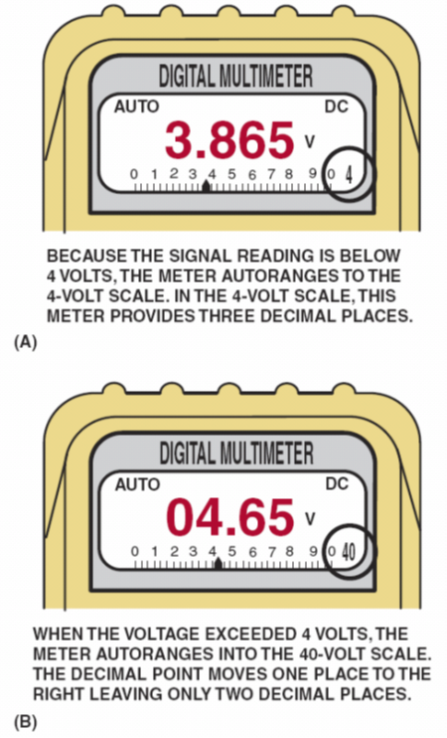
FIGURE 17–30 autoranging DMM automatically selects proper scale to read voltage being tested. Scale selected usually displayed on meter face. (a) Display indicates “4,” meaning that this range can read up to 4 volts. (b) range is now set to 40 volt scale, meaning that meter can read up to 40 volts on scale. Any reading above this level will cause the meter to reset to a higher scale. If not set on autoranging, meter display would indicate OL if a reading exceeds limit of scale selected.

Slide 55
DIGITAL MULTIMETERS (5 OF 9)
Measuring Resistance
  Ohmmeter measures resistance
    Component or circuit section
    No current flowing through
    Connected in series with component
    or wire being measured

Slide 56
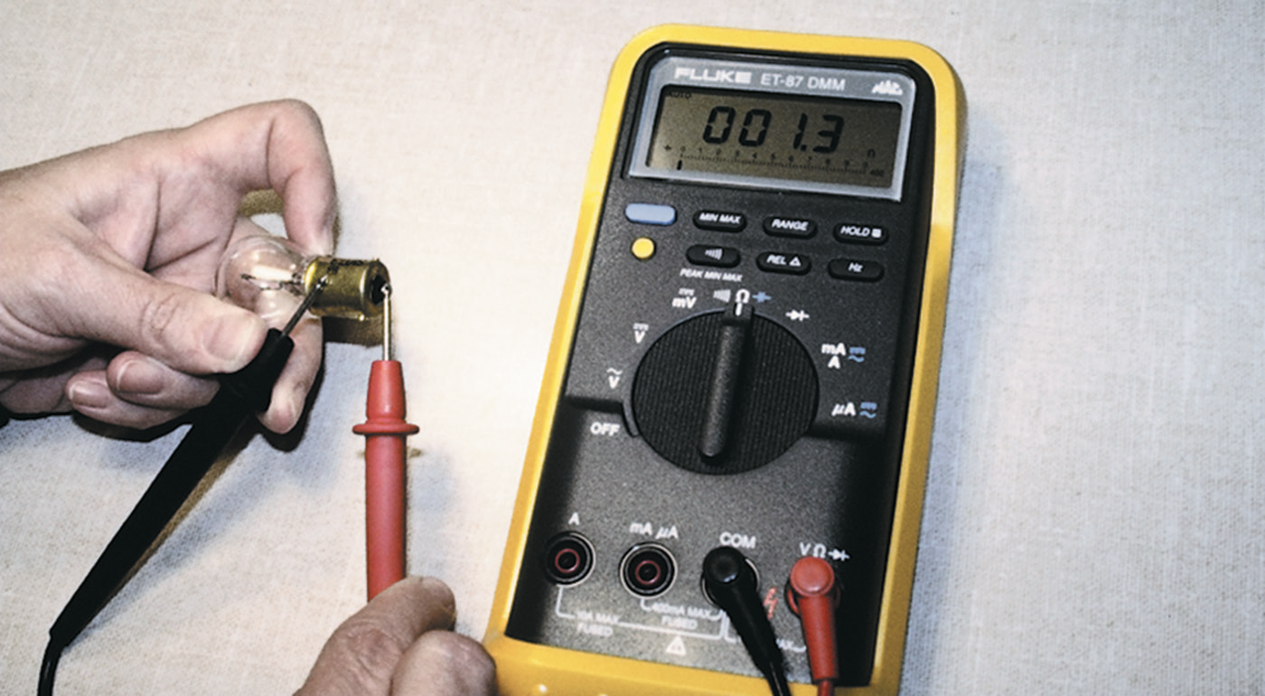
Figure 17–31 Using a DMM set to read ohms (Ω) to test this light bulb. Meter reads resistance of filament

Slide 57

DIGITAL MULTIMETERS (6 OF 9)
Measuring Resistance
  When connected to component
  Current flows through leads
  Voltage drop between leads measured as resistance
  0 ohms means no resistance between test leads
    Indicates continuity for current to flow in closed circuit

Slide 58
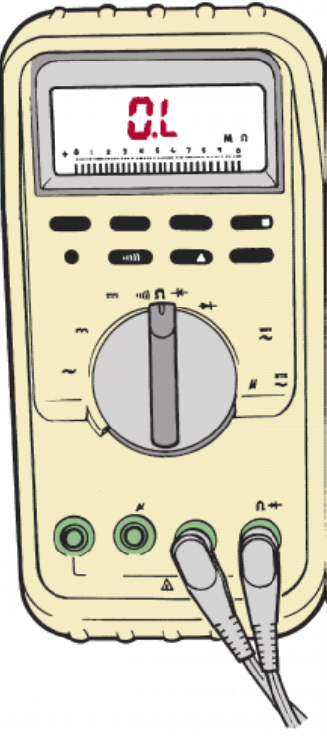
DIGITAL MULTIMETERS (7 OF 9)
Measuring Resistance
  Infinity means no connection, or open circuit
  Ohmmeters have no required polarity
  Even though red & black test leads used
  Meters have different ways of indicating infinity
  Resistance, or reading higher than scale
    OL, meaning over limit or overload

Slide 59

DIGITAL MULTIMETERS (8 OF 9)
Measuring Resistance
  Meters have different ways of indicating infinity
  Resistance, or reading higher than scale allows
    Flashing or solid number 1
    Flashing or solid number 3 on left side of display
    Flashing or solid number 4 on the display

Slide 60
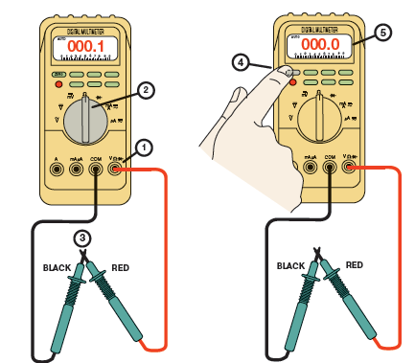
FIGURE 17–32 Many DMM can have display indicate zero to compensate for test lead resistance. (1) Connect leads in v and COM meter terminals. (2) Select 2 scale. (3) Touch 2 meter leads together. (4) Push “zero” or ”relative” button on meter. (5) Meter display will now indicate zero ohms of resistance.

Slide 61
DIGITAL MULTIMETERS (9 OF 9)
Measuring Amperes
  Ammeter measures flow of current
  Through complete circuit in amperes
  Ammeter installed in circuit (in series)
  So it can measure all current flow in circuit

Slide 62
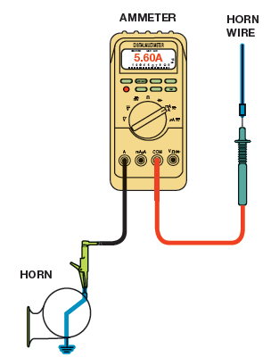
FIGURE 17–33 Measuring the current flow required by a horn requires that the ammeter be connected to the circuit in series and the horn button be depressed by an assistant.

Slide 63
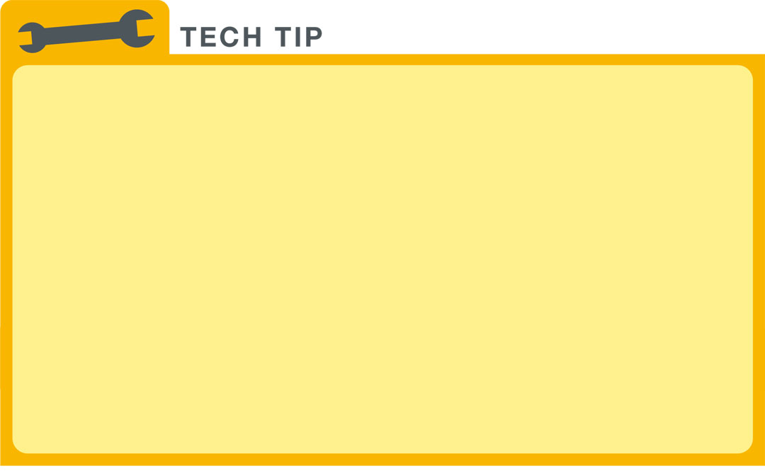
“Fuse Your Meter Leads!” 1
Most digital meters include an ammeter capability. When reading amperes, leads of meter must be changed from volts or ohms (V or ) to amperes (A) or milliamperes (mA). A common problem may then occur next time voltage is measured. Although you may switch selector to read volts, often leads are not switched back to volt or ohm position. Because ammeter lead position results in 0 ohms of resistance to current flow through meter, meter or fuse inside meter will be destroyed if meter is connected to a battery. Many meter fuses are expensive and difficult to find. To avoid this problem, simply solder an inline 10-ampere blade-fuse holder
into one meter lead. FIGURE 17–34.

Slide 64
FIGURE 17–34 Note blade-type fuse holder soldered in series with one of meter leads. A 10-ampere fuse helps protect internal meter fuse (if equipped) and meter itself from damage that may result from excessive current flow if accidentally used incorrectly.

Slide 65
“Fuse Your Meter Leads!” 2
Do not think that this technique is for beginners only. Experienced technicians often get in hurry and forget to switch lead. A blade fuse is faster, easier, and less expensive to replace than meter fuse or meter itself. Also, if soldering is done properly, addition of an inline fuse holder and fuse does not increase resistance of meter leads. All meter leads have some resistance. If meter is measuring very low resistance, touch 2 leads together and read the resistance (usually no more than 0.2 ohm). Simply subtract resistance of leads from resistance of the component being measured.

Slide 66
INDUCTIVE AMMETERS
Inductive Ammeters
  Do not make physical contact with the circuit
  Able to read much higher amperages than 10 amperes.
  Sensor detects strength of field surrounding wire
  Carrying current
  Uses strength of magnetic field measure current

Slide 67
FIGURE 17–35 inductive ammeter clamp is used with all starting and charging testers to measure the current flow through the battery cables.

Slide 68
FIGURE 17–36 typical mini clamp-on-type digital multimeter. This meter is capable of measuring alternating current (AC) and direct current (DC) without requiring that circuit be disconnected to install meter in series. The jaws are simply placed over wire and current flow through circuit is displayed.

Slide 69
TERMINALS & CONNECTORS
Terminal
  Metal end of a wire
Connector
  Plastic housing for terminal
Servicing Terminals

Slide 70
Figure 14–37 Some terminals have seals attached to help seal the electrical connections

Slide 71
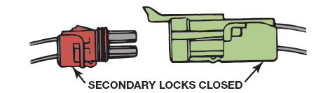
FIGURE 17–38 Separate a connector by opening the lock and pulling the two apart.

Slide 72
FIGURE 14–39 The secondary locks help retain the terminals in the connector.

Slide 73
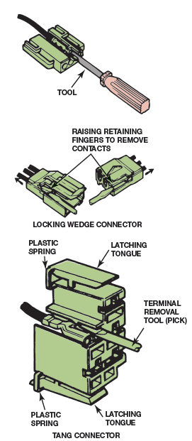
FIGURE 17–40 Use a small removal tool, sometimes called a pick, to release terminals from the connector.

Slide 74
WIRE REPAIR
Soldering
  Many manufacturers recommend that
  All wiring repairs be soldered. Why? Page 197
What is soldering procedure?
Crimping terminals
Heat shrink tubing
Crimp-and-seal connectors

Slide 75
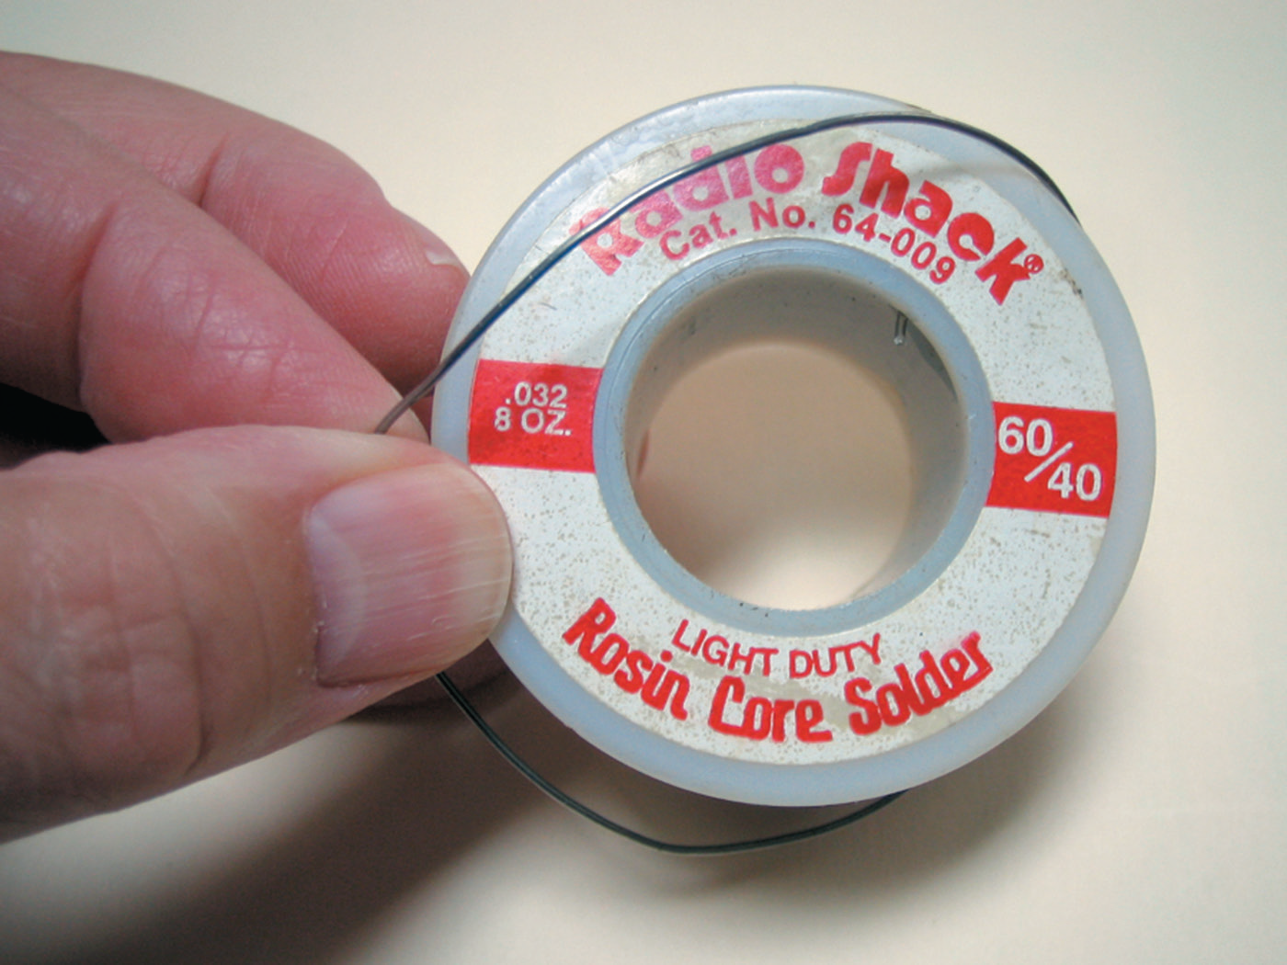
FIGURE 14–41 Always use rosin-core solder for electrical or electronic soldering. Also, use small-diameter solder for small soldering irons. Use large-diameter solder only for large-diameter (large-gauge) wire and higher-wattage soldering irons (guns).

Slide 76
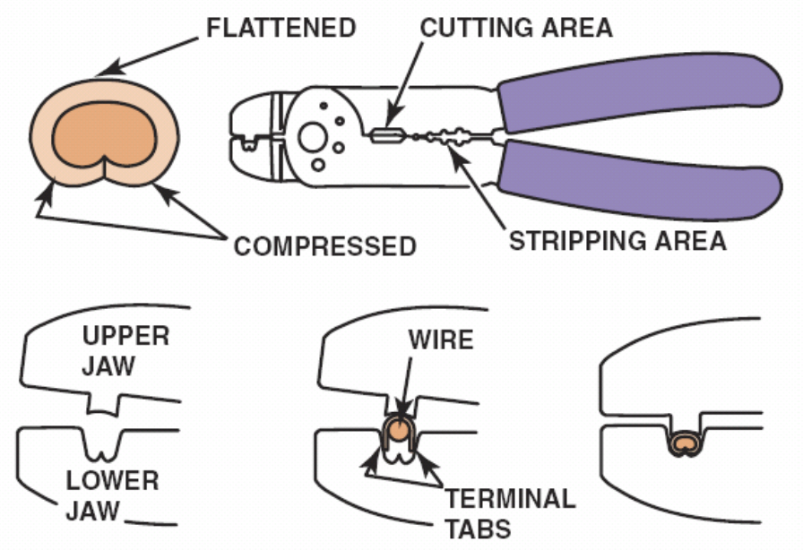
FIGURE 17–42 Notice that to create a good crimp, the open part of the terminal is placed in the jaws of the crimping tool toward the anvil or the W-shape part.

Slide 77
FIGURE 17–43 A ll hand-crimped splices or terminals should be soldered to be assured of a good electrical connection.

Slide 78
FIGURE 17–44 butane torch especially designed for use on heat shrink applies heat without an open flame, which could cause damage.

Slide 79
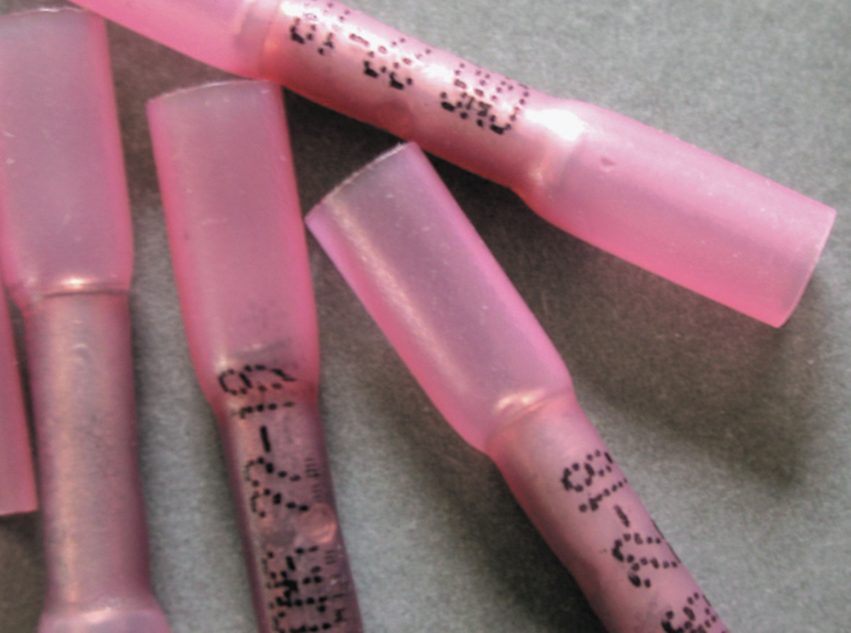
FIGURE 17–45 typical crimp-and-seal connector. This type of connector is first lightly crimped to retain ends of wires and then it is heated. The tubing shrinks around wire splice, and thermoplastic glue melts on inside to provide an effective weather-resistant seal.

Slide 80
FIGURE 17–46 Heating the crimp-and-seal connector melts the glue and forms an effective seal against moisture.

Slide 81
RELAYS
Relay
  Magnetic switch that uses a movable armature
  Control a high-amperage circuit
  Using low-amperage electrical switch
  Terminal identification
    Coil
    Other terminals used to control load current

Slide 82
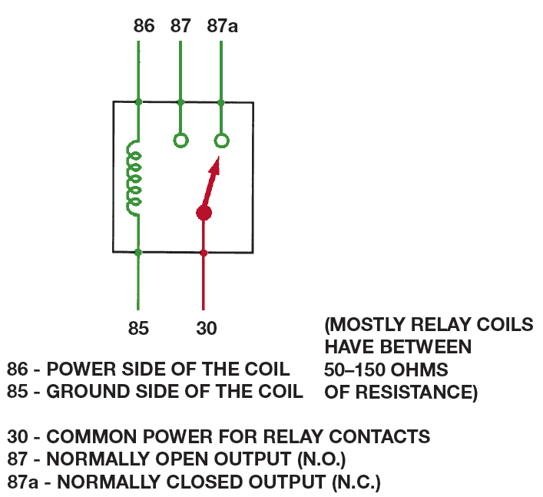
FIGURE 17–47 A relay uses a movable arm to complete a circuit whenever there is a power at terminal 86 and a ground at terminal 85. A typical relay only requires about 1/10 ampere through the relay coil. The movable arm then closes the contacts (#30 to #87) and can often handle 30 amperes or more.

Slide 83
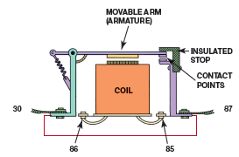
FIGURE 17–48 cross-sectional view of typical four-terminal relay. Current flowing through coil (terminals 86 and 85) causes movable arm (called armature) to be drawn toward coil magnet. The contact points complete electrical circuit connected to terminals 30 and 87.

Slide 84
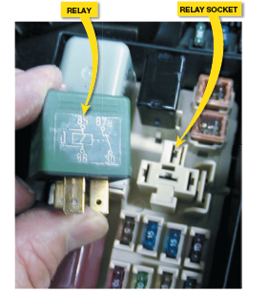
FIGURE 17–49 typical relay showing schematic of wiring in relay.

Slide 85
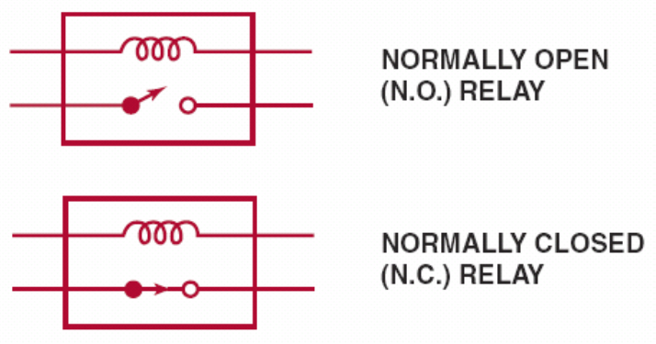
FIGURE 17–50 All schematics are shown in their normal, non-energized position.

Slide 86
SWITCHES
Electrical Switch
  Opens circuit no current flows
  Could also be on return (ground) path wire.
Ohmmeter checks
Voltmeter checks

Slide 87
FIGURE 17–51 typical horn circuit. Note that relay contacts supply heavy current to operate horn when horn switch simply completes low-current circuit to ground, causing relay contacts to close.

Slide 88
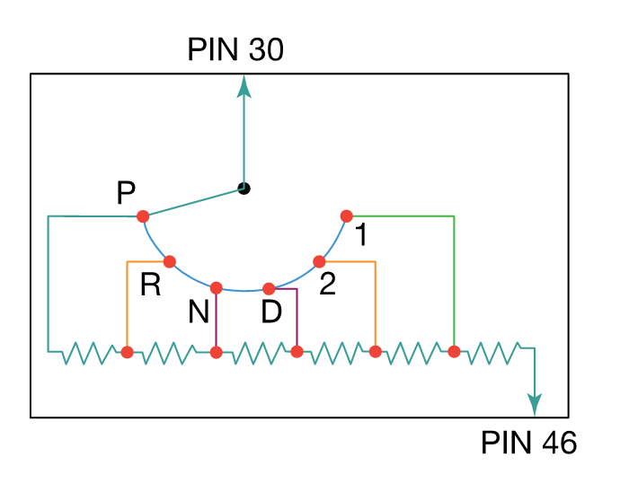
FIGURE 17–52 typical transmission range switch is also similar to the circuit used for electronic transfer case switches. In this example, power, usually 12 volts, is applied at pin 30 and pin 46 is an input to PCM. Change in voltage at pin 46 indicates how much resistance circuit has, which is used to detect gear selected.

Slide 89
SPEED SENSORS
Magnetic Sensor Consists
  Notched wheel and a coil consisting
  Iron core wrapped with fine wire.
  Notched wheel causes magnetic strength changes
  Enough to create usable varying AC voltage signal.
Speed Sensor Tests

Slide 90
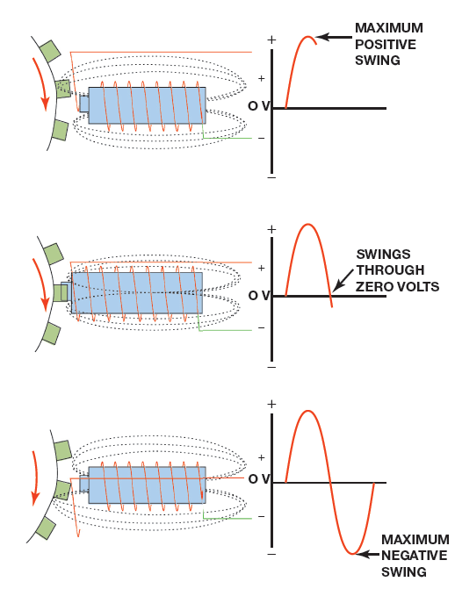
FIGURE 17–53 magnetic sensor uses permanent magnet surrounded by a coil of wire. The notches on rotating shaft create a variable magnetic field strength around the coil. When a metallic section is close to sensor magnetic field is stronger because metal is a better conductor of magnetic lines of force than air.

Slide 91
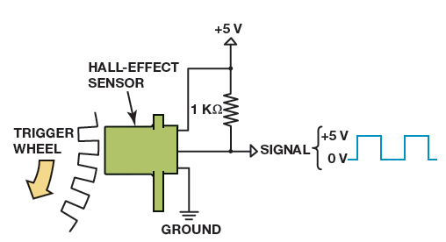
FIGURE 17–54 Hall-Effect sensor produces an on-off voltage signal whether it is used with a blade or a notched wheel.

Slide 92
THROTTLE POSITION (TP) SENSORS
TP Sensor Input
  Determine amount of throttle opening
  Rate of change to determine shift points
  Of an automatic transmission OR engine management.
Parts and operation
Testing a TP Sensor

Slide 93
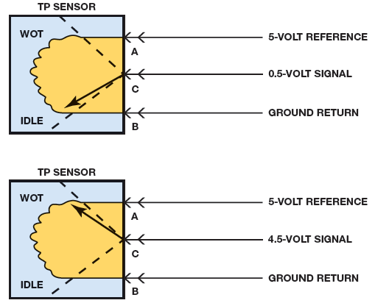
FIGURE 17–55 The signal voltage from a throttle position increases as the throttle is opened because the wiper arm is closer to the 5-volt reference. At idle, the resistance of the sensor winding effectively reduces the signal voltage output to the powertrain control module (PCM).

Slide 94
SUMMARY (1 OF 4)
Electricity is the movement of electrons from one atom to another.
In order for current to flow in a circuit or wire, there must be an excess of electrons at one end and a deficiency of electrons at the other end.
Automotive electricity uses the conventional theory that electricity flows from positive to negative.
The ampere is the measure of the amount of current flow.
Voltage is the unit of electrical pressure.
The ohm is the unit of electrical resistance.

Slide 95
SUMMARY (2 OF 4)
All complete electrical circuits have a power source (such as a battery), a circuit protection device (such as a fuse), a power-side wire or path, an electrical load, a ground return path, and a switch or a control device.
A short-to-voltage involves a copper-to-copper connection and usually affects more than one circuit.
A short-to-ground usually involves a power path conductor coming in contact with a return (ground) path conductor and usually causes the fuse to blow.
An open is a break in the circuit resulting in absolutely no current flow through the circuit..

Slide 96
SUMMARY (3 OF 4)
Circuit testers include test lights and fused jumper leads.
Digital multimeter (DMM) and digital volt-ohm-meter (DVOM) are terms commonly used for electronic test meters.
Ammeters measure current and must be connected in series in the circuit.
Voltmeters measure voltage and are connected in parallel.
Ohmmeters measure resistance of a component and must be connected in parallel with the circuit or component disconnected from power.

Slide 97
SUMMARY (4 OF 4)
A terminal is the metal end of a wire, whereas a connector is the plastic housing for the terminal.
All wire repair should use either soldering or a crimp-and seal connector.
All switches and relays on a schematic are shown in their normal position, either normally closed (N.C.) or normally open (N.O.).
A typical relay uses a small current through a coil (terminals 85 and 86) to operate the higher current part (terminals 30 and 87).

