Slide 1

Light Vehicle Diesel Engines
First Edition
Chapter 20
OBD-II Diesel Monitors
Copyright © 2018, 2015, 2011 Pearson Education, Inc. All Rights Reserved

Slide 2
LEARNING OBJECTIVES (1 of 2)
20.1 Prepare for the Light Vehicle Diesel Engine (A9) ASE certification fuel system diagnosis and repair test content area.
20.2 Identify the major monitors on a modern light-diesel vehicle
20.3 Understand the information obtained from an on-board diagnostics monitor and the criteria to enable an OBD monitor.

Slide 3
LEARNING OBJECTIVES (2 of 2)
20.4 Discuss continuous vs. non-continuous monitors.
20.5 Describe the comprehensive component monitor (CCM).
20.6 Explain enabling conditions.
.

Slide 4
MAJOR SYSTEM MONITORS (1 of 4)
OBD II Self-Diagnostic Capability
  OBD-II software for diesel vehicles continues to evolve
  Snapshot of most commonly used systems
  Refer to OEM service information for specific details
  Understanding of major monitor operation
  Helps to quickly and accurately diagnose failures

Slide 5
MAJOR SYSTEM MONITORS (2 of 4)
2 Types of Monitors:
    Continuous
      Conditions Met Monitors Run
      For Remainder Of Drive Cycle
        Comprehensive Component Monitor
        Misfire Monitor A: 200 RPM, B: 1000
        Fuel Trim Monitor
    Non-Continuous
      Run Once Per Drive Cycle
      Not Run Again Until Conditions Met

Slide 6
FIGURE 20–1 Snap-On Solus scan tool screen capture of the menu to check for the monitor data. All factory scan tools and enhanced aftermarket scan tools can be used to check diesel OBD-II monitors.

Slide 7
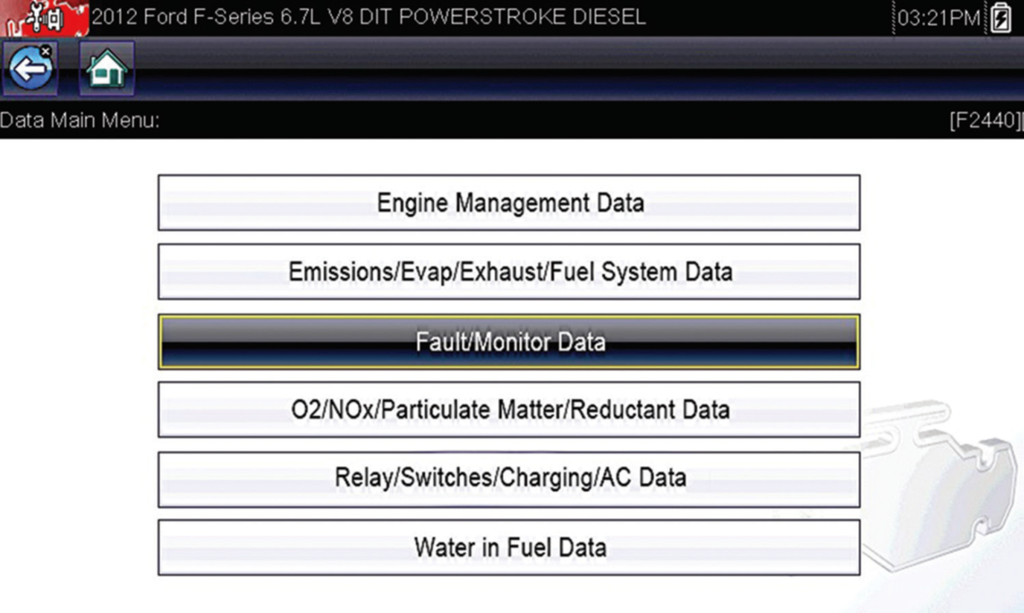
MAJOR SYSTEM MONITORS (3 of 4)
3 Different Continuous Monitors
  When required conditions occur
  Continuous monitors run
  Monitors run for remainder drive cycle

Slide 8
MAJOR SYSTEM MONITORS (4 of 4)
Non-Continuous Monitors:
  Run at most once per vehicle drive cycle
  Once monitor has run to completion,
  Readiness status on scan tool
  Shows “complete” or “done”
  Monitors that have not run to completion
  Show on SCAN TOOL as “incomplete”

Slide 9
COMPREHENSIVE COMPONENT MONITOR (CCM) (1 of 4)
CCM: Continuous Monitor That Monitors
  Inputs & Outputs In OBD-II System
  OBD II requires inputs from powertrain components to PCM
  Be tested for rationality, and that outputs to powertrain
  Components from PCM be tested for functionality.
  Inputs and outputs are to be checked electrically.
  Rationality checks refer to PCM
  Comparison of input value to values.

Slide 10
COMPREHENSIVE COMPONENT MONITOR (CCM) (2 of 4)
Comprehensive Component Monitor (CCM)
  Watches sensors & actuators
  CCM is internal program in PCM
  Monitors components or circuits that
    Provide input/output signals to PCM
  Fault appears, will set code & activate MIL
  Sensors tested at KO or after engine start-up
  Some tested after meeting engine conditions
  Detect fault on 2 consecutive trips before MIL ON

Slide 11
COMPREHENSIVE COMPONENT MONITOR (CCM) (3 of 4)
Some Components tested by CCM:
  Glow plugs and glow plug module
  Manifold absolute pressure (MAP) sensor
    (senses turbocharger boost pressure)
  Injection control pressure (ICP) sensor
  Accelerator pedal position (APP) sensor
  Crankshaft position sensor (CKP)
  Engine coolant temperature (ECT ) sensor
  Mass airflow (MAF) sensor
  Wastegate control operation

Slide 12
COMPREHENSIVE COMPONENT MONITOR (CCM) (4 of 4)
Electrical Test
  Refers to PCM check of
  Both input/outputs for following:
    Opens
    Shorts
    Grounds

Slide 13
ENABLING CRITERIA (1 of 2)
Pending
  Under some situations PCM will not run monitor
  If MIL is ON & DTC stored from another monitor
  PCM postpones monitors pending a resolution of the original fault
  Does not run test until problem is remedied
Conflict
  Times, PCM does not run monitor if another monitor is in progress
  Effects of another monitor running could result in an erroneous failure
Suspend
  PCM may not allow 2 trip fault to mature
  Suspend fault if condition exists that may induce erroneous failure
  Prevents illuminating the MIL for wrong fault

Slide 14
ENABLING CRITERIA (2 of 2)
Enabling Criteria Follow Simple Logic:
  if catalyst monitor is running during a road test
  PCM detects a misfire, catalyst monitor will be
  Suspended for duration of misfire.

Slide 15
MISFIRE MONITOR (1 of 3)
Misfire Monitor Purpose
  Detect imbalance in engine when
  Cylinder fails to produce combustion pressure
  Similar to other cylinders
  Uses CKP & CMP Sensors to calculate
  Rotational speed & acceleration of engine
  Comparing acceleration of each firing event
  Determine if cylinder is not firing correctly

Slide 16
MISFIRE MONITOR (2 of 3)
Monitor Operation
    Unlike gasoline-engine
    Current diesel engines do not use
    Type A & Type B Misfire Strategy
      Similar to Gasoline Type B misfire
      Store one trip failure
      % misfire over 1,000 RPM
      Exceed FTP STD
      2ND consecutive drive cycle
      MIL illuminates DTC stored

Slide 17
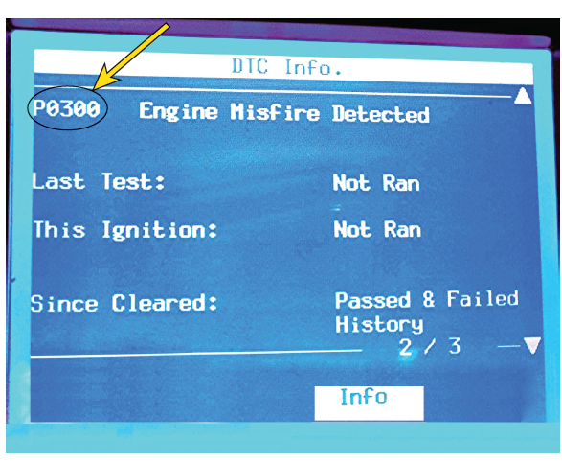
FIGURE 20–2 misfire monitor is enabled on Duramax diesel as seen on Tech 2 scan tool. PCM set P0300, meaning random misfire code because it was not able to detect which of eight cylinders was cause of misfire.

Slide 18
MISFIRE MONITOR (3 of 3)
EWMA Monitor (Exponentially Weighted Moving Average)
  Mathematical method used to determine performance
  Calculations used for following monitors:
    Catalyst monitor
    EGR monitor
    PCM runs six consecutive failed tests; fails in one trip
    3 consecutive failed tests on next trip, then fails
    3 consecutive good trips used to extinguish MIL
    40 warm-up cycles used to erase DTC & freeze-frame

Slide 19
CHART 20-1 Summary showing details of how PCM handles each of mentioned monitors and what it takes to turn off MIL.

Slide 20
FUEL SYSTEM MONITOR (1 of 3)
Fuel System Components
  May Be Monitored Include:
    High-pressure Rail Sensor
    High-pressure Pump
    Pressure Control Valve
    Volume Control Valve
    Low-pressure Lift Pump
    Fuel Injectors

Slide 21
FUEL SYSTEM MONITOR (2 of 3)
PCM Uses Fuel Pressure Monitor
  Continuously monitor fuel system data
  Compares it to what is expected
  Based on programming

Slide 22
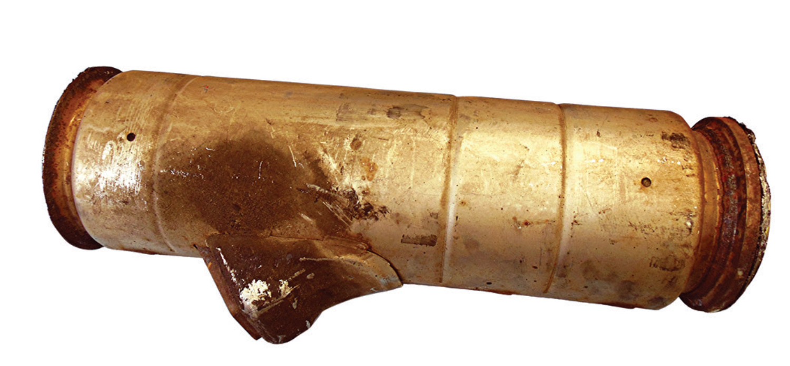
FUEL SYSTEM MONITOR (3 of 3)
NMHC (non-methane hydrocarbon) Catalyst Monitor
  Diesel oxidation catalyst (DOC)
  Catalyst capable of reducing levels
  Hydrocarbons and carbon monoxide
    NOTE: Many OEMS prevent DPF from regenerating if DTC stored for oxidation catalyst (DOC) due to Absence of heat from oxidation process would create failure in regeneration.

Slide 23
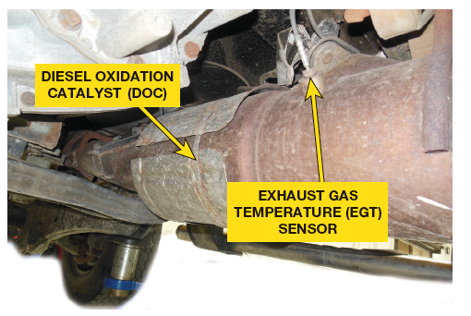
NON-CONTINUOUS MONITOR (1 of 7)
NO_{X} & SCR Catalyst Monitor
  Monitor NO_{X} & SCR
    Measure catalyst efficiency
    Ensure it is capable of reducing levels of NOx

Slide 24
FIGURE 20–3 Diesel oxidation catalyst with a temperature sensor on 6.7 liter Power Stroke diesel engine used in F-250 pickup truck.

Slide 25
NON-CONTINUOUS MONITOR (2 of 7)
Exhaust Gas Sensor Monitor
  Determine if NOx sensors and/or O2 sensors
  Functioning properly

Slide 26
FIGURE 20–4 NOx absorber catalyst used by some OEMS usually before 2010 when NOx emission standards were greatly reduced, requiring most manufacturers to start using SCR

Slide 27
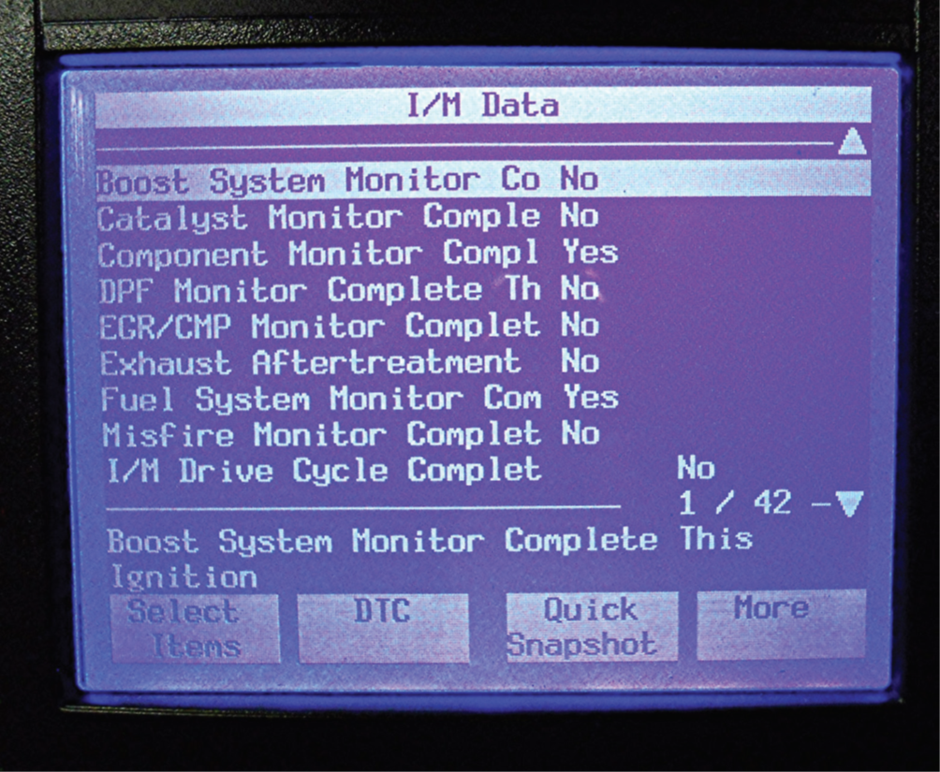
NON-CONTINUOUS MONITOR (3 of 7)
Boost Pressure Monitor
  Ensure volume of air through engine
  Desired Volume
  Under/OVER pressure will affect engine performance
  Affect vehicle emission levels

Slide 28
FIGURE 20–5 boost system monitor information as displayed on a Tech 2 scan tool used on Duramax diesel.

Slide 29

“Boost Pressure Failure”
The leading cause of an under-boost code, and a
lack of performance, is hose clamps on the air intake air system not being torqued to specification, allowing air under pressure to escape to the atmosphere. Therefore, if P0299 DTC (turbocharger has excessively low output) occurs, perform a thorough inspection to make certain that hose clamps are properly torqued to factory specification.

Slide 30
NON-CONTINUOUS MONITOR (4 of 7)
Particulate Matter (PM) Filter Monitor
  Determining filter restrictions, leaks, substrate removal
  Tracking incomplete regeneration events

Slide 31
FIGURE 20–6 failed particulate filter that was so hot from being over-fueled it caused the substrate to melt.

Slide 32
NON-CONTINUOUS MONITOR (5 of 7)
Exhaust Gas Recirculation (EGR) Monitor
  Determine if flow through EGR system is within
  Designed specification.
Exhaust Gas Recirculation (EGR) Cooler Monitor
  Lower temperatures of exhaust gases
  Flowing through intake manifold

Slide 33
FIGURE 20–7 A partially clogged EGR cooler. While they may be able to be cleaned, most are simply replaced because the time needed to clean them exceeds the cost of a new part.

Slide 34

What Are the Monitors for Diesels?
Readiness monitors were changed for the 2010 model year (MY) to reflect changes that occurred with use of high-pressure common rail-type diesel engines and more restrictive emissions standards. 11 readiness monitor bits in diesel OBD system, which is same # as in gasoline OBD system, only 9 are currently assigned for diesels. SEE CHART 20–2

Slide 35
CHART 20-2 Diesel OBD readiness monitors

Slide 36
NON-CONTINUOUS MONITOR (6 of 7)
Cooling System Monitor
  Checks operating temperature
  During warm-up cycle.

Slide 37
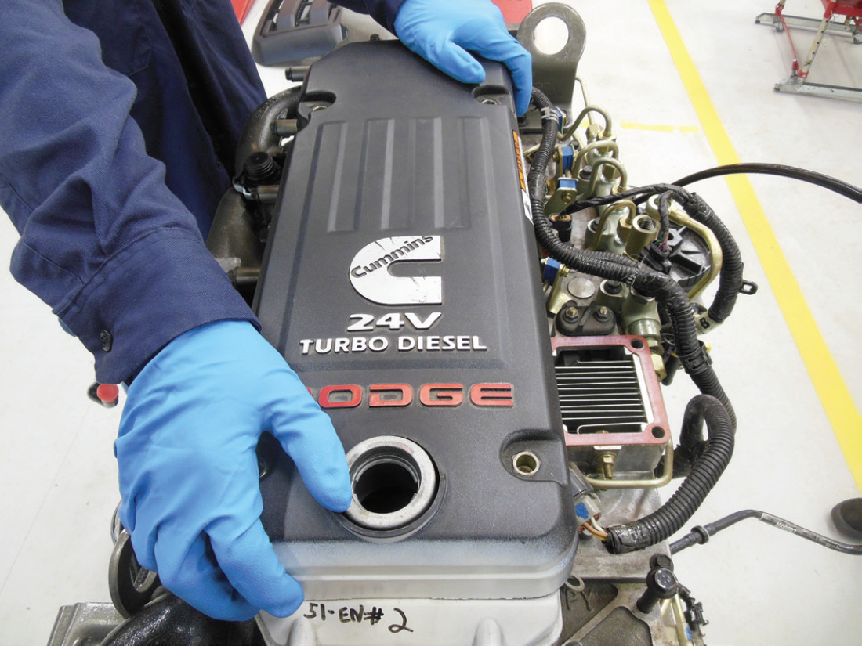
NON-CONTINUOUS MONITOR (7 of 7)
Crankcase Ventilation Monitor
  2007, diesel-equipped vehicles
    No longer allowed vent unfiltered crankcase gases
    Diesel engine makes very little intake manifold vacuum, PCV not possible
    Install & monitor crankcase ventilation system
    Captured Unburned hydrocarbons
    returned them to engine to be burned
    Ensure system flows & NOT leaking to ambient air

Slide 38
FIGURE 20–8 (a) To get access to crankcase breather filter, top plastic cover has to be removed from this Cummins 6.7 liter diesel engine.

Slide 39
FIGURE 20–8 (b) crankcase breather filter is attached to cylinder head cover and can be replaced if needed based on reading from the crankcase pressure sensor.

Slide 40
Summary (1 of 4)
The major systems monitors on current light-duty diesel vehicles are divided into two categories, continuous and non-continuous.
A comprehensive component monitor (CCM) is a continuous monitor that monitors the inputs and outputs in the OBD-II system.
Many PCM sensors and output devices are tested at key-on or immediately after engine start-up. Some devices are tested by the CCM only after the engine meets certain engine conditions.

Slide 41
Summary (2 of 4)
The misfire monitor is able to detect an imbalance in the engine when a cylinder fails to produce a combustion pressure similar to other cylinders and the pre-programmed data in the PCM.
The exhaust gas sensor monitor is designed to determine if the NOx sensors and/or O2 sensors are functioning properly.
The PCM uses fuel pressure monitor to continuously monitor the fuel system data and compares it to what is expected based on programming.

Slide 42
Summary (3 of 4)
The misfire monitor is able to detect an imbalance in the engine when a cylinder fails to produce a combustion pressure similar to other cylinders and pre-programmed data in the PCM.
The exhaust gas recirculation (EGR) monitor is designed to determine if the flow through the EGR system is within designed specification.
The exhaust gas recirculation (EGR) cooler monitor is designed to lower the temperatures of the exhaust gases that are flowing through the intake manifold.

Slide 43
Summary (4 of 4)
The cooling system monitor checks the operating temperature of the engine during the warm-up cycle.
The particulate matter (PM) filter monitor is responsible for determining filter restrictions, filter leaks, filter substrate removal, and tracking incomplete regeneration events.
The purpose of the crankcase ventilation monitor is to ensure the system flows and is not leaking to the ambient air.

