Slide 1
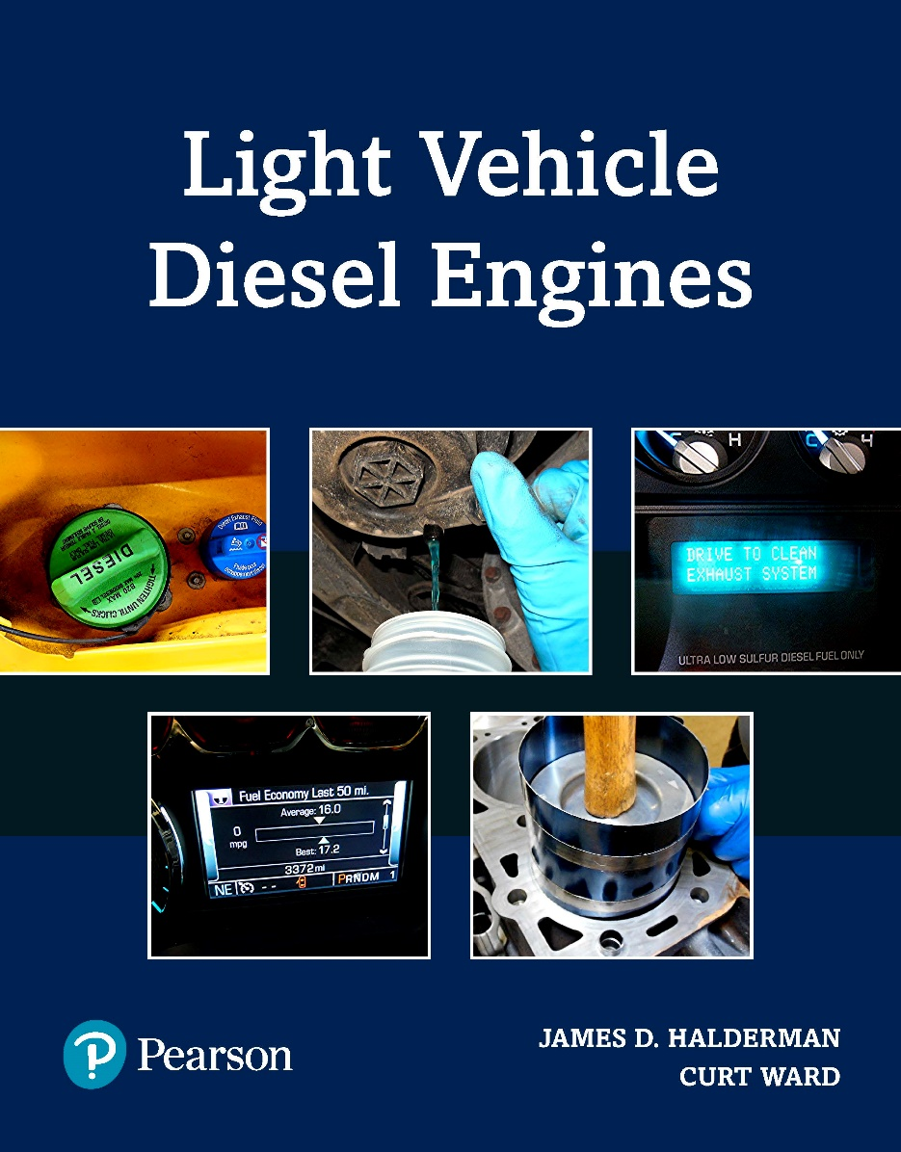
Light Vehicle Diesel Engines
First Edition
Chapter 22
FORD Power Stroke Diesel Engines
Copyright © 2018, 2015, 2011 Pearson Education, Inc. All Rights Reserved

Slide 2
LEARNING OBJECTIVES (1 of 2)
22.1 Identify the major engine components on the 7.3, 6.0, 6.4, and 6.7 liter diesel engines. •
22.2 Explain the cooling system, air intake system, and the lubrication system service on the various Power Stroke diesel. •
22.3 Explain unique features of the Ford Power Stroke upper engine, lower engine, and the engine timing system.

Slide 3
LEARNING OBJECTIVES (2 of 2)
22.4 Perform component identification; verify the location and function of the major engine inputs and outputs of the Ford Power Stroke diesel engines.
22.5 Explain the location, function, and diagnosis of the low-pressure fuel system.
22.6 Identify the components, location, and function of the high-pressure fuel system.

Slide 4
BACKGROUND (1 of 3)
7.3L DI Power Stroke
  Ford/International IDI 6.9 L V8
    Introduced in 1983 became 7.3L IDI in 1988
    1994 7.3L with direct injection (DI)
    DI version named “Power Stroke V8”
      Common rail Hydraulically Actuated Electronic Unit Injection
      HEUI injection system of both 7.3L and 6.0L DI engines

Slide 5
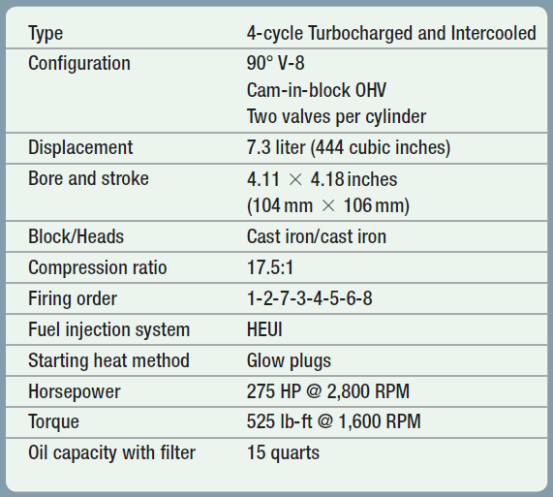
CHART 22-1 specifications for 7.3-liter Ford Power Stroke diesel engine used in 1994–2003 model years (MY).

Slide 6

Case of Noisy 7.3-Liter Power Stroke
Starter (1 of 2)
2002 Ford F-Super Duty 7.3-liter turbo diesel engine had buzzing/screeching starter noise during some engine start attempts. Customer thought engine needed a new starter. Technician was aware that diesel starter mounting bolts can loosen over time, so they were checked first. Both bolts on the 2-bolt starter were found to be extremely loose, allowing starter to jump around with intermittent engagement. Factory specification for the 10 mm * 1.5 bolts calls for 16-20 ft.-lbs. However, replacement starter instructions specified a torque specification of 40-57 ft.-lbs. Technician tightened both bolts to 50 ft.-lbs. After tightening starter bolts, noisy starter problem was solved.

Slide 7
Case of Noisy 7.3-Liter Power Stroke
Starter (2 of 2)
Summary
  Complaint – The owner complained of a noisy starter.
  Cause – Loose starter attachment bolts were found.
  Correction – The starter bolts were tightened to specifications found in replacement starter instructions

Slide 8
BACKGROUND (2 of 3)
6.0L V8 for 2003-2007
  International built 6.0-liter designed and built
  Provide increased power and torque
  Had less piston displacement
  Meet the new emission standard
  Older 7.3-liter diesel not able to meet
  International version VT365.

Slide 9
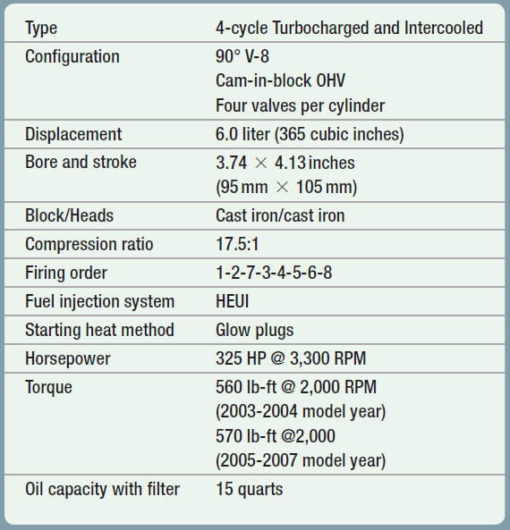
CHART 22-2 specifications for 6.0-liter Ford Power Stroke diesel engine 2003–2007 model years (MY).

Slide 10
BACKGROUND (3 of 3)
2008 6.4L Power Stroke
  MaxxForce® 7 Ford Power Stroke
    IH V8 platform,
      High-pressure common-rail fuel injection system utilizing
      Electronically actuated piezo-electric injectors

Slide 11

Use a 6.4 Starter on a 6.0
While more expensive, using a starter for a 6.4-liter Power Stroke diesel engine on a 6.0 will cause the engine to crank a lot faster making starting easier. The starter bolts up without any issues.

Slide 12
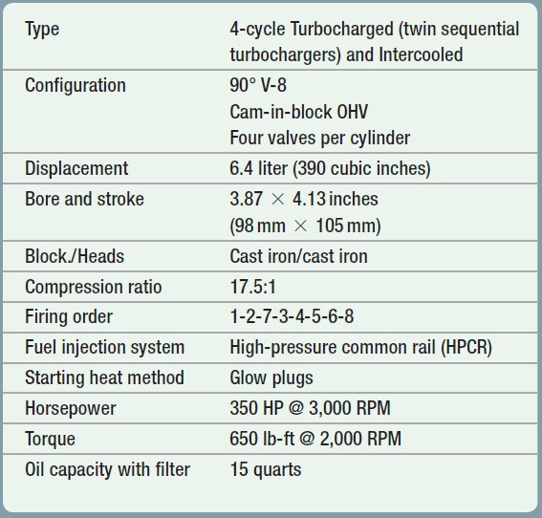
CHART 22-3 specifications for 6.4-liter Ford Power Stroke diesel engine 2008–2010 model years (MY)

Slide 13
6.7-LITER POWER STROKE
6.7L Diesel
  First medium-duty diesel designed & built by Ford
  Designed in conjunction with AVL of Austria
  Ford engineers code named this engine Scorpion
  Compacted Graphite Iron (CGI) Block
  OTHER ENGINE FEATURES: Page 252

Slide 14
Purchase International Parts for Ford Power Stroke Diesels
When purchasing service or repair parts for a Ford 7.3, 6.0, or 6.4-liter Power Stroke diesel engine, look
at a store that sells parts for the International version of these engines. They are often same exact part and the cost is usually lower.

Slide 15
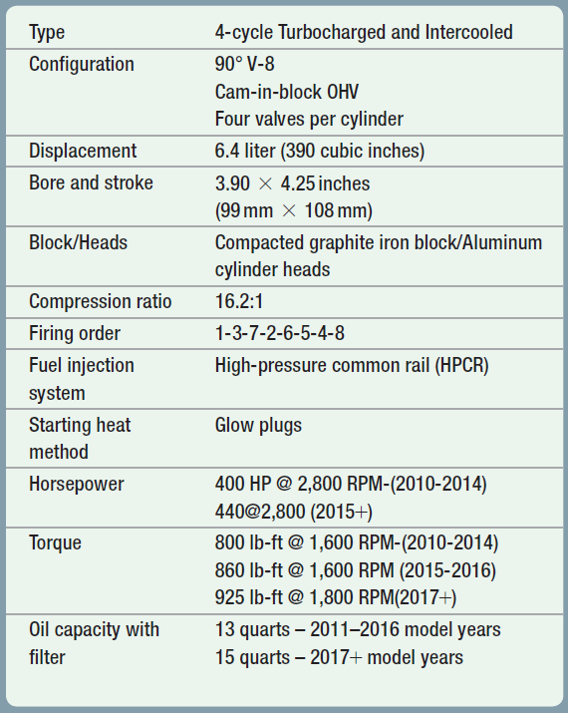
CHART 22-4 specifications for 6.7 liter Ford Power Stroke diesel engine used in the 2011+ model years (MY).

Slide 16
Be Sure to Check Cylinder Numbering
Older Ford Power Stroke diesel engines (7.3, 6.0,
and 6.4 liter) were made by International and used
their typical cylinder numbering. 6.7-liter diesel is built by Ford and uses the typical Ford V-8 cylinder numbering. Using the incorrect cylinder numbering can cause confusion when trying to diagnosis a misfire fault. Always check service information that the cylinders are correctly identified on the engine being serviced.● SEE FIGURE 22–1.

Slide 17
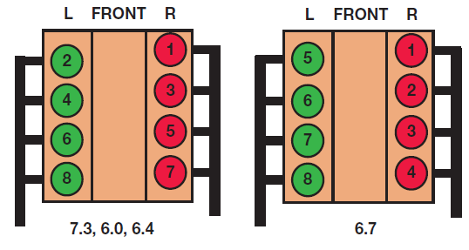
FIGURE 22–1 Older Ford Power Stroke diesel engines (7.3, 6.0, and 6.4 liter) were built by International and used by International cylinder numbering as shown on left. 6.7-liter Power Stroke is built by Ford and uses typical Ford cylinder numbering as shown on right.

Slide 18
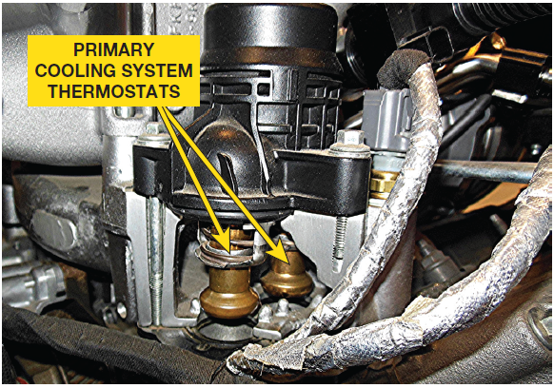
6.7 COOLING SYSTEM (1 of 3)
6.7L has 2 Cooling Systems
  (primary and secondary).
  Primary Cooling System: 29.4 Quarts (28 L):
    Rear-mounted radiator
    Water pump on left front
    Engine, oil, turbocharger cooling
    Charge air cooler (CAC ) cooling
    Heater core to provide cab heat
    2 engine-mounted thermostats
    Fuel cooler, EGR cooler, degas bottle

Slide 19
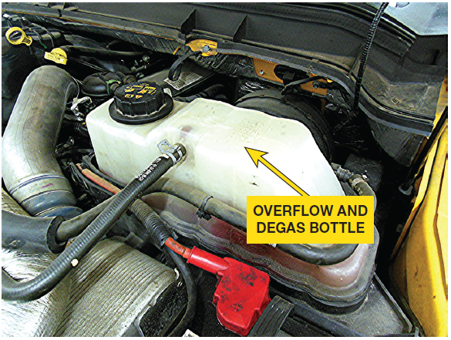
6.7 COOLING SYSTEM (2 of 3)
6.7L has 2 Cooling Systems
  Secondary Cooling System 11.7 Quarts (11L):
    Forward-mounted Radiator
      Allows secondary cooling system to operate at lower temperature
      Than primary cooling system
    Radiator-mounted Thermostats (Two)
    Water Pump On Right Front
    Transmission Fluid Cooler
    Degas Bottle

Slide 20
6.7 COOLING SYSTEM (3 of 3)
Block Heater: Page 253 of text
Engine Cooling Fan Page 253 of text
Coolant Page 253 of text

Slide 21
FIGURE 22–2 primary cooling system uses 2 thermostats designed to precisely control coolant temperature. One thermostat opens at 194°F (90°C) and the other opens at 201°F (94°C).

Slide 22

FIGURE 22–3 overflow and Degas bottle located under hood on driver’s side.

Slide 23
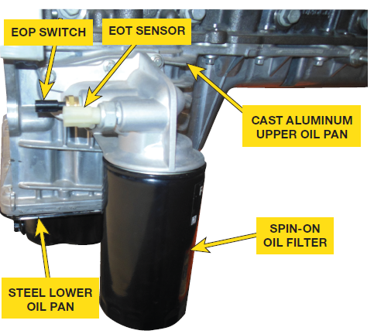
6.7 LUBRICATION SYSTEM (1 of 2)
Oil Pump Flow:
  Through galleries in pan to oil cooler
  From oil cooler to oil filter FIGURE 22–4
  To main gallery, feeds both right & left side galleries.
  Left gallery feeds following:
    Vacuum pump lubrication
    HPFP gears
    Left bank piston cooling jets
    Camshaft journals
    Left head lifters & rocker arms

Slide 24
6.7 LUBRICATION SYSTEM (2 of 2)
Oil Pump Flow:
  Right gallery feeds the following:
    Turbocharger lubrication
    Right head lifters & rocker arms
    Right bank piston & cooling jets
    Main and rod bearings

Slide 25
FIGURE 22–4 oil filter used on 6.7 Power Stroke is a spin-on type. Oil pan was updated for 2012 model year with stamped steel lower pan with conventional plug instead of plastic (composite) pan used with plastic drain plug on 2011 model year version.

Slide 26
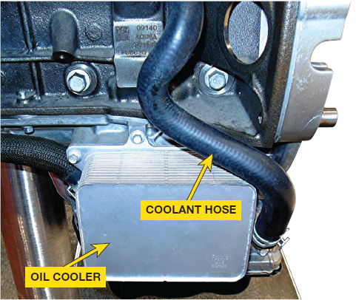
FIGURE 22–5 Large rubber coolant hoses are used to supply coolant to and from the oil cooler.

Slide 27
ENGINE MECHANICAL (1 of 2)
Lower Engine: Page 254 Figure 22-6
  Both crankshaft main & rod bearings
  Color coded, do not use a tang
  Crankshaft main bearing lower half dark gray color
  Upper half bright metal with lubrication groove
  Slot for oil to flow through.
  Rod bearing upper half is dark gray
  Lower half bright metal with no grooves
Upper Engine Page 255 Figure 22-7

Slide 28
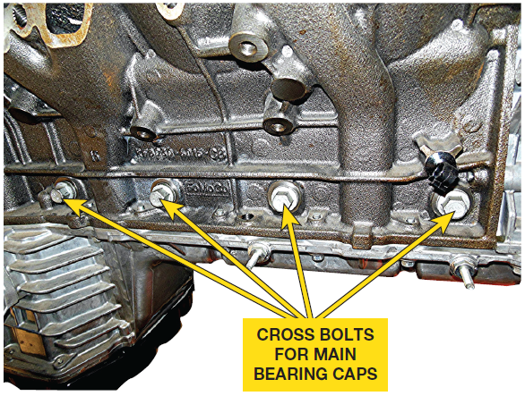
FIGURE 22–6 6.7 block made from compacted graphite iron (CGI) & uses cross-bolted main bearing caps for strength.

Slide 29
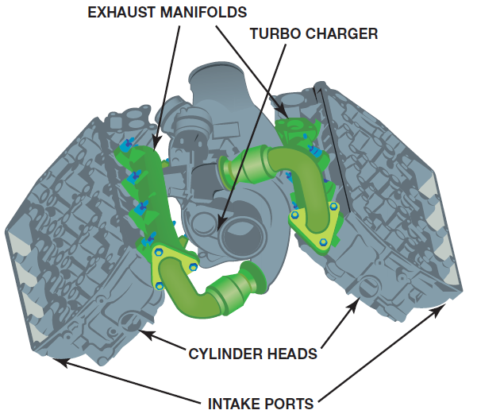
FIGURE 22–7 aluminum cylinder head features intake ports on outside of head where exhaust ports are usually located. This design allows exhaust posts to be close to turbocharger, making it more efficient.

Slide 30
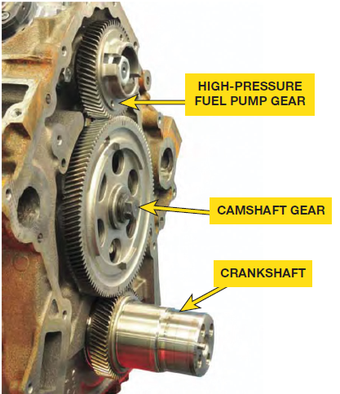
ENGINE MECHANICAL (2 of 2)
Timing System
  Crankshaft drives camshaft & High-pressure fuel pump
  With helical gears
  Timing gears accessible removing front cover
    Camshaft, crankshaft, & high-pressure fuel pump
    Timed together
    HP pump timed so that fuel pump stroke happens
    Same time as injection stroke
    Provides more consistent fuel delivery, reduces noise

Slide 31
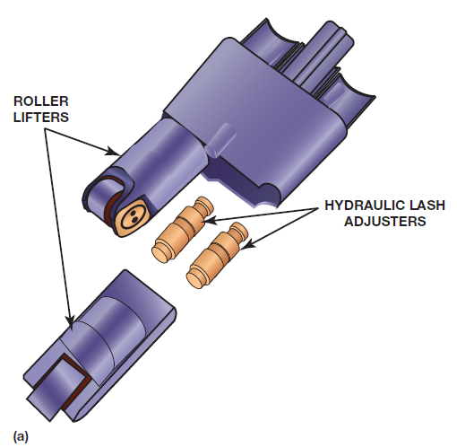
FIGURE 22–8 (a) patented dual hydraulic lash adjusters within one roller lifter, allows 6.7 liter Power Stroke diesel to use single rocker arm for each valve.

Slide 32
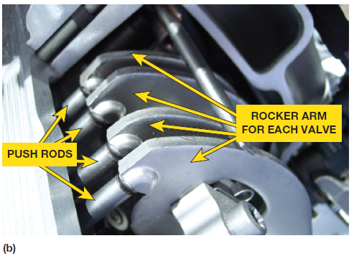
FIGURE 22–8 (b) Each valve is opened by its own stamped steel rocker arm. Using incorrect engine oil can often lead to wear problems especially on push rods and rocker arm fulcrums and pads

Slide 33
FIGURE 22–9 forged module steel crankshaft uses a shrink fit front drive gear to rotate camshaft gear, which is timed to high-pressure fuel pump (HPFP).

Slide 34
LOW-PRESSURE FUEL
SYSTEM
Fuel
  Ultra-low sulfur diesel (ULSD)
  Aftertreatment system requires ULSD
  2 additives to insure best fuel economy
  Lowest possible emissions including:
    Anti-gel additive – PM 23A U.S. (PM 23B Canada)
    Cetane booster – PM 22A U.S. (PM 22B Canada)
  Cetane at 40

Slide 35
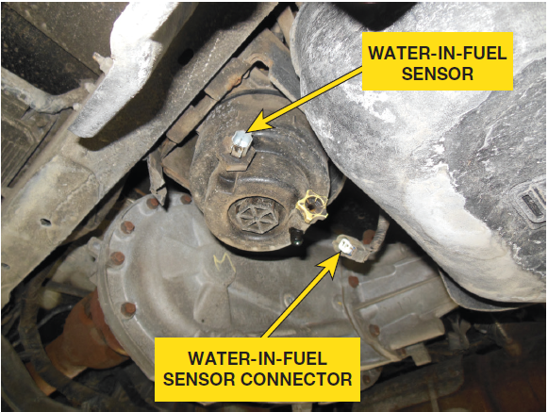
DIESEL FUEL CONDITIONER MODULE (DFCM) (1 of 2)
DFCM located on Frame
  Contains following components:
    Lift (transfer) fuel pump.
    Top assembly is where fuel lines attached
    Electrical connector for fuel pump
    10 micron cartridge-type primary filter
    Water-in-fuel (WIF) sensor located inside DFCM
  Fuel Filter Replacement
    Page 257 of text Figure 22-12

Slide 36
FIGURE 22–11 water-in-fuel sensor is a two-wire sensor shown with the connecter disconnected.

Slide 37
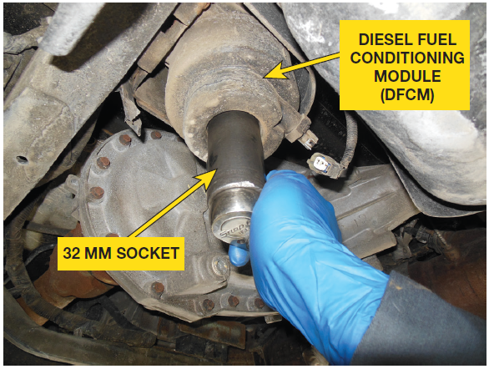
FIGURE 22–12 Use 32 mm socket with a ratchet to loosen filter housing. After loosening, housing can often be removed by hand, rotating it counterclockwise.

Slide 38
FIGURE 22–13 old filter is removed for housing over an oil drain unit so as to not spill diesel fuel onto floor.

Slide 39
DIESEL FUEL CONDITIONER MODULE (DFCM) (2 of 2)
SERVICE
  Primary Fuel Filter Replacement Page 257
  Secondary Fuel Filter Replacement Page 258
  Fuel Pressure & Temperature Page 258

Slide 40
FIGURE 22–14 Lubricating the O-ring with grease will allow the housing to move freer when the housing is being rotated back into the DFCM.

Slide 41
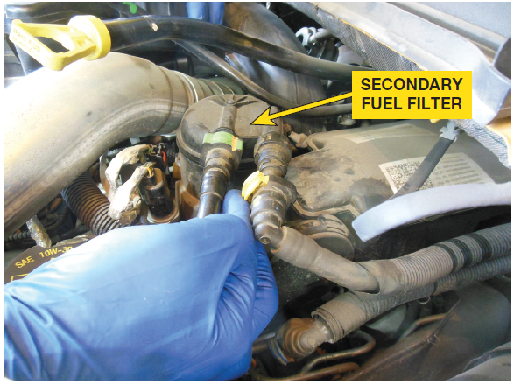
FIGURE 22–15 connector tabs are depressed to release them from the fuel filter.

Slide 42
FIGURE 22–16 new filter is on left and old filter is on right. Dispose of old filter according to federal, state, and local laws. (SECONDARY)

Slide 43
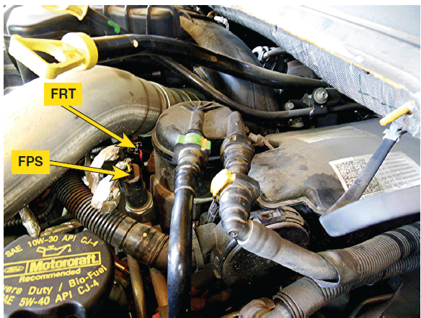
FIGURE 22–17 fuel rail temperature (FRT) sensor and the fuel rail pressure (FPS) sensor are both next to secondary fuel filter under the hood on the driver’s side.

Slide 44

Why Is a Fuel Cooler Used?
Depending on temperature of fuel from injectors, fuel cooler can be used to either cool or heat fuel going back to DFCM. The powertrain secondary cooling system provides coolant for fuel cooler. Cold fuel needs to be heated to be able to flow easily through high-pressure system, and hot fuel many be too hot to lubricate the high pressure pump. Fuel cooler on a 6.7-liter Power Stroke diesel located on left frame rail forward of DFCM. Black fuel line is used for fuel return from engine to cooler. Gray fuel line returns fuel from cooler to DFCM.

Slide 45
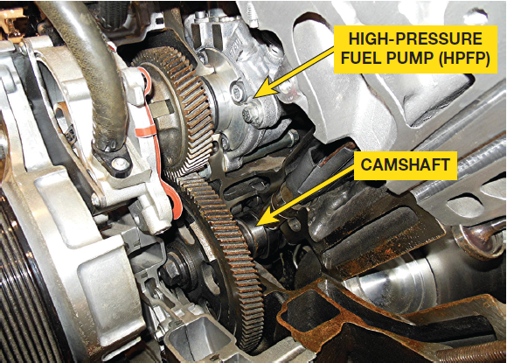
HIGH-PRESSURE FUEL
SYSTEM (1 of 3)
High-Pressure Fuel Pump (HPFP)
  2-cylinder design
  Front of intake valley
  Delivers 2,900–29,008 PSI
  Volume Control Valve (VCV)
    Top of HPFP
    Restricts fuel flow as duty cycle increased
    Low Duty Cycle Creates More Volume
    Higher Duty Cycle Creates Less Volume

Slide 46
FIGURE 22–18 partial cutaway of 6.7-liter Ford Power Stroke engine showing how HP pump is driven by camshaft gear, and timed so that pump stroke happens about same time as injection event, reducing noise.

Slide 47
HIGH-PRESSURE FUEL
SYSTEM (2 of 3)
Pressure Control Valve (PCV)
  Regulate pressurized fuel
  Rear of left side fuel rail
  N.O. solenoid
  Low duty cycle means low pressure
  High duty cycle creates higher pressure

Slide 48
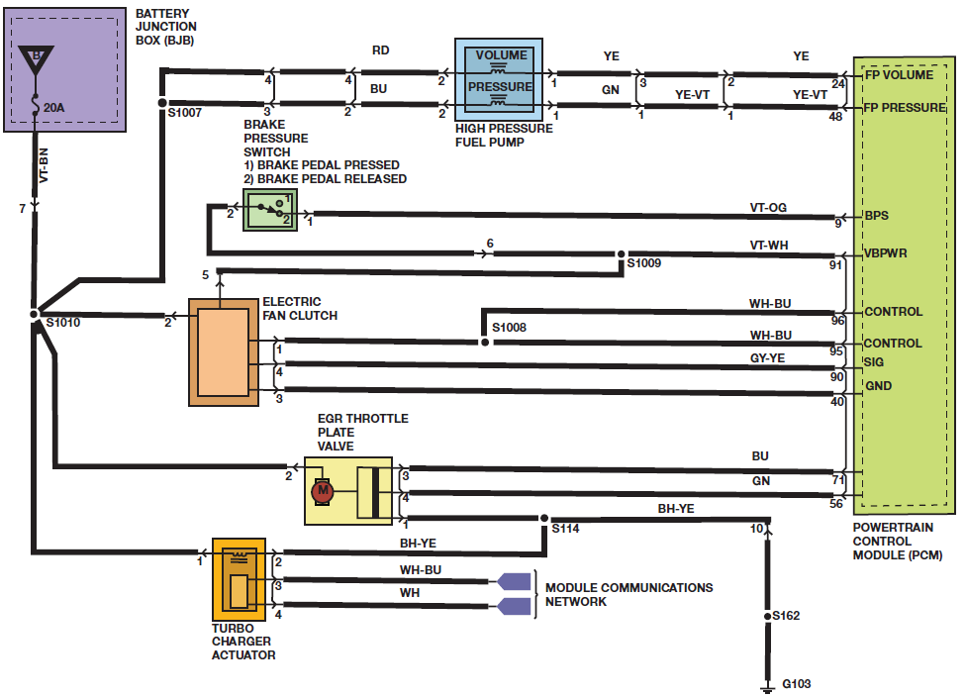
FIGURE 22–19 schematic of Ford 6.7 Power Stroke Diesel engine showing pressure and volume solenoids.

Slide 49
HIGH-PRESSURE FUEL
SYSTEM (3 of 3)
KOEO –PCV & VCV solenoids open
  Engine Cranking: VCV low, but PCV commanded high to build pressure
    Injectors will not operate until FRP sensor indicates enough pressure
  Engine Startup – engine speed increases VCV will increase to restrict volume, PCV decrease to bleed pressure.
  Normal: PCM controls both solenoids achieve desired pressure to injectors.
  Deceleration VCV closed & PCV opened on deceleration

Slide 50
HIGH-PRESSURE COMMON RAIL FUEL INJECTORS (1 of 2)
Fuel Rails: Page 260 of text
Injector Low-Pressure Connections
  Page 260 of text
Injector Operation Page 260 of text
Hydraulic Coupler Page 261 of text
Control Valve Page 261 of text
Injector Nozzle Needle Page 261 of text

Slide 51
HIGH-PRESSURE COMMON RAIL FUEL INJECTORS (2 of 2)
Injector Operation
  Piezo actuator stack of piezo crystals.
    Current applied to crystals, they expand
    Fuel Injector opens/injection
    Current removed from piezo crystals
    Contract injector closes injection ends
  Injector Quantity Adjustment (IQA) Page 262

Slide 52
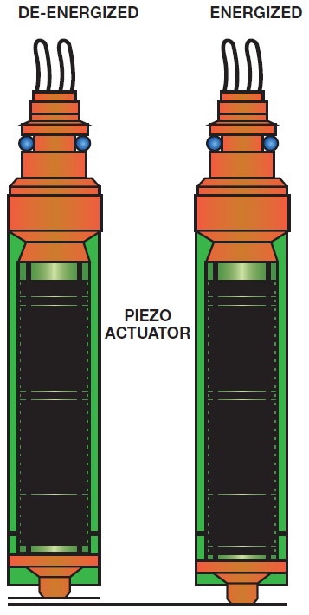
FIGURE 22–20 A piezo fuel injector uses piezoelectric crystals to create a small movement when a voltage is applied to open the injector.

Slide 53
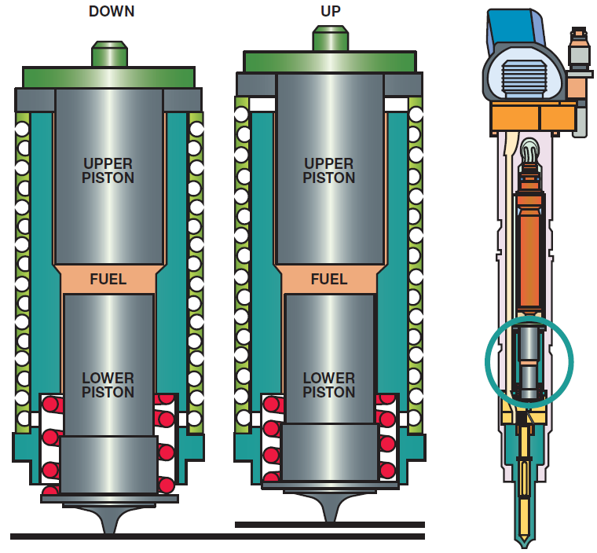
FIGURE 22–21 hydraulic coupler inside injector is used to multiply small movement of piezo actuator to produce more travel.

Slide 54
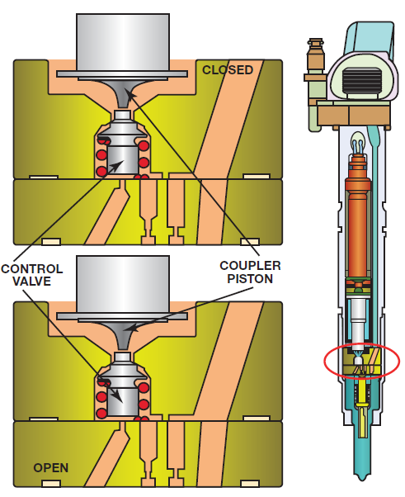
FIGURE 22–22 injector nozzle needle operates to open and close injector to deliver fuel to combustion chamber.

Slide 55
CONTROL SYSTEM INPUTS
Crankshaft Position Sensor (CKP) Page 262
Camshaft Position Sensor (CMP) Page 262
Mass Air Flow Sensor Page 262
Exhaust Gas Recirculation Valve Position (EGRVP) Page 262

Slide 56
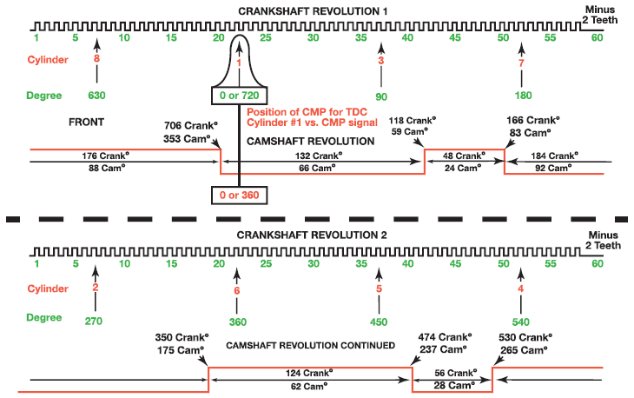
FIGURE 22–23 relationship between crankshaft position sensor (CKP) and camshaft position sensor (CMP) over period of 2 crankshaft revolutions.

Slide 57
ENGINE OUTPUTS
Glow Plugs & Glow Plug Module (GPCM)
  Page 263 OF TEXT
Glow Plugs Page 263 OF TEXT
Exhaust Gas Recirculation Valve (EGR)
  Page 263 OF TEXT
EGR Cooler Bypass Valve Page 263 OF TEXT
Intake Air Flow Control Valve Page 264 OF TEXT

Slide 58
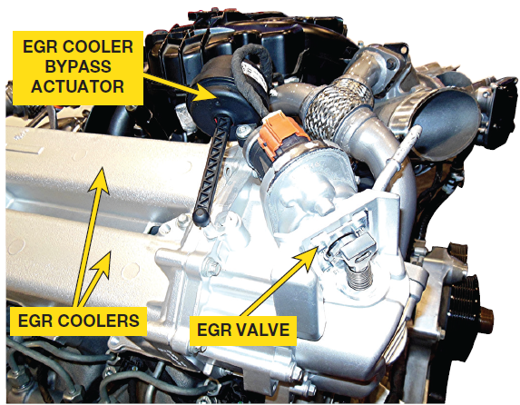
FIGURE 22–24 EGR bypass actuator is located on top of engine above EGR cooler.

Slide 59
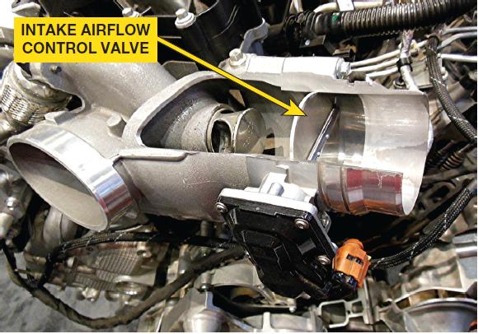
FIGURE 22–25 cutaway of intake air flow control valve used on 6.7-liter Ford Power Stroke diesel engine.

Slide 60
Case of the Stuck Open EGR Valve (1 of 2)
2011 Ford Power Stroke stated that while driving down highway, engine lost power. Engine still running, but it had no power and would blow black smoke from exhaust when accelerating. Retrieved a P1355 DTC (exhaust gas recirculation (EGR) position sensor minimum/maximum stop performance). Inspection of EGR valve showed that it was stuck open by a large carbon particle that looked like a small rock. Most likely cause of this type of failure is due to small coolant leak in EGR cooler, which causes carbon particles to loosen and break off, causing EGR valve to become clogged. This fault required that the EGR cooler be replaced and EGR valve cleaned. After the repair, the truck ran normally.

Slide 61
Case of the Stuck Open EGR Valve (2 of 2)
Summary:
Complaint—Vehicle owner complained that the engine lost power while driving.
Cause—stuck open EGR valve caused by carbon particles from a defective EGR cooler
Correction—EGR cooler was replaced and EGR valve was cleaned, which restored proper engine operation.

Slide 62
DIESEL AFTERTREATMENT SYSTEM
Emissions Controls Include:
  EGR (exhaust gas recirculation)
  SCR (selective catalytic reduction) converter
  DPF (diesel particulate filter)
    See Chapter 15 for details on these systems
  6.7-liter Power Stroke DEF: Page 264

Slide 63
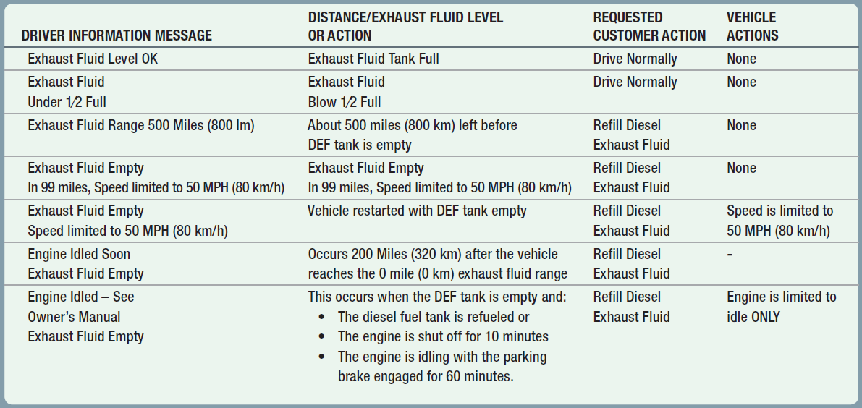
CHART 22-5 Low DEF warnings and actions, plus instrument cluster messages

Slide 64
FIVE- & SIX-CYLINDER POWER STROKE DIESEL ENGINES
3.2-liter Five-Cylinder Power Stroke Engine
3.0 Liter V-6 Power Stroke Engine
  See Page 265 of text

Slide 65
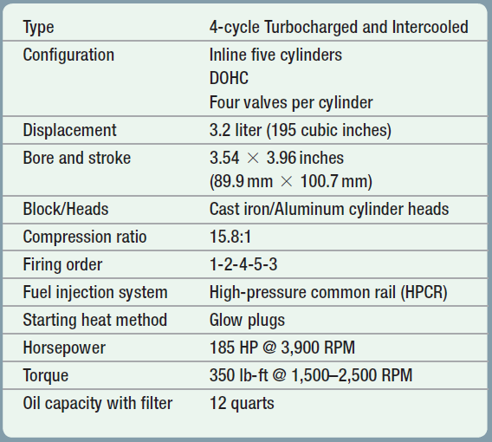
CHART 22-6 specifications for 3.2 liter Ford Power Stroke diesel engine used in 2015+ model year (MY) in Transit vans.

Slide 66
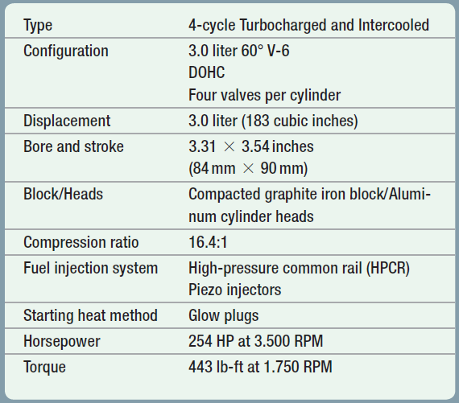
CHART 22-7 specifications for 3.0 liter V-6 Ford Power Stroke diesel engine in 2018+ model year (MY) F-150 trucks.

Slide 67
QUESTION 1
Why is an intake air flow control valve used on the 6.7-liter Power Stroke diesel engine?

Slide 68
ANSWER 1
The position of the valve determines the mix of fresh air and exhaust gasses in the intake manifold. The PCM uses the feedback from the O2 sensor to help determine the valve position. The default position of the valve is the open position.

Slide 69
QUESTION 2
What Power Stroke diesel engines were made by International?

Slide 70
ANSWER 2
Ford Power Stroke diesel engines (7.3, 6.0, and 6.4 liter) were built by International

Slide 71
Summary (1 of 3)
The old 7.3 and 6.0-liter Power Stroke diesel engines used direct injection and the HEUI fuel injection system and built by International.
6.4-liter Power Stroke was equipped with four valves per cylinder and used a high-pressure common rails (HPCR) fuel injection system built by International.
6.7-liter Power Stroke is built by Ford and Incorporates a high-pressure common rails (HPCR) fuel injection system with increased power compared to previous Power Stroke diesel engines.
6.7-liter diesel engine uses two cooling systems and four thermostats.

Slide 72
Summary (2 of 3)
The 6.7-liter Power Stroke diesel engine uses a gerotor type oil pump driven from the front of the crankshaft. The lubrication system includes a spin-on type oil filer located at the lower right of the engine, under the starter motor.
The block is cast from compacted graphite iron (CGI) and the cylinder heads are aluminum.
The air inlet located on the outboard side of the cylinder heads and the exhaust outlet is located on the in-board side (lifter side) of the cylinder head to reduce the loss of heat to improve the efficiency of the turbocharger.
The water-in-fuel (WIF) sensor is located inside the diesel fuel control module (DFCM).

Slide 73
Summary (3 of 3)
Fuel pressure and volume are controlled by two solenoids, volume control valve (VCV) solenoid and the pressure control valve (PCV) solenoid.
A piezo fuel injector uses piezoelectric crystals to create a small movement when a voltage is applied to open the injector.
EGR system uses an EGR cooler after the EGR valve.
The diesel exhaust fluid (DEF) tank holds five gallons and is usually enough to last to the next scheduled oil change, or ever 7,500 miles under normal operating conditions.
Ford Power Stroke family of engines also includes, inline five cylinder used in Transit vans and 3.0 liter V-6 used in the F-150.

