Slide 1

Light Vehicle Diesel Engines
First Edition
Chapter 23
DURAMAX Diesel Engines
Copyright © 2018, 2015, 2011 Pearson Education, Inc. All Rights Reserved

Slide 2
LEARNING OBJECTIVES (1 of 2)
23.1 Identify the major engine components on the GM Duramax diesel engines.
23.2 Explain the cooling system, air intake system, and the lubrication system service on Duramax engines.
23.3 Discuss the unique features of the upper engine, lower engine, and the engine timing system.
23.4 Discuss engine and component identification.

Slide 3
LEARNING OBJECTIVES (2 of 2)
23.5 Explain the location, function, and diagnosis of the low-pressure fuel system.
23.6 Identify the components, location, and function of the high-pressure fuel system.
23.7 Discuss messages associated with DEF system

Slide 4
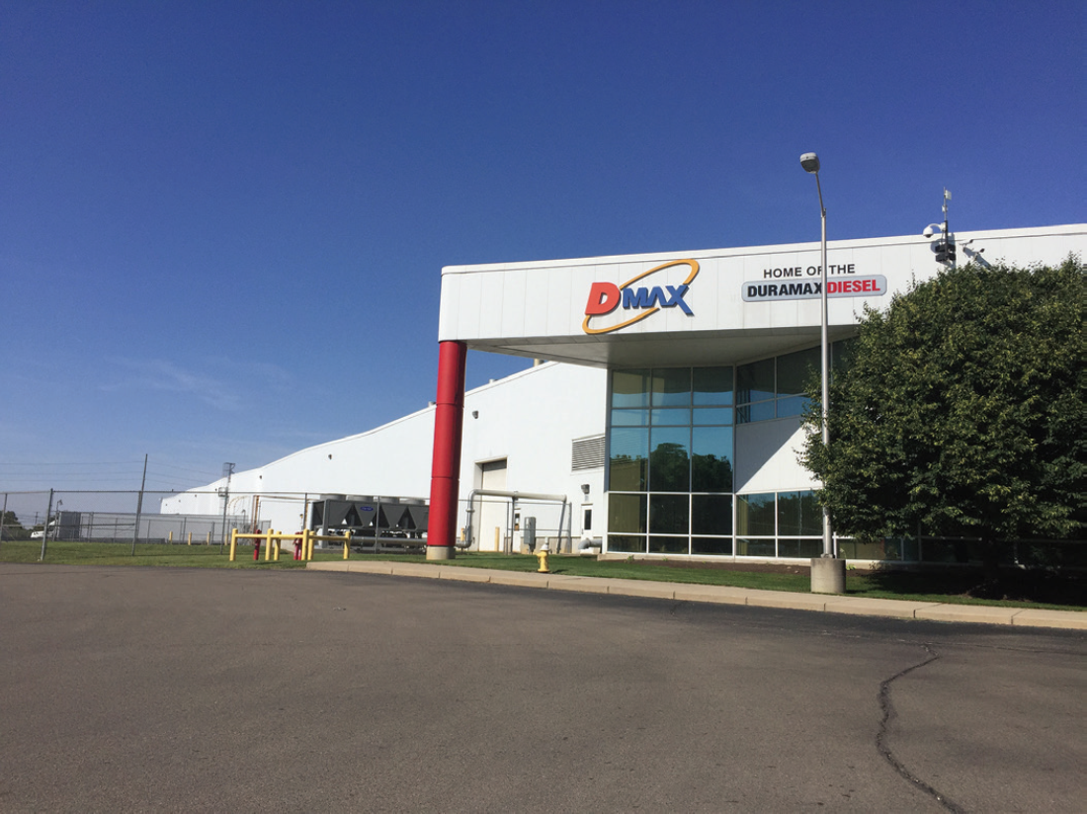
BACKGROUND (1 of 9)
Duramax GM Diesel
  Light- to medium-duty trucks
  Block & heads cast at GM Powertrain foundry
  Built by GM & Isuzu called DMAX
  Joint venture in Moraine, Ohio

Slide 5
FIGURE 23–1 DMAX plant is located near I-75, and railroad access makes transport of materials and finished engines easy from Ohio plant.

Slide 6
BACKGROUND (2 of 9)
LB7 2001–2003 model year
  RPO code 2001 model year
    Cast-iron block, aluminum crankcase & head
      4 valves per cylinder
      HPCR
      300 hp 3,000 rpm
      520 lb-ft 1,600 rpm
    LB7 Duramax engine suffered from injector cracking issues that could cause symptoms: SEE PAGE 268 OF TEXT

Slide 7
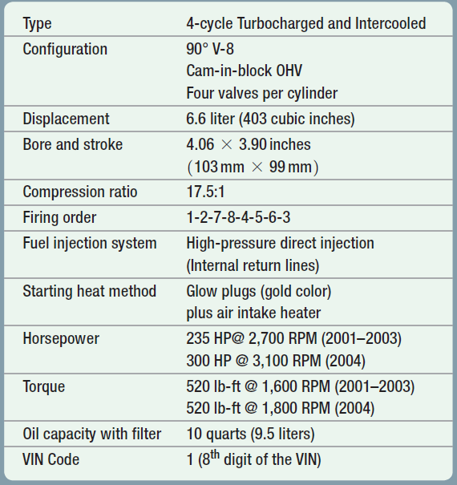
CHART 23-1 First years of Duramax were labeled as LB7 and used in 2002–2004 model years.

Slide 8
BACKGROUND (3 of 9)
LLY January 2004
  310 bhp, 545 lb-ft
  NOx & particulates by 90%
    EGR valve
      Lower NOx EGR cooler
      Cool exhaust gases using engine coolant to increase gas density, which increases flow
      EGR Position sensor, ECM monitor position
        EGR cooler known to fail over time,
        Coolant enter intake manifold, caused loss of coolant & steam from tailpipe

Slide 9
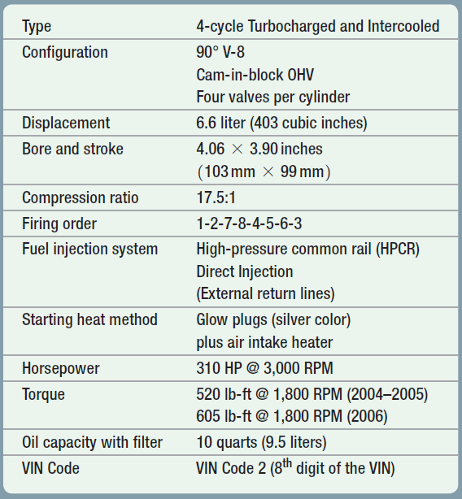
CHART 23-2 second generation of Duramax diesel engines were referred to as LLY

Slide 10
BACKGROUND (4 of 9)
LBZ 2006 only
  Output 310 bhp & 590 lb-ft of torque
  Block redesigned
  Stronger pistons & rods
  Power was increased
  Larger radiator & EGR cooler
  Allison 1000 or ZF 650 6-speed manual transmissions
  2007 last year that the Duramax diesel engine available with MT
    ISSUES. Because this model was used in only one year, no pattern failures

Slide 11
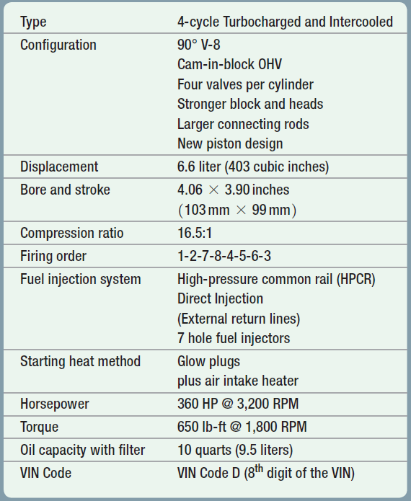
CHART 23-3 third generation of Duramax diesel engines were referred to as LBZ and were considered to be hot rod version because they did not use diesel particulate filter.

Slide 12
BACKGROUND (5 of 9)
LMM Engine, 4th Generation
  2007
    365 bhp @ 3,200 rpm
    660 lb-ft of torque at 1,600 rpm
      Class 4 & 5 medium-duty trucks
      FEATURES. ultra-low sulfur diesel (ULSD) fuel and the use of a diesel particulate filter (DPF).
      ISSUES. DPF caused engine to produce lower fuel economy due to regeneration of diesel particulate filter. Driven as intended,
      Extra fuel for regeneration not needed compared to when vehicle driven lightly loaded & low speeds.

Slide 13
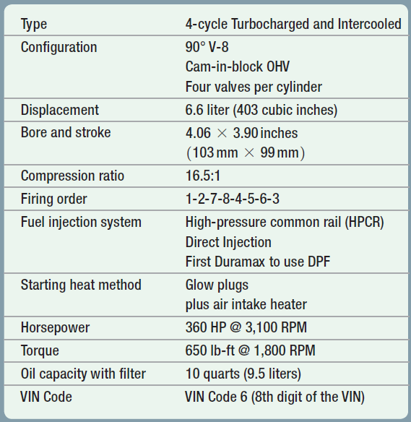
CHART 23-4 fourth generation of Duramax diesel engines were referred to as LLM and were first version to use diesel particulate filter.

Slide 14
BACKGROUND (6 of 9)
EARLY DURAMAX Versions:
  4 Variations Early Duramax Diesel Engine:
    2001–2004 LB7: 2001 no EGR or catalytic converter.
      Some 2002–2004 had EGR & catalyst
    2005–2006 RPO code LLY: EGR, catalyst, & variable geometry turbocharger, 310 bhp, 545 lb-ft of torque
    2006.5 LLY and LBZ
      310 bhp & 590 lb-ft of torque for automatic transmission
        Increased to 360 bhp and 650 lb-ft of torque in 2007
    2006–2008: RPO LMM: higher horsepower lower emissions
      Aggressive EGR operation, intake throttle, particulate trap
        365 bhp at 3,200 rpm and 660 lb-ft of torque at 1,600 RPM

Slide 15

BACKGROUND (7 of 9)
LML 2011–2016 Version
  60% of components
  Redesigned from previous version:
    Upgraded engine block casting
    Oil pump
    Higher strength pistons and connecting rods
    1ST to use selective catalyst reduction (SCR) & DEF
    Use of piezo injectors
    “ninth injector” to supply fuel to DPF during regeneration
    Able to use bio-diesel up to B20
    NO known pattern failures

Slide 16
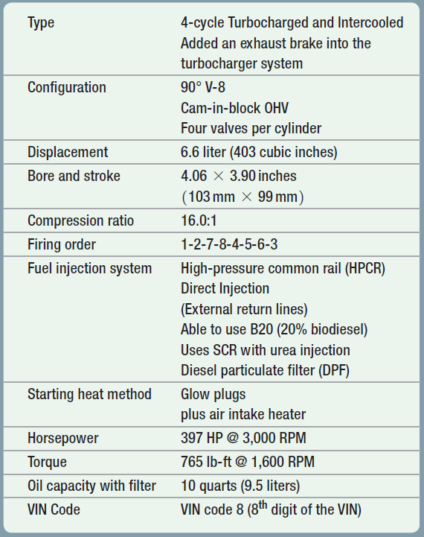
CHART 23-5 fifth generation of Duramax diesel engines were referred to as LML and first version to use SCR requiring use of DEF.

Slide 17
BACKGROUND (8 of 9)
LGH RPO
  Detuned version of LML
  Cab, chassis vehicles
  Commercial vans with following
    Used in commercial vehicles
    Not need to meet same EPA STDS as LML
    Uses a different turbocharger
    Larger EGR cooler
    Higher capacity SCR system
    Still able to use bio-diesel up to B20
    N o service issues unique to this version.

Slide 18
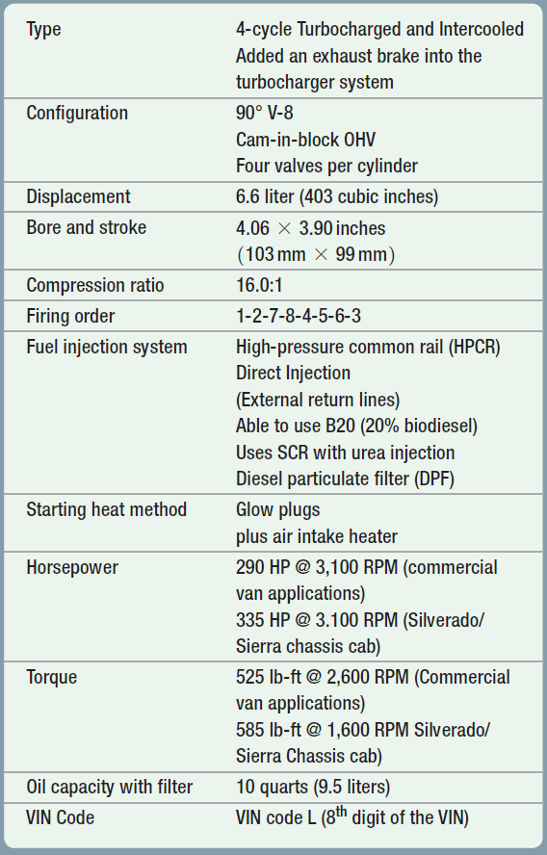
CHART 23-6 LGH Duramax diesel engine is a detuned version of the LML and used in commercial vehicles only.

Slide 19
BACKGROUND (9 of 9)
L5P 2017 & Later Version
  Upgraded Version Includes:
    New camshaft profile
    Electronically-controlled variable vane turbocharger
    Improved cylinder head design
    New engine block and larger-diameter crankshaft connecting rod journals
    New air intake system with functional hood scoop
      No known pattern failures are known for this version at this time.

Slide 20
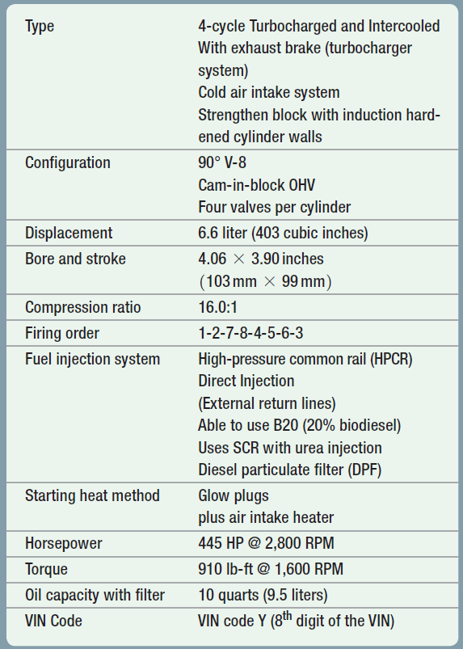
CHART 23-7 L5P version of Duramax diesel engine features higher horsepower & torque from previous versions, uses unique cold air intake scoop on hood.

Slide 21
2.8 INLINE 4-CYLINDER
DURAMAX
2.8-liter Four-Cylinder Duramax
  Option in medium size Chevrolet Colorado
  GMC Canyon pickup trucks.
    SEE CHART 23–8 Page 272 of text

Slide 22
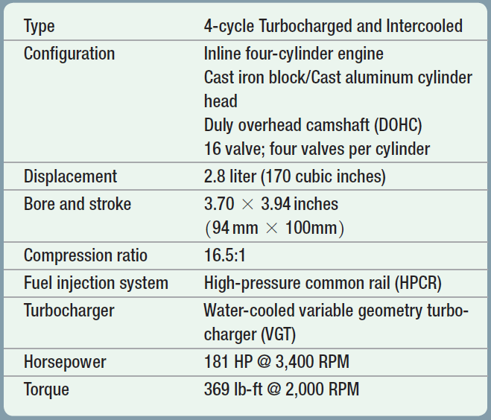
CHART 23-8 summary of technical specifications for 4-cylinder 2.8-liter Duramax diesel engine

Slide 23

What Happened to the 4.5-liter V-8 Duramax?
4.5-liter 72° V-8 was designed to be used in light duty pickup trucks and vans in 2009. However, economic situation in 2009 caused the project to be placed on hold. It was designed to produce 310 HP and 520 lb-ft of torque, and used SCR and piezoelectric
common-rail fuel system.

Slide 24
ENGINE MECHANICAL (1 of 5)
Cast Iron Engine Block
  90 degree “V” deep-skirted design
  Induction hardened cylinder tops for durability
  Date code is stamped on block
  “5227” stands for 227 day of 2005 (8/15/2005)
  “1200” stands for time block was built
    Engines built after this date use longer head bolts
    Engines built before this date use shorter head bolts

Slide 25
FIGURE 23–2 Cylinder induction hardening is not visible on this engine, but often seen on engines that have a lot of miles on them because upper third of cylinder walls are often different color.

Slide 26
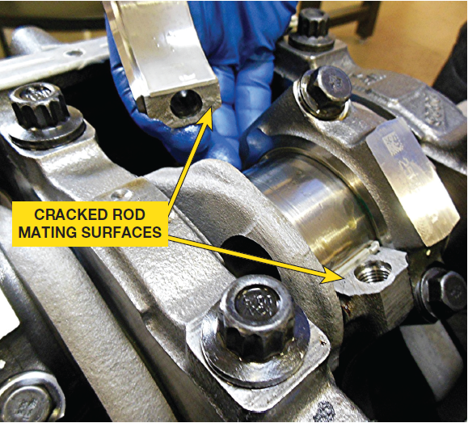
ENGINE MECHANICAL (2 of 5)
Crankshaft & Rods
  Forged steel crankshaft hardened BY “nitriding”
    Crankshaft covered in liquid nitrogen
  Supported on 5 main bearings using 4 bolt main bearing
    Extra two bolts from side through block
  Endplay controlled by rear thrust main bearing
  Rods forged & scored and snapped (broken)
    Create rough mating surface between cap & rod
    Rough surface makes it a perfect match

Slide 27
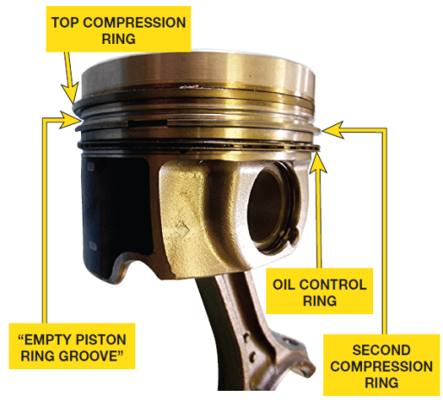
ENGINE MECHANICAL (3 of 5)
Pistons & Rings
  Forged Aluminum Piston With Unique Bowl
  Increase swirl for combustion
  2 compression rings and 1 oil control ring
  Ring groove W/NO ring between top & 2ND compression ring
    Groove helps reduce blow-by because expanding gases
    During combustion can expand into void space
    Acts as heat dam to prevent heat from combustion chamber
    Traveling to lower part of piston
    Called “empty piston ring groove”

Slide 28
FIGURE 23–3 connecting rods are scored and then broken. Cap stays secure because mating surfaces are perfectly matched.

Slide 29
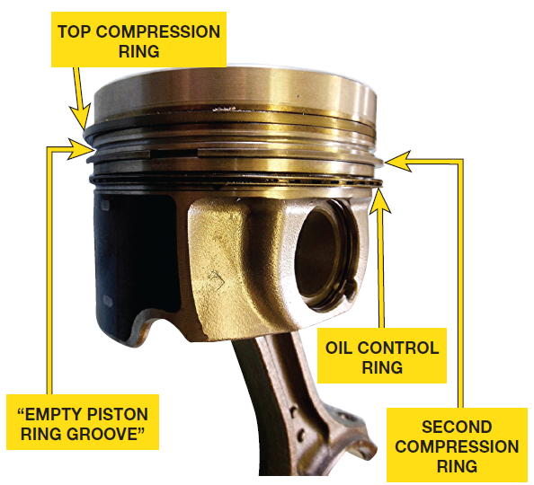
FIGURE 23–4 piston has 4 grooves for 3 piston rings, but one of 3 grooves is used as heat dam & often referred to as “empty piston ring groove”.

Slide 30
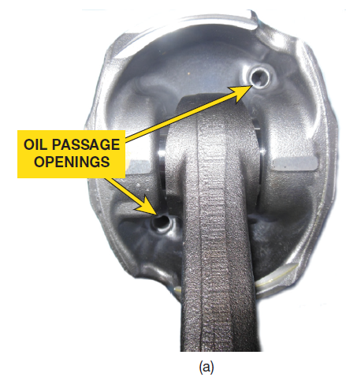
FIGURE 23–5 (a) openings on underside of piston are designed to allow engine oil to flow to head of piston.

Slide 31
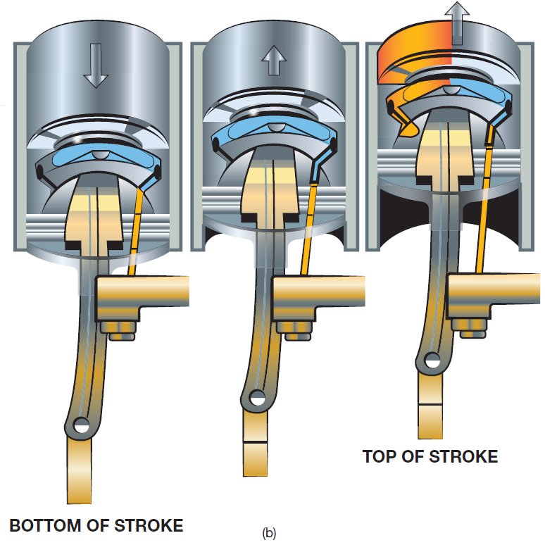
FIGURE 23–5 (b) oil squirters are used to keep head of pistons cooled because most of heat generated in engine is in combustion chamber. This heat needs to be transferred to the engine oil where it can be cooled by engine oil cooler.

Slide 32
What is a “Remelted Piston”?
The L5P Duramax diesel engine features cast aluminum pistons that have bowl rim of remelted piston used to reduce grain size of the aluminum and to create a more consistent grain structure for greater strength.

Slide 33

Case of the Tuner Program Gone Bad (1 of 2)
2-year-old Duramax engine was not running smoothly and had MIL on. A DTC check indicated stored P0300 (random misfire code) DTC . Technician verified that engine had noticeable misfire, plus noticed some engine noise. When one of the valve covers was removed to check for possible valve train-related issues, several bent pushrods were discovered. DSM discovered following: PCM had been reflashed 5 times, yet the factory program was currently installed. Engine had been operated up to 5,500 RPM, which is much higher than factory programming allowed. Based on these findings, the warranty was canceled. The customer was notified that while a hand-held tuner can be used to recalibrate the PCM to increase engine power, it does so by “taking emissions out of compliance” and can often cause engine damage as in this case. The owner decided to have engine repaired and left programming of PCM the same as when it left factory.

Slide 34
Case of the Tuner Program Gone Bad (2 of 2)
Summary:
Complaint—owner complained of a rough running engine and the check engine light was on.
Cause—engine had been operated at a speed that was higher than it was designed to operate,
Correction—bent pushrods were replaced, at the customer’s expense, which corrected the rough running engine concern

Slide 35
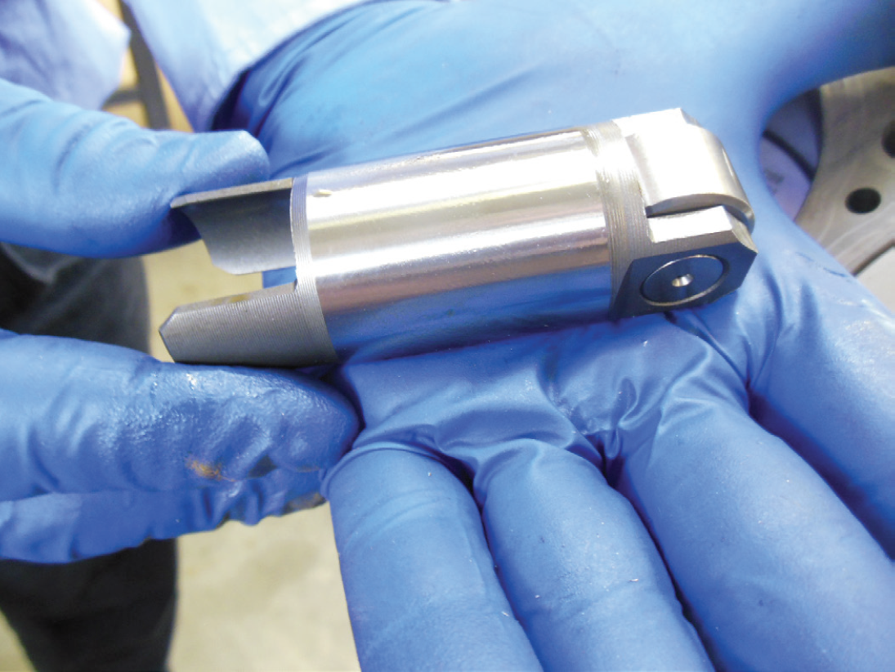
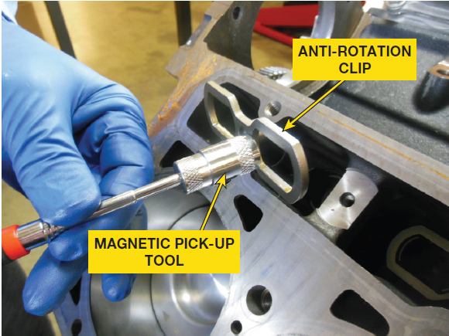
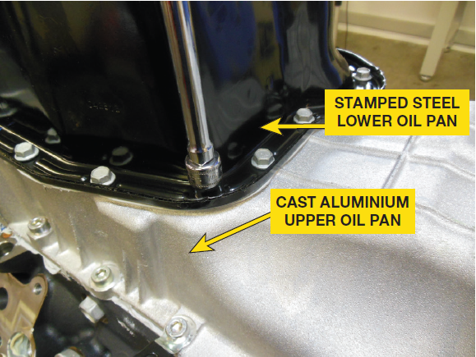
ENGINE MECHANICAL (4 of 5)
Valve Train
  Camshaft driven by a helical cut gear off crankshaft
  Roller solid lifters
  With anti-rotation clips
Oil Pan
  Upper pan cast aluminum
  Lower pan laminated steel
    Noise suppressant
    Oil level sensor

Slide 36
FIGURE 23–6 (a) Duramax diesel engine uses large diameter roller solid (non-hydraulic) valve lifters.

Slide 37
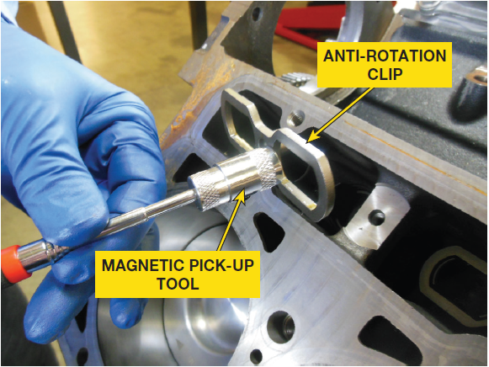
FIGURE 23–6 (b) To keep valve lifters from rotating in their bores, an anti-rotation clip is used that allows lifters to move up and down freely.

Slide 38

FIGURE 23–7 lower oil pan is stamped steel

Slide 39
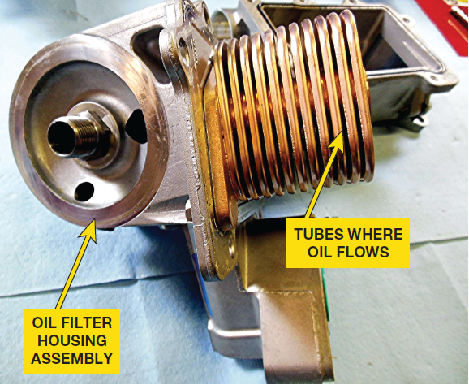
ENGINE MECHANICAL (5 of 5)
Oil Pump/Cooler
  Oil pump driven off crankshaft
  Regulator located on high pressure side of pump
  Reaches pressure piston moves uncovers bleed ports
  Oil pressure:
    1,000 RPM – 6 PSI (42 kPa) minimum
    2,000 RPM – 18 PSI (125 kPa) minimum
    4,000 RPM – 24 PSI (166 kPa) minimum

Slide 40
FIGURE 23–8 Oil cooler showing construction

Slide 41
COOLING SYSTEM (1 of 3)
Gear Driven Water Pump
  Mounted on left side of engine
  Driven by camshaft
    Uses Two Thermostats
    Primary & Secondary
  Primary Thermostat controls both bypass coolant flow
  Engine cold & flow though radiator when hot
  Primary starts to open at 180°F (82°C)
  Bypass is still open so flow split between
  Recirculated through engine & to radiator
  At 185°F (85°C), primary thermostat blocks
  Fully open at 203°F (95°C).

Slide 42
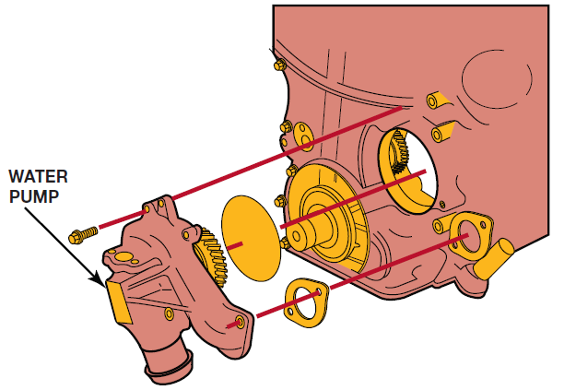
FIGURE 23–9 water pump gear driven by camshaft gear

Slide 43
FIGURE 23–10 (a) water pump assembly as it looks after removal from engine.

Slide 44
FIGURE 23–10 (b) impeller & bearing assembly as it is being removed from housing

Slide 45
COOLING SYSTEM (2 of 3)
Secondary Thermostat
  Used to restrict flow of coolant through radiator
  When closed
  Starts to open at 185°F (85°C)
  Fully open at 212°F (100°C).
  2 bleed holes must be correctly positioned
  For proper operation of cooling system

Slide 46
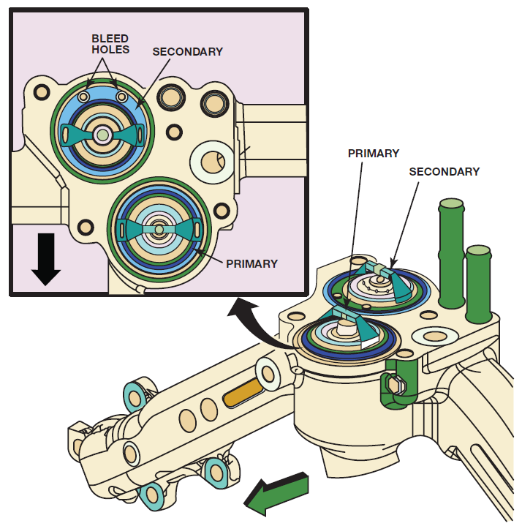
FIGURE 23–11 Duramax diesel engines use two thermostats, a primary and a secondary to precisely control engine temperature.

Slide 47
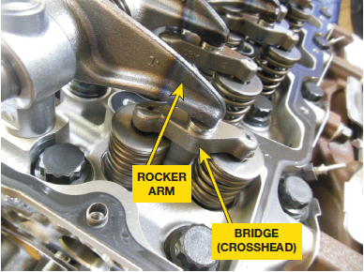
CYLINDER HEADS
Aluminum Cylinder Heads
  4 valves to cause swirl effect
  2 intake & 2 exhaust valves
  Operated by bridge (crosshead)
  Connects 1 rocker arm
  Open both valves same time
  Head Gaskets: Multilayered steel (MLS) gaskets

Slide 48
FIGURE 23–12 Rocker arms depress valve bridges which then open 2 valves at same time.

Slide 49
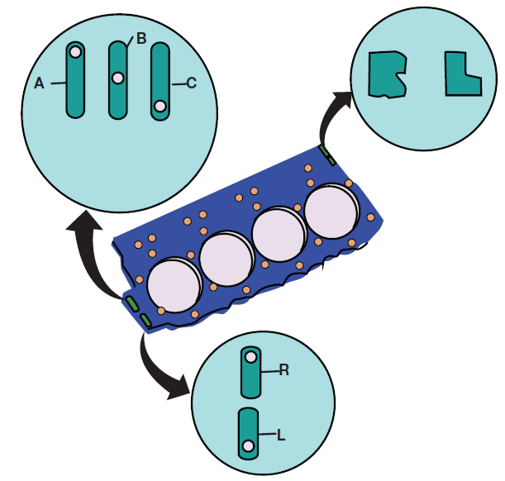
FIGURE 23–13 markings on head gasket include left (L) and right (R) heads, as well as thickness for LMM, LML and LGH Duramax diesel engines with location of a hole within an oval. Check service information for exact marking and specifications for engine being serviced.

Slide 50
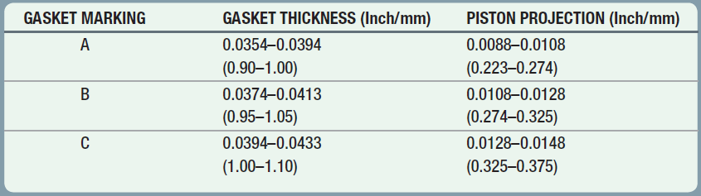
CHART 23-9 gasket thickness and piston intrusion (distance piston rises above block at TDC). This measurement seldom needed unless engine has been machined. In most cases, all that is needed is to replace head gasket with replacement of same thickness.

Slide 51
SERVICE INFORMATION
Engine Oil:
  API CJ-4, SAE 15W-40 under most conditions
  SAE 5W-40 < 0°F (–18°C)
  Coolant
    DEX-COOL mixed 50/50 with demineralized water
  Air Filter
    Restriction indicator, on air cleaner housing
    Indicator plunger green, air filter is useable
    Indicator plunger red, filter should be replaced

Slide 52

Quick and Easy Test for Diesel Fuel in the Oil
Using a clean paper towel is a quick and easy way to check for diesel fuel in engine oil. Remove dipstick and place end of it above a clean white paper towel. The engine oil dripped from end of dipstick will cause a dark spot in center. If there is diesel fuel in oil, this will spread out causing lighter area around oil spot.

Slide 53
LOW-PRESSURE SIDE
FUEL SYSTEM
Fuel Tank
  Fuel tank module in tank
    2 components:
      1. Pickup screen
      2. Fuel level sensor: resistance of 40 ohms empty, 250 ohms full
  Fuel Conditioning Module
    Fuel filter
    Water-in-fuel (WIF) sensor
    Located at bottom next to drain
    Manual primer pump
  Fuel Filter Replacement Page 279

Slide 54
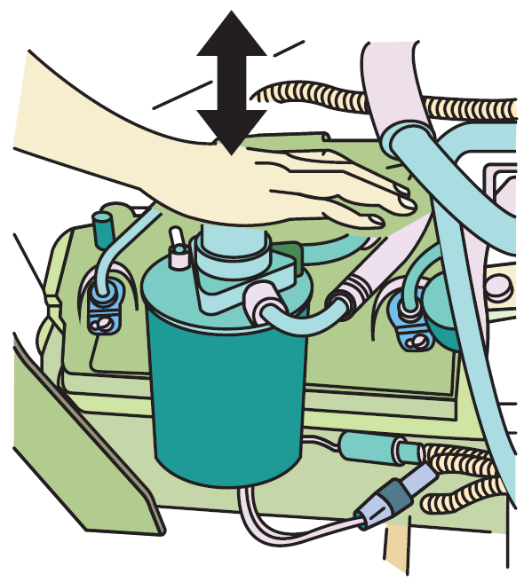
FIGURE 23–15 Depressing primer pump bleeds air from system.

Slide 55
FUEL AERATION
Aeration
  Low-pressure fuel system under vacuum
  Air can enter system, small holes, loose fittings
  Yet fuel will not leak
  Symptoms of Air: Page 279 of text
  Diagnosis of Fuel Aeration: Page 279 of text

Slide 56
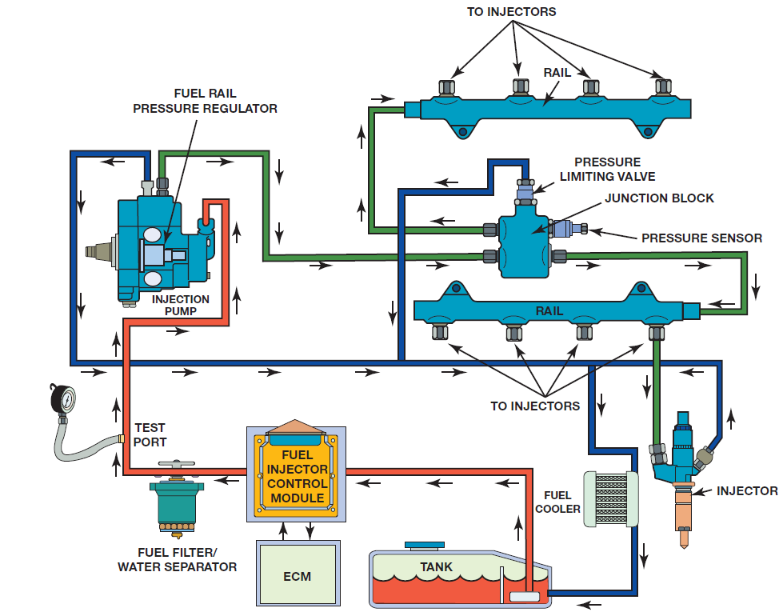
FIGURE 23–16 low-pressure fuel system on a Duramax is under a vacuum created by suction pump inside high-pressure fuel pump assembly.

Slide 57
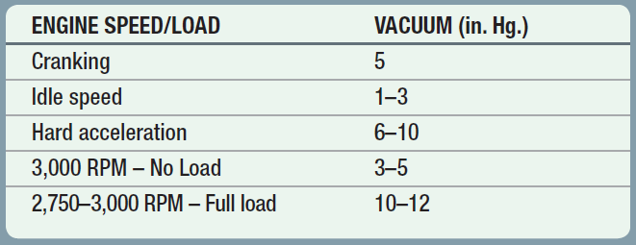
CHART 23-10: vacuum values when testing low side of Duramax diesel engine fuel system. If this vacuum test fails, it is usually due to a restricted fuel filter.

Slide 58
HIGH-PRESSURE FUEL
SYSTEM (1 of 4)
High-Pressure Fuel Pump (HPFP)
  Gear pump used to draw fuel from fuel tank
  3-cylinder design mounted to right head
  Timed to engine
  Delivers 2,900–29,000 PSI
  Fuel Rail Pressure Regulator (FRPR)
    Control Fuel Rail Pressure: Figure 23-16

Slide 59
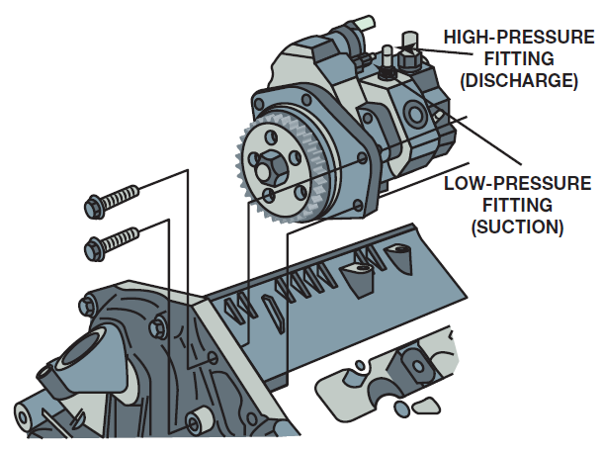
FIGURE 23–17 high-pressure fuel pump (HPFP) driven by camshaft gear at front of engine.

Slide 60
WARNING
High-pressure fuel lines deliver fuel under extreme pressures. Use extreme caution when looking for leaks as fuel under pressure may penetrate skin causing injury or death.

Slide 61
HIGH-PRESSURE FUEL
SYSTEM (2 of 4)
HPFP Flow
  Fuel drawn in by gear-type suction
  PCM pulses fuel pressure regulator (FPR)
  Meter amount of fuel entering pump pistons
  Pump pistons moved by lobes on gear driven shaft
  Each piston has its own outlet
  Both go to fuel rail on right bank
  Line from right fuel rail feeds left side fuel rail
  Injector Operation: Page 279 of text
    Piezo injectors controlled by PCM

Slide 62
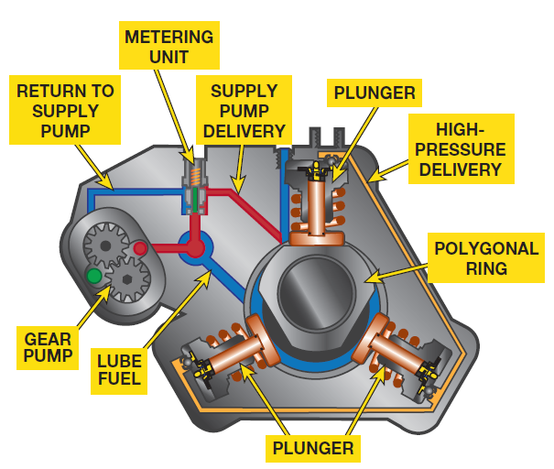
FIGURE 23–18 Green area represents fuel being drawn into pump. Orange area low-pressure fuel from suction pump, feeding fuel to high-pressure pistons and for lubrication. Red sections represent high-pressure fuel that is delivered to fuel lines. blue area is fuel return and lube circuit.

Slide 63
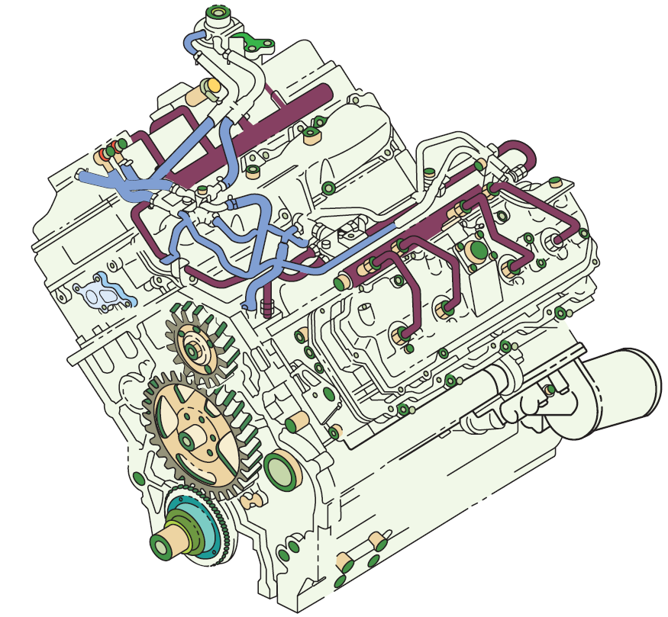
FIGURE 23–19 fuel high-pressure lines are highlighted to show how they are routed.

Slide 64
HIGH-PRESSURE FUEL
SYSTEM (3 of 4)
Duramax Injectors
  Controlled by ECM/PCM after 2006
  High-side (positive) driver & low-side (negative) driver
  Allows ECM/PCM monitor injector operation
  Run internal diagnosis
FICM (Fuel Injection Control Module)
  Early PCM used boost capacitor
  increase vehicle system voltage
  12 volts-250 volts 20 amperes power injectors
  Drivers located in FICM (PRIOR TO 2006 ENGINES)
  After 2006 in ECM

Slide 65
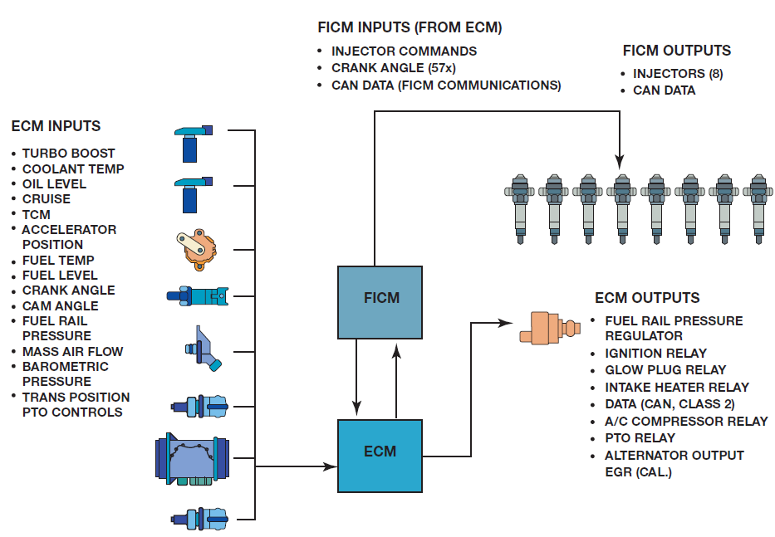
FIGURE 23–20 typical Duramax fuel control system showing the role of the ECM/PCM & FICM (EARLY ENGINES LB7 LBZ & LLY, Dropped in 2006 with Bosch ECM)

Slide 66
HIGH-PRESSURE FUEL
SYSTEM (4 of 4)
Fuel Injector
  Injector Quantity Adjustment (IQA) Code
  Marked on each injector
  Indicates flow rate of injector to WCM/PCM
  Programed into PCM
  Early Injectors Solenoid Controlled
  Late Model Piezo Controlled

Slide 67
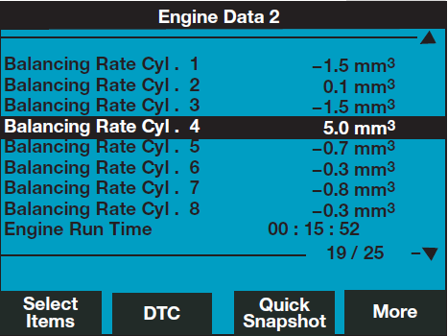
FIGURE 23–21 modifiers for each cylinder are displayed on scan tool and are shown in cubic millimeters (mm3).

Slide 68
GLOW PLUGS & EGR
Each Cylinder Has Glow Plug
  Less than one ohm of electrical resistance
  Draw 20 to 25 amperes each.
  glow plug control module (GPCM)
  Controls operation of glow plugs
Exhaust Gas Recirculation (EGR)
  Reduce NOx) emissions
  Uses two-wire stepper motor
  3-wire integrated position sensor
  PCM also cycles EGR 5 times at key-on
  Remove any built up soot

Slide 69
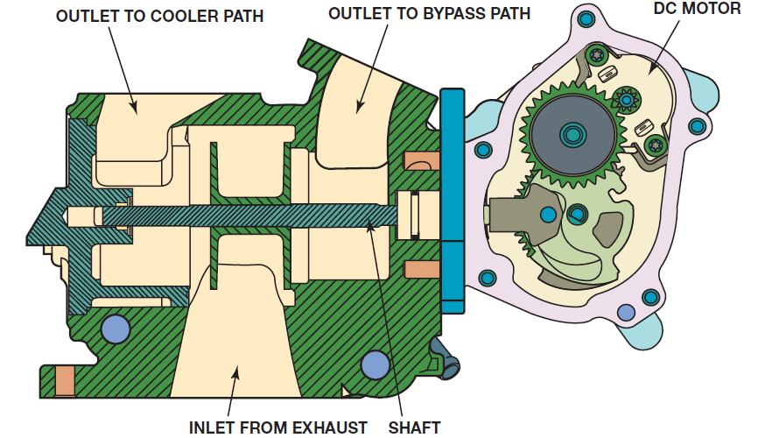
FIGURE 23–23 EGR valve is complex unit and includes passages that allow exhaust gases to bypass cooler when at idle speed and is located over rear of right head.

Slide 70
Case of the Limited Engine Speed (1 of 2)
Customer was concerned that 6.6 Duramax engine ran great, but would not rev over 2,200 RPM. service technician checked and did not find any stored DTC s or technical service bulletins (TSBs) that were related to this fault. A quick check with other technicians revealed that if the power take-off (PTO) button was in the “on” position, this would cause the engine to not rev higher than 2,200 RPM. The PTO button was found to be in “on” position and PTO speed set to 2,200 RPM. After turning PTO button to “off,” engine operated normally. ● SEE FIGURE 23–22.

Slide 71
Case of the Limited Engine Speed (2 of 2)
Summary:
Concern—Customer stated that diesel engine would not rev faster than 2,200 RPM.
Cause—power take-off (PTO) button was in “on” position, which limited maximum engine speed to 2,200 RPM
Correction—PTO button, located below climate controls in center of vehicle instrument panel, was turned to “off” and this solved customer concern.

Slide 72
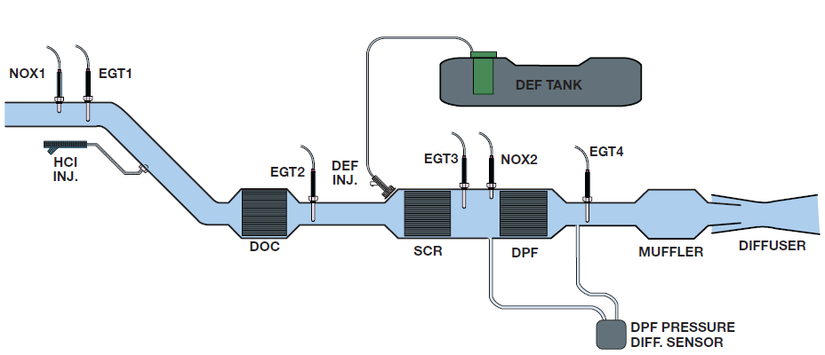
FIGURE 23–24 Snap-on scan tool screen shot of PTO status

Slide 73
DURAMAX DIESEL AFTERTREATMENT
SYSTEM (1 of 3)
Aftertreatment System
  Conform To Diesel Emissions:
    Non-methane hydrocarbons (NMHC)
    Carbon monoxide (CO)
    Oxides of nitrogen (NOx)
    Particulate matter (PM)

Slide 74
DURAMAX DIESEL AFTERTREATMENT
SYSTEM (2 of 3)
Components & Sensors: Pages 282-283
  NOX1, NOX2
  EGT 1, EGT 2, and EGT 3
  Diesel Particulate Filter (DPF)
  Diesel Oxidation Catalyst (DOC)
  HCI Injector
  SCR & Diesel Exhaust Fluid (DEF) injector
  Diesel Exhaust Fluid (DEF) Tank & Injector
  DEF Warning System

Slide 75
DURAMAX DIESEL AFTERTREATMENT
SYSTEM (3 of 3)
Page 284 of text
  Exhaust Fluid Low Speed Limited Soon..
  Exhaust Fluid Empty Refill Now Is Displayed
  Exhaust Fluid Quality Poor See Owners
  Manual Now
  Xxx Mile (Km) Until 65 Mph (105 Km/H) Max Speed
  Xxx Miles (Km) Until 55 Mph (88 Km/H) Max
  XXX MILES (KM)) UNTIL 4 MPH (7km/H MAX Speed

Slide 76
QUESTION? 1 (1 of 2)
What is the purpose and function of the fourth piston ring groove?

Slide 77
ANSWER 1 (1 of 2)
Ring groove W/NO ring between top & 2ND compression ring
  Groove helps reduce blow-by because expanding gases
  During combustion can expand into void space
  Acts as heat dam to prevent heat from combustion chamber
  Traveling to lower part of piston
  Called “empty piston ring groove”

Slide 78
QUESTION? 1 (2 of 2)
How does the fuel get to the high-pressure fuel pump from the fuel tank?

Slide 79
ANSWER 1 (2 of 2)
High-Pressure Fuel Pump (HPFP) uses a Gear pump used to draw fuel from fuel tank

Slide 80
Summary (1 of 4)
Duramax engines are built by a GM and Isuzu partnership company called DMAX, a joint venture in Moraine near Dayton in southwest Ohio.
All Duramax diesel engines used a cast iron block and aluminum cylinder heads.
The regular production option (RP O) code for Duramax engines changes with each version and includes LB7, LLY, LBZ, LLM, LML, LGH, and L5P.
The cylinder block is cast from grey iron and uses a deep skirt design. The cylinder area is induction hardened and then polished to increase wear resistance

Slide 81
Summary (2 of 4)
The crankshaft is supported on five main bearings using four bolt main bearing caps and an extra two bolts from the side through the block for added support.
The Duramax family of diesel engines uses two thermostats, a primary and a secondary.
There are three different thicknesses of head gaskets used and they are marked so that the correct replacement gasket can be used.
The specified engine oil to be used in Duramax diesel engines includes API CJ-4 with a viscosity of SAE 15W-40 under most conditions.

Slide 82
Summary (3 of 4)
From the fuel tank, fuel is drawn through the lines to the fuel conditioning module which contains the:
  Fuel filter
  Water-in-fuel (WIF) sensor and is located at the bottom of the filter next to the drain
  Manual primer pump
The high-pressure fuel pump (HPFP) used on a Duramax diesel engine includes a gear pump used to draw fuel from the fuel tank. The high-pressure pump is a 3-cylinder design and is mounted to the right front cylinder head, timed to the engine.

Slide 83
Summary (4 of 4)
The aftertreatment system on the 2007+ Duramax diesel engine allows it to conform to diesel emission regulations pertaining to:
  Non-methane hydrocarbons (NMHC)
  Carbon monoxide (CO)
  Oxides of nitrogen (NOx)
  Particulate matter (PM)
When the diesel exhaust fluid (DEF) level is getting low, range remaining will be displayed in either miles or kilometers.

