Slide 1

Light Vehicle Diesel Engines
First Edition
Chapter 3
Diesel Cylinder Heads & Valve Trains
Copyright © 2018, 2015, 2011 Pearson Education, Inc. All Rights Reserved

Slide 2
LEARNING OBJECTIVES (1 of 2)
3.1 Prepare for the Light Vehicle Diesel Engine (A9) ASE certification test content area “B” (Cylinder Head and Valve Train Diagnosis and Repair).
3.2 Explain the design and construction of cylinder heads.
3.3 Discuss camshaft design and valve train component operation.

Slide 3
LEARNING OBJECTIVES (2 of 2)
3.4 Discuss the purpose and function of rocker arms and bridges.
3.5 Discuss the purpose, function, and operation of hydraulic valve lifters.
3.6 Describe how to disassemble a cylinder head.
3.7 Discuss valve-stem-to-guide clearance.

Slide 4
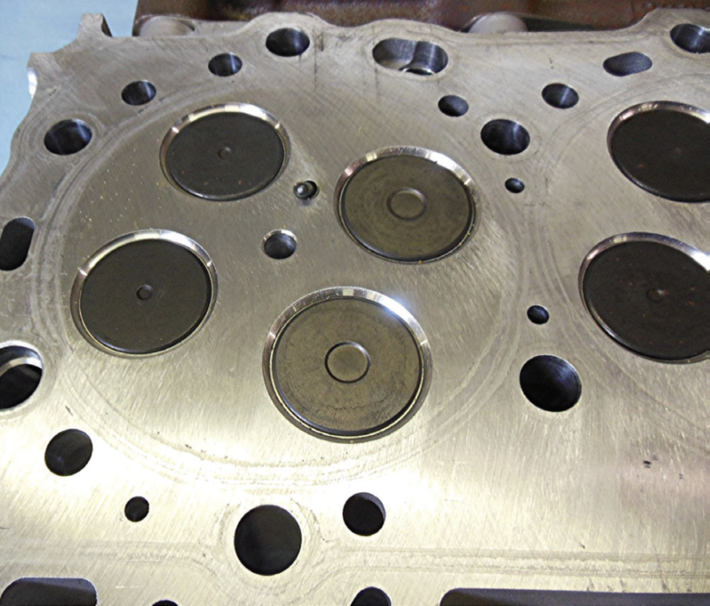
CYLINDER HEADS (1 of 4)
Cylinder Heads
  Cast iron or aluminum alloy
  Support valves & valve train
  Passages: intake air, exhaust gases, coolant
    Overhead camshaft design
    Supports all of the valve train components

Slide 5
FIGURE 3–1 (A) Aluminum GM Duramax v-8 diesel engine cylinder head.

Slide 6
CYLINDER HEADS (2 of 4)
Diesel Engines
  Two-valve configuration
    1 intake valve & 1 exhaust valve
    4-stroke engines
  Current designs are 4-VALVE type
    2 intake valves & 2 exhaust valves
    Adding more than 2 valves per cylinder permits more air flow into and out of engine
  Valve Duration
    Number of degrees by which crankshaft rotates when valve is off valve seat

Slide 7
FIGURE 3–1(B) Cast iron Cummins 6.7 liter inline six cylinder diesel engine cylinder head.

Slide 8
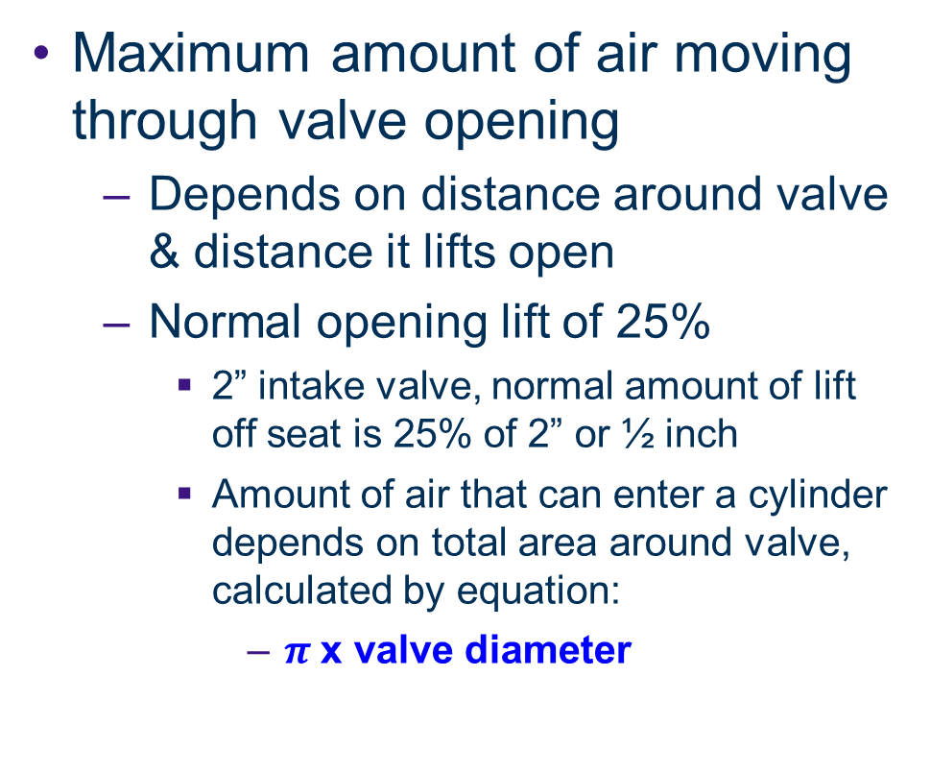
CYLINDER HEADS (3 of 4)
Maximum amount of air moving through valve opening
  Depends on distance around valve & distance it lifts open
  Normal opening lift of 25%
    2” intake valve, normal amount of lift off seat is 25% of 2” or ½ inch
    Amount of air that can enter a cylinder depends on total area around valve, calculated by equation:
      $π$x valve diameter

Slide 9
FIGURE 3–2 Four valve cylinder head from a Fiat Chrysler 3.0 liter diesel engine.

Slide 10
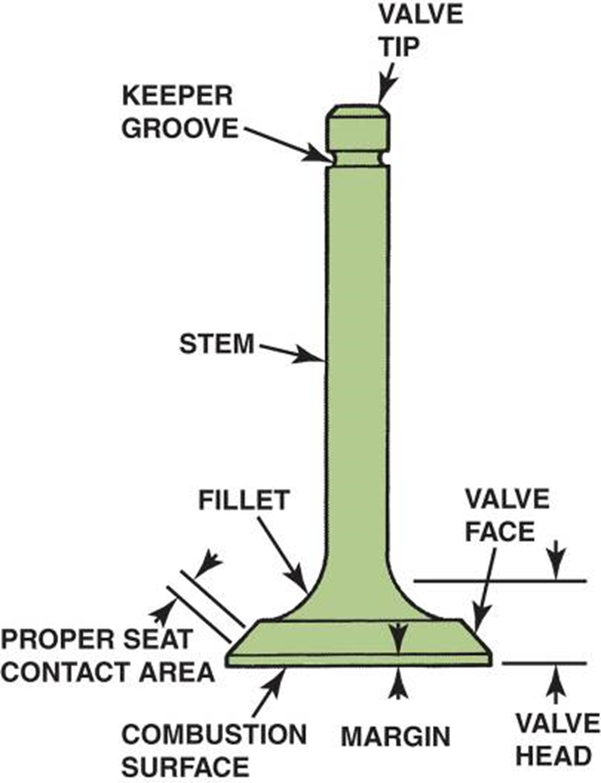
INTAKE AND EXHAUST VALVES (1 of 2)
Intake Valves
  Control Inlet Of Cool, Low-pressure Induction Charges.
Exhaust Valves
  Handle Hot, High-pressure Exhaust Gases.
    Parts Involved
    Valve Size Relationships
    Valve Materials
    Two-material Valves
    Sodium-filled Valves

Slide 11
FIGURE 3–3 Identification of the parts of a valve.

Slide 12
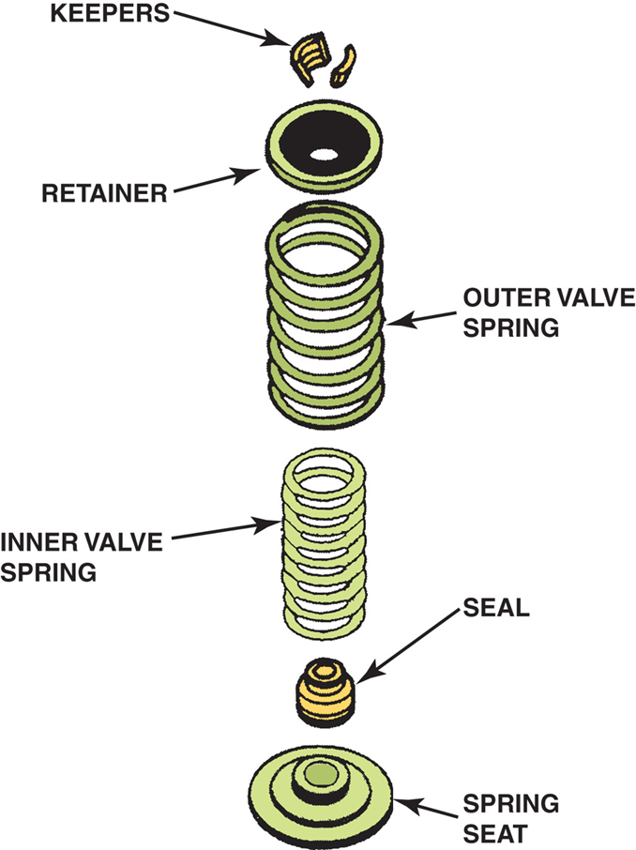
FIGURE 3-4 Typical valve spring and related components. Dual valve springs are used to reduce valve train vibrations and a spring seat is used to protect aluminum heads.

Slide 13
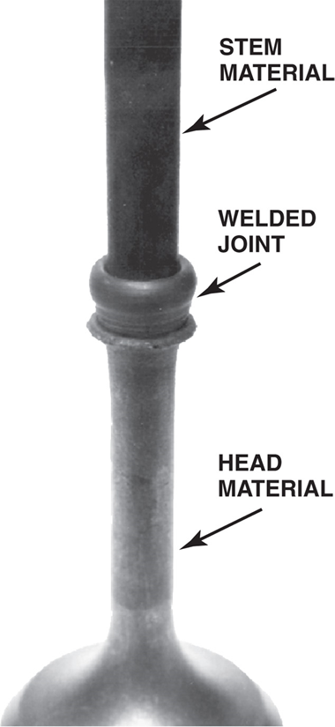
FIGURE 3–5 Inertia welded valve stem and head before machining.

Slide 14
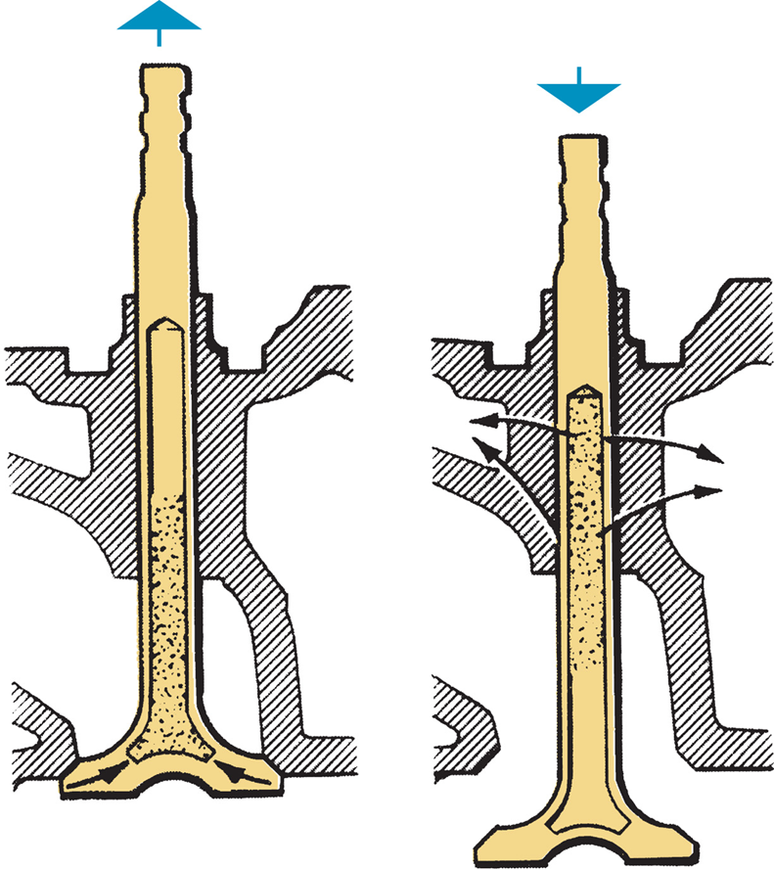
FIGURE 3–6 Sodium-filled valve uses a hollow stem, which is partially filled with metallic sodium (a liquid when hot) to conduct heat away from the head of the valve.

Slide 15
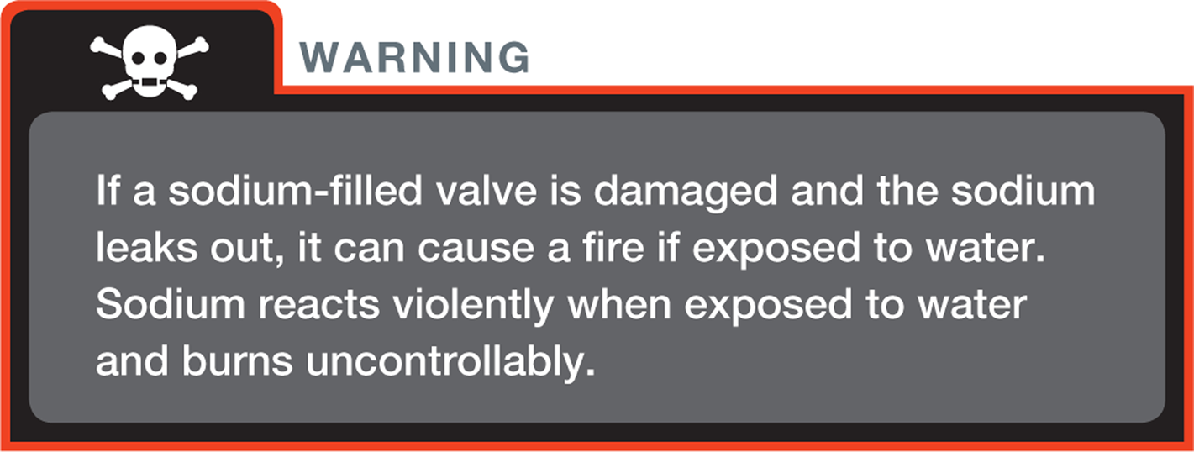
WARNING (1 of 2)

Slide 16
QUESTION 1: ?
Why are Sodium filled valves used?

Slide 17
ANSWER 1:
Sodium-filled valve uses hollow stem, which is partially filled with metallic sodium (a liquid when hot) to conduct heat away from head of valve.

Slide 18
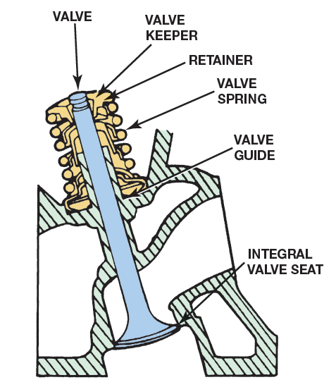
VALVE SEATS (1 of 3)
Valve Face Closes Against Valve Seat
  Seal combustion chamber.
  Seat is generally formed as part of cast-iron head
  Called an integral seat.
  Insert seat fits into a machined recess in
    Steel or aluminum cylinder head.
  Insert seats
    Used in all aluminum head engines
    Applications for which corrosion & wear resistance are critical

Slide 19
FIGURE 3-7 Integral valve seats are machined directly into the cast-iron cylinder head and are induction hardened to prevent wear.
Seats induction hardened to minimize
Valve recession as engine operates. Wearing away of seat results in valve recession, causing valve to sit further
Into cylinder head

Slide 20
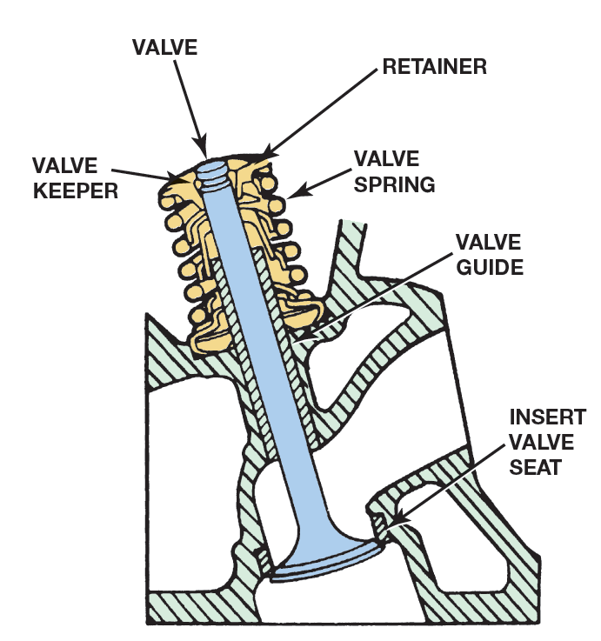
FIGURE 3–8 Insert valve seats are a separate part that is interference fitted to a counterbore in the cylinder head..

Slide 21
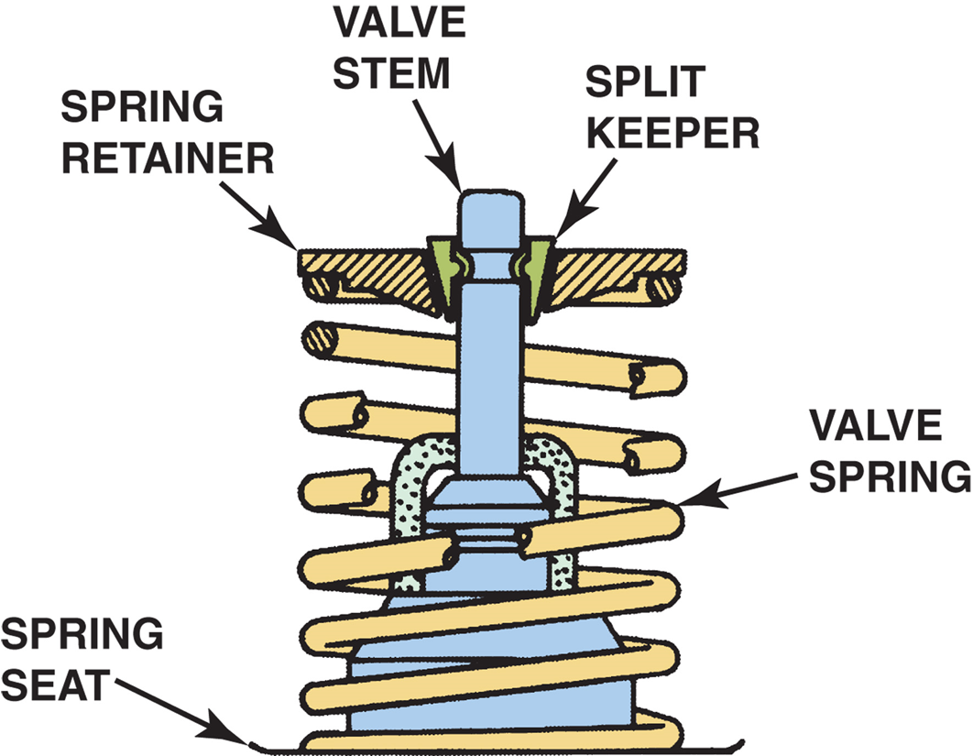
VAVLE SPRINGS (1 of 1)
Valve Spring Holds
  Valve against seat when valve not being opened
  One end of valve spring is seated against head
  Other end of spring attached under compression
  To valve stem through valve spring retainer
  & valve spring keeper (lock)
    Spring Materials and Design
    Variable Rate Springs
    Valve Spring Inspection

Slide 22
FIGURE 3–9 A retainer and two split keepers hold the spring in place on the valve. A separate metal washer is used to prevent the valve spring from wearing into the aluminum cylinder head on aluminum heads. On cast iron heads, the spring seat is a machined area in the head.

Slide 23
QUESTION 2: ?
Where do you position the close coil of a valve spring?

Slide 24
ANSWER 2:
Toward the cylinder head.

Slide 25
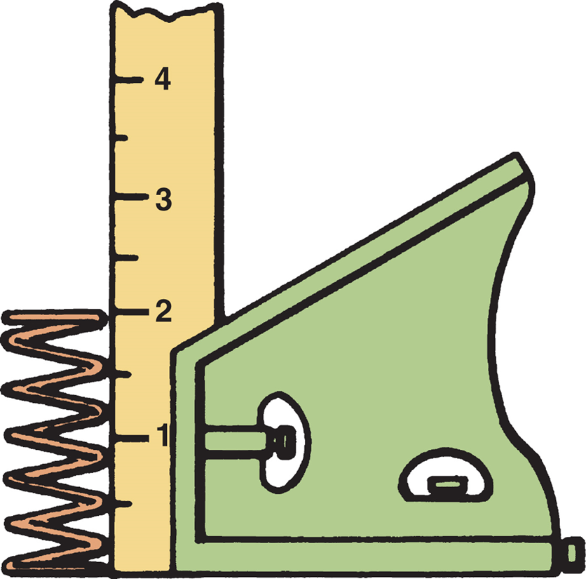
FIGURE 3–10 All valve springs should be checked for squareness by using a square on a flat surface and rotating the spring while checking.

Slide 26
FIGURE 3–11 one popular type of valve spring tester used to measure compressed force of valve springs. Specifications usually include (1) free height (height without being compressed), (2) pressure at installed height with valve closed, and (3) pressure with valve open to height specified.

Slide 27
CYLINDER HEAD PASSAGES (1 of 3)
Coolant flows from coolest portion of engine
  To warmest portion
  water pump circulates coolant from radiator
  Through block around cylinders
  Flows upward through head gasket to head
  Returned to radiator to be cooled

Slide 28
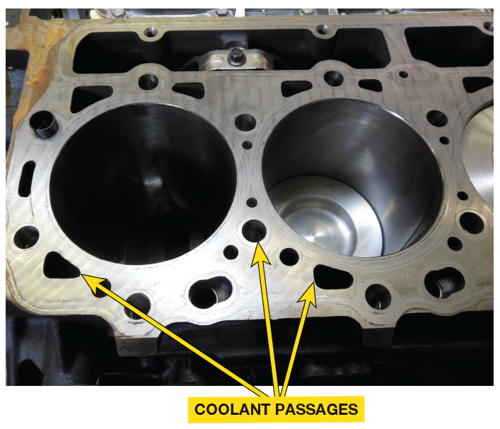
FIGURE 3–12 Coolant passages on a Duramax diesel engine block.

Slide 29
CYLINDER HEAD PASSAGES (2 of 3)
Lubricating oil delivered to OHV
  Through pushrods, or through drilled passages
  Special openings in head gasket for oil
  After the oil passes through valve mechanisms
  returns to pan through oil return passages
    Called drainback holes
    Cast holes are large and not easily plugged

Slide 30
CYLINDER HEAD PASSAGES (3 of 3)
NOTE: Many aluminum cylinder heads have smaller than-normal drain back holes. If an engine has excessive oil consumption, check the drain holes as a possible cause before removing engine.

Slide 31
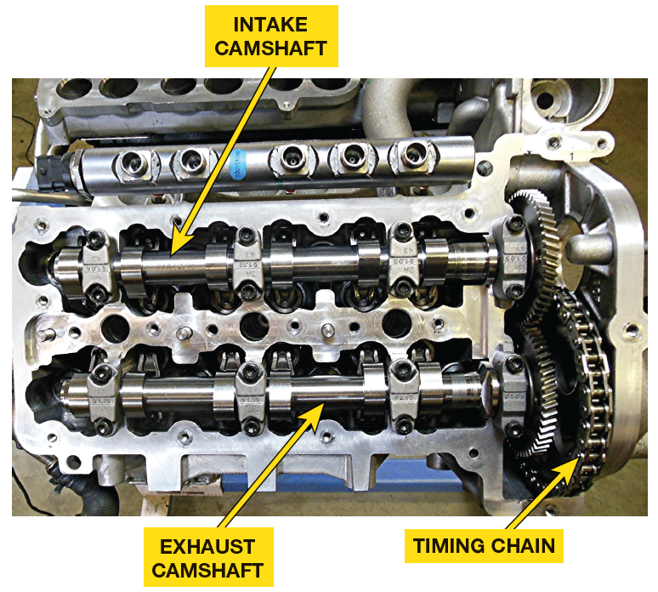
CAMSHAFT (1 of 7)
Camshaft opens valves
  Eccentric shapes called lobes
  Open valve against force of valve springs.
  Valve spring closes valve when
  Camshaft rotates off lobe
  Camshaft lobe changes rotary motion (camshaft)
    To linear motion (valves).
  Cam shape or contour is major factor
    Determining operating characteristics of engine

Slide 32
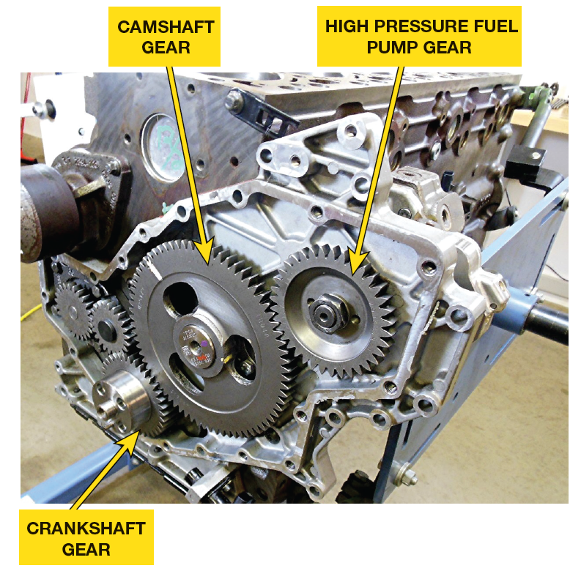
CAMSHAFT (2 of 7)
Camshaft Driven By
  Timing gears
  Timing chains
  Timing belts

Slide 33
FIGURE 3–13 Cummins 6.7 liter inline six-cylinder diesel camshaft is driven by a gear from the crankshaft.

Slide 34
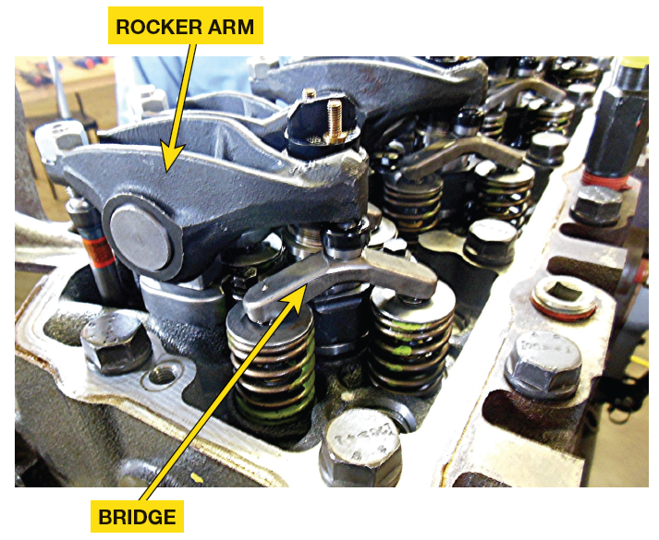
CAMSHAFT (3 of 7)
Camshaft Located
  IN Engine Block
    Cam-in-block Design
      Camshaft supported in block by bearings,
      Driven by crankshaft with gear/sprocket
      Pushrod or overhead valve (OHV) engines

Slide 35
CAMSHAFT (4 of 7)
Overhead CAM
  Belt or chain driven from crankshaft
  Located in head(s)
  Called overhead camshaft (OHC) design
  Single overhead camshaft for each bank SOHC
  2 overhead camshafts per bank
  SEE FIGURE 3–14

Slide 36
FIGURE 3–14 Fiat-Chrysler 3.0 liter V-6 diesel engine that has double overhead camshafts. Exhaust camshaft is driven by a chain from crankshaft and intake camshaft is driven by a gear off exhaust camshaft.

Slide 37
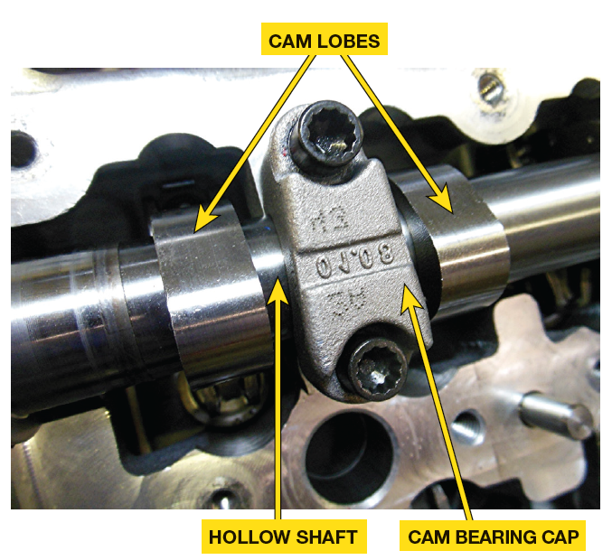
CAMSHAFT (5 of 7)
Construction
  Lobes
  Bearing journals
  Accessory drive gear
Other types of construction:
  Forged steel (often used in diesel engines)
  Steel machined from a solid billet
  Composite camshafts
    Lightweight tubular shaft with hardened steel lobes, SEE Figure 3-15

Slide 38
FIGURE 3–15 Hardened steel lobes are a press-fit onto the hollow steel tube to create a composite camshaft that is both light weight and flexible as well.

Slide 39
CAMSHAFT (6 of 7)
NOTE: Rockwell is a type of hardness test, and the represents the scale used. Higher the number is, harder surface. Abbreviation Rc60, indicates Rockwell hardness of 60 as measured on “c” scale

Slide 40
QUESTION 3: ?
What are eccentric shapes on Camshafts called ?

Slide 41
ANSWER 3:
Lobes

Slide 42
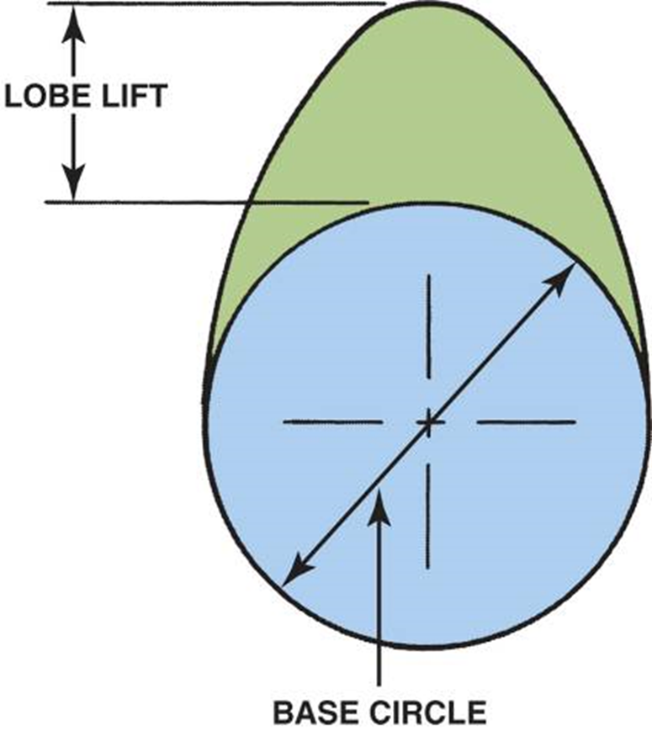
FIGURE 3–16 Lobe lift is the amount the cam lobe lifts the lifter. The blue circle is called the base circle.
Camshaft lobes
  in overhead valve (OHV) engines lubricated by splash oil
  thrown up by movement of the crankshaft
  At low engine speed, there is less splash lubrication than occurs at higher engine speeds.

Slide 43

CAMSHAFT (7 of 7)
Lobe Lift
  Higher lift of camshaft lobe
    Greater amount of air that can enter engine
    More air in engine, greater the power
  Lift Amount different for
    Intake and exhaust valves
  Asymmetrical if specifications vary
  Symmetrical if lift is same

Slide 44
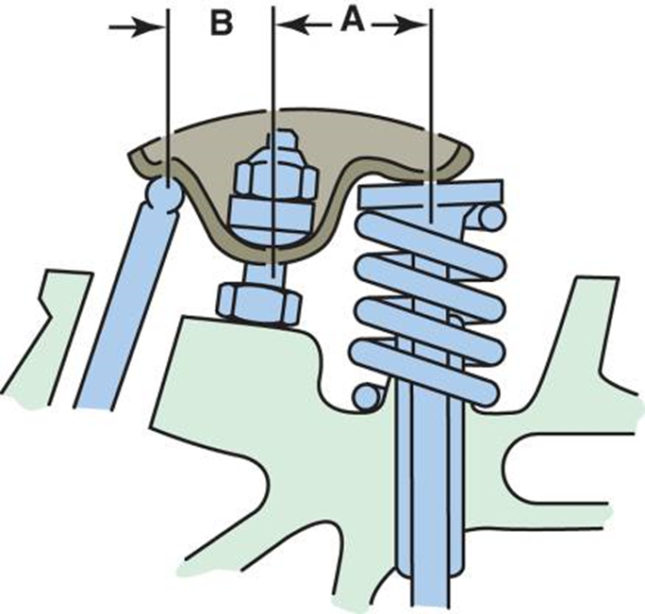
ROCKER ARMS &
BRIDGES (1 of 3)
Rocker Arm
  Reverses upward movement of pushrod
  Produce downward movement on tip of valve
  Designed to reduce travel of cam follower
    Or Lifter & pushrod while maintaining required lift
  Done by using rocker arm ratio usually of 1.5:1.

Slide 45

ROCKER ARMS &
BRIDGES (2 of 3)
Rocker arms may be
  Cast
  Forged
  Stamped steel

Slide 46

FIGURE 3–17 1.5:1 ratio rocker arm means that dimension
A is 1.5 times length of dimension B. Therefore, if pushrod is moved up 0.4 inch by camshaft lobe, the valve will be pushed down (opened) 0.4 inch 3 1.5, or 0.6 inch.

Slide 47
ROCKER ARMS &
BRIDGES (3 of 3)
Bridges
  Also called Crossheads, LIKE rocker arms
  Used in diesel engines to span 2 valves
  From one pushrod
  Can be bent causing one of 2 valves to open less/more than other valve
  Valve clearance needs to be checked to make sure bridges are straight not warped or bent

Slide 48
FIGURE 3–18 Bridges are used in many light diesel engines so that one rocker arm can operate 2 valves, which simplify valve train when 4 valves per cylinder heads are used in a cam-in-block engine.

Slide 49
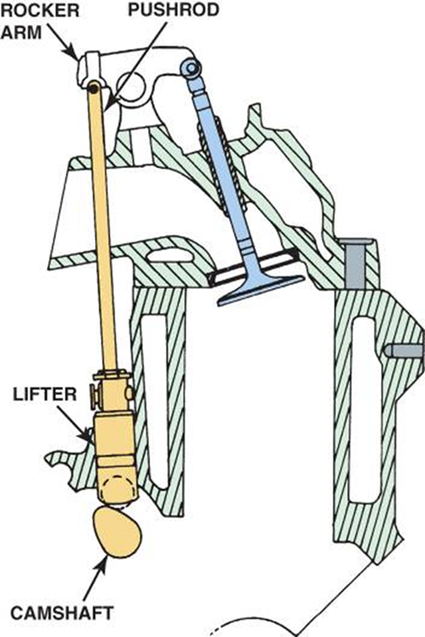
PUSHRODS (1 of 3)
Pushrods
  Transfer lifting motion of valve train
  from cam lobe and lifters to rocker arms

Slide 50
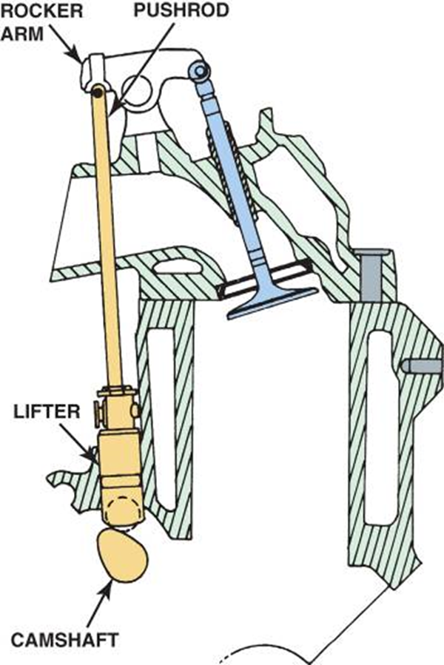
FIGURE 3–19 Overhead valve engines are also known as pushrod engines because of the long pushrod that extends from the lifter to the rocker arm.

Slide 51
PUSHRODS (2 of 3)
Pushrods
  Designed to be as light as possible
  Solid or hollow
  Used as passages for oil
  to lubricate rocker arms, they must be hollow
  Use convex ball on lower end that seats in lifter
  Rocker arm end is also a convex ball

Slide 52
PUSHRODS (3 of 3)
Pushrods
  One of following changes made to engine, different pushrod length may be necessary:
    Block deck height machined
    Cylinder head deck height machined
    Valve length increased (seats being ground)

Slide 53
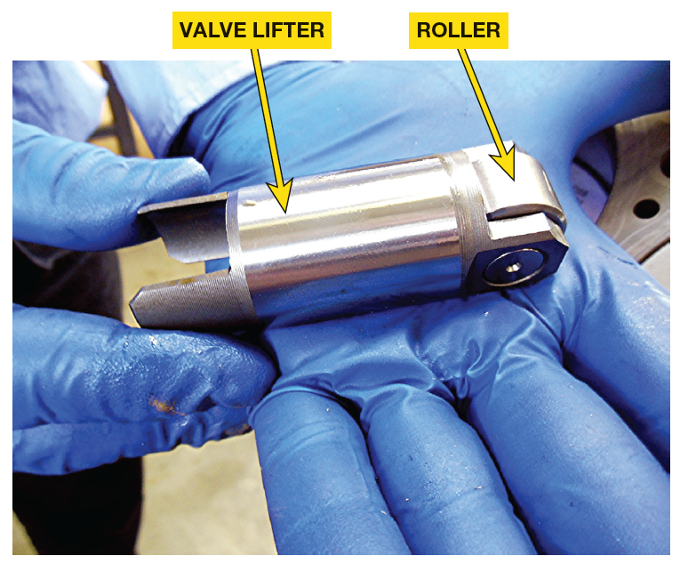
LIFTER OR TAPPETS (1 of 3)
Valve Lifters or Tappets
  Follow contour or shape of camshaft lobe
  Changes rotary cam motion to Reciprocating motion in valve train
  Diesel engines use roller lifters

Slide 54
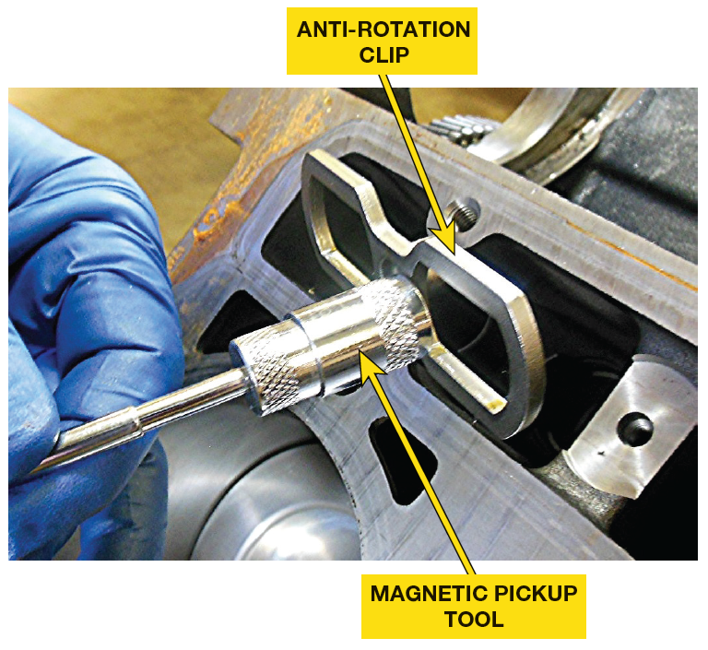
FIGURE 3–20(A) Duramax diesel engine anti-rotation clip used to keep roller lifter from turning in its bore so that roller will always be rotating along lobes of cam. Duramax uses non-hydraulic roller lifters.

Slide 55
LIFTER OR TAPPETS (2 of 3)
Valve Adjustment
  Two methods used
    One method involves solid valve lifter, adjusted mechanically at rocker arm, or by changing shims
    Other method involves lifter with automatic hydraulic adjustment built into lifter body, hydraulic valve lifter

Slide 56
FIGURE 3–20(B) A lifter from a Duramax that shows the large size compared to a lifter from a typical gasoline-powered engine.

Slide 57
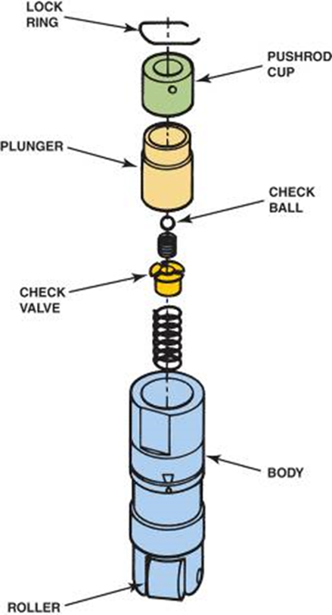
LIFTER OR TAPPETS (3 of 3)
HYDRAULIC LIFTERS
  Take up all clearance in valve train
    Hollow cylinder body enclosing hollow plunger, check valve, & pushrod cup.
  Lifters feed oil up through pushrod use metering disc under pushrod cup
  Engine oil under pressure fed through engine passage to exterior lifter body.
  Undercut portion allows oil under pressure to surround Lifter body
  Oil under pressure goes through holes in undercut section
    Into center of plunger

Slide 58

FIGURE 3–21 exploded view of hydraulic roller lifter

Slide 59

CAMSHAFT REMOVAL (1 of 2)
CAM-IN-BLOCK ENGINES
  Overhead valve (OHV) design
  Camshaft located in block above crankshaft
  Timing chain & gears should be removed
  After timing chain (gear) cover is removed
  Loosen rocker arms (or rocker arm shaft)
  Remove pushrods
  Remove valve lifters before removing camshaft

Slide 60
CAMSHAFT REMOVAL (2 of 2)
NOTE: Be sure to keep each pushrod and rocker arm matched together if they are to be reused.

Slide 61
CYLINDER HEAD DISASSEMBLY (1 of 4)
Cylinder Head Servicing Sequence
Disassembling Overhead Camshaft Head
Valve Train Disassembly
Cylinder Head Inspection

Slide 62
CYLINDER HEAD DISASSEMBLY (2 of 4)
Cylinder Head Disassembly
  Valve train components to be reused
    Must be kept together
      Be sure to keep top part of pushrod at top.
      Keep rocker arms with same pushrods
        As they wear together.
      Intake and exhaust valve springs can be different
      Must be kept with correct valve

Slide 63
WARNING (2 of 2)
Cast-iron Cummins inline six-cylinder head is very heavy, requiring an engine hoist to remove it from the block. Attempting to lift the head without help or a hoist could result in personal injury.

Slide 64
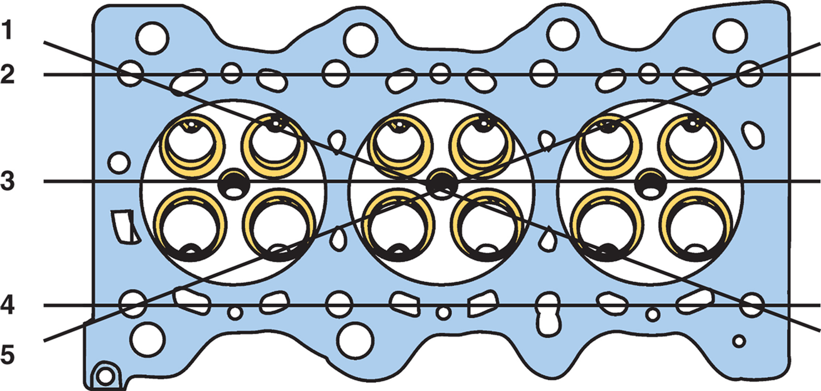
CYLINDER HEAD DISASSEMBLY (3 of 4)
Cylinder Head Inspection
  STEP 1 After removing old gasket material, use file & draw it across surface of head to remove any small burrs.
  STEP 2 head should be checked in 5 planes. Checking cylinder head gasket surface in 5 planes checks head for warpage, distortion, bend, & twist.

Slide 65

FIGURE 3–22 Cylinder heads should be checked in five planes for warpage, distortion, bend, and twist.

Slide 66
CYLINDER HEAD DISASSEMBLY (4 of 4)
Injector Tips & Pre-chambers
  Protruded injector, or nozzle tip
    Must be measured & compared to specs
    Protrusions, which could include a pre-chamber on older indirect light vehicle diesel engines, must be checked & corrected if necessary when cylinder head is machined.

Slide 67
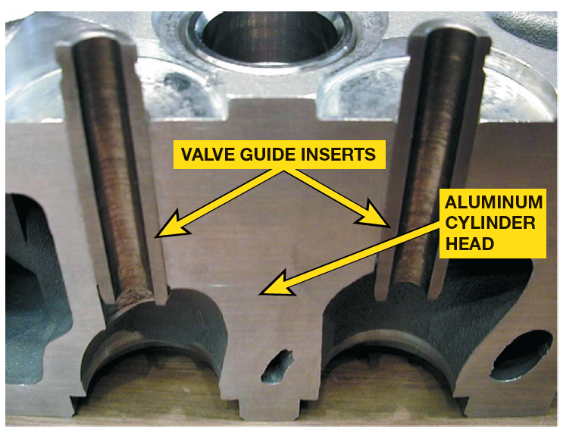
FIGURE 3–23 All aluminum cylinder heads use valve guide inserts.

Slide 68
FIGURE 3–24 A small-hole gauge and a micrometer are being used to measure the valve guide. The guide should be measured in three places: at the top, middle, and bottom.

Slide 69
FIGURE 3–25 Diameter of the valve stem is being measured using a micrometer. The difference between the inside diameter of the valve guide and the diameter of the valve stem is the valve guide-to-stem clearance.

Slide 70
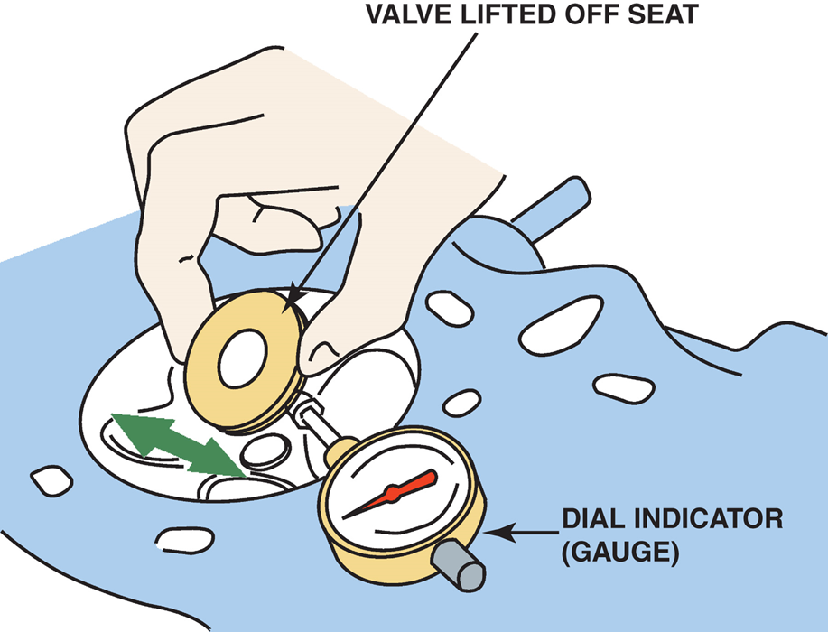
FIGURE 3-26 Measuring valve guide clearance
Measuring valve guide-to-stem clearance with dial indicator while rocking stem in direction of normal thrust. Reading on dial indicator should be compared to specifications because it does not give guide-to-stem clearance directly. Valve is usually held open to its maximum operating lift. After checking in this direction, rotate dial indicator and measure movement 90 degrees from what is shown.

Slide 71
Summary (1 of 4)
Camshaft rotates at one-half crankshaft speed.
On overhead valve engines, camshaft is usually placed in the block above the crankshaft.
Overhead camshaft engines use 1 or 2 camshafts located in cylinder head above cylinders, and called single overheard camshaft (SOHC) engines or double overhead camshaft (DOHC) engines, depending on design.

Slide 72
Summary (2 of 4)
Lobes of camshaft are usually lubricated by splash lubrication.
Valve lift is usually expressed in decimal inches and represents distance that valve is lifted off valve seat.
In many engines, camshaft lobe lift is transferred to tip of valve stem to open valve by use of a rocker arm or follower.

Slide 73
Summary (3 of 4)
Valve train clearance is also called valve lash, which is needed to help compensate for thermal expansion and wear.
Pushrods transfer camshaft lobe movement upward from camshaft to rocker arm.
Camshaft duration is number of degrees of crankshaft rotation for which valve is lifted off seat.
Coolant and lubricating openings and passages are located throughout most cylinder heads.

Slide 74
Summary (4 of 4)
Removing cylinder head is achieved by first loosening all of head bolts in reverse order of tightening sequence.
Head should be checked in 5planes. Checking cylinder head gasket surface in 5planes checks head for warpage, distortion, bend, and twist.
Valve guides should be checked for wear using a ball gauge or dial indicator. Typical valve stem-to-guide clearance is 0.001 to 0.003 inch for intake valves & 0.002 to 0.004 inch for exhaust valves.

