Slide 1
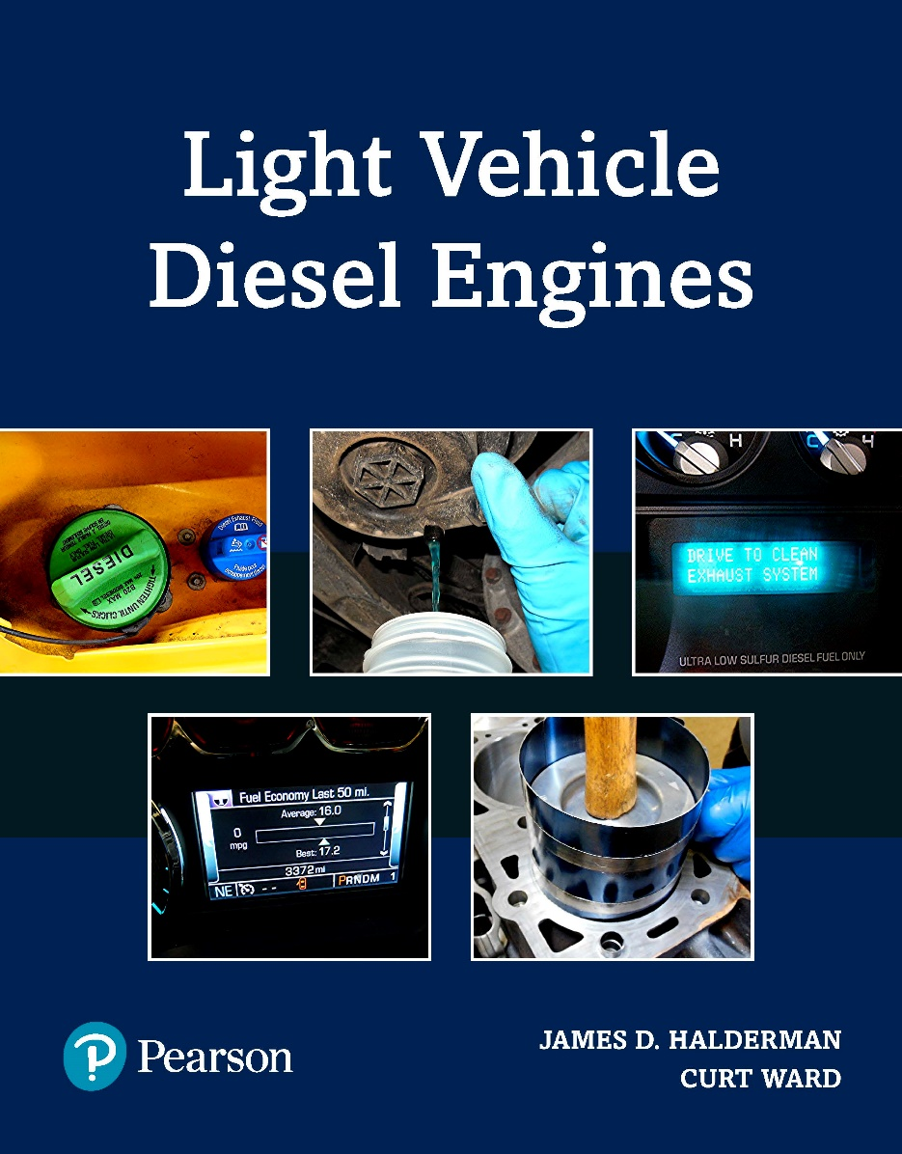
Light Vehicle Diesel Engines
First Edition
Chapter 4
Diesel Engine Lubrication Systems
Copyright © 2018, 2015, 2011 Pearson Education, Inc. All Rights Reserved

Slide 2
LEARNING OBJECTIVES (1 of 2)
4.1 Prepare for the Light Vehicle Diesel Engine (A9) ASE certification test content area “D” (Lubrication and Cooling Systems Diagnosis and Repair).
4.2 Describe the operation of oil pumps.
4.3 Discuss the purpose and function of oil coolers.
4.4 Explain the purpose of engine oil and engine oil additives.

Slide 3
LEARNING OBJECTIVES (2 of 2)
4.4 Discuss the properties of engine oil.
4.5 Discuss SAE and API rating oil ratings.
4.6 Discuss the purpose and function of oil filters.
4.7 Describe the oil change procedure.

Slide 4
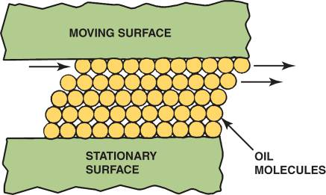
LUBRICATING PRINCIPLES (1 of 3)
Lubrication between 2 moving surfaces results from an oil film that separates surfaces and supports load

Slide 5

Figure 4–1 Oil molecules cling to metal surfaces but easily slide against each other

Slide 6
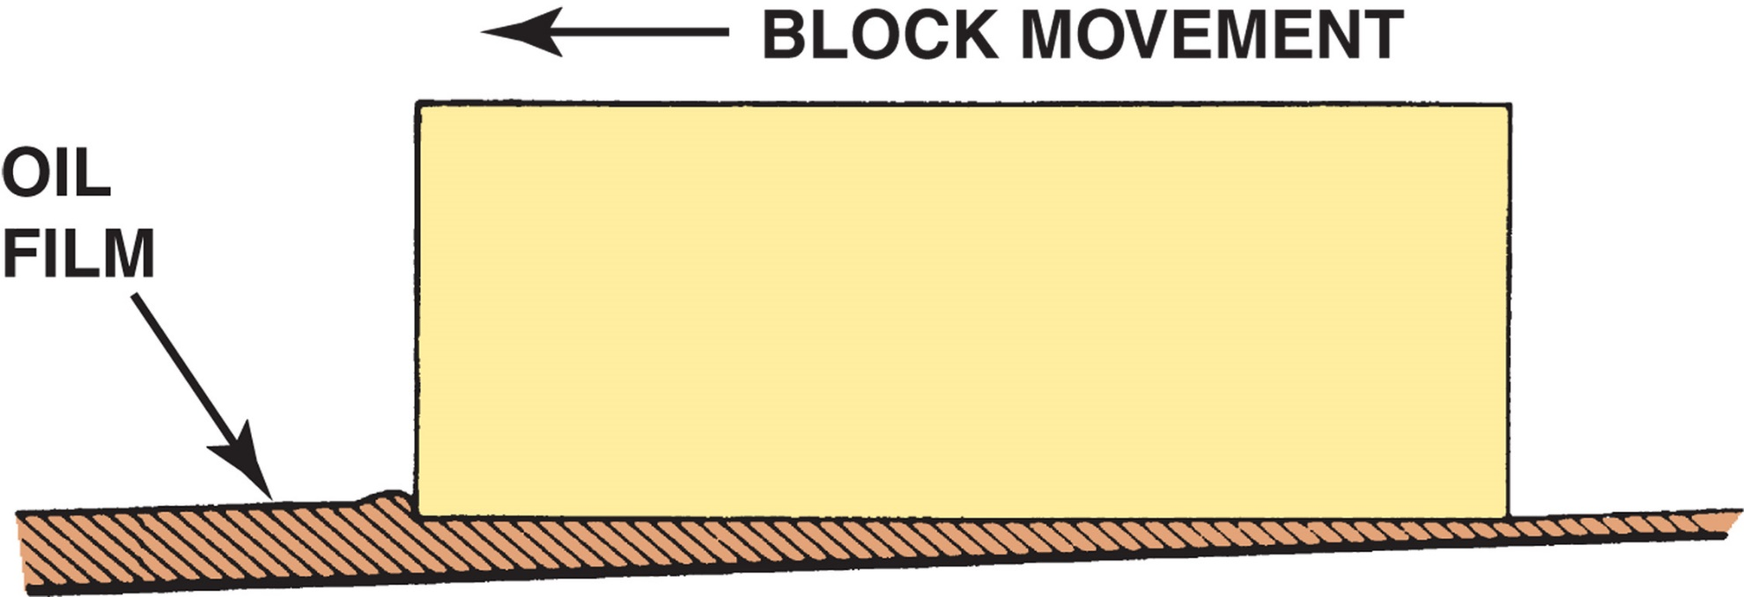
Figure 4–2 Wedge-shaped oil film developed below a moving block.

Slide 7
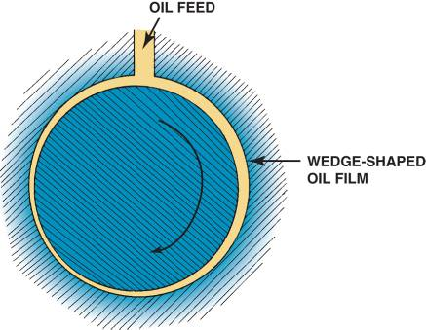
LUBRICATING PRINCIPLES (2 of 3)
This wedging action is called hydrodynamic lubrication
Depends on force applied to rate of speed between objects and thickness of oil

Slide 8

FIGURE 4–3 Wedge-shaped oil film curved around a bearing journal

Slide 9
QUESTION 1: ?
What is the Wedge-shaped oil film developed below a moving block called in an engine?

Slide 10
ANSWER 1:
This wedging action is called hydrodynamic lubrication
Depends on force applied to rate of speed between objects and thickness of oil.

Slide 11
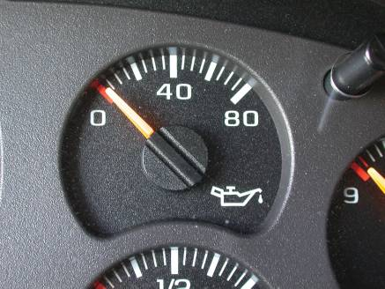
LUBRICATING PRINCIPLES (3 of 3)
Normal Oil Pressure
  0-60 PSI (200-400 kPa) or 10 PSI per 1,000 RPM
Oil Temperature
  Excessive temperatures, too low or too high, are harmful

Slide 12
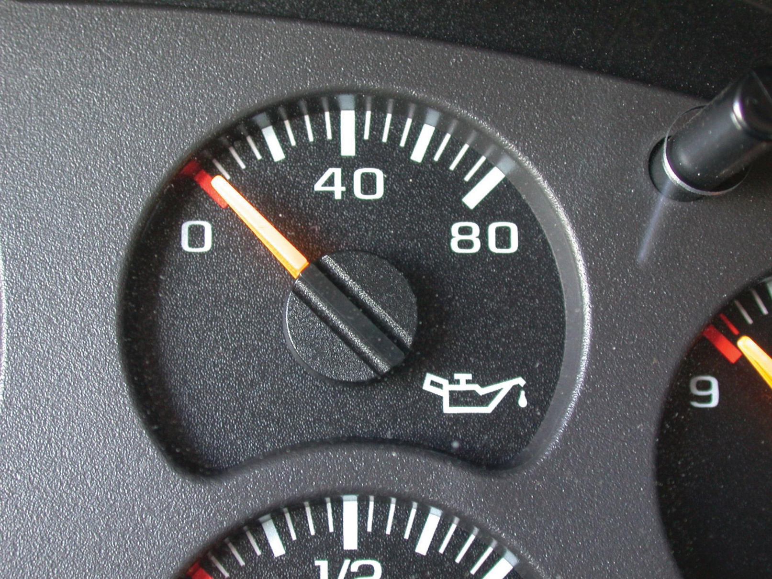
FIGURE 14–4 The dash oil pressure gauge may be a good indicator of engine oil pressure. If there is any concern about the oil pressure, always use a mechanical gauge to be sure.

Slide 13
OIL PUMPS: INFO
Purpose and Function
Parts and Operation
Types of Oil Pumps
  External gear type
  Internal/external gear type
  Rotor type
  Gerotor type

Slide 14
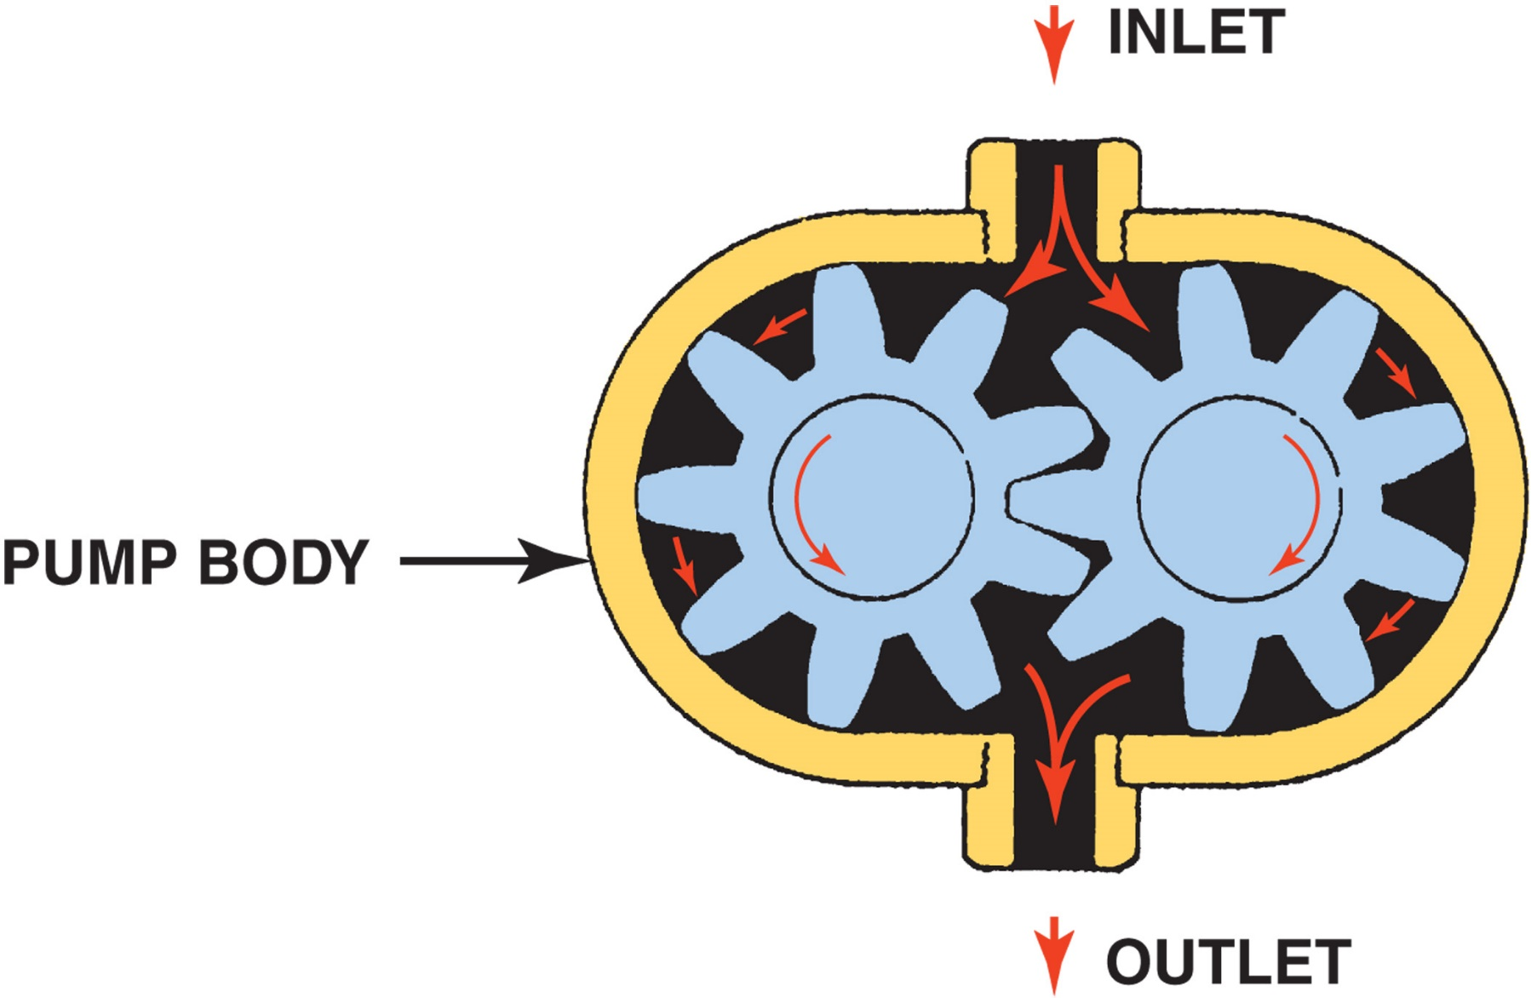
FIGURE 4-5 In an external gear-type oil pump, the oil flows through the pump around the outside of each gear. This is an example of a positive displacement pump, wherein everything entering the pump must leave the pump.

Slide 15
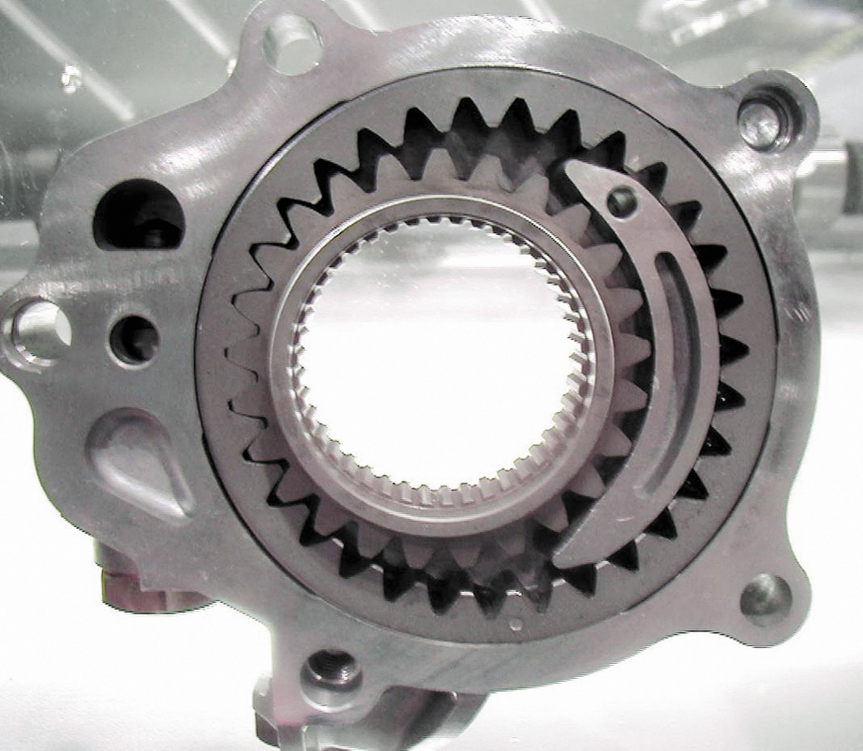
FIGURE 4–6 typical internal/external oil pump mounted in the front cover of the engine that is driven by the crankshaft.

Slide 16
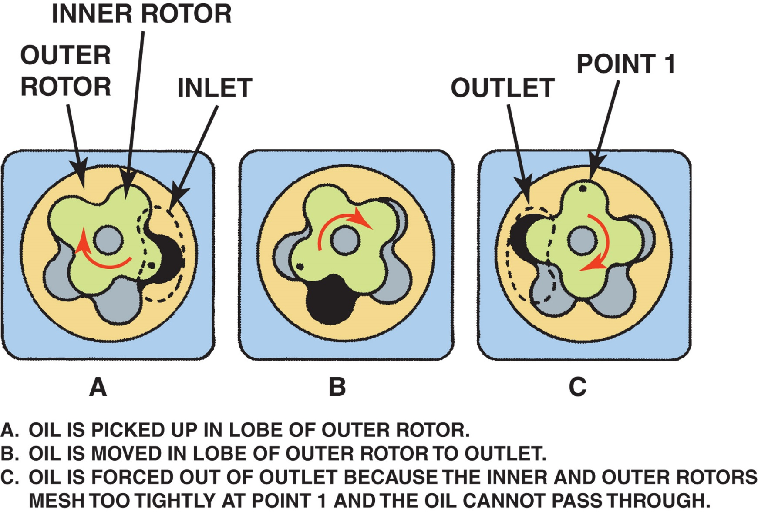
FIGURE 4–7 operation of a rotor-type oil pump.

Slide 17
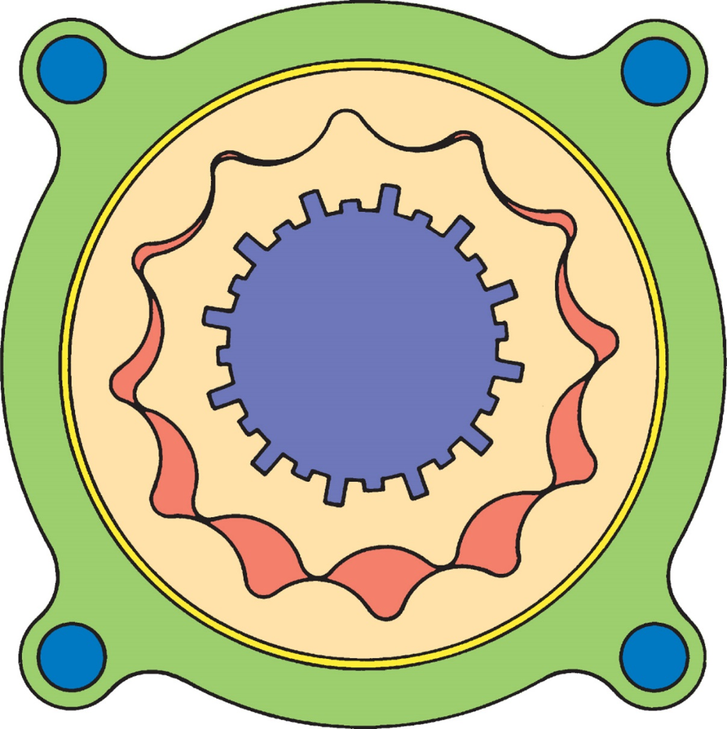
FIGURE 4–8 Gerotor-type oil pump driven by the crankshaft.

Slide 18
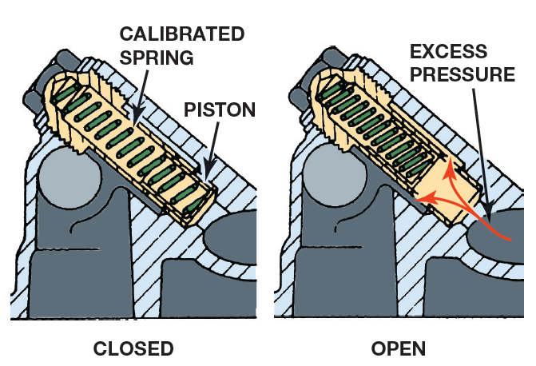
FIGURE 4–9 Oil pressure relief valves are spring loaded. The stronger the spring tension, the higher the oil pressure.

Slide 19
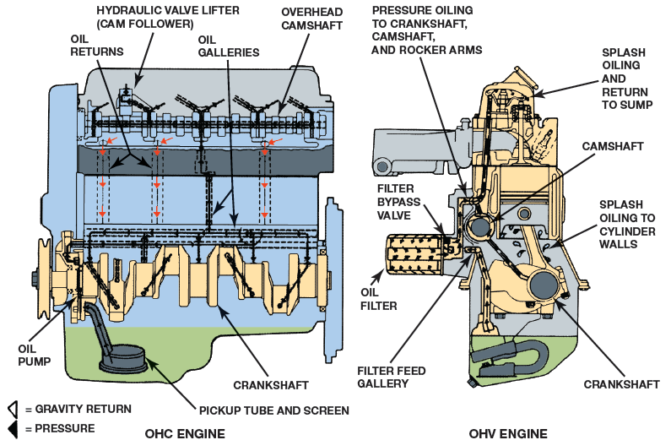
FIGURE 4–10 typical engine design that uses both pressure and splash lubrication. Oil travels under pressure through galleries to reach top of engine. Other parts lubricated as oil flows back down into oil pan or is splashed onto parts.

Slide 20
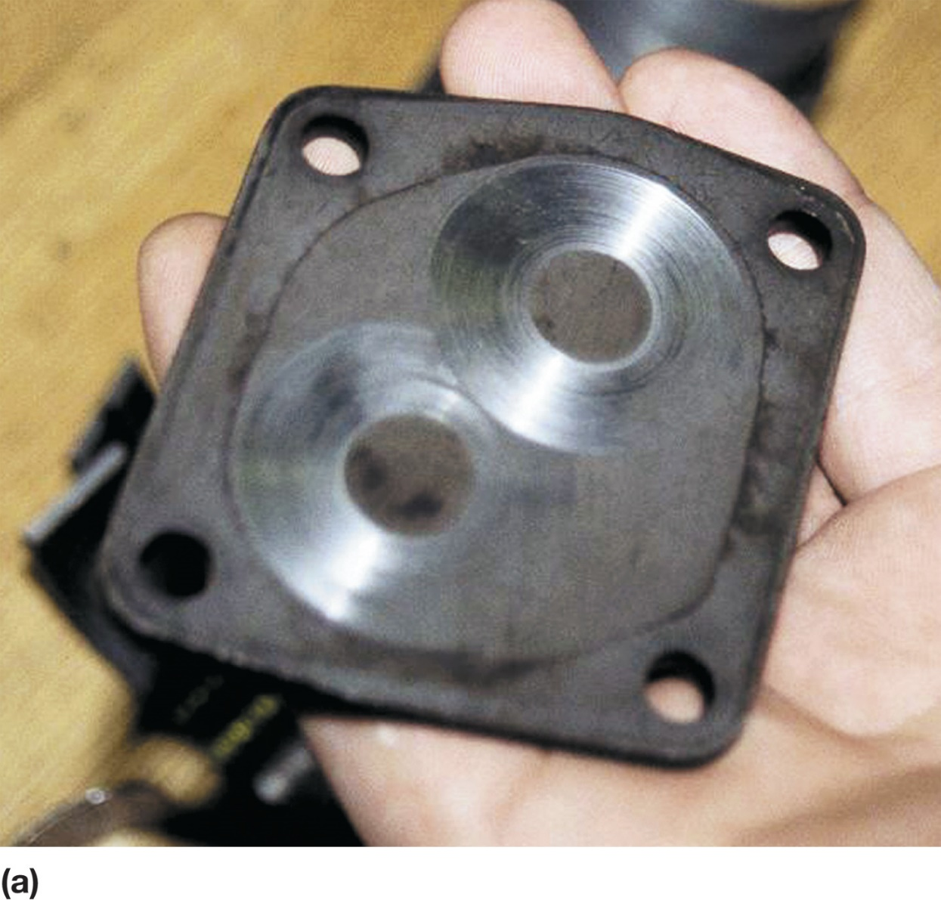
FIGURE 4–11a visual inspection indicated that this pump cover was worn

Slide 21
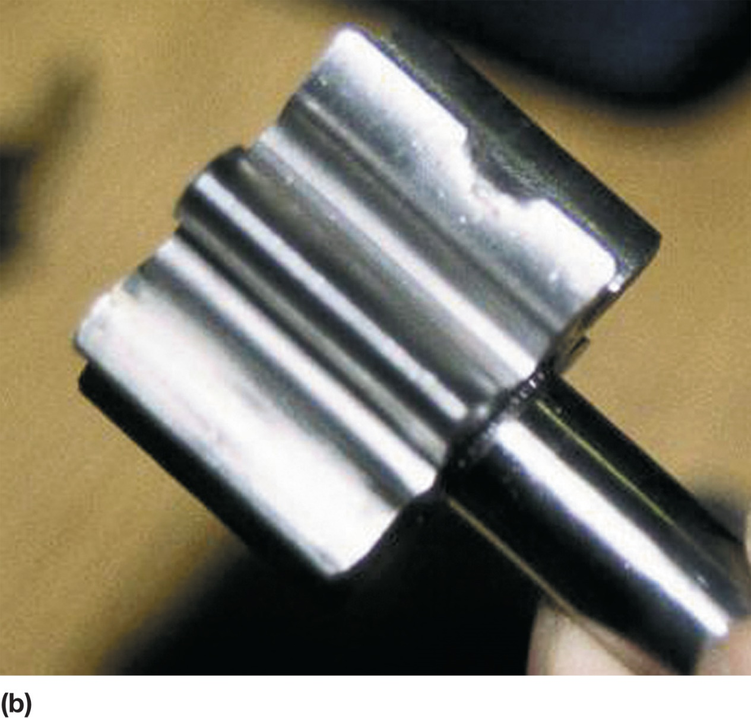
FIGURE 4–11B An embedded particle of something was found on one of the gears, making this pump worthless except for scrap metal.

Slide 22
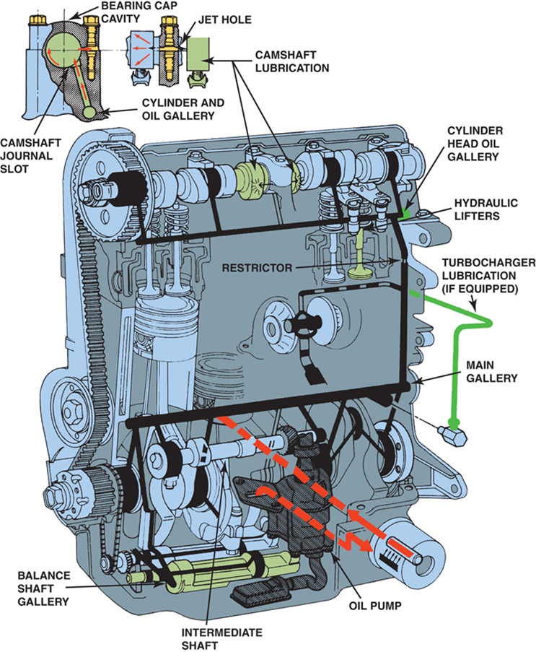
OIL PASSAGES ( 1 of 2)
Oil from pump first flows through oil filter
  Then through drilled hole that intersects
  With drilled main oil gallery or longitudinal header
  This is long hole drilled from front of block to back
  Inline engines use one oil gallery
  V-type engines may use 2 or 3 galleries

Slide 23
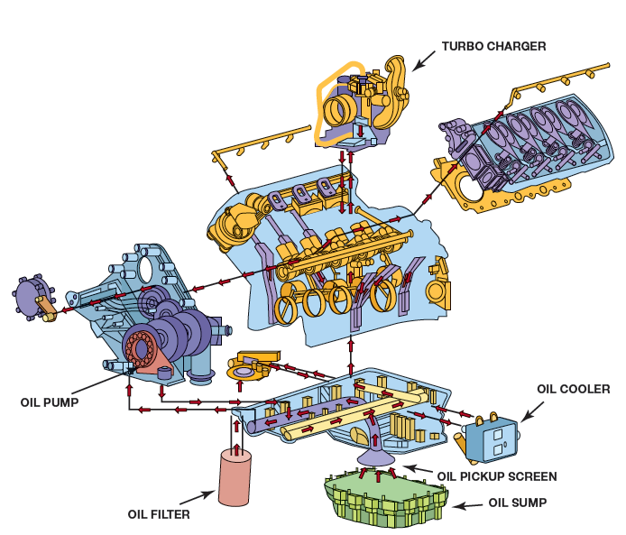
FIGURE 4–12 flow of oil in 6.7 liter Power Stroke diesel engine.

Slide 24
OIL PASSAGES ( 2 of 2)
Passages drilled through block bulkheads
  Oil goes from main oil gallery to main & cam bearings
  Oil goes to cam bearings on some engines
  Then to main bearings
  Oil in diesel sent through oil cooler
  To turbocharger,
    FIGURE 4–12.

Slide 25
QUESTION 2: ?
Oil from pump first flows through?

Slide 26
ANSWER 2:
The oil filter

Slide 27

Why Are There Holes on the Underside of
Diesel Pistons?
Most diesel engines use piston squirt nozzles to force engine oil to the underside of the piston to help remove heat from the top of the piston. The nozzles are connected to the main oil gallery and oil is squirted through the nozzles whenever the engine is running. ● SEE FIGURE 4–13a.

Slide 28
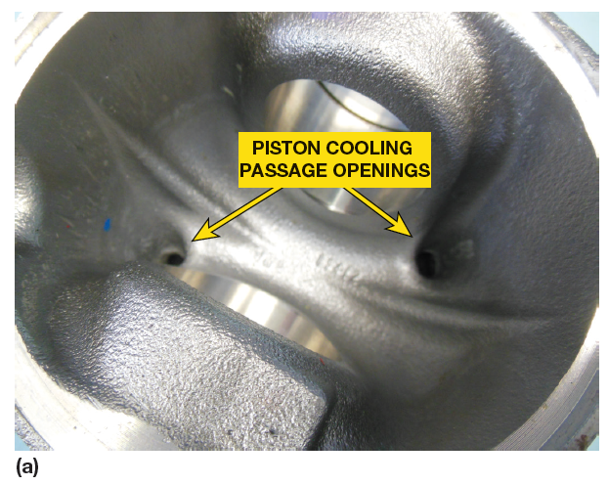
FIGURE 4–13 (a) two holes in the underside of the piston lead to a passage where oil is squirted from nozzles to help cool the top of the piston.

Slide 29
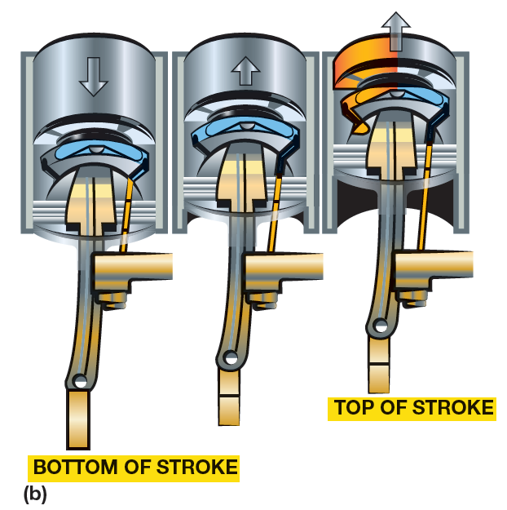
FIGURE 4–13 (B) as the oil flows through the opening underneath the top of the piston, it absorbs heat and the heated oil returns to the oil pan where the oil is cooled by the oil cooler.

Slide 30
FIGURE 4–14 Oil must be used to lubricate the gears used to drive the camshaft and high-pressure fuel pump on all engines, such as this 6.7 liter Cummins inline six-cylinder diesel engine.

Slide 31
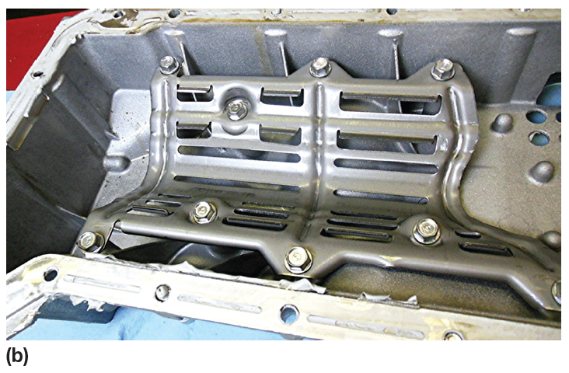
OIL PANS ( 1 of 2)
Oil Pan
  Engine oil stored for lubricating engine
  Another name for the oil pan is a sump
  Pan baffles & oil pan shapes used to keep
  Oil inlet under the oil at all times

Slide 32
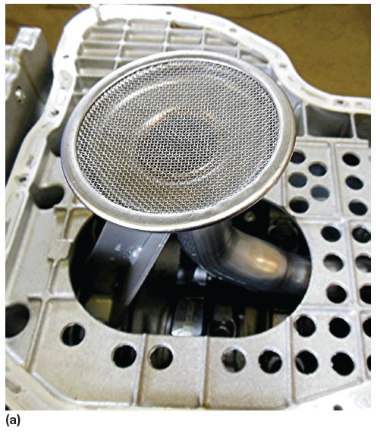
FIGURE 4–15 (A) the pickup screen on a Duramax diesel engine is surrounded by many baffles.

Slide 33
OIL PANS ( 2 of 2)
Oil Pan
  Crankshaft rotates & acts like fan
  Causes air within crankcase to rotate with it
  Causing draft on oil, churning it so that air bubbles
  Enter oil & causes foaming
  Foaming causes bearing failure
  Baffle or windage tray
  Used to eliminate oil churning

Slide 34
FIGURE 4–15 (B) the oil pan has a built-in windage tray to help prevent the oil from being aerated during engine operation.

Slide 35
QUESTION 3: ?
What is a windage tray?

Slide 36
ANSWER 3:
The windage tray is used to keep oil from being churned up by the rotating crankshaft.

Slide 37
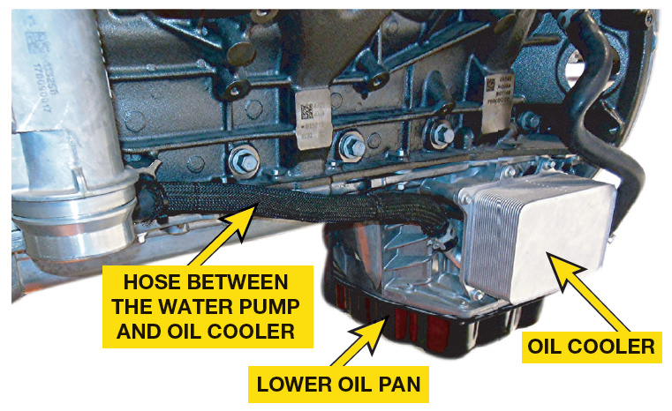
OIL COOLERS ( 1 of 1)
Coolant flows through oil cooler
  To help warm oil when engine is cold and cool oil when engine is hot
  Oil temp should be:
    Above 212°F (100°C) to boil off any accumulated moisture
    Below 280°F to 300°F (138°C to 148°C)

Slide 38
Figure 16–18 Oil is cooled by the flow of coolant through the oil filter adaptor

Slide 39
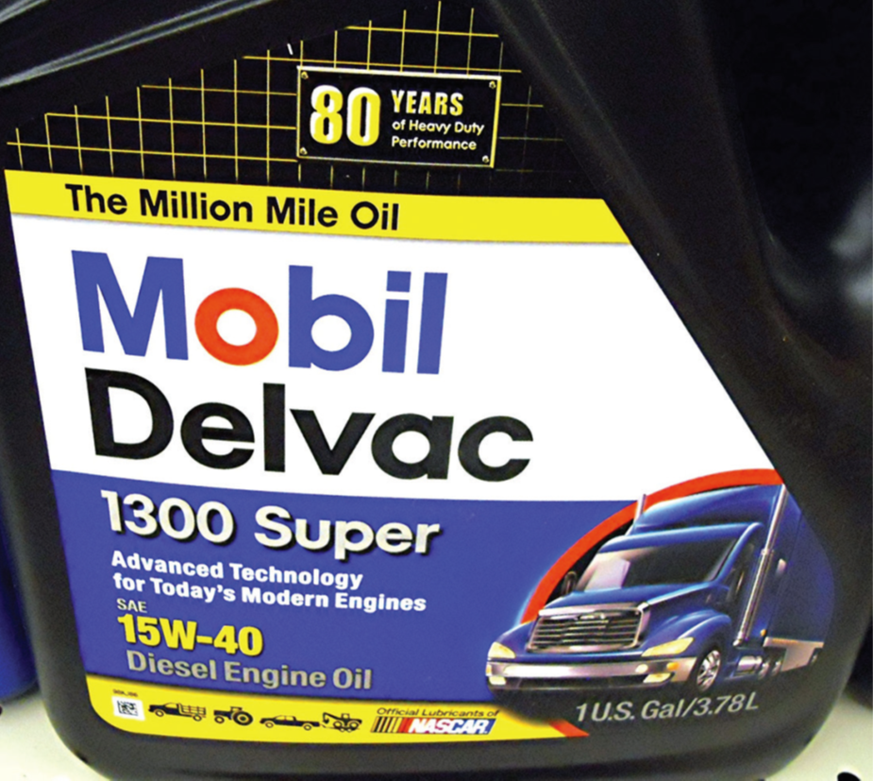
ENGINE OIL (1 of 12)
Most important engine oil property
  Thickness or viscosity
  As oil is cooled, it gets thicker
  As oil is heated, it gets thinner

Slide 40

ENGINE OIL (2 of 12)
Pour Point
  Lowest temperature at which oil will pour
  Viscosity Index (VI)
    Called Index of change in viscosity
    Between cold & hot extremes
    Oils with high VI thin less with heat than oils with low VI
    Oils must be miscible, capable to mixing with other oils

Slide 41
ENGINE OIL (3 of 12)
SAE # Indicates Viscosity Range
  Oils tested at 212°F (100°C)
    Number with no letter following
  Oils tested at 0°F (−18°C)
    Rated with number & letter W, which means winter
  Most OEMS Recommend following multi-viscosity
    Diesel Engine Oils:
      SAE 15W-40
      SAE 10W-30
      SAE 5W-40

Slide 42
ENGINE OIL (4 of 12)
NOTE: Always use specified viscosity engine oil.
● SEE FIGURE 4–17.

Slide 43
FIGURE 4–17 Container of SAE 15W-40 engine oil that may be suitable for use in many light diesel engines.

Slide 44
ENGINE OIL (5 of 12)
API Rating
  American Petroleum Institute (API)
  Established engine oil performance classification
  Oils are tested and rated
  In production automotive engines
  SAE grade & API markings: only information
  Available to help determine
  Which oil is satisfactory for use in an engine.

Slide 45
ENGINE OIL (6 of 12)
Diesel Oil Classifications
  Diesel classifications begin with letter C
  Stands for commercial
  Can indicate compression ignition
  CJ-4–Required for use in all 2007 and newer
    Using ultra-low-sulfur diesel (ULSD) fuel
  CK-4–Replaced CJ-4 in 2018
  FA-4–Designed for improved fuel economy
    (for use in designated 2018 or newer diesel engines only)

Slide 46
ENGINE OIL (7 of 12)
Engine Oil Additives
  Balance additives are called additive package
  Additives to Improve Base Oil
  Viscosity index (VI) improver allows
  Lubricant to operate over wider temperature range
  Pour point depressant keeps lubricant
  Flowing at low temperatures
  Antifoam agents reduce/stop foaming

Slide 47
FIGURE 4–18 viscosity index (VI) improver is a polymer and feels like finely ground foam rubber. When dissolved in the oil, it expands when hot to keep the oil from thinning.

Slide 48
ENGINE OIL (8 of 12)
Additives to Protect Base Oil
  Antioxidants slow breakdown of base fluid
  Caused by oxygen and heat
  Oxidants prevent acid formation (corrosion)
  In form of sludges, varnishes

Slide 49
ENGINE OIL (9 of 12)
Additives to Protect Engine
  Total base number (TBN) neutralizes
  Acids created during combustion
  Rust inhibitor inhibits action of water
  On ferrous metal, such as steel

Slide 50
ENGINE OIL (10 of 12)
Additives to Protect Engine
  Corrosion inhibitor protects nonferrous metals,
  Such as copper
  Antiwear additive forms protective layer
    On metal surfaces to reduce friction and prevent wear
    Extreme pressure additive functions
    When heavy loads & temperatures occur

Slide 51
ENGINE OIL (11 of 12)
European Oil Rating System
  Starting in 2004
    ACEA began using combined ratings such as A1/B1, A3/B3, A3/B4, and A5/B5
    Diesel engine oils—ACEA B1, B2, B3, or B4
    Higher number, more robust engine oil
    ACEA oil requires low levels of sulfated ash, phosphorous, and sulfur (SAPS) and has high temperature/high shear rate viscosity (HTHS)

Slide 52
ENGINE OIL (12 of 12)
European Oil Rating System
  C ratings are catalytic converter compatible oils:
    C1: basically A5/B5 oil with low SAPS, low HTHS
    C2: A5/B5 with low HTHS and mid–level SAPS
    C3: A5/B5 with high HTHS and mid–level SAPS
    C4: low SAPS; high HTHS

Slide 53
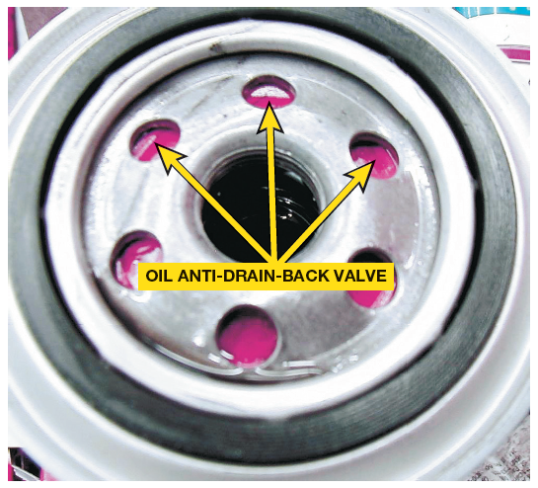
OIL FILTERS (1 of 3)
Construction
  Filter is made from closely packed cloth fibers or porous paper
Oil Filter Valves
  Many oil filters have an antidrainback valve
  Valve keeps oil in filter, allows engine to receive immediate lubrication on startup

Slide 54
Figure 4–19 A rubber diaphragm acts as an antidrainback valve to keep the oil in the filter when the engine is stopped and the oil pressure drops to zero.

Slide 55
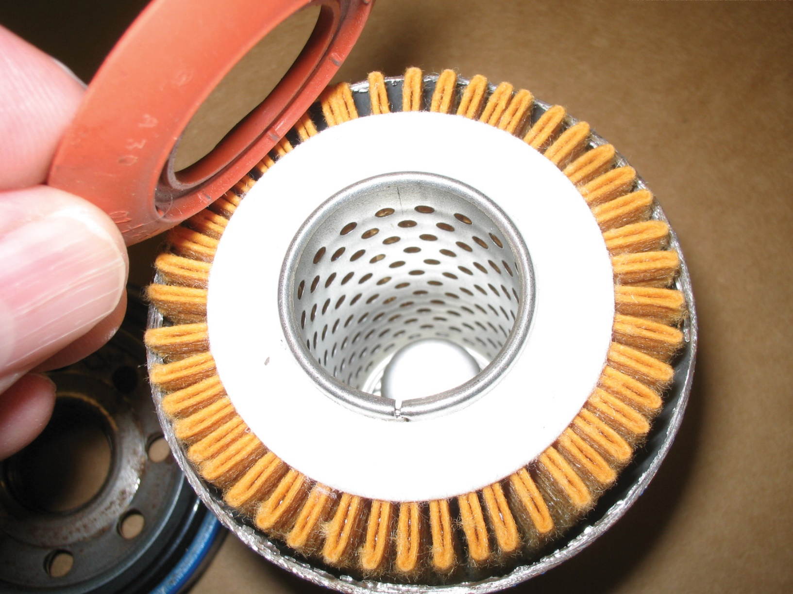
Figure 4-20 A cutaway of typical spin-on oil filter. Engine oil enters filter through small holes around center of filter & flows through pleated paper filtering media & out large hole in center of filter. Center metal cylinder with holes is designed to keep paper filter from collapsing under pressure. Bypass valve can be built into center on oil filter or is part of oil filter housing and located in engine.

Slide 56
OIL FILTERS (2 of 3)
Oil Filter Valves
  Engine or filter has bypass valve to allow oil to go around filter
  Bypass allows engine to be lubricated with dirty oil rather than none
Oil Filter Disposal
  Crush or drain before discarding as metal scrap

Slide 57
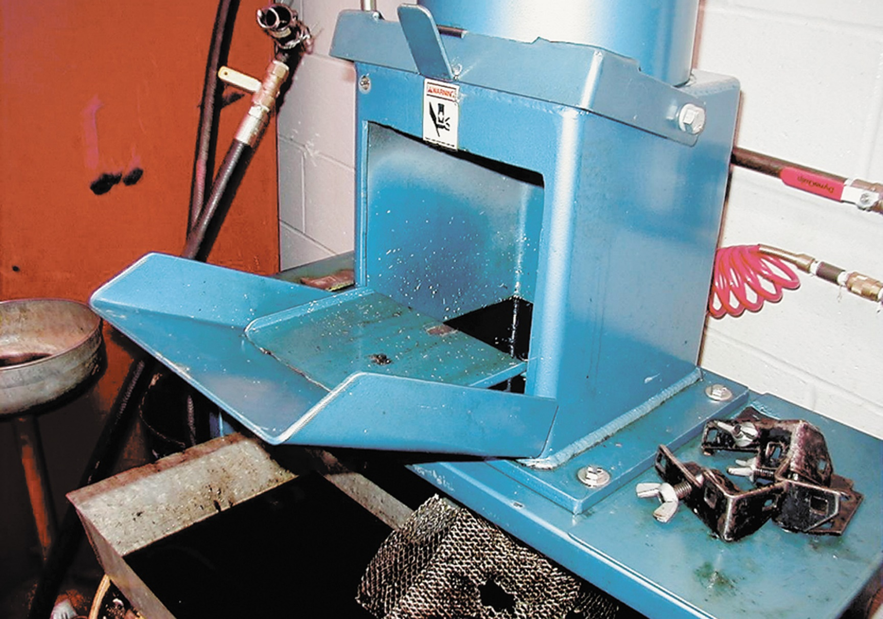
Figure 4–21 A typical filter crusher. The hydraulic ram forces out most of the oil from the filter. The oil is trapped underneath the crusher and is recycled

Slide 58
QUESTION 4: ?
What does the rubber diaphragm in most spin-on oil filters used for?

Slide 59
ANSWER 4:
A rubber diaphragm acts as an antidrainback valve to keep the oil in the filter when the engine is stopped and the oil pressure drops to zero..

Slide 60
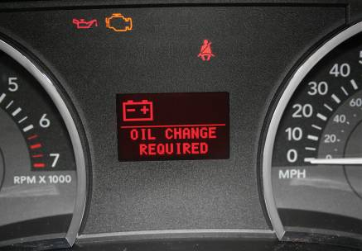
OIL FILTERS (3 of 3)
Oil Life Monitors
  Vehicles since mid–1990s equipped with a warning light
  Lets YOU know when engine oil should be changed.
  2 basic types of OLM
    Service light on based on mileage
    Algorithm. Computer programs contain algorithms that specify instructions a computer should perform before light comes on

Slide 61

Figure 4–22 Many vehicle manufacturers can display the percentage of oil life remaining, whereas others simply turn on a warning lamp when it has been determined that an oil change is required.

Slide 62
What is the Relationship Between Miles Driven and Engine Hours?
Most OEMs specify that each hour of engine run time is equal to 25 miles. Most pickup trucks have an hour meter that can be accessed using trip odometer button to scroll through miles & then hours. When servicing a truck, it is wise to check both mileage & hours of operation to see if service needs to be increased based on the number of hours spent idling compared to actual driving miles. SEE FIGURE 4–23.

Slide 63
FIGURE 4–23 (a) number of miles shown on this two year old Ford F-250 with a Power stroke 6.7 liter diesel engine.

Slide 64
FIGURE 4–23 (b) The number of hours with the engine running at idle (481 hours) is equal to about 12,000 miles, so the total is equal to about 26,000 miles instead of what the odometer reads (14,726).

Slide 65
OIL CHANGE
Oil Change Procedure
  Step 1: Check oil level.
  Step 2: Safely hoist vehicle.
  Step 3: Position drain pan under drain plug; remove plug.
  Step 4: Allow oil to drain freely.
  Step 5: Examine oil plug gasket; replace if damaged.

Slide 66
WARNING
Used engine oil has been determined to be harmful. Protective gloves should be worn to protect the skin. If used engine oil gets on the skin, wash thoroughly with soap and water.

Slide 67
Summary (1 of 2)
Viscosity is the oil thickness or resistance to flow.
Normal engine oil pump pressure ranges from 10 to 60 PSI (200 to 400 kPa) or 10 PSI for every 1,000 engine RPM.
Hydrodynamic oil pressure around engine bearings is usually over 1,000 PSI (6,900 kPa).
The oil pump is driven directly by the crankshaft or by a gear or shaft from the camshaft.

Slide 68
Summary (2 of 2)
Viscosity is the oil thickness or resistance to flow.
SAE rating measures the viscosity of the oil.
API ratings reflect the quality of the oil.
One hour of idling time is equal to about 25 miles of driving distance.

