Slide 1
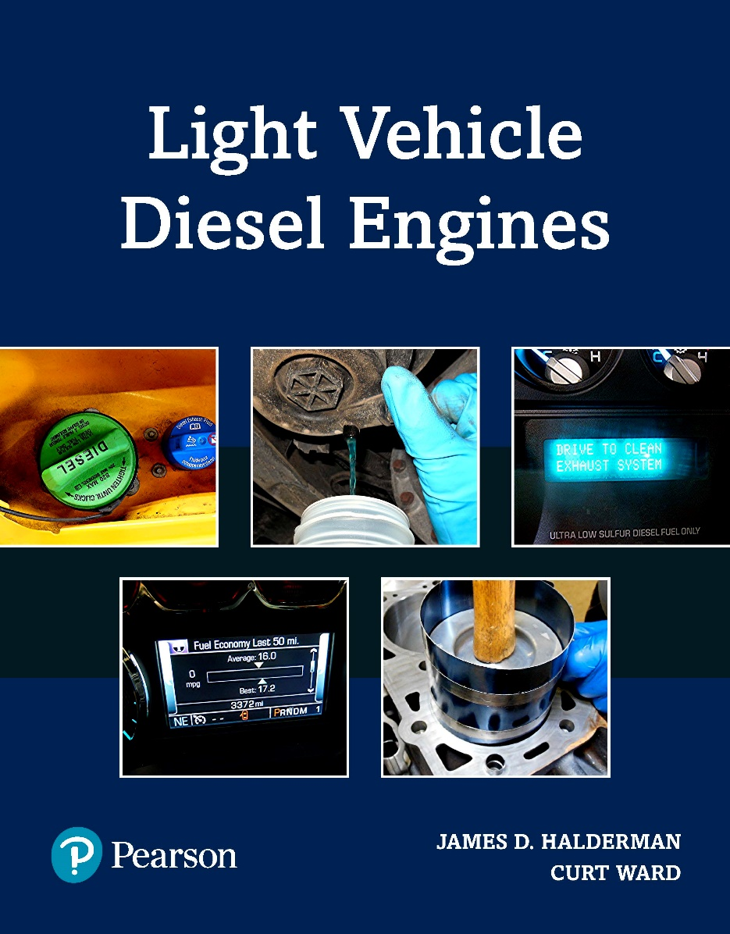
Light Vehicle Diesel Engines
First Edition
Chapter 6
Diesel Engine Condition Diagnosis
Copyright © 2018, 2015, 2011 Pearson Education, Inc. All Rights Reserved

Slide 2
LEARNING OBJECTIVES (1 of 2)
6.1 Prepare for the Light Vehicle Diesel Engine (A9) ASE certification test content area “A” (General Diagnosis).
6.2 Discuss the importance of checking for diagnostic trouble codes (DTCs) and technical service bulletins (TSBs).
6.3 Discuss typical engine-related complaints and diesel engine smoke diagnosis.
6.4 Discuss the importance of visual checks.
6.5 Discuss engine noise diagnosis.

Slide 3
LEARNING OBJECTIVES (2 of 2)
6.6 Explain oil pressure testing and the purpose of oil pressure warning lamps.
6.7 Discuss the crankcase pressure test.
6.8 Explain compression testing, and compare wet and compression tests.
6.9 Describe the cylinder power balance test.
6.10 Discuss engine starting and charging system tests.
.

Slide 4
TYPICAL ENGINE RELATED
COMPLAINTS (1 of 4)
Engine Mechanical-Related Complaints:
  Excessive oil consumption
  Engine misfiring
  Loss of power
  Smoke from the engine or exhaust
  Engine noises
Test Drive
Vehicle History

Slide 5
DIAGNOSTIC TROUBLE CODES & TECHNICAL SERVICE BULLETINS (2 of 4)
Diagnostic Trouble Codes (DTCs)
  ECM/PCM) detects faults
    DTC can help pinpoint the fault to an area for
    DTC present illuminates MIL

Slide 6
FIGURE 6–1 typical “Check Engine” light which should come on when ignition is first turned on as bulb check and then go out. If check engine light remains on, then PCM detected fault & DTC set

Slide 7
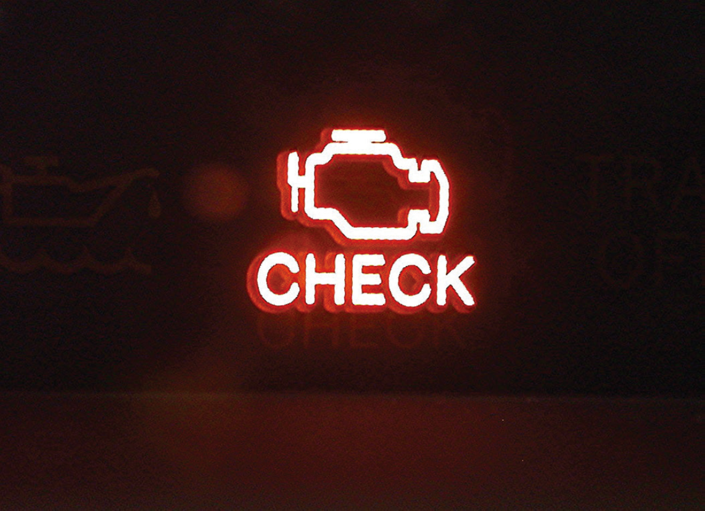
DIAGNOSTIC TROUBLE CODES & TECHNICAL SERVICE BULLETINS (3 of 4)
DTC Status:
  History DTC—store history DTC s for 40 trips
  MIL Request—PCM has MIL on
  Last Test Fail—only DTC failed last time
    Test of system or sensor ran
  Test Fail Since Code Cleared (SCC)—
    DTC s reported test failed since the last time cleared
  Not Run Since Code Cleared (SCC)—DTC not run
  DTC Status—DTCs not run during drive cycle

Slide 8
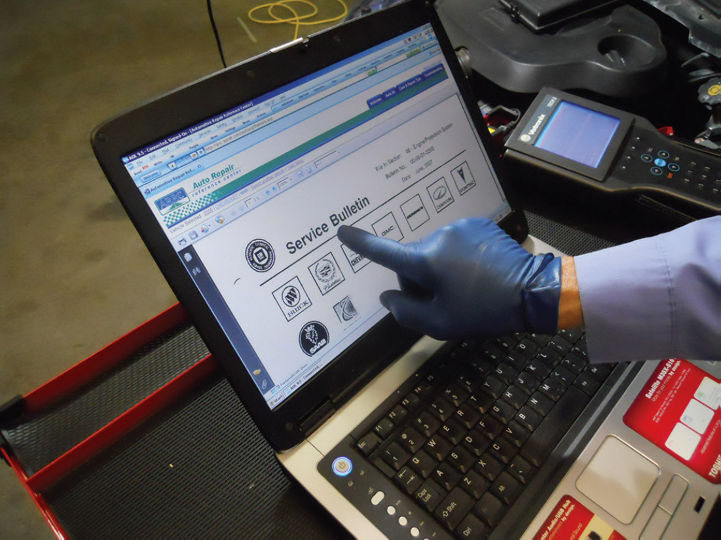
DIAGNOSTIC TROUBLE CODES & TECHNICAL SERVICE BULLETINS (4 of 4)
Technical Service Bulletins: Strategy Diagnosis
Scan Tool
  Check values of sensors
  Verify normal action/reaction activity
  When operating system

Slide 9
FIGURE 6–2 After checking for stored DTCs, wise technician checks service information for any technical service bulletins that may relate to the vehicle being serviced.

Slide 10
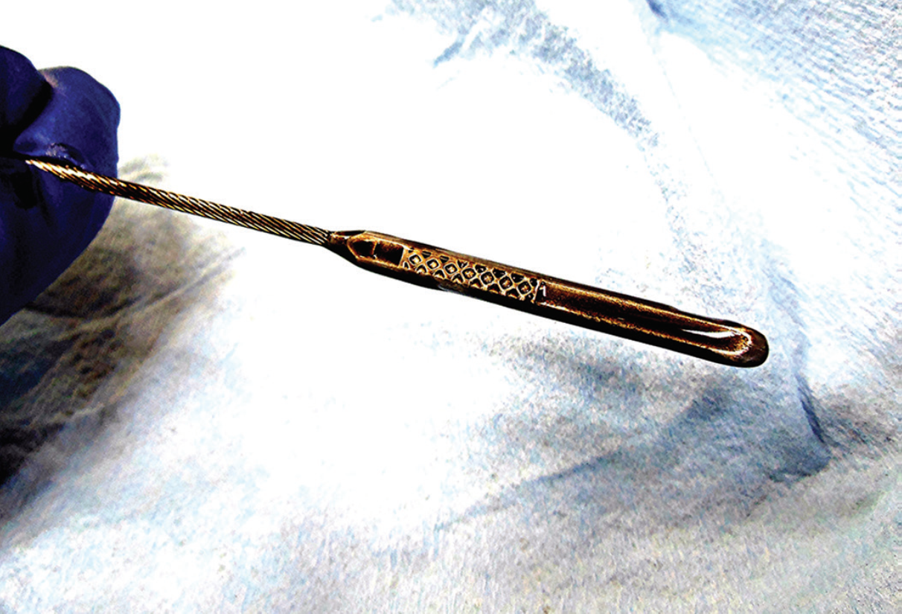
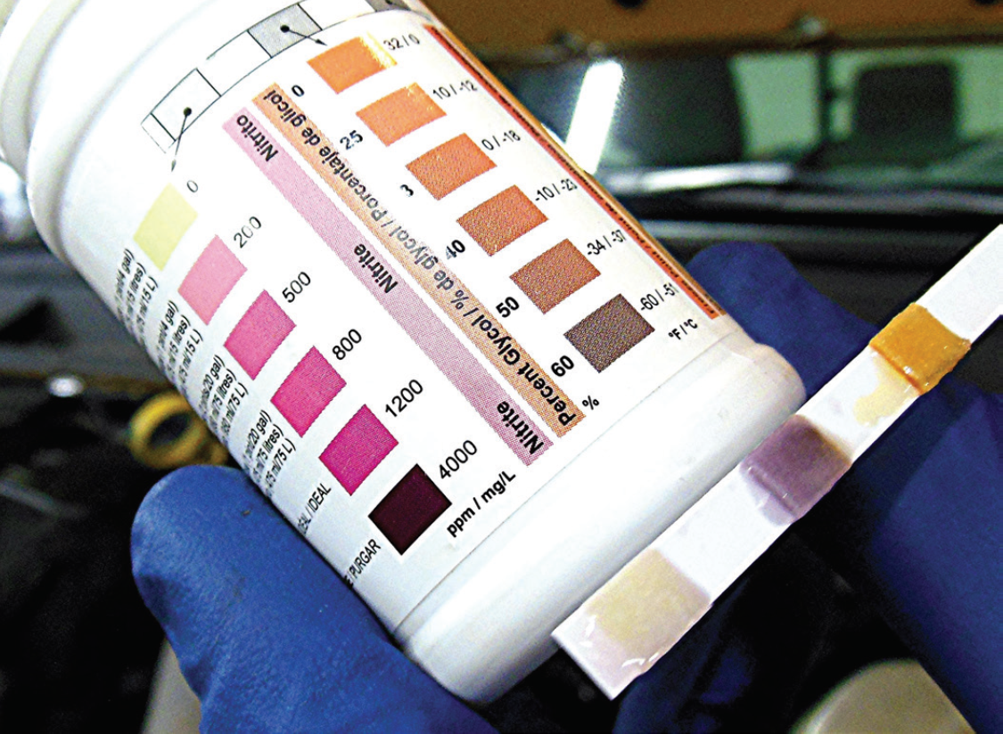
VISUAL INSPECTION
Thorough Visual Inspection Includes
  Overall inspection of vehicle
  Oil Level and Condition
  Coolant Level and Condition
  Oil Leaks

Slide 11
FIGURE 6–3 Checking engine oil level and condition is almost always first step in diagnosis of any diesel engine diagnosis.

Slide 12
WARNING
If radiator is hot and radiator cap is removed, the drop in pressure above coolant will cause coolant to boil immediately and can cause severe burns when the coolant explosively expands upward and outward from the radiator opening, which can cause personal injury. Always wait until the engine cooling system has cooled to ambient temperature before removing cap.

Slide 13
FIGURE 6–4 Coolant condition can be easily checked using test strips.

Slide 14
FIGURE 6–5 Using black light to spot leaks after adding dye to oil. Fluorescent dye works best with clean oil.

Slide 15
ENGINE NOISE/
VIBRATION DIAGNOSIS
Engine knocking noise difficult to diagnose
  Several items can cause deep engine knock include:
    Valves clicking
    Torque converter
    Cracked flex plate
    Loose or defective drive belts or tensioners
    Piston pin knock
    Piston slap
    Timing chain noise
    Rod-bearing noise
    Main-bearing knock

Slide 16
FIGURE 6–6 accessory belt tensioner. Most tensioners have a mark that indicates normal operating location. If belt has stretched, this indicator mark will be outside of normal range. Anything wrong with belt or tensioner can cause noise.

Slide 17
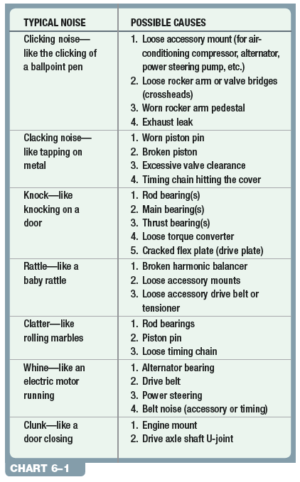
CHART 6-1: Typical noises and possible causes.

Slide 18
CRANKCASE PRESSURE TEST (1 of 2)
Causes for Excessive Crankcase Pressure:
  Crankcase oil level too high.
  Obstruction or damage to rocker cover breather
  Defective turbocharger
  Worn or damaged valve or cylinder
NOTE: Newer vehicles have pressure sensor in crankcase breathing element located in valve cover. Set DTC if there is restriction.
Crankcase Pressure Test Procedure: Page 73

Slide 19
FIGURE 6–7 crankcase breather being removed from valve cover of a 6.7 liter Cummins diesel engine.

Slide 20
FIGURE 6–8 gauge measures low positive and negative pressures in units of inches of water. (1 inch of mercury (in. Hg) equals 14 inches of water so this unit is very small.) Connect gauge to source that can measure crankcase pressure, usually at oil dipstick tube.

Slide 21
CRANKCASE PRESSURE
TEST (2 of 2)
Newer Diesel Engines/Crankcase Pressure Test
  See Page 73 of text
  Cummins 6.7L crankcase pressure sensor
    Detect excessive blow-by, a restriction, or NO filter
    DTC P04bd SETS
  Ford 6.7L no longer lists crankcase pressure test
  6.6 Duramax does not list crankcase pressure test
    Crankcase Depression Regulator (CDR) valve
    Maintains crankcase pressure between
    Approximately negative 6-16 inches of water running

Slide 22

Quick & Easy Crankcase Pressure Test
With engine running, remove oil fill cap and then set it back down on the opening without threading it in. If the pressure causes it to whistle or blow off engine, pressure is too high. Not very scientific, but it works great.

Slide 23
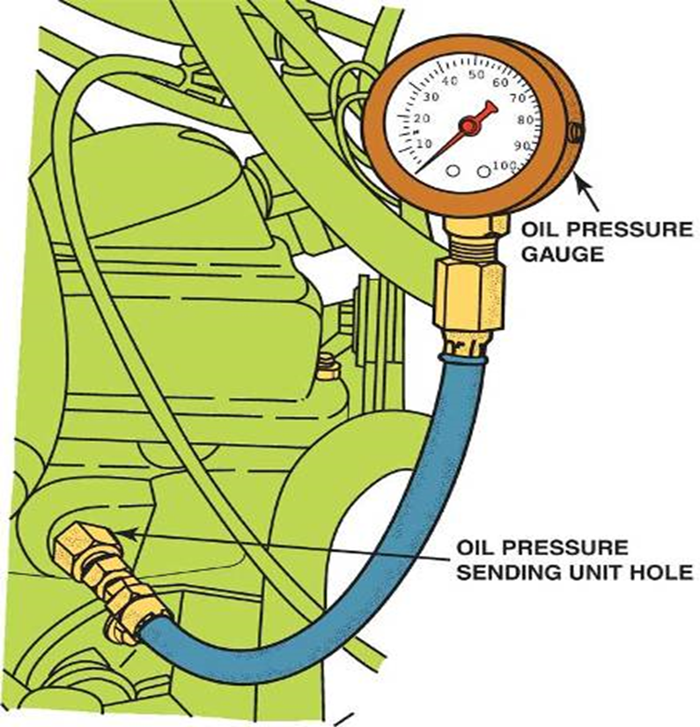
OIL PRESSURE TESTING
Proper Oil Pressure Important
  Low oil pressure can cause engine wear, and engine wear can cause low oil pressure.
  Main thrust or rod bearings are worn
  Pressure reduced from leakage around bearings
  Oil Pressure Testing:
    STEP 1 Operate engine until normal operating temperature achieved.
    STEP 2 With engine off, remove oil pressure sending unit or sender
    STEP 3 Start engine and observe gauge. Record oil pressure at idle and at 2500 RPM

Slide 24

FIGURE 6–9 measure engine oil pressure, remove oil pressure sending (sender) unit, usually located near the oil filter. Screw the pressure gauge into the oil pressure sending unit hole.

Slide 25

If the Oil Pressure Light Is Not On, Why Should I Check the Oil Pressure?
The red oil pressure warning lamp in dash usually lights when oil pressure is less than 4 to 7 PSI, depending on vehicle and engine. The oil light should not be on during driving. If the oil warning lamp is on, stop engine immediately. Always confirm oil pressure with a reliable mechanical gauge before performing engine repairs. Sending unit or circuit may also be defective.

Slide 26
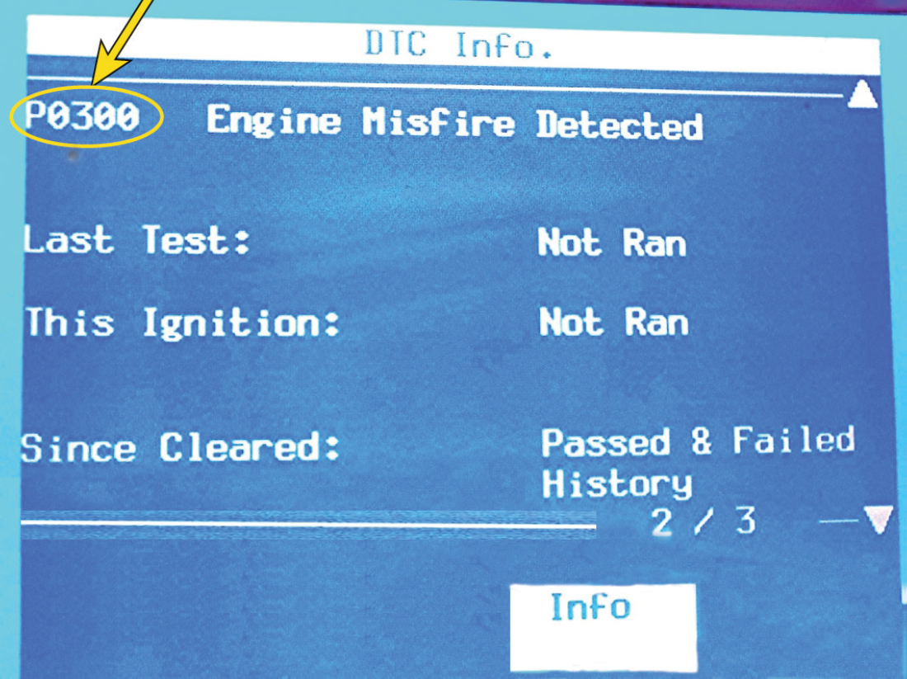
MISFIRE DIAGNOSIS
Engine Misfire
  Cylinder does not fire, or fire well enough
  Contribute to operation of engine
  Cylinder misfiring, speed drops
  When misfire detected
  PCM sets P0300, Turns on MIL
  Causes of Engine Mech Misfires: Pages 74-75 of text
  Engine-Related Misfire Diagnosis: Page 75

Slide 27
FIGURE 6–10 GM Tech 2 scan tool display showing a random misfire DTC (P0300) has been detected.

Slide 28
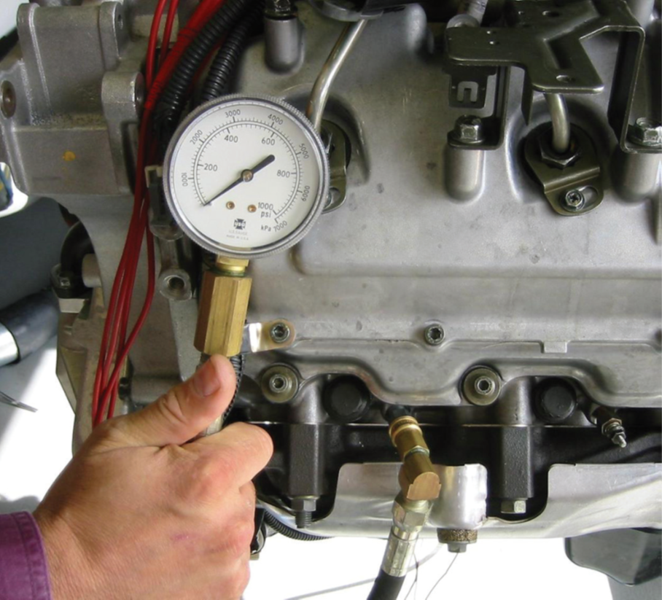
COMPRESSION TEST
Cranking Compression Test
  All cylinders must have equal compression
  Low Compression Causes
    Intake or exhaust valve
    Piston rings (or piston, if there is a hole)
    Cylinder head gasket
      For best results, engine should be
      Warmed to normal operating temperature
  Compression Test Process: Page 76
  Wet Compression Test: Page 76

Slide 29
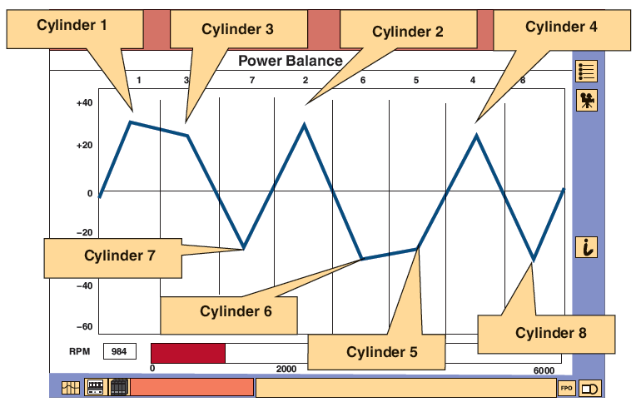
FIGURE 6–11 Ford IDS scan tool has graph function that allows technician to view data on cylinder contribution test visually, making diagnosis easier. Cylinders on bank 2 on Ford 6.7 Power Stroke (cylinders 7, 6, 5, & 8) are weak.

Slide 30
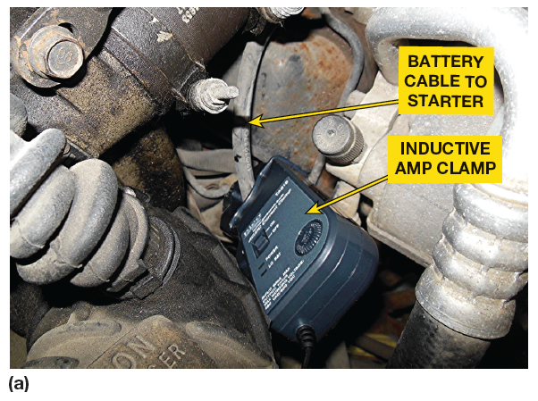
FIGURE 6–12 (a) relative compression test using an amp clamp around starter motor power cable & Pico scope.

Slide 31
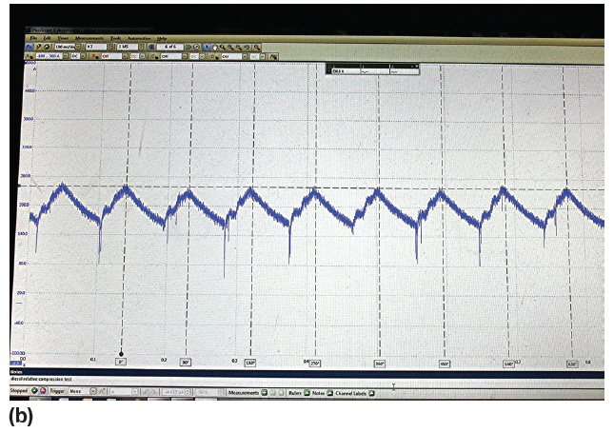
FIGURE 6–12 (b) result is a waveform that displays current needed for each cylinder under compression. This test indicates that all cylinders are requiring same current to rotate starter motor, indicating that all cylinders have same relative compression.

Slide 32
FIGURE 6–13 diesel engine compression gauge being used to test compression on Duramax diesel engine.

Slide 33
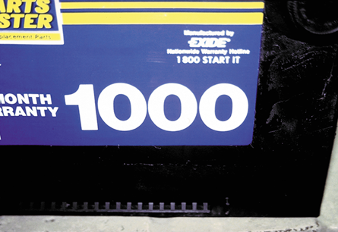
ENGINE STARTING AND
CHARGING DIAGNOSIS (1 of 8)
Automotive Battery
  Source of electrical power for
  Starting and for electrical demands
  that exceed alternator output
  Battery also acts as a voltage stabilizer
  For entire electrical system

Slide 34

ENGINE STARTING AND
CHARGING DIAGNOSIS (2 of 8)
Batteries Rated
  According to amount of current
  Can produce under specific conditions.
    Cold-cranking Amperes
    Cranking Amperes
    Marine Cranking Amperes
    Ampere-hour Rating
    Reserve Capacity

Slide 35
QUESTION 1: ?
What does CCR stand for?

Slide 36
ANSWER 1:
Cold Cranking Amps:
The cold-cranking power of a battery is number of amperes that can be supplied at 0°F (-18°C) for 30 seconds while battery still maintains a voltage of 1.2 volts per cell or higher. This means that battery voltage would be 7.2 volts for a 12 volt battery and 3.6 volts for a 6 volt battery. Cold-cranking performance rating is called cold-cranking amperes (CCA).
What is CA or Cranking Amps? CA refers to the number of amperes that can be supplied by battery at 32°F (0°C). This rating results in a higher number than more stringent rating of CCA.

Slide 37
How Should You Test a Vehicle Equipped with Two Batteries?
Many vehicles equipped with diesel engine use 2 batteries. Usually electrically connected in parallel to provide additional current (amperes) at same voltage. To successfully test batteries, they should be disconnected and tested separately. If just 1 battery found to be defective, most experts recommend that both be replaced to help prevent future problems. Because 2 batteries are electrically connected, fault in 1 battery can cause good battery to discharge into defective battery, thereby affecting both even if just one battery is defective. FIGURE 6–14

Slide 38
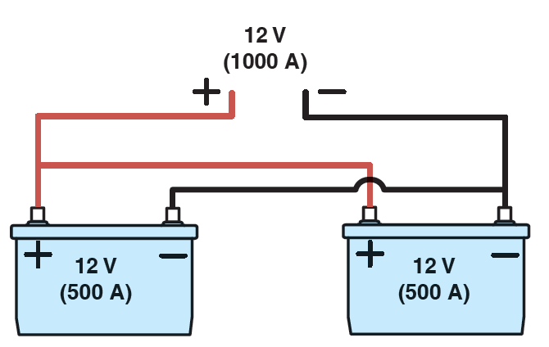
FIGURE 6–14 Most light-duty diesel vehicles are equipped with two batteries connected in parallel as shown. Two 500 amperes, 12-volt batteries are capable of supplying 1,000 amperes at 12 volts, which is needed to start many diesel engines.

Slide 39
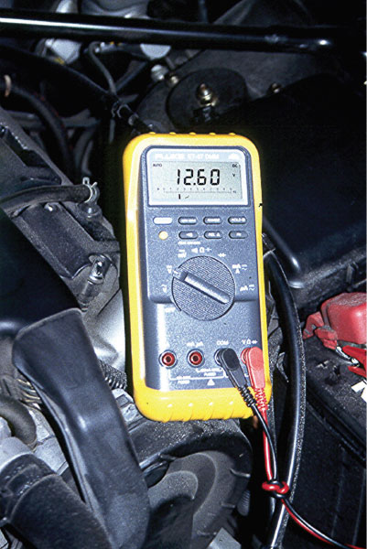
FIGURE 6–15 battery that measures 12.6 volts or higher after the surface charge has been removed is 100% charged.

Slide 40
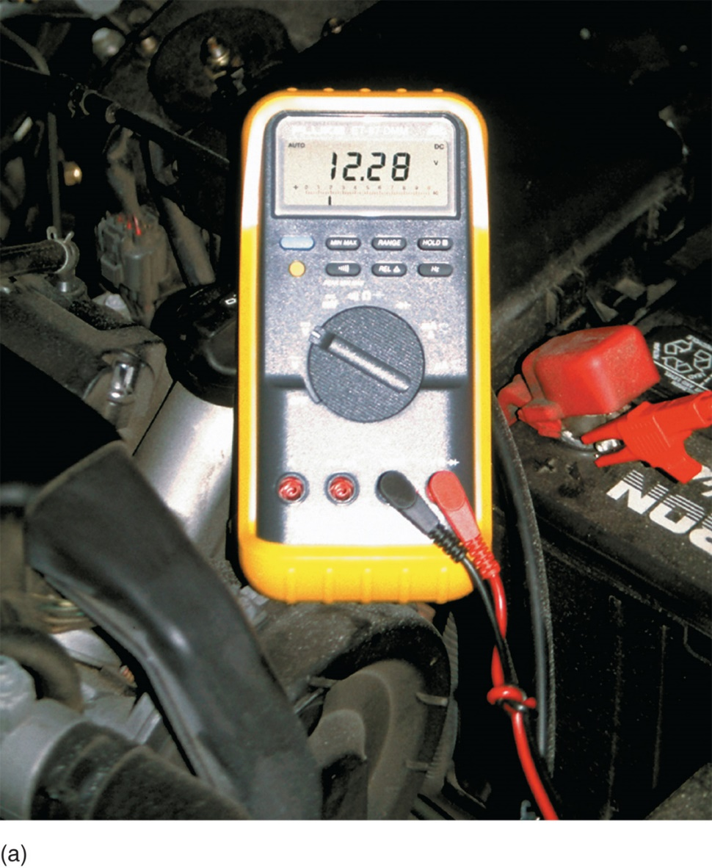
ENGINE STARTING AND
CHARGING DIAGNOSIS (3 of 8)
Voltmeter showing the battery voltage when the headlights were on (engine off) for one minute.

Slide 41
ENGINE STARTING AND
CHARGING DIAGNOSIS (4 of 8)
Headlights were turned off and battery voltage quickly recovered to indicate 12.6 volts
Battery Load Test
  Page 76

Slide 42
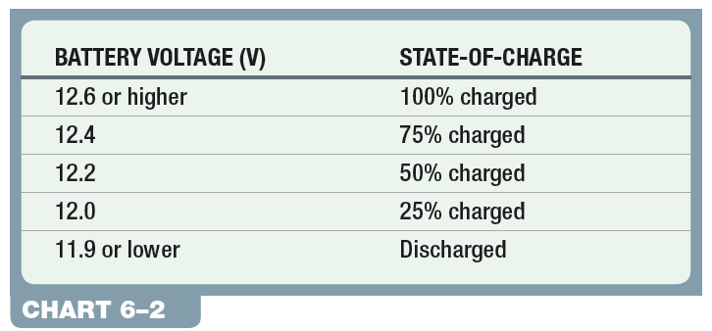
CHART 6-2: estimated state of charge of a 12-volt battery after surface charge has been removed. surface charge is removed by turning headlights on high beam for one minute, then turning the headlights off and waiting two minutes.

Slide 43
ENGINE STARTING AND
CHARGING DIAGNOSIS (5 of 8)
GM, Chrysler Corporation, Ford, and other OEMS
Specify that Conductance Tester be used
Test batteries still under factory warranty
Tester uses its internal electronic circuitry
Determine the state of charge and capacity
By measuring voltage & conductance of plates

Slide 44
FIGURE 6–16 Midtronics tester that can not only test battery, but can also detect faults with starter & alternator.

Slide 45
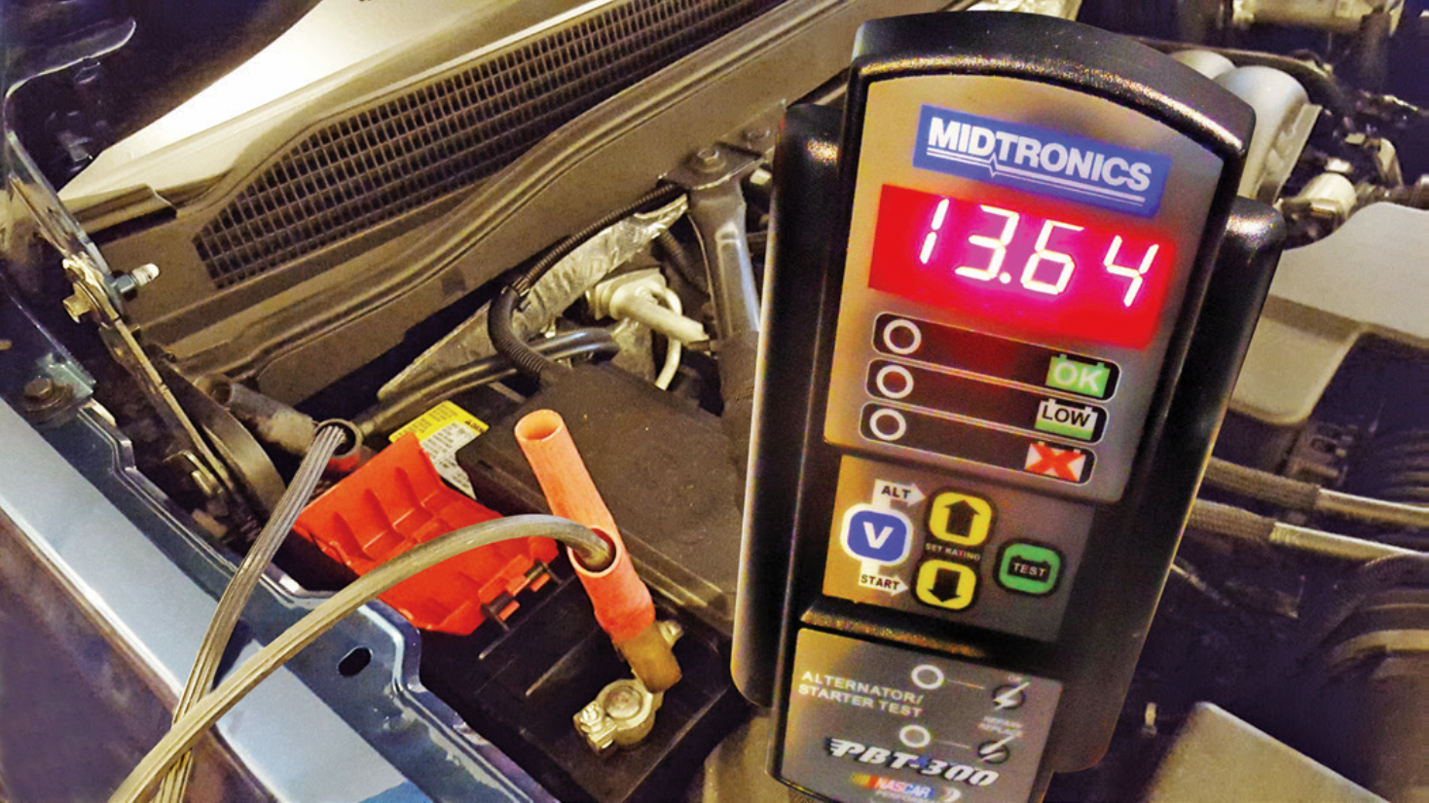
ENGINE STARTING AND
CHARGING DIAGNOSIS (6 of 8)
Conductance Tester Determines
  Good battery, can return to service
  Charge and retest
    Fully recharge battery and return to service
  Replace battery
    Battery not serviceable and should be replaced
  Bad cell—replace
    Battery not serviceable and should be replaced

Slide 46
Dead Batteries Can Freeze
If a battery becomes discharged, electrolyte can freeze. This occurs because when a battery is discharged, the “acid” (PbSO4) leaves electrolyte and is deposited on both negative and positive plates, leaving just water. Never attempt to charge or place into service a battery that is frozen. Often the case is spilt, requiring battery to be replaced. If a battery is found to be frozen, place the battery into a warm room with good ventilation and allowed it to thaw. If the case is not cracked, then it may be able to be restored to useful service if charged at a low rate for several hours. Test and recharge as needed.

Slide 47
QUESTION 3: ?
What is a battery conductance test?

Slide 48
ANSWER 3:
GM, Chrysler Corporation, Ford, and other OEMS
Specify that a conductance tester be used
Test batteries still under factory warranty
Tester uses its internal electronic circuitry
Determine the state of charge and capacity
By measuring voltage & conductance of plates

Slide 49
ENGINE STARTING AND
CHARGING DIAGNOSIS (7 of 8)
Battery Electrical Drain Test
  Determines if some component or circuit
  Causing drain on battery when everything is off.
  Called ignition off-draw (IOD) or parasitic load test
  Performed whenever one of following exists:
    Battery is being charged or replaced
    Battery is suspected of being drained

Slide 50
FIGURE 6–17 Clamp-on digital multimeter (DMM) used to check battery electrical drain. Meter reads over a half an ampere, which exceeds normal specification of 0.050A.

Slide 51
FIGURE 6–18 After connecting shut-off tool, start engine operate all accessories. Stop engine and turn off everything. Connect ammeter across shut-off switch in parallel. Wait 20 minutes. This time allows all electronic circuits to “time out” or shut down. Open switch—all current now will flow through ammeter. A reading greater than specified (usually > 50 milliamperes, or 0.05 ampere) indicates a problem that should be corrected.

Slide 52
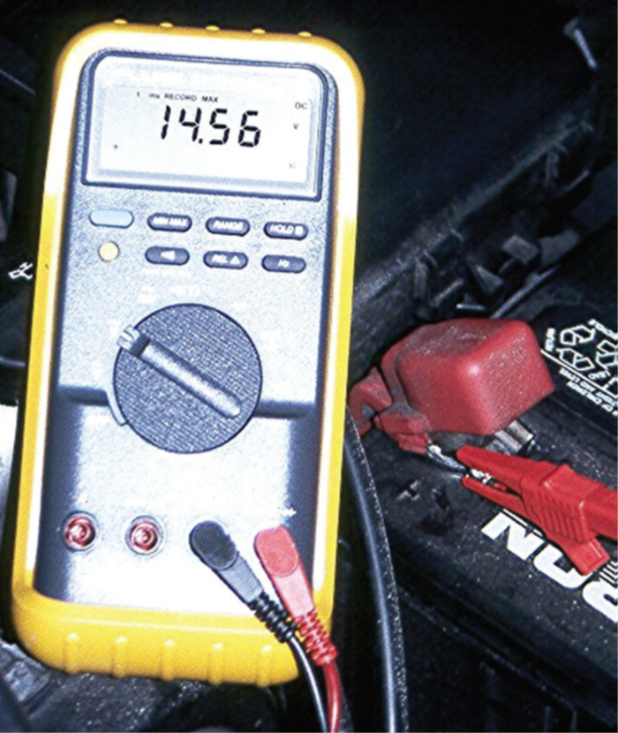
ENGINE STARTING AND
CHARGING DIAGNOSIS (8 of 8)
Cranking System Testing: Page 79
Charging Voltage Testing: Page 79

Slide 53
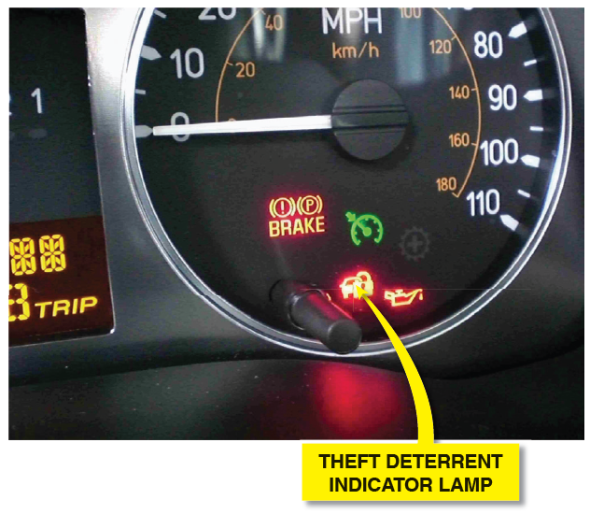
FIGURE 6–19 A theft deterrent indicator lamp of the dash. A flashing lamp usually indicates a fault in the system, and the engine may not start.

Slide 54
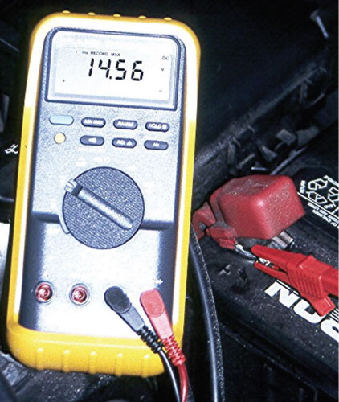
FIGURE 6–20 With engine running, the battery voltage should be between 13.5 and 15 volts.

Slide 55
Summary (1 of 2)
The first step in diagnosing engine condition is to perform a thorough visual inspection, including a check of oil and coolant levels and their condition.
Oil can be tested by a lab for wear metals and other conditions which may help the service technician become aware of engine faults before they become major.
Many engine-related problems make a characteristic noise.

Slide 56
Summary (2 of 2)
The oil pressure should be tested using a mechanical gauge.
A compression test can be used to test the condition of valves and piston rings.
Cylinder balance test, relative compression test, and cylinder contribution tests indicate whether all cylinders are working normally.
Starting and charging system testing includes checking for voltage and determining the condition of the batteries.

