Slide 1

Light Vehicle Diesel Engines
First Edition
Chapter 7
Diesel Engine Disassembly, Cleaning, and Crack Detection
Copyright © 2018, 2015, 2011 Pearson Education, Inc. All Rights Reserved

Slide 2
LEARNING OBJECTIVES (1 of 2)
7.1 Prepare for the Light Vehicle Diesel Engine (A9) ASE certification test content area “B” (Cylinder Head Diagnosis and Repair) and content area “C” (Engine Block Diagnosis and Repair).
7.2 Explain the engine removal procedure.
7.3 Explain the disassembly of the short block, rotating engine assembly, and cylinder head.
7.4 Explain the mechanical cleaning procedure of engines.

Slide 3
LEARNING OBJECTIVES (2 of 2)
7.5 Discuss chemical cleaners.
7.6 Compare spray, steam cleaning, thermal cleaning, tank, vapor cleaning, ultrasonic and vibratory cleaning.
7.7 Explain crack detection.

Slide 4
PREPARING THE ENGINE
FOR REMOVAL (1 of 4)
Check Service Information
  Usual Engine Removal Procedures
    Remove the hood
    Clean the engine area
    Disconnect the negative (−) battery cable
    Remove the air cleaner assembly
    Remove all accessories
    Drain the coolant
    Remove the radiator
    Disconnect the exhaust system
    Recover the air-conditioning refrigerant

Slide 5
PREPARING THE ENGINE
FOR REMOVAL (2 of 4)
Usual Engine Removal Procedures
  Remove the power steering pump
  Drain the engine oil
  Disconnect fuel lines
  Disconnect wiring

Slide 6
PREPARING THE ENGINE FOR REMOVAL (3 of 4)
Procedure For Engine Removal
    Rear-wheel-drive vehicle Page 83
    NOTE: For the best results, use the factory installed lifting hooks that are attached to the engine. These hooks are used in the assembly plant to install the engine and are usually in best location to remove the engine.

Slide 7
FIGURE 7–1 Several sections of the exhaust system to the turbocharger on a Duramax diesel engine need to be disconnected before the engine can be easily removed.

Slide 8
FIGURE 7–2 Cummins 6.7 liter inline six-cylinder diesel engine is so long that it is best to use an engine stand that supports the engine from the side rather than from the bell housing section of the block..

Slide 9
PREPARING THE ENGINE
FOR REMOVAL (3 of 4)
Mounting Engine On Stand Page 83
Disassembling Engine Page 83
Cylinder Head Removal Page 84
Piston Removal Page 84

Slide 10
FIGURE 7–3 Rocker arm shaft being removed from a
Duramax V-8 diesel engine.

Slide 11
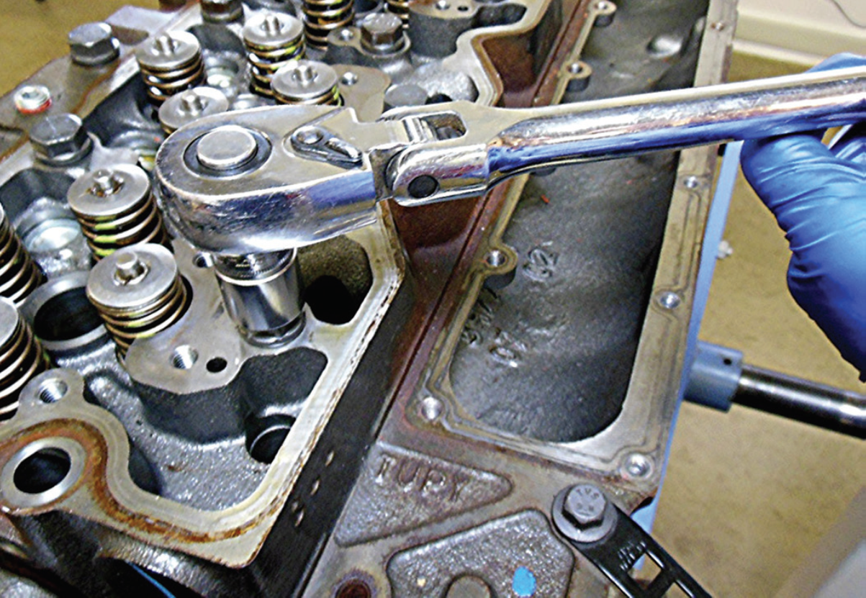
FIGURE 7–4 Cylinder head bolts being loosened on a Cummins 6.7-liter diesel engine, starting at the ends of the head and working toward the center.

Slide 12
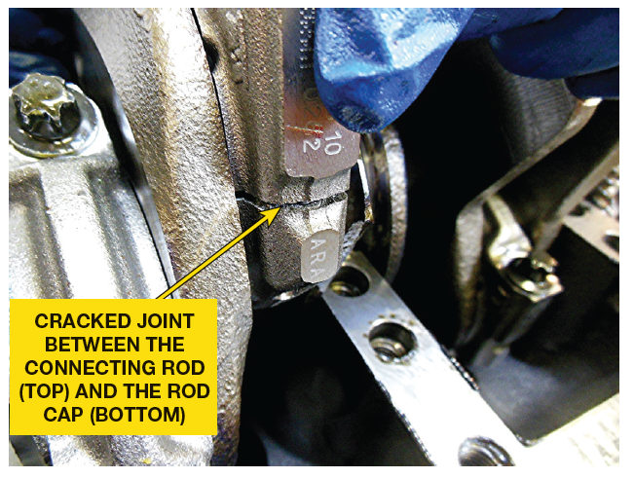
FIGURE 7–5 Removing the rod cap from a Fiat Chrysler 3.0 liter V-6 diesel engine shows that the rod uses a fracture rod cap design.

Slide 13
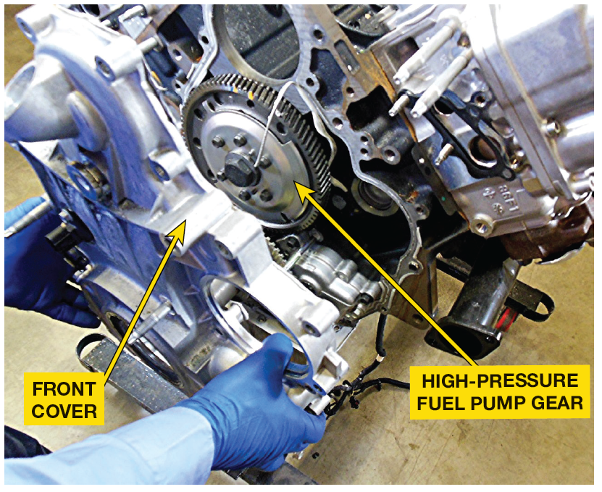
ROTATING ENGINE ASSEMBLIES REMOVAL (1 of 1)
Harmonic Balancer Removal
Camshaft Removal
Crankshaft and Main Bearing Removal
Block Inspection

Slide 14
FIGURE 7–6 front cover covering gears for camshaft and high-pressure pump is being removed from a Duramax diesel engine.

Slide 15
FIGURE 7–7 Main bearing cap being removed from a
Cummins 6.7-liter diesel engine. The caps are marked so there was no need to mark their location or direction.

Slide 16

Mark it to Be Safe
When you disassemble anything, it is always wise to mark location of parts, bolts, hoses, and other items that could be incorrectly assembled. Remember, the first part removed will be the last part that is assembled. If you think you will remember where everything goes—forget it! It just does
not happen in the real world. One popular trick is to use correction fluid to mark location of parts before they are removed. Most of these products are alcohol or water based, dry quickly, and usually contain a brush in cap for easy use. Another way is to take a series of pictures as parts are removed.

Slide 17
CYLINDER HEAD
DISASSEMBLY (1 of 4)
PROCEDURE
  After heads are removed
  Placed on bench, valves can be removed
  Procedure Pages 85-86 of text
CAUTION: Always wear safety glasses when working on a cylinder head. Valve springs can release quickly, causing valve parts to fly.

Slide 18
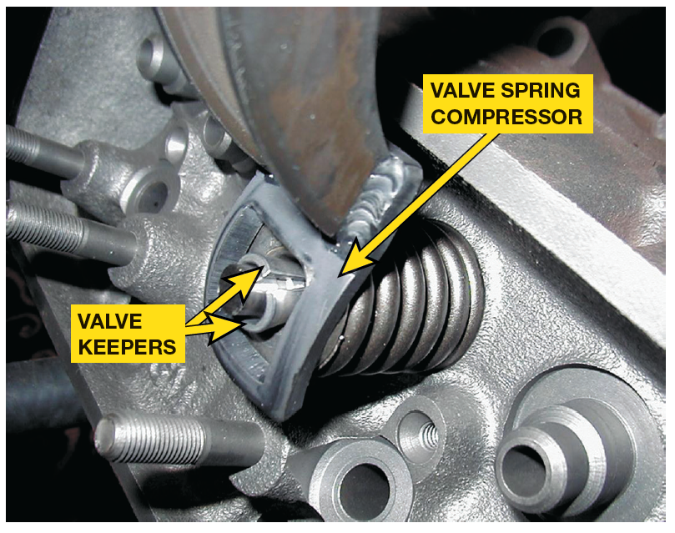
FIGURE 7–8 valve spring compressor is used to compress the valve spring before removing the keepers (locks).

Slide 19
MECHANICAL CLEANING (1 of 4)
Mechanical Cleaning Involves:
  Scraping
  Abrasive Brushing
  Abrasive Blasting
  ABRASIVE PADS/DISCS
    White — finest grit size, used for
    cleaning aluminum parts.
    Yellow —coarse grit, used on aluminum
    Green — use on cast-iron components

Slide 20
Use a Plastic Ice Scraper
Using a steel scraper can damage aluminum head deck surfaces. To prevent damage, try using a file to sharpen a plastic ice scraper and then use this to scrape gaskets from aluminum engine parts. This method works very well and will not harm the Aluminum parts.

Slide 21
FIGURE 7–9 Abrasive disc commonly called by its trade name, Scotch Brite™ pad.

Slide 22
MECHANICAL CLEANING (2 of 4)
Media Blasting
  Media blasting with baking soda is
  Cleaning method of choice
    Baking soda (bicarbonate of soda)
      Works well because it is
        Nontoxic
        Nonflammable
        Nonhazardous
        Environmentally safe

Slide 23
FIGURE 7–10 Smaller engine parts can be blasted clean in a sealed cabinet.
Some blasting done automatically in airless shot-blasting
machine. Another method is to hard-blast parts in a sealed
cabinet

Slide 24
MECHANICAL CLEANING (3 of 4)
CAUTION: Glass beads often remain in internal passages of engine parts, can come loose and travel through the cylinders when engine is started. Among other places, these small, but destructive, beads can easily be trapped under oil baffles of rocker covers and in oil pans & piston ring grooves. To help prevent glass beads from sticking, be sure the parts being cleaned are free of grease and dirt, and completely dry.

Slide 25
QUESTION 1: ?
What does mechanical cleaning involve?

Slide 26
ANSWER 1:
Mechanical cleaning involves:
Scraping
Abrasive brushing
Abrasive blasting

Slide 27
CHEMICAL CLEANERS (1 of 1)
pH: Page 87 of text
Solvent-based Cleaning Page 87 of text
Water-based Chemical Cleaning
CAUTION: When cleaning aluminum cylinder heads, blocks, or other engine components, make sure that chemicals used are “aluminum safe.” Always test solvent or cleaning chemical first by using a small aluminum part or scrap aluminum. Many chemicals that are not aluminum safe may turn aluminum metal black. Try explaining that to a customer!

Slide 28
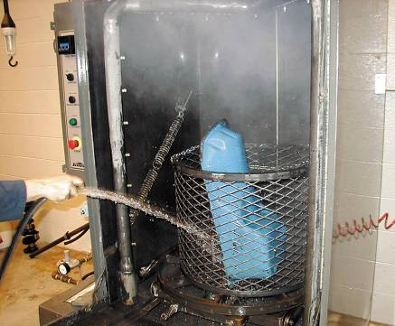
SPRAY & STEAM WASHING
Spray Washing
  Spray washing is faster than soaking
Steam Cleaning
  Steam vapor is mixed with high-pressure water and sprayed on the parts

Slide 29
FIGURE 7–11 A pressure jet washer is similar to a large industrial-sized dishwasher. Each part is then rinsed with water to remove chemicals or debris that may remain there while it is still in the tank.

Slide 30
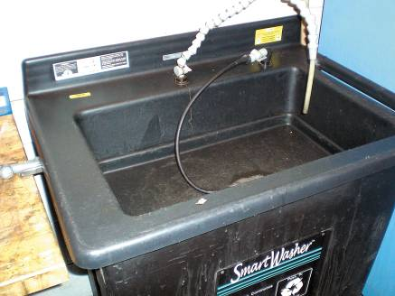
THERMAL CLEANING
Text Pages 87-88
  Temperatures Involved
  Advantages
  Microbial Cleaning
  Pyrolytic Oven

Slide 31
FIGURE 7–12 A microbial cleaning tank uses microbes to clean grease and oil from parts.

Slide 32
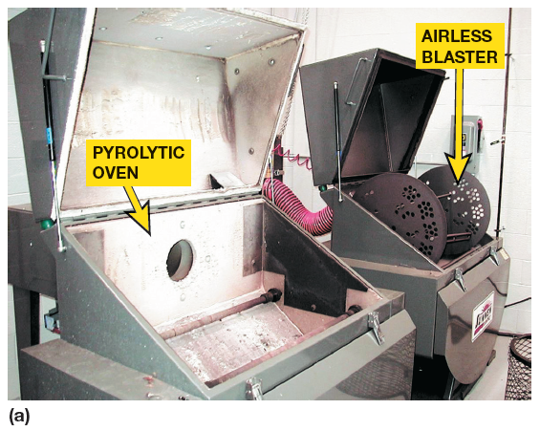
FIGURE 7–13 (a) A pyrolytic (high-temperature) oven cleans by baking engine parts. After parts have been cleaned, they are then placed into an airless blaster. This unit uses a paddle to scoop stainless steel shot from a reservoir and forces it against the engine part. The parts must be free of grease and oil to function correctly.

Slide 33
FIGURE 7–13 (b) This cleaned engine block has been baked and shot blasted.

Slide 34
TANK & VAPOR CLEANING
Text Page 88-89
  Cold Tank Cleaning
  Hot Tank Cleaning
  Vapor Cleaning

Slide 35
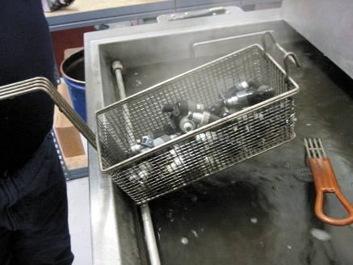
ULTRASONIC AND VIBRATORY CLEANING
Ultrasonic Cleaning
  To clean small parts that must be absolutely clean
Vibratory Cleaning
  Best on small parts
  The movement of the vibrating solution and the scrubbing action of the media do an excellent job of cleaning metal.

Slide 36
FIGURE 7–14 ultrasonic cleaner is used to clean fuel injectors.

Slide 37
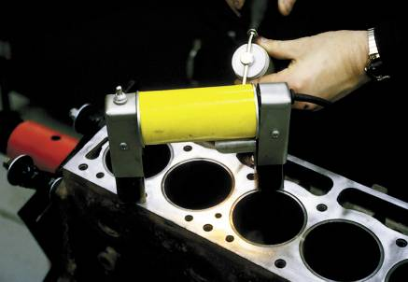
CRACK DETECTION
Pages 90-91 of text
  Visual Inspection
  Magnetic Crack Detection
  Dye-penetrant Testing
  Fluorescent-penetrant Testing
  Pressure Testing

Slide 38
FIGURE 7–15 top deck surface of a block is being tested using magnetic crack inspection equipment.

Slide 39
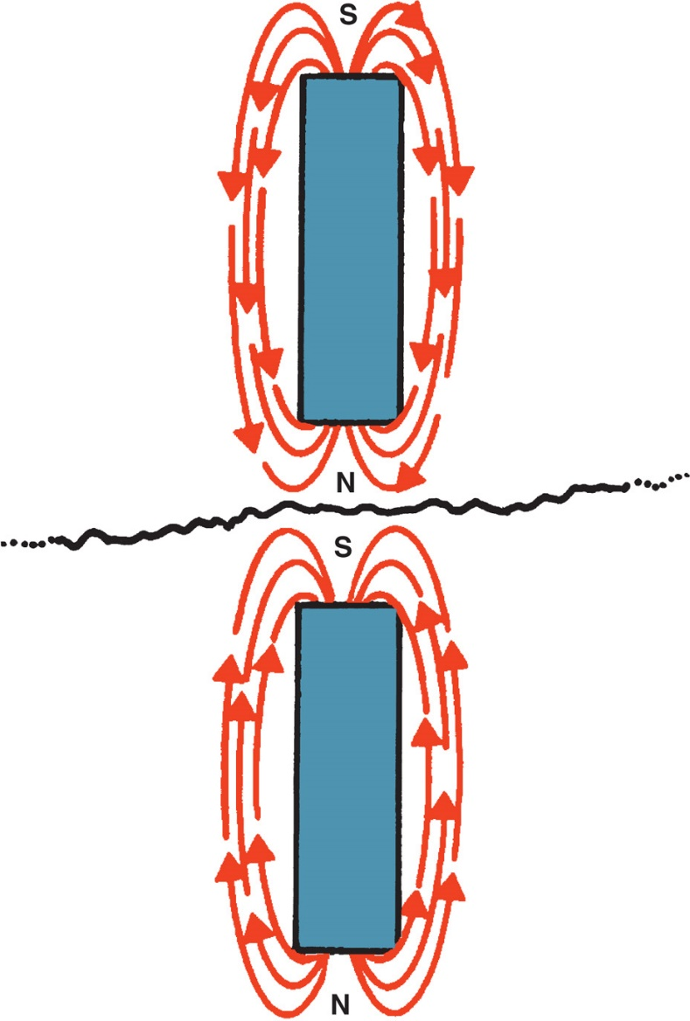
Figure 7–16 If the lines of force are interrupted by a break (crack) in the casting, then two magnetic fields are created and the powder will lodge in the crack.

Slide 40
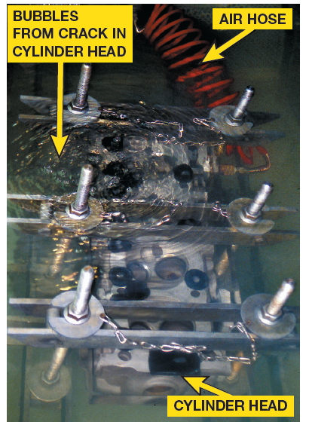
Figure 7–17 cylinder head is under water and being pressure tested using compressed air. Note that the air bubbles indicate a crack.

Slide 41
QUESTION 2: ?
What methods are used for engine crack detection?

Slide 42
ANSWER 2:
Visual Inspection
Magnetic Crack Detection
Dye-penetrant Testing
Fluorescent-penetrant Testing
Pressure Testing

Slide 43
Summary (1 of 3)
Factory lifting hooks should be used when hoisting an engine.
Cylinder heads should only be removed when the engine is cold. Also, always follow the torque table backwards, starting with highest-number head bolt and working toward the lowest number. This procedure helps prevent cylinder head warpage.
Connecting rod and main bearing caps should be marked before being removed to ensure that they can be reinstalled in the exact same location when the engine is reassembled.
The tip of the valve stem should be filed before removing valves from the cylinder head to help prevent damage to the valve guide.

Slide 44
Summary (2 of 3)
Mechanical cleaning with scrapers or wire brushes is used to remove deposits.
Steel wire brushes should never be used to clean aluminum parts.
Most chemical cleaners are strong soaps called caustic materials.
Always use aluminum-safe chemicals when cleaning aluminum parts or components.
Thermal cleaning is done in a pyrolytic oven in temperatures as high as 800°F (425°C) to turn grease and dirt into harmless ash deposits.

Slide 45
Summary (3 of 3)
Blasters use metal shot or glass beads to clean parts.
All of the metal shot or glass beads must be thoroughly cleaned from the part so as not to cause engine problems.
All parts should be checked for cracks using magnetic, dye-penetrant, fluorescent-penetrant, or pressure testing methods.

