Slide 1

Light Vehicle Diesel Engines
First Edition
Chapter 8
Diesel Engine Assembly
Copyright © 2018, 2015, 2011 Pearson Education, Inc. All Rights Reserved

Slide 2
LEARNING OBJECTIVES (1 of 2)
8.1 Prepare for the Light Vehicle Diesel Engine (A9) ASE certification test content area “B” (Cylinder Head Diagnosis and Repair) and “C” (Engine Block Diagnosis and Repair).
8.2 Explain short block and cylinder head preparation.
8.3 Discuss final short block assembly.
8.4 Describe camshaft installation and piston/rod installation.

Slide 3
LEARNING OBJECTIVES (2 of 2)
8.5. Explain cylinder head installation procedure.
8.6. Discuss torque-to-yield (TTY) head bolts.
8.7. Explain valve train assembly and final assembly of an engine.

Slide 4
DETAILS (1 of 1)
Read
  Read all instructions specifications, etc.
Understand
  Everything stated in instructions
  Call company to be sure
Follow
  Follow all of the instructions
    Do not pick easy procedures & skip others

Slide 5
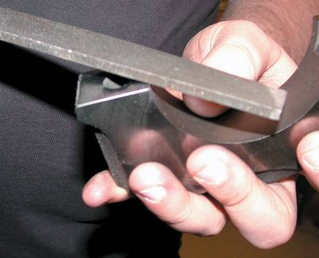
SHORT BLOCK
PREPARATION (1 of 4)
Items to Check: Page 94
  Surface Finish
  Checking Surfaces Before Assembly
  Preparing Block For Studs
  Preparing Threaded Holes

Slide 6
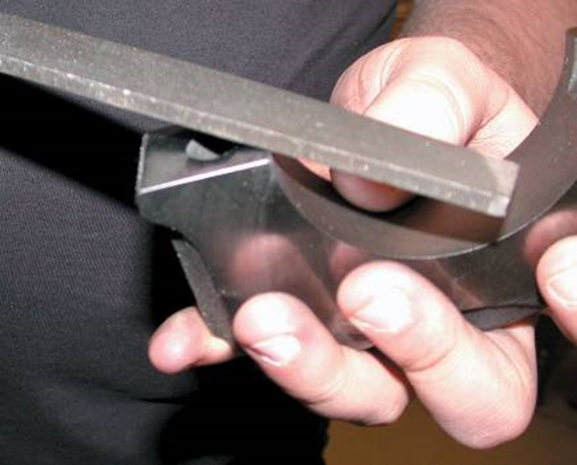
FIGURE 8–1 Deburring all sharp edges is an important step to achieve proper engine assembly.

Slide 7
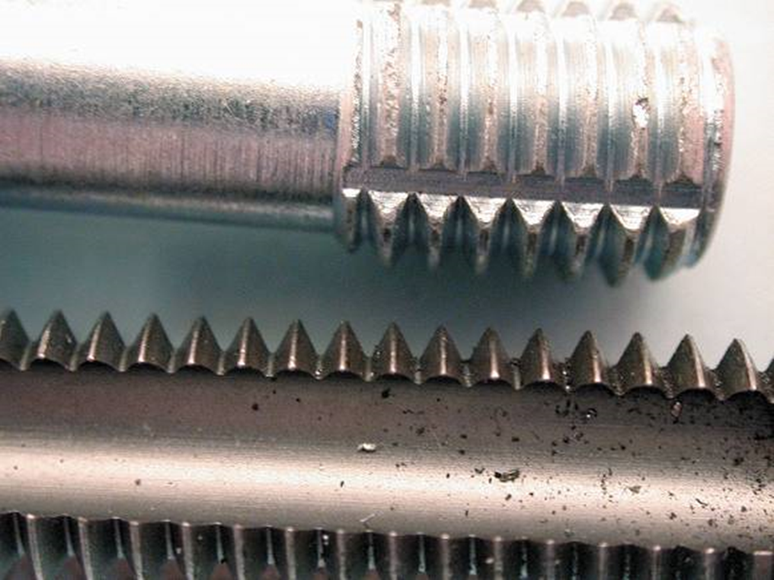
FIGURE 8–2 thread chaser (top) is preferred tool to clean threaded holes because it cleans without removing metal compared to a tap (bottom).

Slide 8
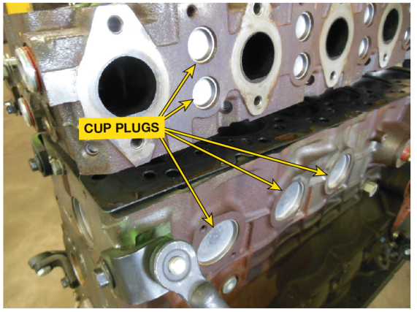
CYLINDER HEAD
PREPARATION (1 of 1)
Cylinder Head Items To Check
  Surface finish of deck specified for head gasket
  All valves should be checked for leakage
  All valve springs checked for pressure & installed height
  Check for proper pushrod length
  If replacement rocker arms are used
    Be sure geometry and total lift meet factory specifications

Slide 9

SHORT BLOCK
ASSEMBLY (1 of 4)
Pages 94-95
  Installing Cups And Plugs
  Cam Bearings
  Measuring Main Bearing Clearance
  Lip Seal Installation
CAUTION: Avoid using Teflon tape on threads of oil gallery plugs or coolant drain plugs. Tape is often cut by threads and thin strips of tape are then free to flow through oil galleries. Tape can cause a clog, thereby limiting lubricating engine oil to important parts of engine.

Slide 10
FIGURE 8–3 This Cummins 6.7-liter inline six-cylinder diesel engine uses many cup plugs to block off coolant openings.

Slide 11
FIGURE 8–4 Sealer should be applied to the cup plug before being driven into the block

Slide 12
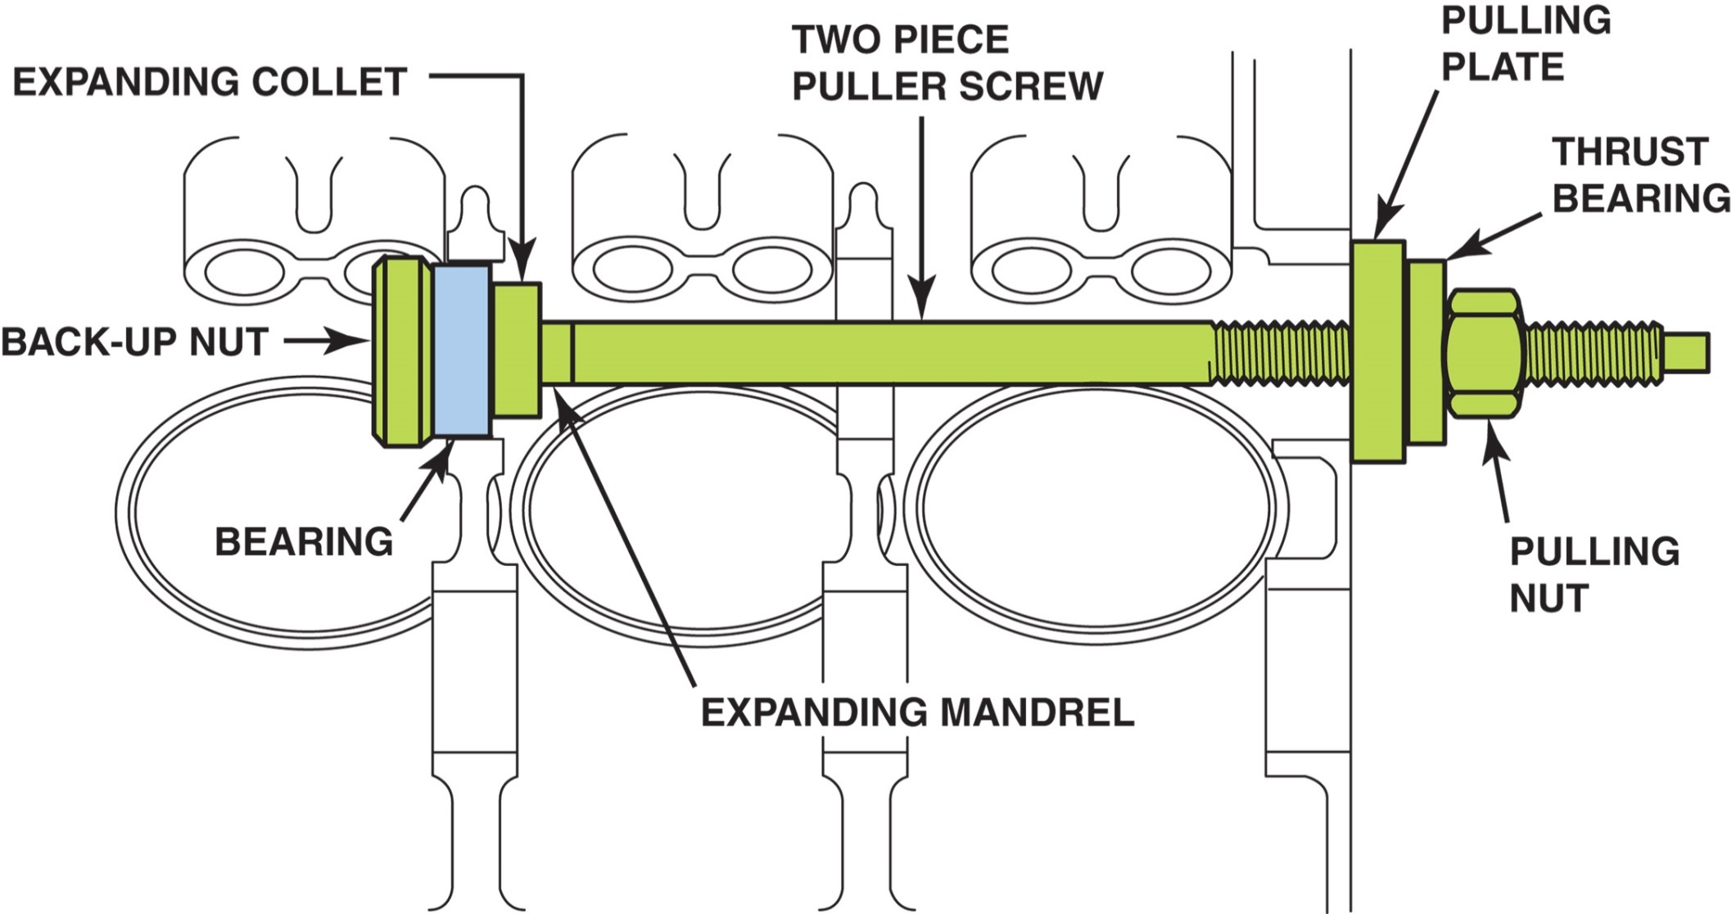
Figure 8–5 Screw-type puller being used to install a new cam bearing. most cam bearings are crush fit. The full round bearing is forced into the cam bearing bore. most vehicle manufacturers specify that the cam bearings be installed “dry” without lubrication to help prevent them from spinning, which would cause the bearing to block the oil feed hole.

Slide 13
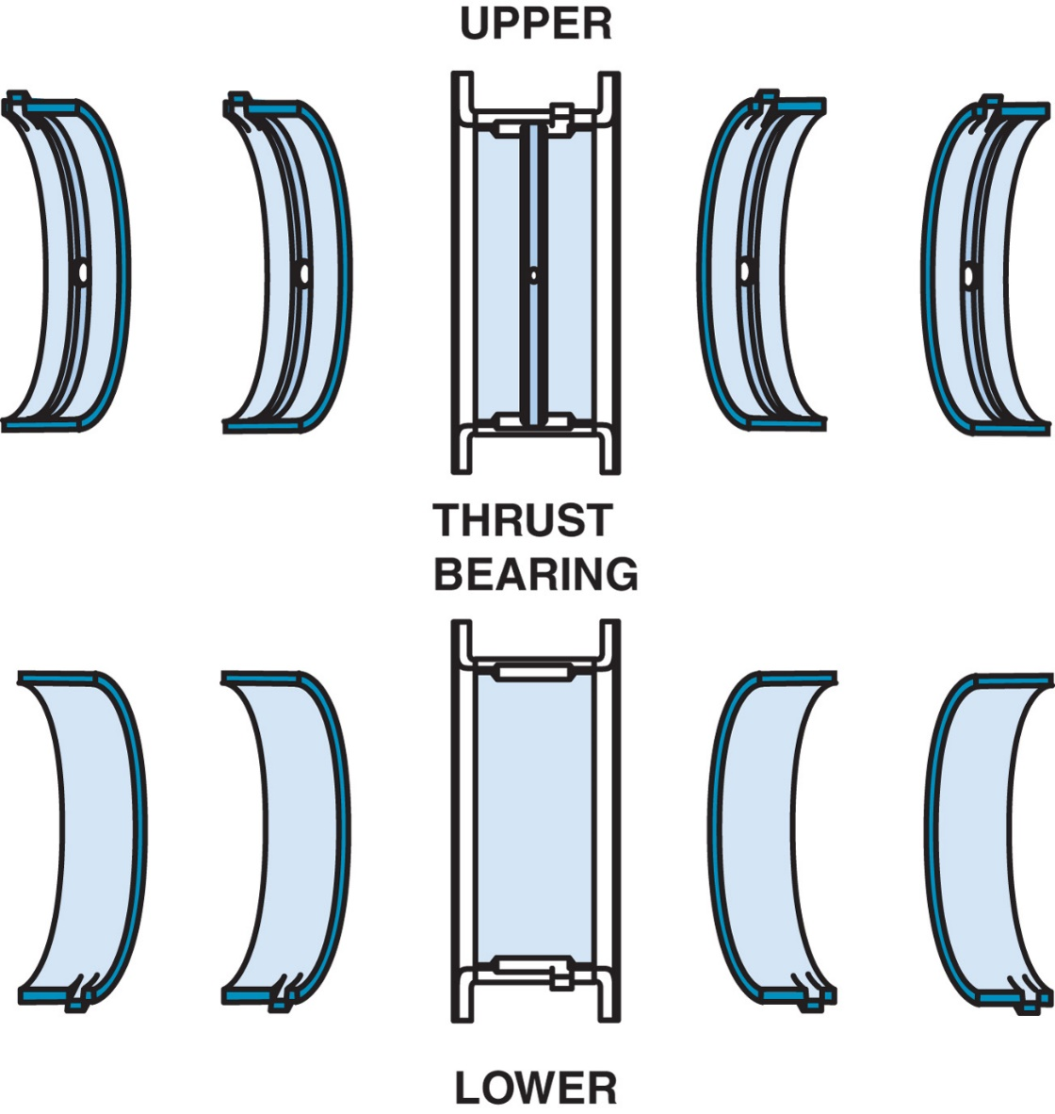
FIGURE 8–6 Typical main bearing set. Note that the upper halves are grooved for better oil flow and the lower halves are plain for better load support. This bearing set uses the center main bearing for thrust control. Notice that the upper bearing set has the holes for oil, whereas the lower set does not.

Slide 14
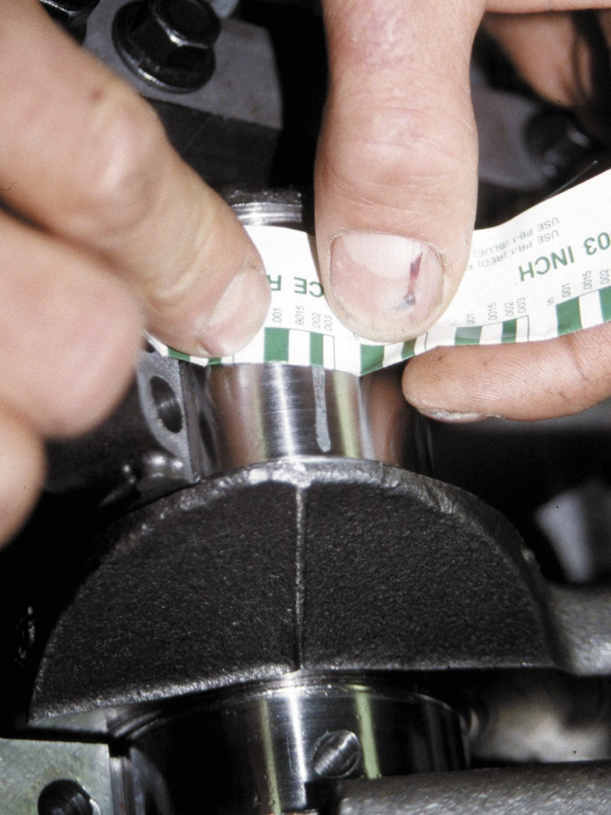
FIGURE 8–7 width of plastic gauging strip determines oil clearance of main bearing. An alternate method of determining oil clearance includes careful measurement of crankshaft journal and bearings after they are installed, and the main housing bore caps are torqued to specifications. Most main and rod bearing clearance falls within 0.001 and 0.002 inch.

Slide 15
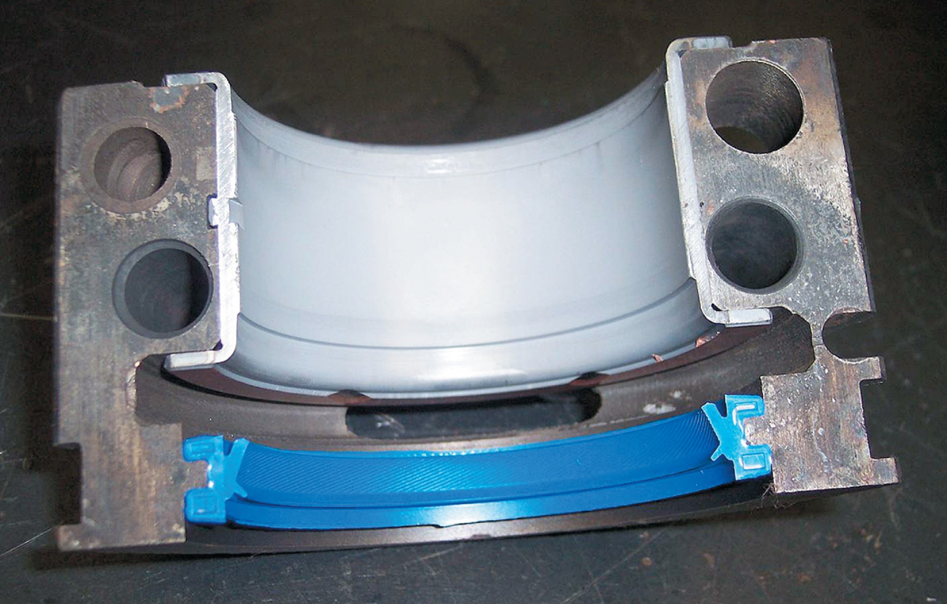
Figure 8–8 Lip-type rear main bearing seal in place in the rear main bearing cap. The lip should always be pointing toward the inside of the engine.

Slide 16

“One to Two”
When engine technicians are talking about clearances
and specifications, the unit of measure most often used is thousandths of an inch (0.001 inch). Therefore, a clearance expressed as “one to two” would actually be a clearance of 0.001 to 0.002 inch. The same applies to parts of a thousandth of an inch. For example, a specification of 0.0005 to 0.0015 inch would be spoken of as simply being “one-half to one and one-half.” The unit of a thousandth of an inch is assumed, and this method of speaking reduces errors and misunderstandings.

Slide 17
“One to Two” NOTE:
NOTE: Most engine clearance specifications fall within one to two thousandths of an inch. The written specification could be a misprint. SO, if specification does not fall within this general range, double-check clearance value using a different source.

Slide 18
CAUTION
CAUTION: Teflon seals should not be lubricated. This type of seal should be installed dry. When engine is first started, some of Teflon transfers to the crankshaft to create a Teflon-to-Teflon surface. Even touching seal with your hands could remove some of outer coating on seal and cause a leak. Carefully read, understand, and follow installation instructions that come with seal.

Slide 19

SHORT BLOCK
ASSEMBLY (2 of 4)
Pages 97-
  Crankshaft Installation
  Thrust Bearing Clearance
  Main Bearing Tightening Procedure

Slide 20
Fogging Oil and Assembly Lube
When assembling engine, parts should be coated with a light oil film to keep them from rusting. This type of oil is referred to as fogging oil and is available in spray cans. SEE FIGURE 8–9.
During engine assembly, internal parts should be lubricated. While engine oil or grease could be used, most experts recommend the use of a specific lubricant designed for engine assembly. This lubricant, designed to remain on the parts and not drip or run, is called assembly lube. SEE FIGURE 8–10.

Slide 21

Figure 8–9 Fogging oil is used to cover bare metal parts when the engine is being stored to prevent corrosion.

Slide 22
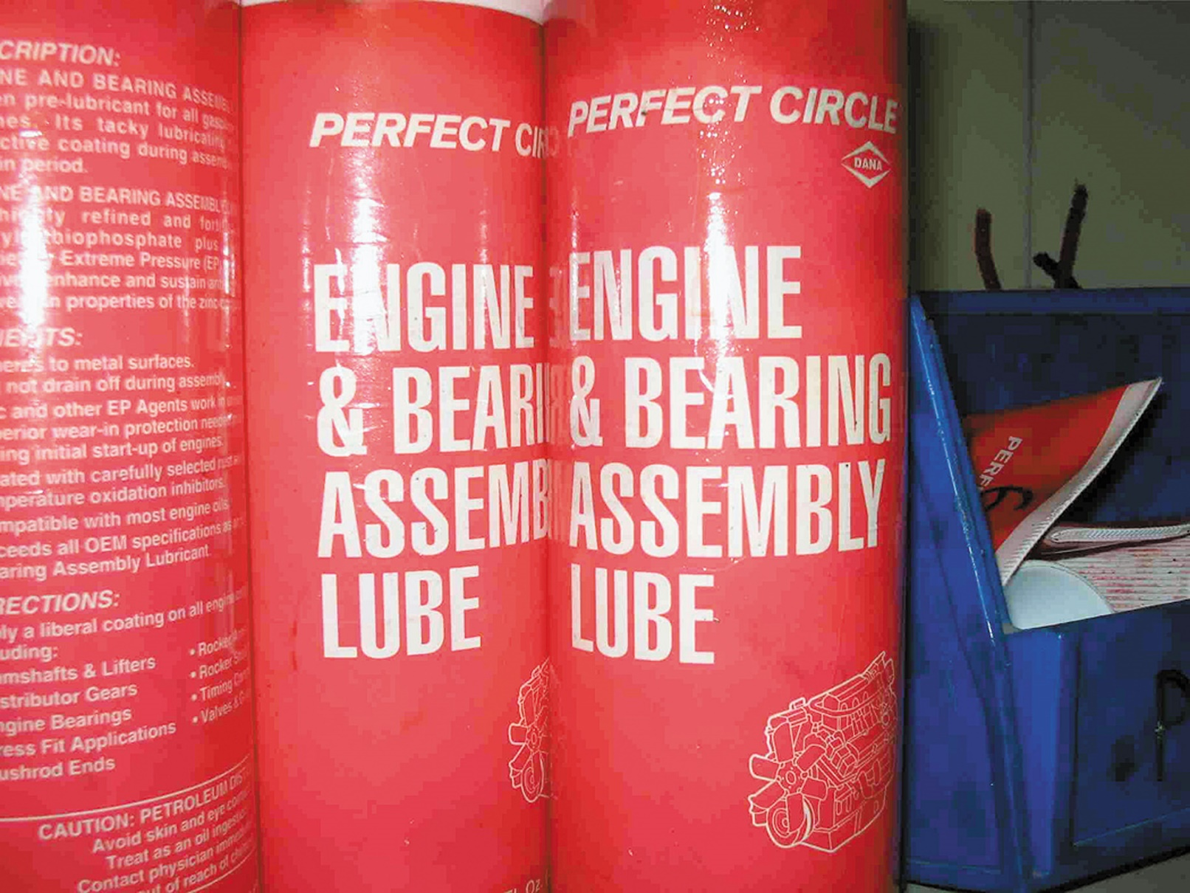
Figure 8–10 Engine assembly lube is recommended to be used on engine parts during assembly.

Slide 23
QUESTION 1: ?
What items are checked when assembling a short block?

Slide 24
ANSWER 1:
Items to Check are:
Surface Finish
Checking Surfaces Before Assembly
Preparing Block For Studs
Preparing Threaded Holes
.

Slide 25
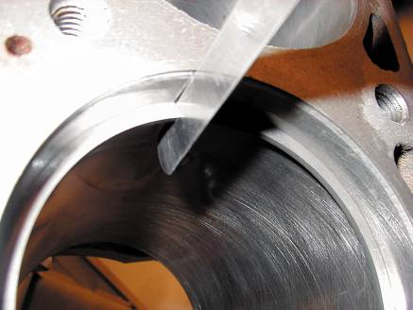
PISTON/ROD INSTALLATION (1 of 4)
Text Pages 98-100
  Checking Piston Rings
  Piston Markings
  Connecting Rod Bearing Clearance
  Piston Installation
  Connecting Rod Side Clearance

Slide 26
PISTON/ROD INSTALLATION (2 of 4)
Piston Ring Gap Note
  NOTE: If gap is greater than recommended, some engine performance lost. However, too small a gap will result in scuffing, because ring ends can be forced together during operation, which forces the rings to scrape the cylinders

Slide 27

FIGURE 8–11 feeler gauge is used to check piston ring gap.

Slide 28
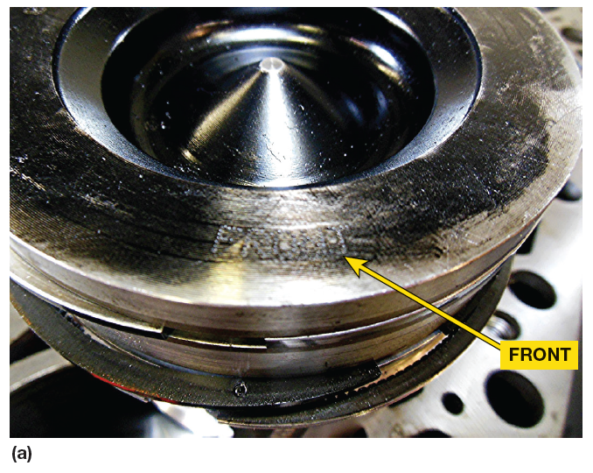
FIGURE 8–12 (A) Cummins 6.7-liter six-cylinder piston showing that the word “front” is marked on the top
Notch, arrow, or word “front” on piston head indicating front.
Correctly position piston pin offset toward right Side of engine

Slide 29
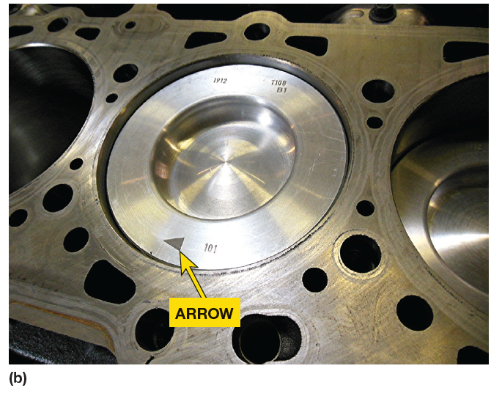
FIGURE 8–12 (B) Duramax diesel engine uses an arrow on the top of the piston to indicate the front of the engine.

Slide 30
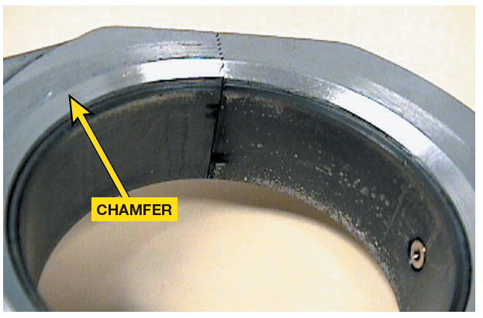
FIGURE 8–13 on V-type engines that use paired rod journals, the side of the rod with the large chamfer should face toward the crank throw (outward).

Slide 31
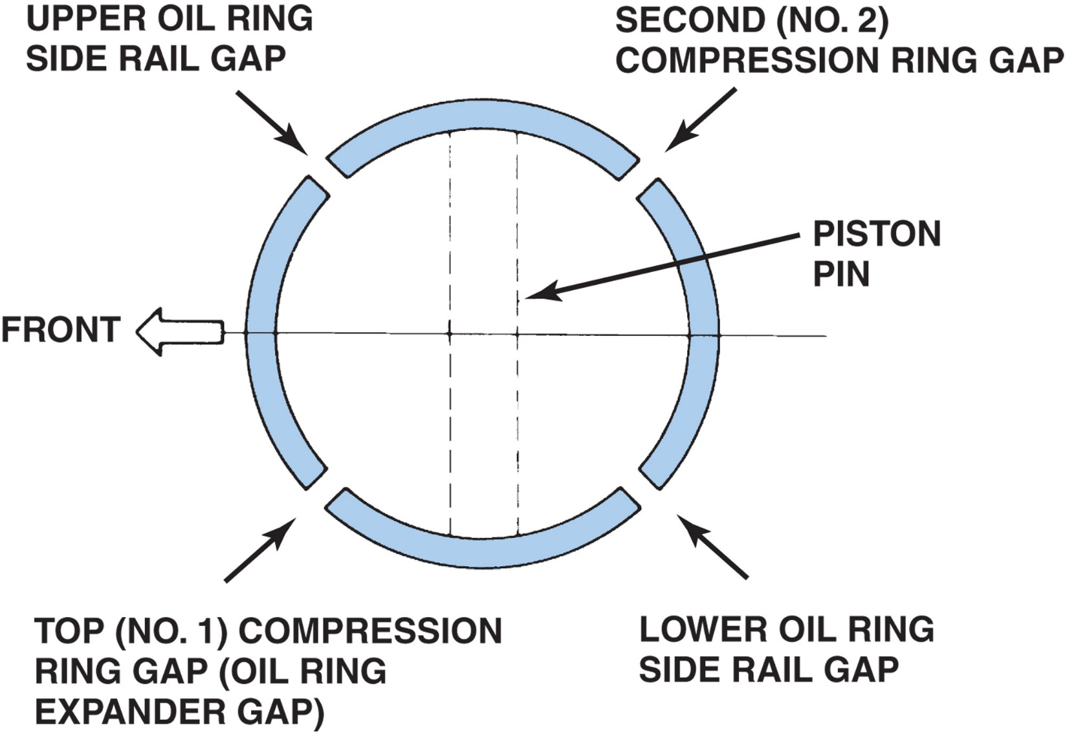
Figure 8–14 One method of piston ring installation showing the location of ring gaps. Always follow the manufacturer’s recommended method for the location of ring gaps and for ring gap spacing.

Slide 32
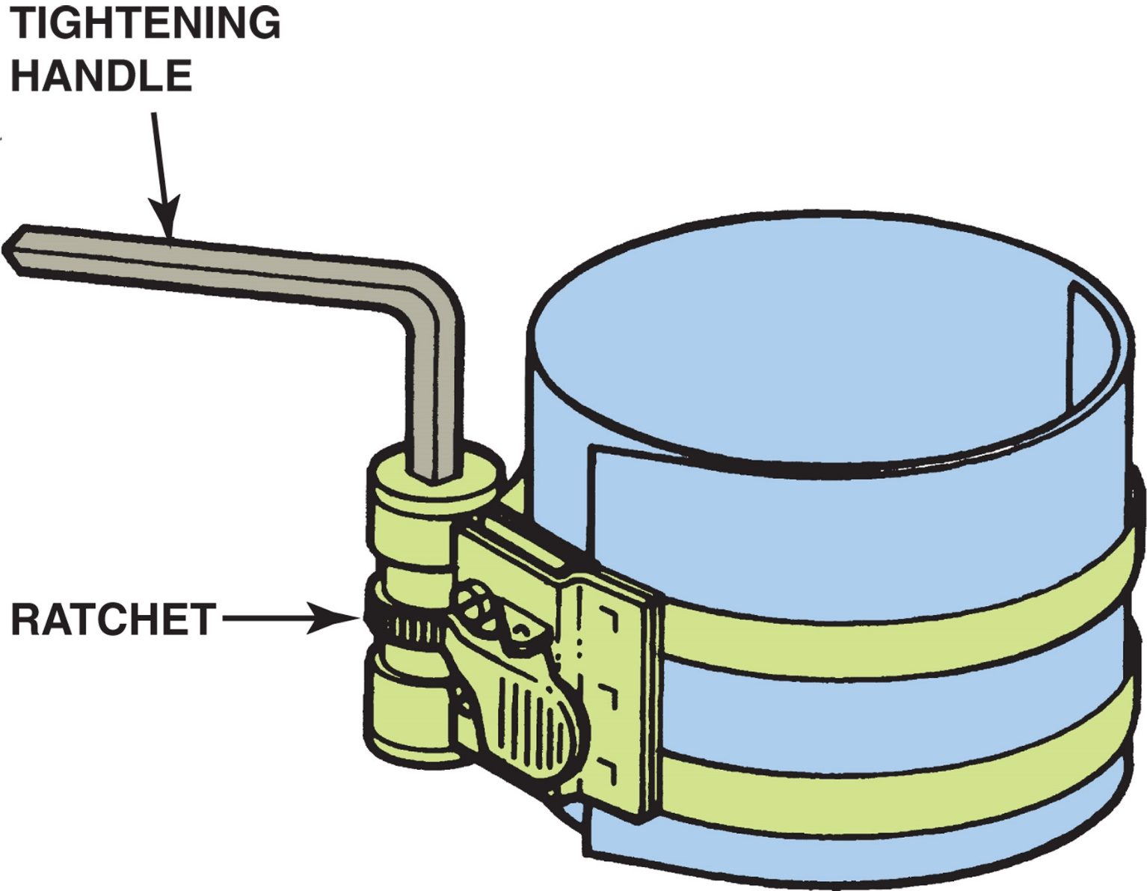
Figure 8–15 This style of ring compressor uses a ratchet to contract the spring band and compress the rings into their grooves

Slide 33

Figure 8–16 This pliers-like tool is used to close the metal band around the piston to compress the rings. An assortment of bands is available to service different size pistons.

Slide 34
PISTON/ROD INSTALLATION (3 of 4)
Piston Installation: Pages 99-100
  Sample steps 1-12
  NOTE: Always Use Correct OEM
  Procedure Found in Service Information
Connecting Rod Bearing Clearance P100
Connecting Rod Side Clearance P100

Slide 35
FIGURE 8–17 Installing a piston using a ring compressor to hold the rings into the ring grooves of the piston and then using a hammer handle to push the piston into the bore. Connecting rod stud protectors have been installed to help prevent possible damage to the crankshaft during piston installation.

Slide 36
FIGURE 8–18 connecting rod side clearance is measured with a feeler gauge.

Slide 37
CYLINDER HEAD
INSTALLATION (1 of 4)
Clamping Force: Pages 100-101
Head Bolt Torque Sequence
Fastener Consideration
Thread Lubricant

Slide 38
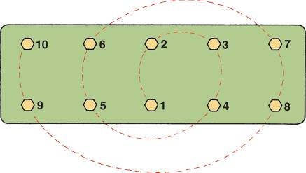
FIGURE 8–19 Typical cylinder head tightening sequence.

Slide 39
Watch Out for Wet and Dry Holes
Engines use head bolts that extend through top deck of block & end in coolant passage. These holes are called wet holes. When installing head bolts into holes that end up in coolant, always use sealer on threads of head bolt. Some engines have head bolts that are “wet,” whereas others are “dry” because they end in solid cast-iron material. Bolts being installed into dry holes do not require sealant, but still require some oil on threads for lubrication. Do not put oil into dry hole because bolt may bottom out on oil. Liquid oil cannot compress, so force of bolt tightened transferred to block by hydraulic force, which can crack block.

Slide 40
Tech Tip Note
NOTE: Apply oil to a shop cloth and rotate the bolt in the cloth to lubricate the threads. This procedure lubricates the threads without applying too much oil.

Slide 41
TORQUE-TO-YIELD
HEAD BOLTS (1 of 4)
Text Pages 101-103
  Definition and Terminology
  Bolt Construction
  Torque-to-yield Procedure
  Torque Angle Method

Slide 42
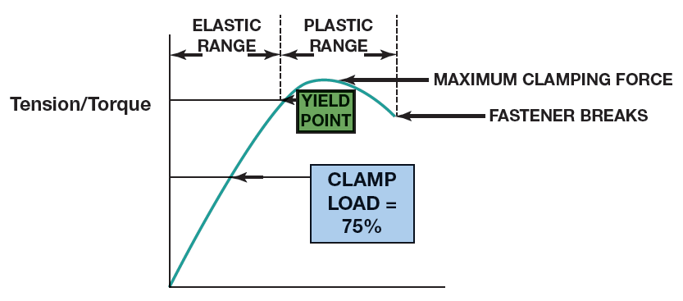
FIGURE 8–20 The maximum clamping force is achieved when the bolt is stretched to its yield point.

Slide 43
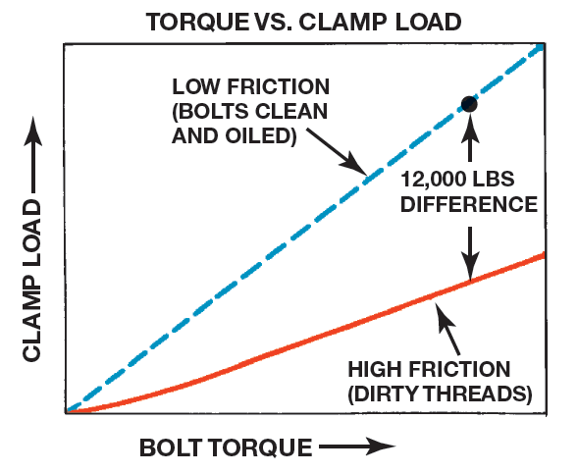
FIGURE 8–21 To ensure consistent clamp force (load), many manufacturers are recommending the torque-angle or torque-to-yield method of tightening head bolts. The torque angle method specifies tightening fasteners to a low-torque setting and then giving an additional angle of rotation. were used.

Slide 44
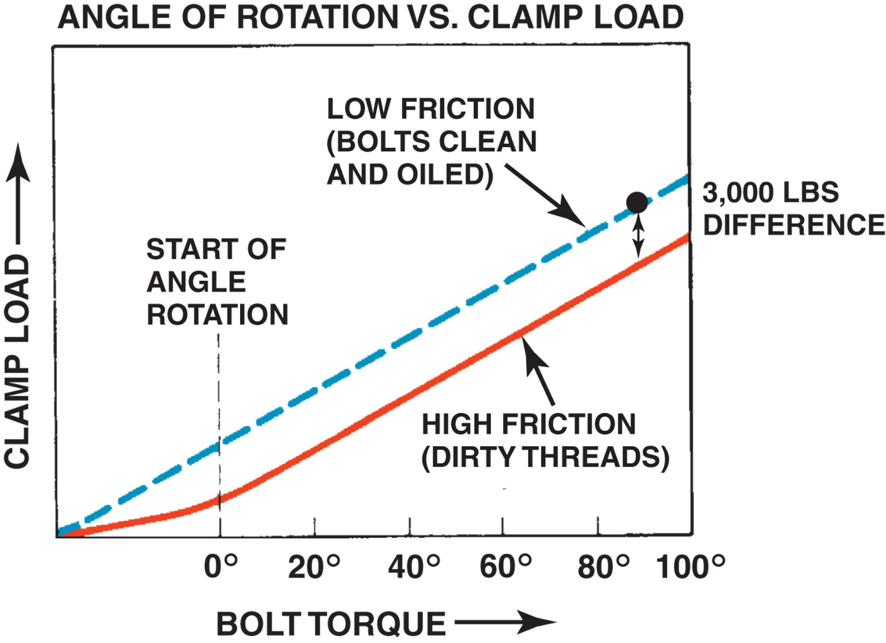
FIGURE 8–21 Notice that difference in clamping force is much smaller than it would be if just a torque wrench with dirty threads were used.

Slide 45
FIGURE 8–22 Torque angle can be measured using a special adaptor.

Slide 46
FIGURE 8–23 an electronic torque wrench showing number of degrees of rotation. These very accurate torque wrenches can be programmed to display torque or number of degrees of rotation.

Slide 47

What Do the Markings on the Head
Gasket Mean?
Most light diesel engines use head gaskets that are of a specific thickness to insure that compression ratio is correct. Various thickness of head gaskets are used to fine-tune head installed height that can vary due to machining tolerances of block deck & cylinder head gasket surfaces. Always check service information for information on these markings and thickness of gasket so the engine can be restored to proper specifications after being disassembled. SEE FIGURE 8–24.

Slide 48
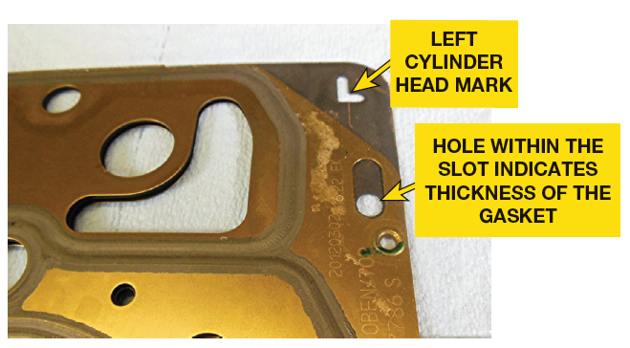
FIGURE 8–24 A head gasket from the left cylinder head on a Duramax V-8 diesel engine. The “L” means it is for the left head and the hole in the slot indicates its thickness.

Slide 49
VALVE TRAIN ASSEMBLY (1 of 4)
Text Pages: 103-104
  Timing Gears for Cam-In-Block Engines
  Timing Drives for OHC Engines
  Timing Gear Installation
  OHV Engine Lifter & Pushrod Installation
  Valve Lash Adjustment

Slide 50
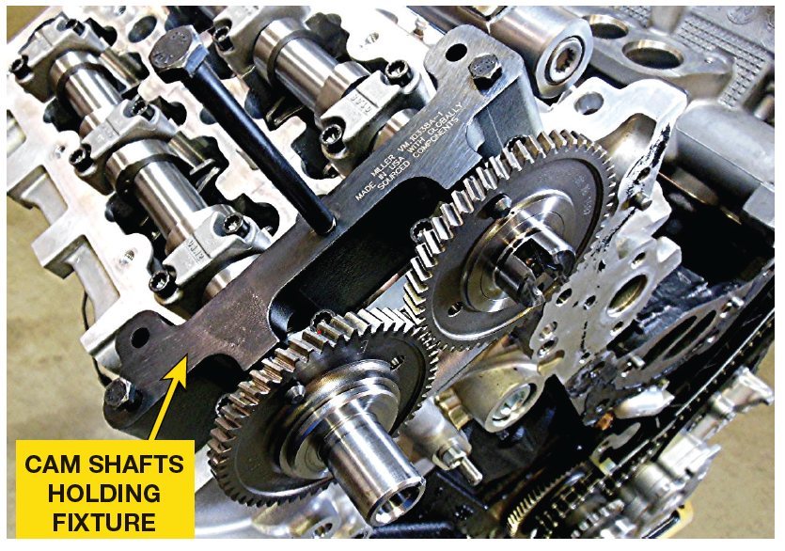
FIGURE 8–25 special holding fixture is required when installing the camshafts on the Fiat Chrysler 3.0 liter V-6 diesel engine to keep them aligned and in the proper position before the timing chain is installed

Slide 51
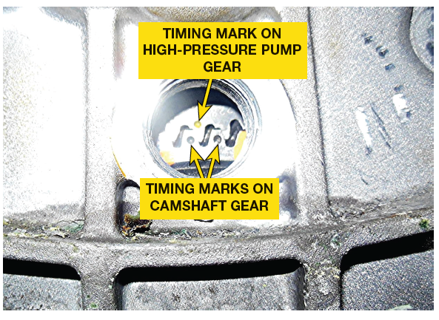
FIGURE 8–26 timing gears on Duramax diesel engine can be seen through an opening in timing cover for te high-pressure pump to camshaft. Duramax diesel HP Pump is timed so that fuel pressure regulator (FPR) solenoid commands at same time as piston stokes, which helps reduce vibration and noise.

Slide 52
FIGURE 8–27 The valve lash is being checked on a Duramax diesel engine. Always follow the vehicle manufacturer’s specified procedures.
VALVE LASH ADJUSTMENT
Some diesel engines use solid roller lifters: Duramax V-8, Cummins & require valve lash, be
adjusted to a specified clearance

Slide 53
FIGURE 8–28 1/8 to 3/16 inch (3 to 5 mm) bead of RTV silicone on a parting surface with silicon going around the bolt hole..

Slide 54
FINAL ASSEMBLY (1 of 4)
Text Pages 104-105
  Timing Cover Installation
  Oil Pan Installation
  Prelubricating the Engine

Slide 55
What is “Torque Paint”?
Whenever a major fastener is tightened to proper torque at assembly plant, a dab of paint is applied to head of fastener to indicate that it was properly torqued. This is part of quality control procedure used to help ensure that all fasteners are properly tightened to factory specification. SEE FIGURE 8–29

Slide 56
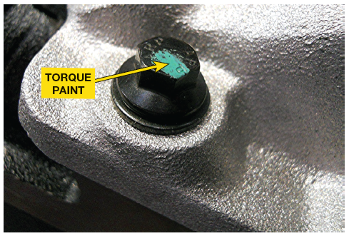
FIGURE 8–29 Torque paint applied to the head of the fastener indicates that it has been properly torqued to factory specification

Slide 57
FIGURE 8–30 Using a hammer to straighten the gasket rail surface of the oil pan before installing a new gasket. When the retaining bolts are tightened, some distortion of sheet metal covers occurs. If the area around the bolt holes is not straightened, leaks can occur with the new gasket.

Slide 58
Summary (1 of 2)
Before assembling an engine, the technician should read, understand, and follow all instructions that came with the parts and gaskets to ensure proper assembly.
Assembling the short block includes preparing the block, and installing the crankshaft, camshaft, and the piston/rod assemblies.
Soft core plugs are also called expansion plugs, freeze plugs, or Welsh plugs.

Slide 59
Summary (2 of 2)
All bearing oil clearances should be checked using a micrometer, telescoping gauges, or Plastigage.
Piston ring end gap should be checked before the pistons are installed.
Cylinder head bolts should be properly tightened and in the specified sequence.
Timing chain or gear covers are installed using the specified gaskets or sealers.

